Slide 1
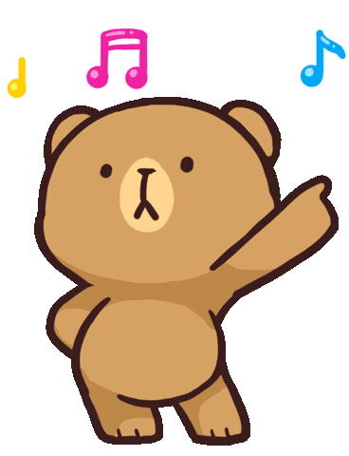
Welcome to our class!

Slide 2
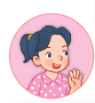
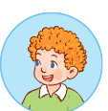
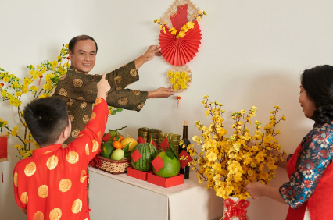
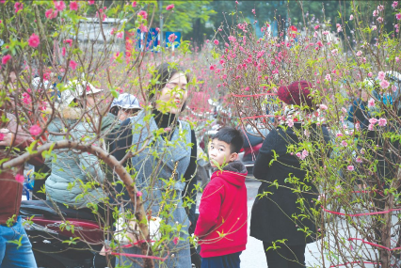
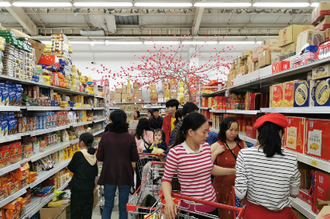
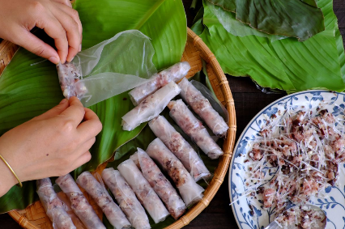
Review
Will you _____ for Tet?
Yes, I will.
won’t = will not
I’ll = I will
No, I won’t. I’ll ____.
decorate the house / yes
buy roses / no / buy a branch of peach blossoms
do the shopping / yes
make banh chung / no / make spring rolls

Slide 3
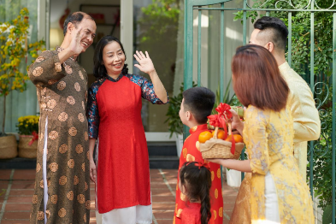
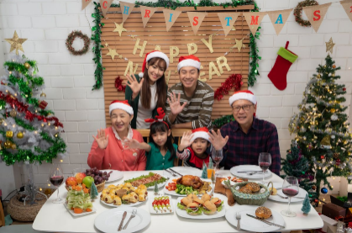
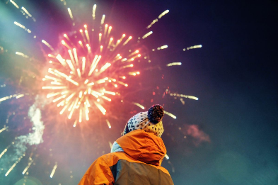
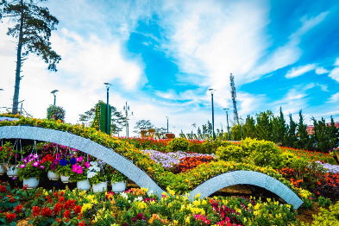
Review
Where will you go at Tet?
I’ll go to ________.
my grandparents’ house
a New Year party
a fireworks show
a flower festival

Slide 4
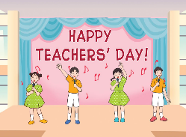
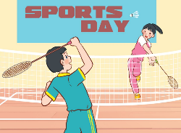
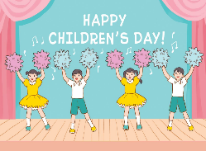
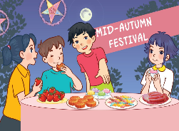
Monday, February 10th 2025
Unit 13
Our special days
Lesson 1 (1+2+3)

Slide 5
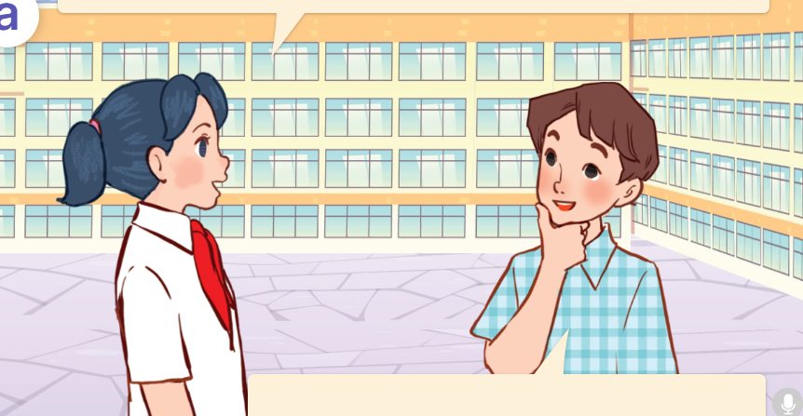
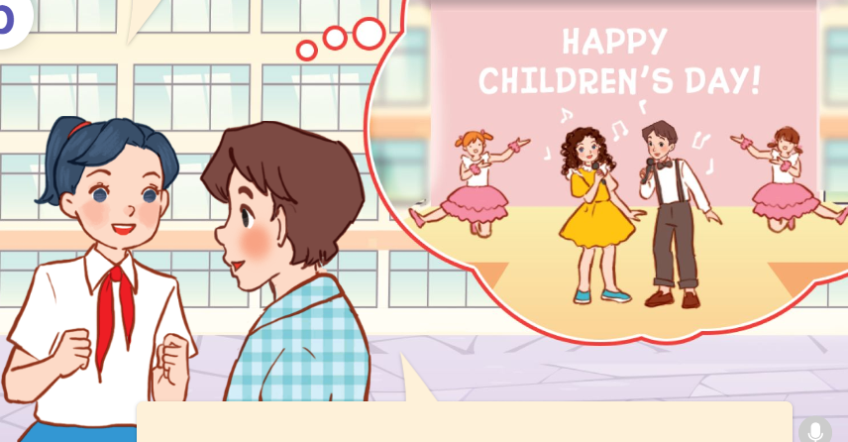
1. Look, listen and repeat.
Do you have
Children’s Day in your country?
What will you do on Children’s Day?
Hello, David.
a
b
Yes, we do.
It’s coming soon.
We’ll sing, dance and have a party.
They’re in the schoolyard.
Who are they?
They are Mai and David.
Where are they?
They’re talking about Children’s Day.
What are they talking about?
Click on the speaker / sentences to listen.

Slide 6
New words

Slide 7
New words
at Mid-Autumn Festival
/ət mɪd ˈɔːtəm ˈfestɪvəl/
Tết Trung Thu
Click on the English words to listen.

Slide 8
on Children’s Day
/ɒn ˈtʃɪldrən’s deɪ/
ngày Quốc tế Thiếu nhi

Slide 9
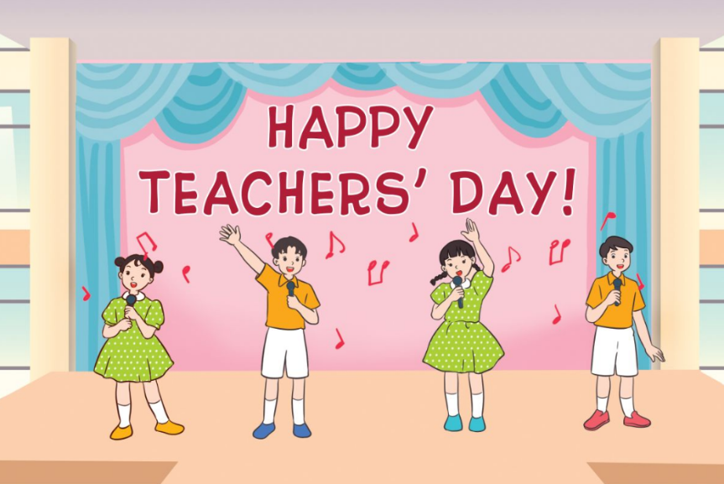
on Teachers’ Day
/ɒn ˈtɪːtʃərs deɪ/
ngày Nhà giáo Việt Nam

Slide 10
on Sports Day
/ɒn ˈspɔːts deɪ/
ngày hội thể thao

Slide 11
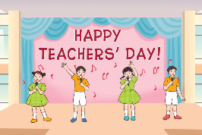
New words
1. at Mid-Autumn Festival
: Tết Trung Thu
2. on Children’s Day
: ngày Quốc tế Thiếu nhi
3. on Teachers’ Day
: ngày Nhà giáo Việt Nam
4. on Sports Day
: ngày hội thể thao
Click on the English word to listen again.

Slide 12
Checking vocabulary!

Slide 13
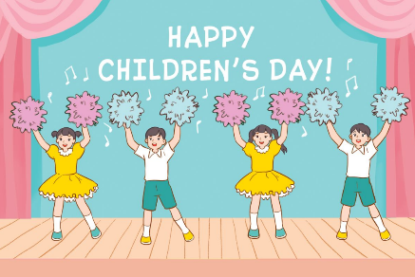
Look and say.
On children’s Day

Slide 14
Look and say.
at Mid-Autumn Festival

Slide 15
Look and say.
on Sports Day

Slide 16
Look and say.
on Teachers’ Day

Slide 17
Sentence

Slide 18
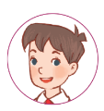
Cách hỏi và đáp về dự định tương lai:
What will you do _____?
( Bạn sẽ làm gì _____?)
We’ll _____.
( Chúng mình sẽ _____.)
Example:
What will you do on Children’s Day?
We’ll dance.
* we’ll = we will

Slide 19
2. Listen, point and say.
a
b
What will you do ____?
on Children’s Day / dance
on Teachers’ Day / sing
c
d
We’ll _____.
on Sports Day / play badminton
at Mid-Autumn Festival / have a party
Click on the words / phrases to listen again.

Slide 20
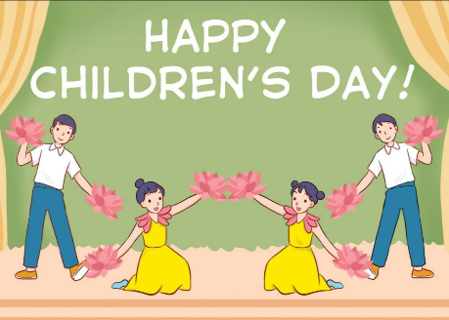
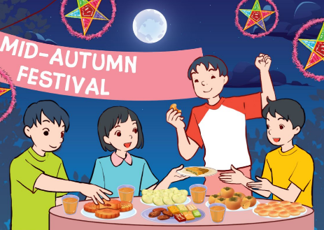
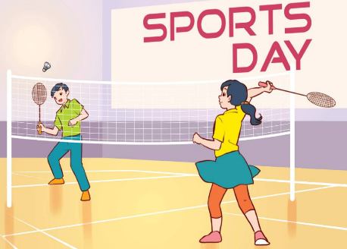
3. Let’s talk.
What will you do ______?
_____________.

Slide 21
Fun corner
& wrap - up

Slide 22
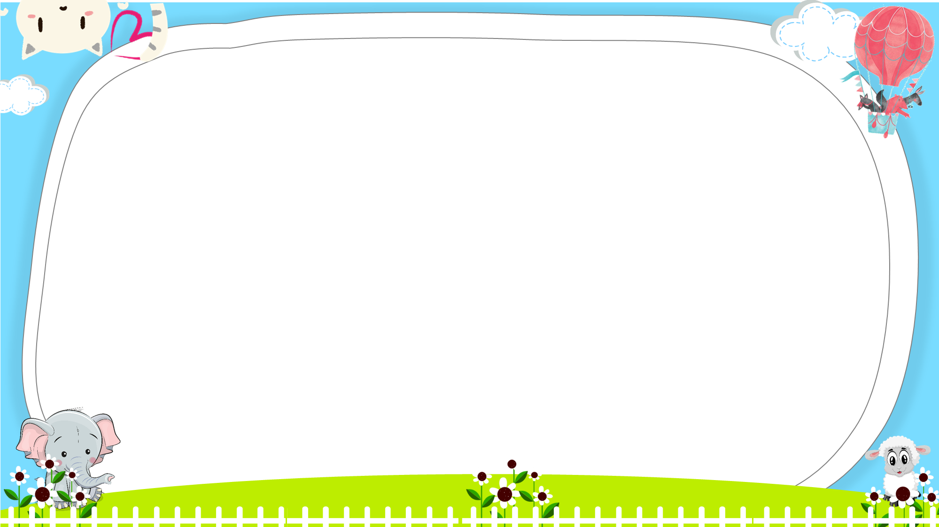
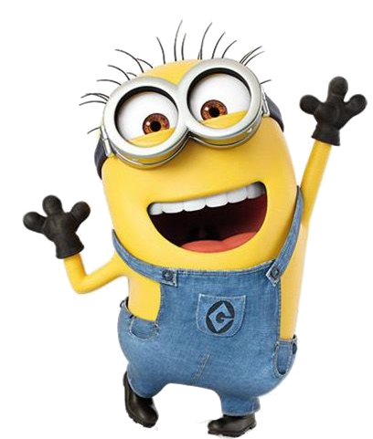

Slide 23
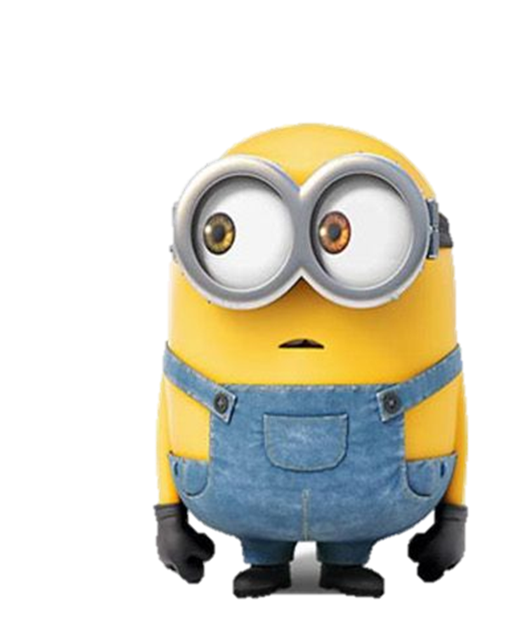
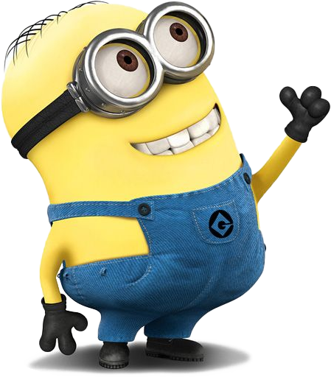
A: What will you do _____________?
B: We’ll ___________.
1/8
A. at Mid-Autumn Festival - dance
B. at Mid-Autumn Festival - have a party

Slide 24
A: What will you do ______________?
B: We’ll __________.
2/8
A. on Children’s Day - dance
B. on Teachers’ Day - dance

Slide 25
A: What will you do _________?
B: We’ll _________.
3/8
A. on Sports Day - play badminton
B. on Sports Day - play table tennis

Slide 26
A: What will you do _____________?
B: We’ll ___________.
4/8
A. on Teachers’ Day - dance
B. on Teachers’ Day - sing

Slide 27
A: ____ will you do __ Mid-Autumn Festival?
B: We’ll have a party.
5/8
A. What - on
B. What - at

Slide 28
A: What will you ___ on Teachers’ Day?
B: We ____ dance.
6/8
A. do - will
B. does - will

Slide 29
A: What will you do Children’s Day?
B: _______________________
7/8
A. We’ll play the piano.
B. We collected seashells.

Slide 30
A: _________________________
B: We’ll play volleyball.
8/8
A. What will you do on Sports Day?
B. Where will you go at Tet?

Slide 31
Homework
Learn by heart all the new words and the model sentences.
Read again the dialogue in part 1. Prepare for lesson 1 (4+5+6)

Slide 32
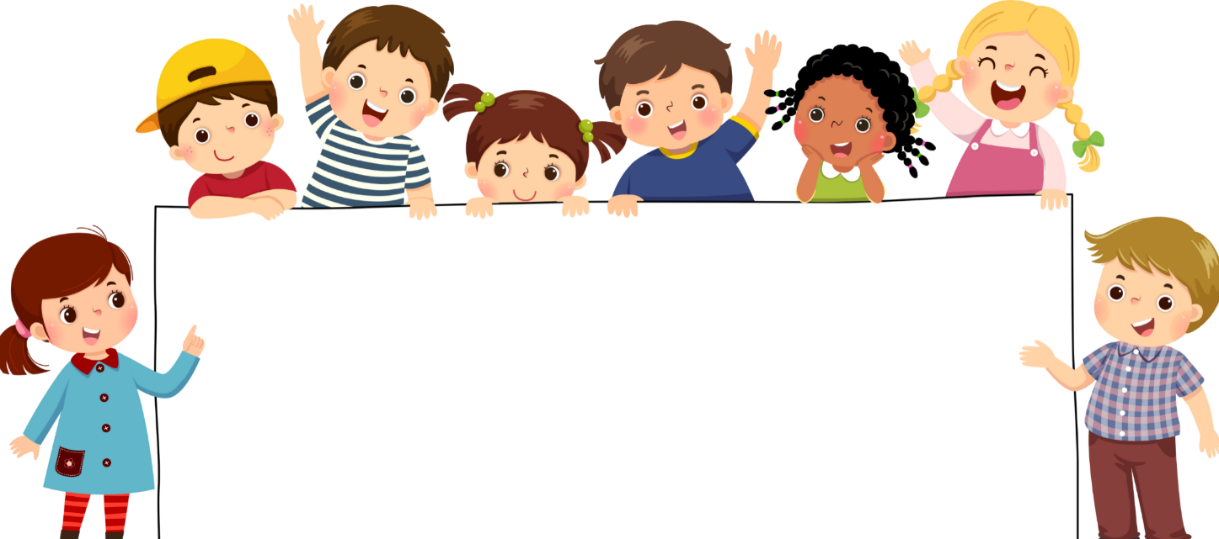
Goodbye!

