Slide 1
Warm-up

Slide 2
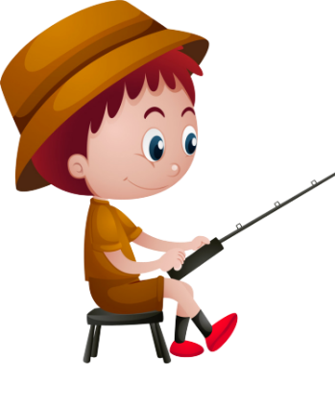
GO FISHING
Game
PLAY

Slide 3
Click vào con cá có số để chuyển tới câu hỏi
7
4
6
2
8
1
5
3
EXIT
13
12
11
14
15

Slide 4
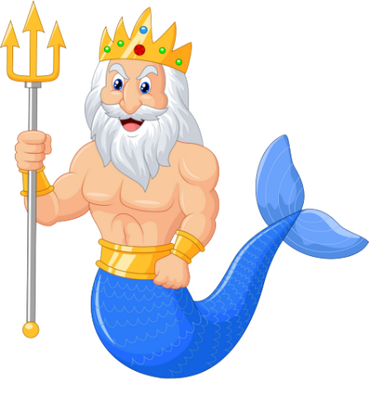
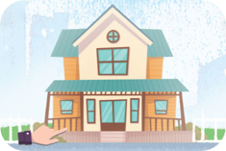
A
No, I don’t.
A: Do you live in this house?
B: _____________
B
Yes, I can.
C
Yes, I do.
D
Next to

Slide 5
A
No, I don’t.
A: Do you live in that building?
B: _____________
B
No, it isn’t.
C
No, I can’t.
D
Next to

Slide 6
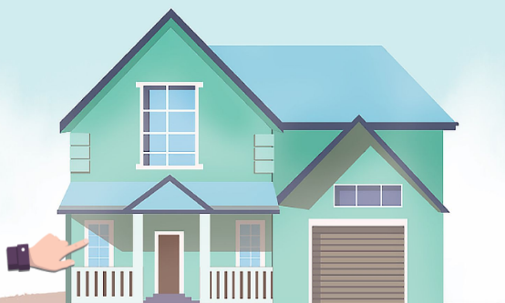
A: Do you live in this house?
B: No, I don’t.
A
True
B
False
D
They likes sport.

Slide 7
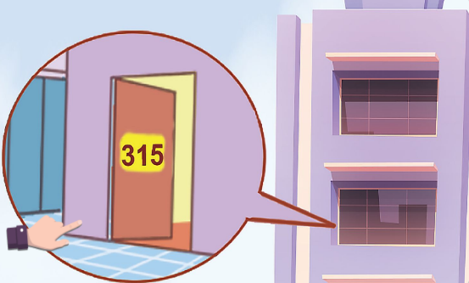
A: Do you live in that tower?
B: Yes, I do.
A
True
B
False
D
She should take some warm water.

Slide 8
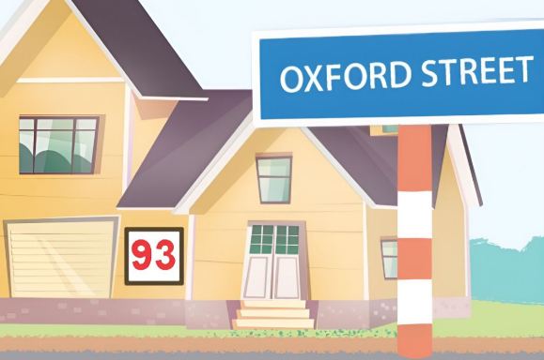
A: _______ your address?
B: It’s 93 Oxford Street.
A
Where is
B
What is
C
When is
D
Watch

Slide 9
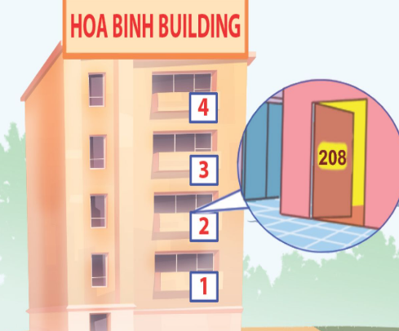
A
Do you lie in that flat?
B
Do you live in this flat?
A: __________________
B: Yes, I do.
C
Do you lie in that house?
D
She should take some warm water.

Slide 10
Great!

Slide 11
Unit 2
Monday, Sep 16th 2024
Our homes
Lesson 3 (1+2+3)

Slide 12
Contents
Listen and repeat.
Circle, listen and check.
Let’s chant.

Slide 13
1. Listen and repeat.
'
'
fif teen
I live at fif teen Ba Dinh Street.
'
'
six teen
She lives at six teen London Street.
Click on the letters / words / sentences to listen again.

Slide 14
Word stress
Click on the
words to listen.
'
'
'
thirteen
fourteen
fifteen
'
'
'
'
sixteen
seventeen
eighteen
nineteen
'
'
'
'
'
twenty
thirty
forty
fifty
sixty
'
'
'
seventy
eighty
ninety

Slide 15
2. Circle, listen and check.
1.
a. thirteen
b. fourteen
c. thirty
2.
a. nineteen
b. sixty
c. ninety
3.
a. twenty
b. sixteen
c. eighteen
Click on the speaker / leaves to listen.

Slide 16
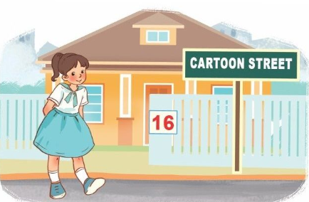
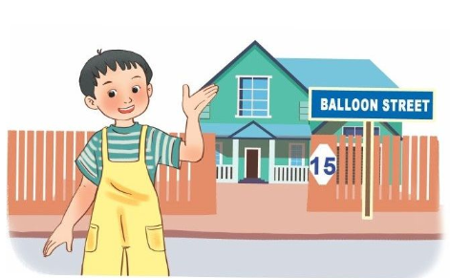
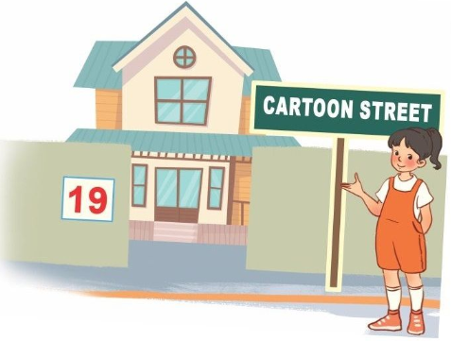
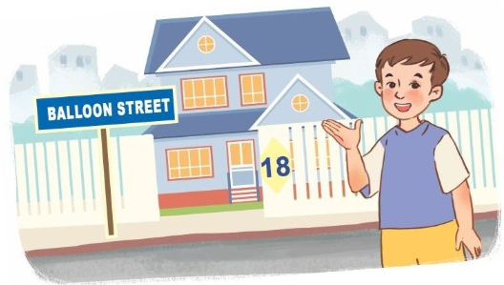
3. Let’s chant.
Where do you live?
I live at 15 Balloon Street.
Where do you live?
I live at 16 Cartoon Street.
What’s your address?
It’s 18 Balloon Street.
What’s your address?
It’s 19 Cartoon Street.
Click on the speker to listen (click on the sentences to listen again).

Slide 17
Homework
Learn by heart all the new words and the model sentences of unit 2. Prepare for Unit 2 lesson 3 (4+5+6).

