Slide 1

Welcome to our class
4A
TEACHER: TRINH THI HA

Slide 2





Slide 3
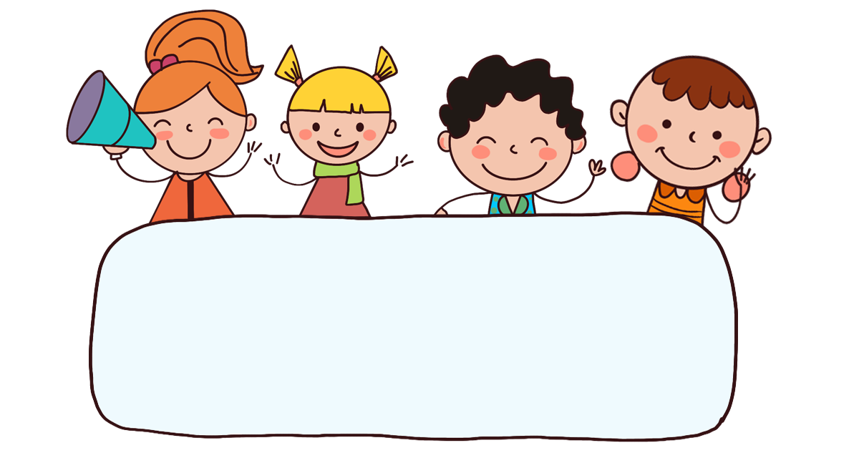
Let’s sing!

Slide 4

WISHPER

Slide 5

Thursday , September 25th ,2025
UNIT 2 : TIME AND DAILY ROUNTINES
LESSON 1 : PART 1,2,3

Slide 6


Time and daily routines
2
Lesson 1 - Period 1

Slide 7
Table of contents
Warm-up and Review
04
01
02
03
Let’s talk.
Look, listen and repeat.
05
Fun corner & wrap-up
Listen, point and say.

Slide 8
01
Warm-up & Review

Slide 9
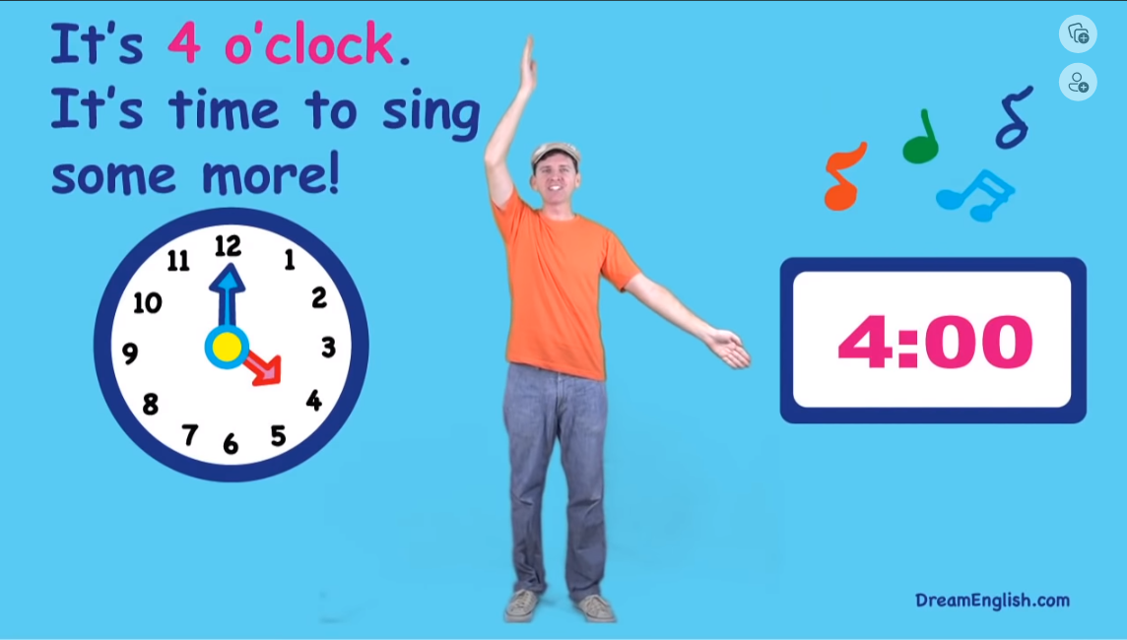

Sing the song.

Slide 10
02
Look, listen and repeat.

Slide 11
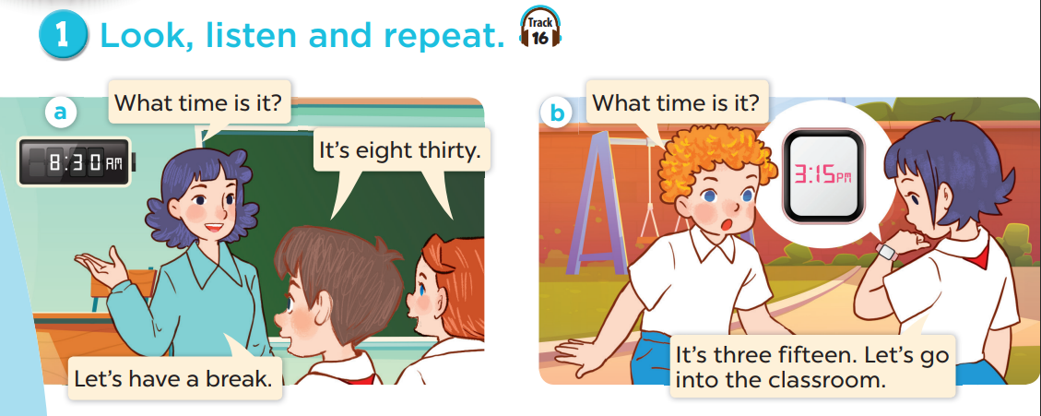


Slide 12
03
Listen, point and say.

Slide 13
Vocabulary

Slide 14
Checking up rud out and remember

Slide 15
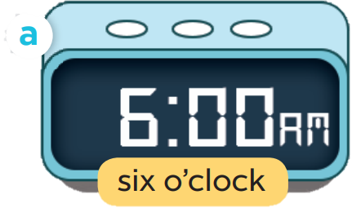
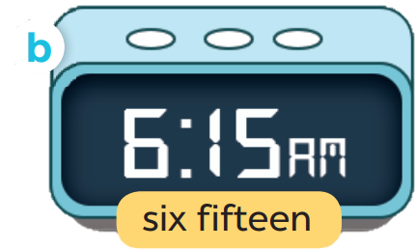
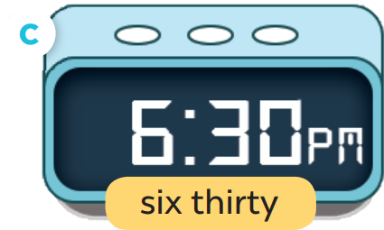
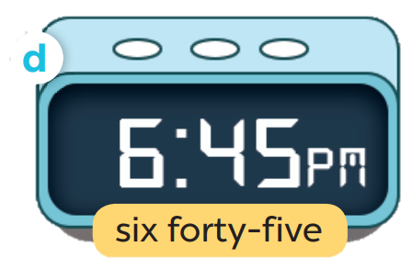

Slide 16
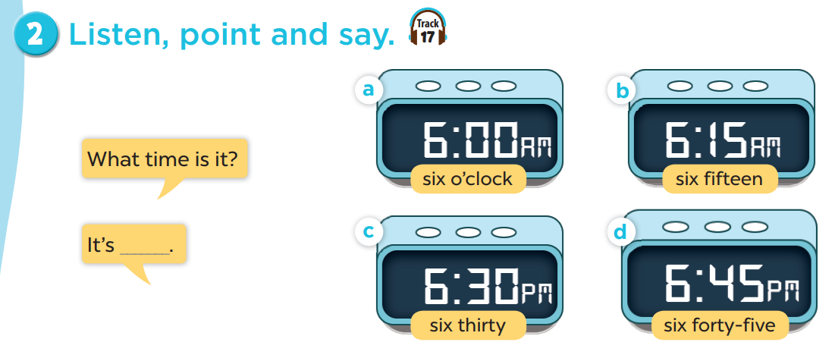

Slide 17

What time is it?
I six o’clock.

Slide 18
04
Let’s talk.

Slide 19
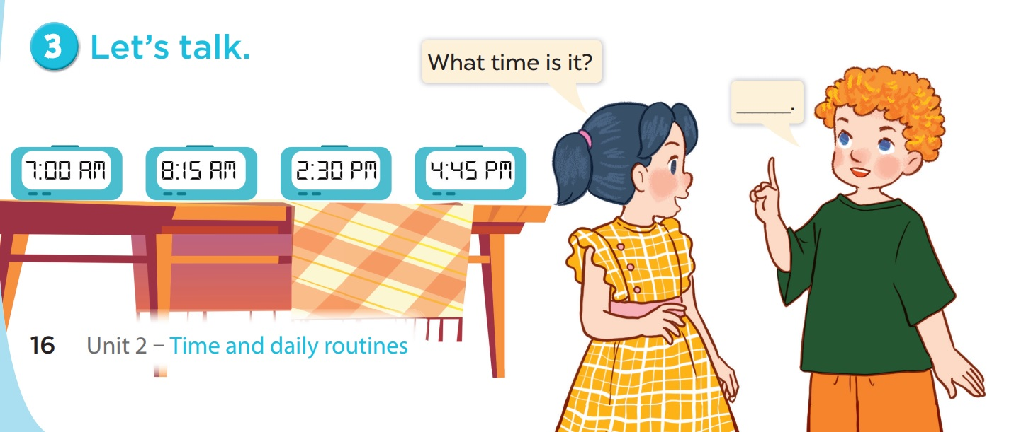

Slide 20
05
Fun corner & wrap-up

Slide 21



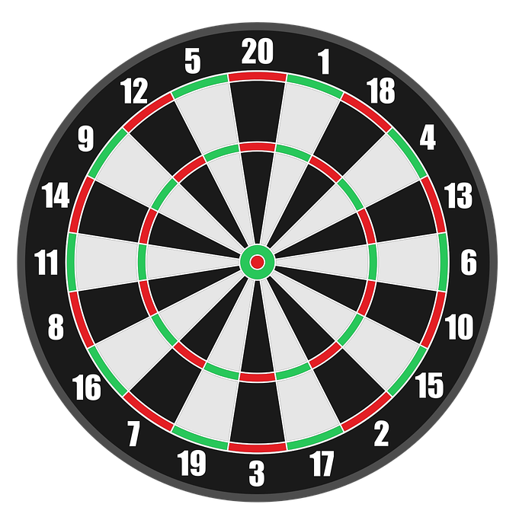

PLAY

Slide 22

A: What time is it?
B: It’s ___________.
+50
b. seven thirty
a. seven o’clock
c. six o’clock
Next

Slide 23
A: What time is it?
B: It’s ___________.
+50
b. eight fifteen
a. eight fifty
c. eight five
Next

Slide 24
A: What time is it?
B: It’s ___________.
+25
b. two three
a. two thirty
c. two thirteen
Next

Slide 25
A: What time is it?
B: It’s ____________.
+25
b. four fifteen
a. four forty
c. four forty-five
Next

Slide 26
WELL DONE!
EXIT

Slide 27
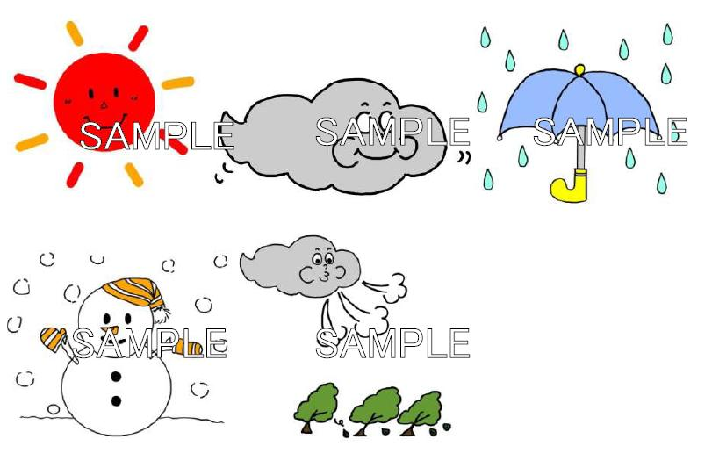
THANK YOU FOR YOUR ATTENTION

