Slide 1
WELCOME TO OUR ENGLISH CLASS
PEOPLE’S COMMITTEE OF PHU MY DISTRICT
My Hoa Primary School
Teacher: Phan Thi My Hoa
Class: 3C
Notes:
Game: Who’s faster?
- Teacher calls 2 pupils to come to the board.
- Pupils on the board have a quick look at the break time activities on the board.
- When the teacher says the sentences, who get the pictures of those sentences first will get the points.

Slide 2
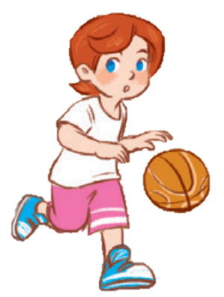
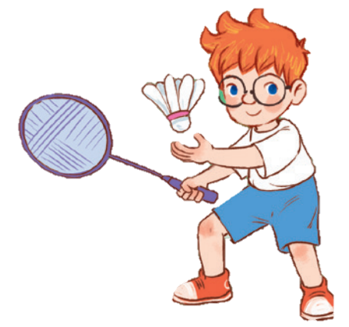
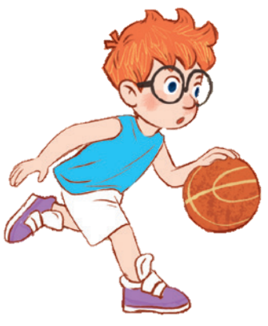
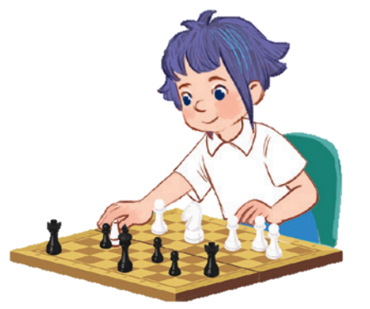
10

Slide 3
Contents
1
5
Fun corner and wrap-up
Warm-up and review
4
2
3
Let’s play.
Listen and number.
Read and match.

Slide 4
Warm-up AND REVIEW
Notes:
Game: Who’s faster?
- Teacher calls 2 pupils to come to the board.
- Pupils on the board have a quick look at the break time activities on the board.
- When the teacher says the sentences, who get the pictures of those sentences first will get the points.

Slide 5
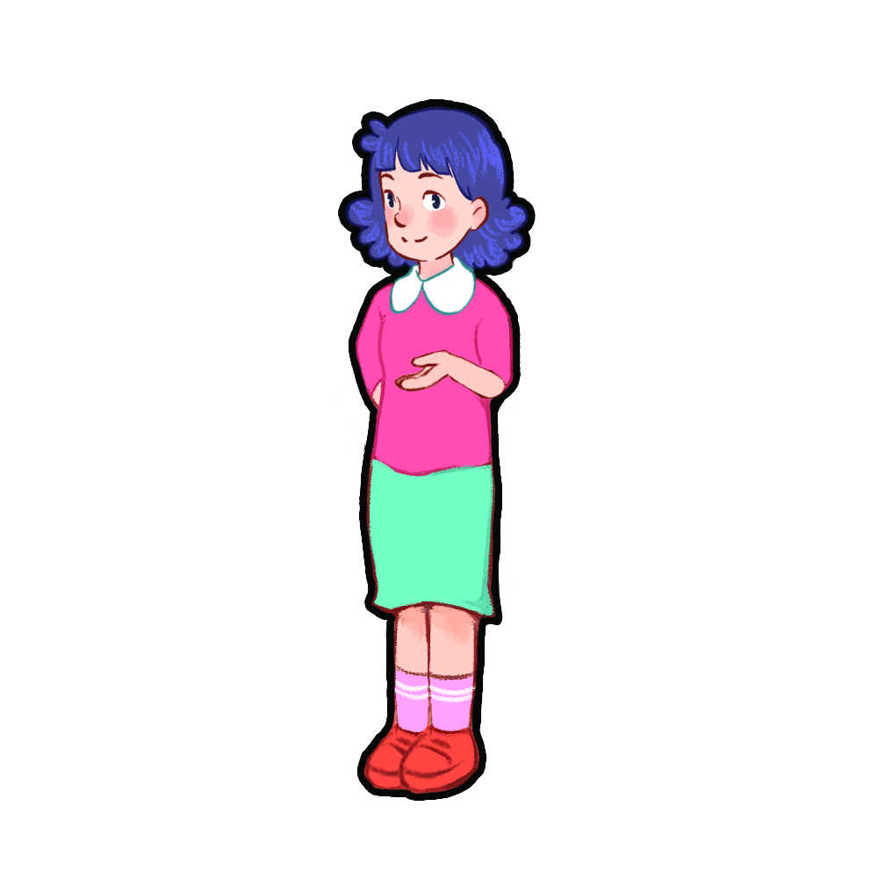
LET’S SING.

Slide 6
Notes:
Game: Who’s faster?
- Teacher calls 2 pupils to come to the board.
- Pupils on the board have a quick look at the break time activities on the board.
- When the teacher says the sentences, who get the pictures of those sentences first will get the points.

Slide 7
game: WHO’S THE FASTEST?

Slide 8
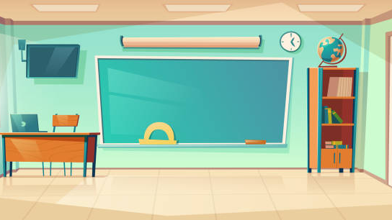
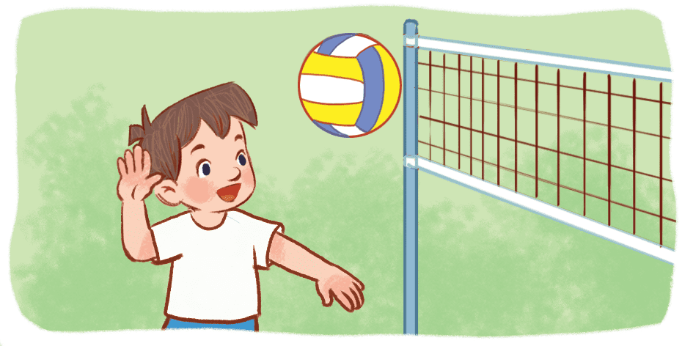
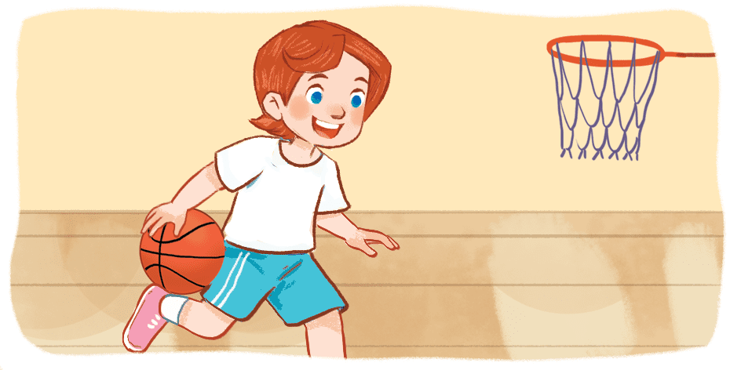
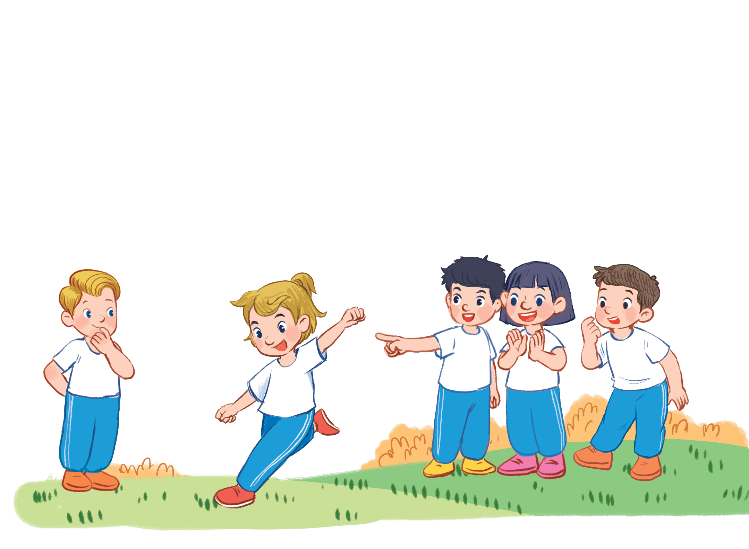
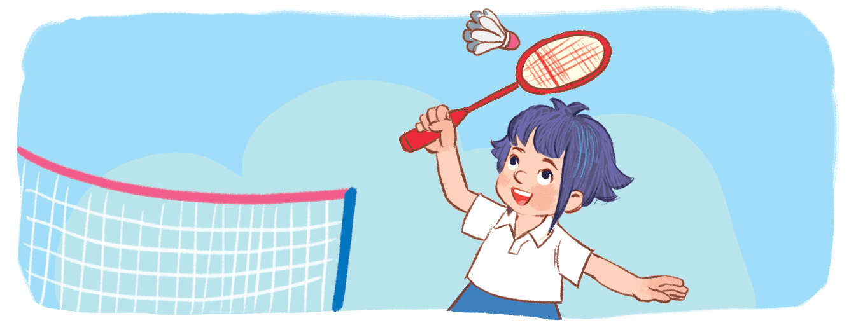
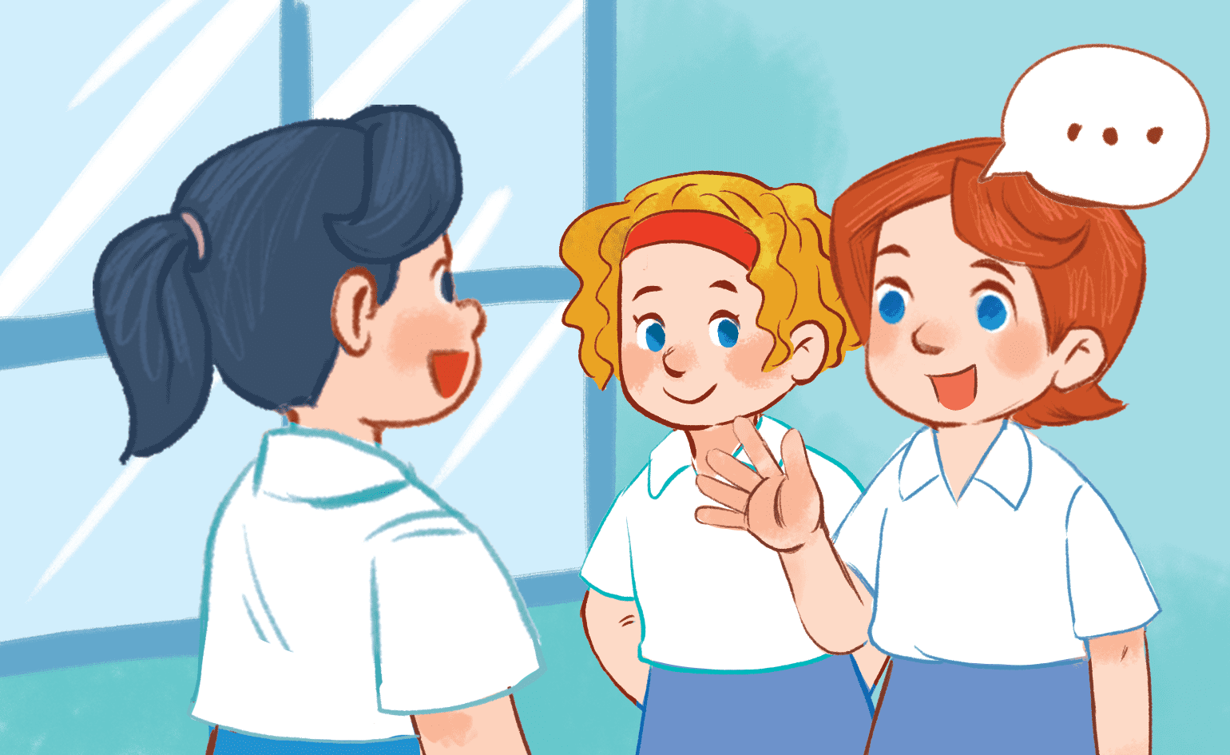
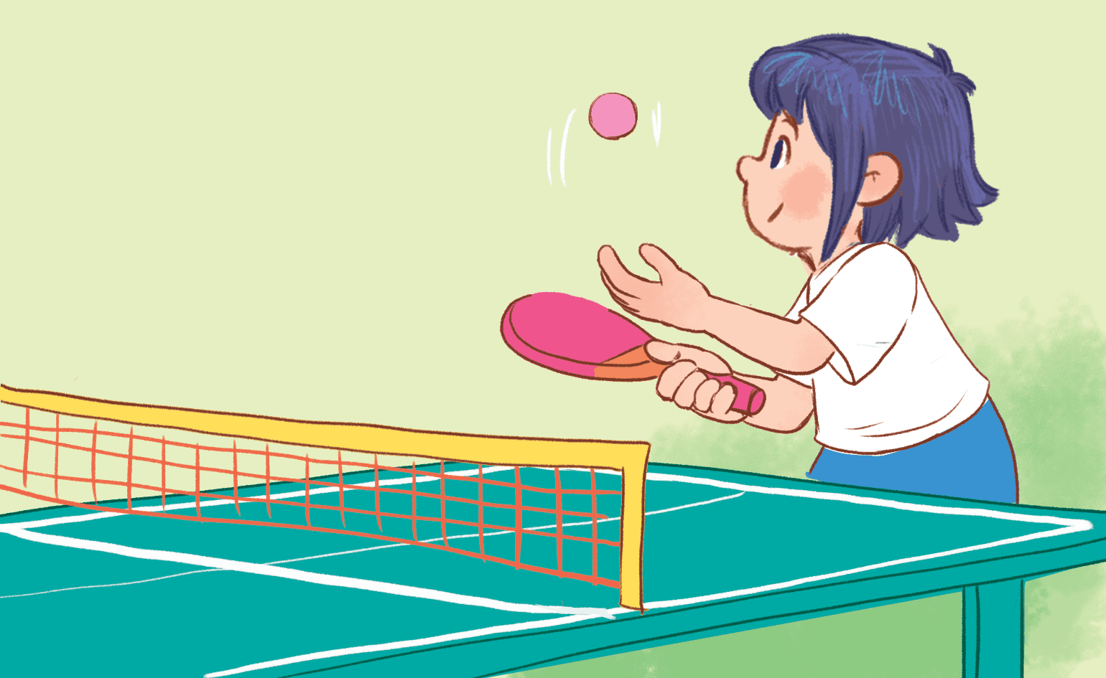
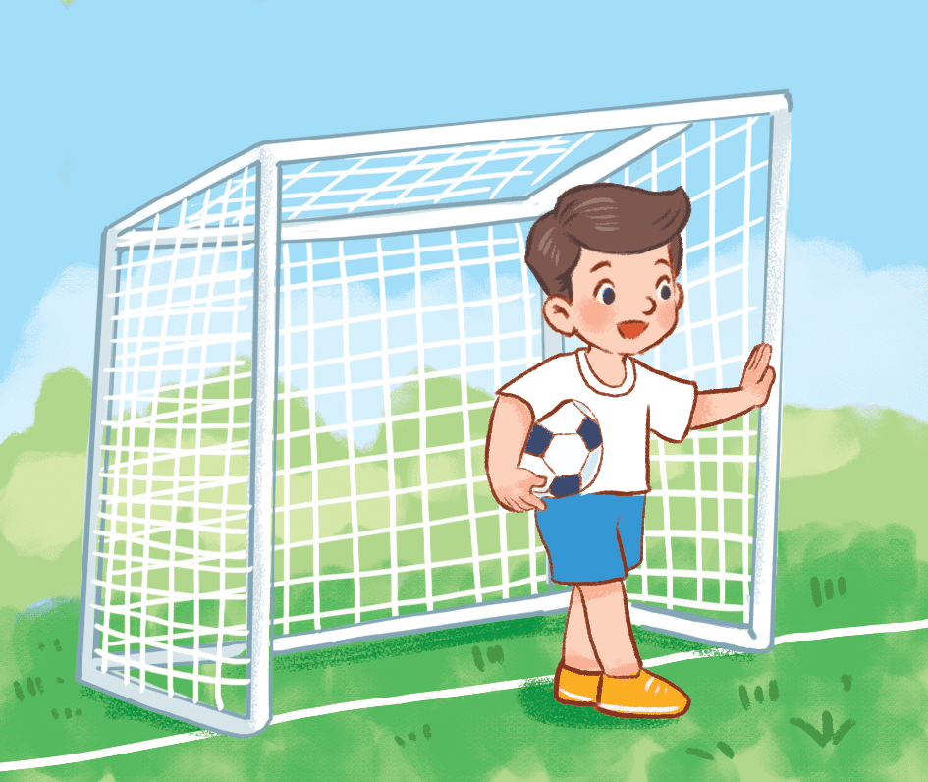
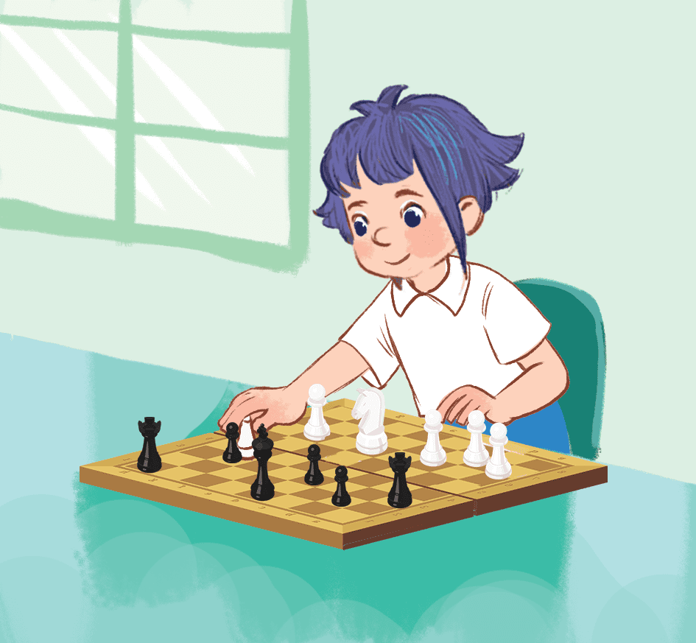
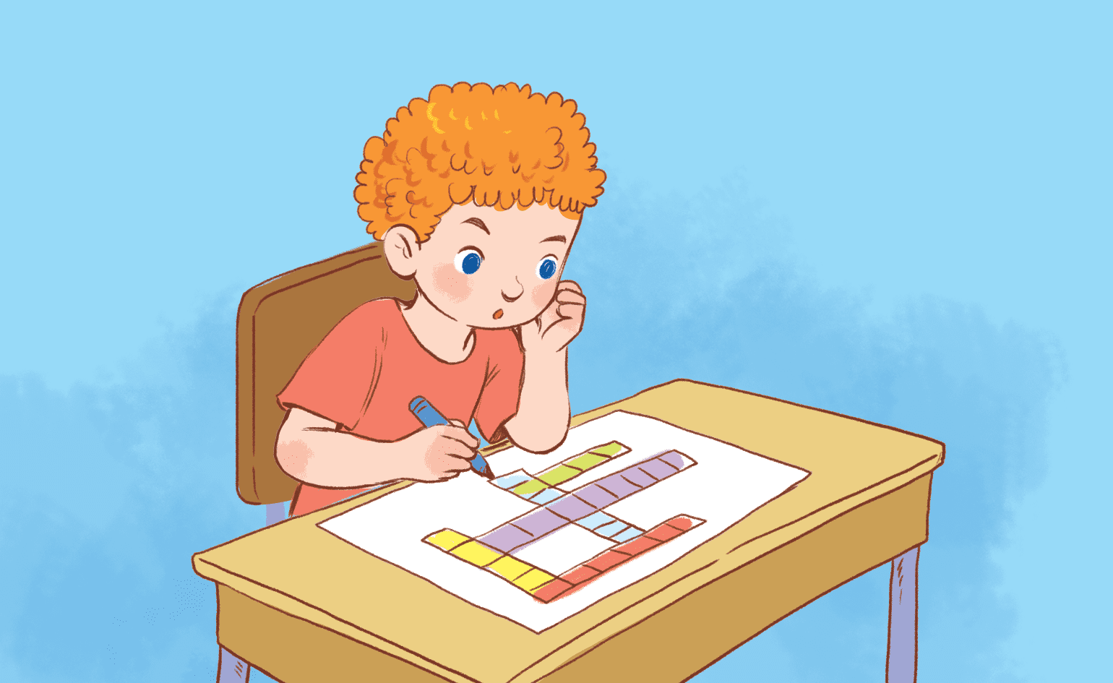
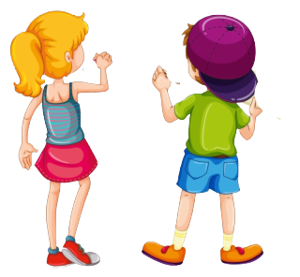
Game time
I play table tennis.
Notes:
Game: Who’s faster?
- Teacher calls 2 pupils to come to the board.
- Pupils on the board have a quick look at the break time activities on the board.
- When the teacher says the sentences, who get the pictures of those sentences first will get the points.

Slide 9
Game time
Good job!
Notes:
Game: Who’s faster?
- Teacher calls 2 pupils to come to the board.
- Pupils on the board have a quick look at the break time activities on the board.
- When the teacher says the sentences, who get the pictures of those sentences first will get the points.

Slide 10
4. LISTEN AND NUMBER.

Slide 11
2
1
4
3

Slide 12
5. READ AND MATCH.

Slide 13
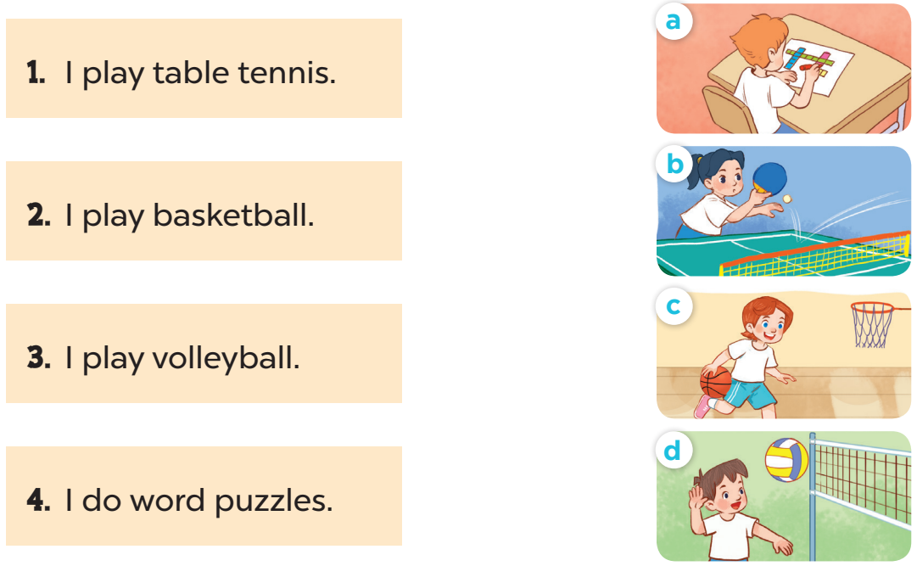

Slide 14
6. Let’s PLAY.

Slide 16
Fun corner and Wrap-up
Notes:
Game: Who’s faster?
Teacher calls 4 pupils to come to the board.
Pupils on the board have a quick look at the break time activities on the board.
On the four chairs, there are phrases written on pieces of paper which match with the pictures.
When the teacher points to the pictures, 4 pupils try to run fast and look for the matching pieces of paper and sit on the chairs having those pieces.
There are 3 correct answers, so one pupil has to go back to his or her seat.
Repeat the game until the last picture.

Slide 17
LABUBU

Slide 18
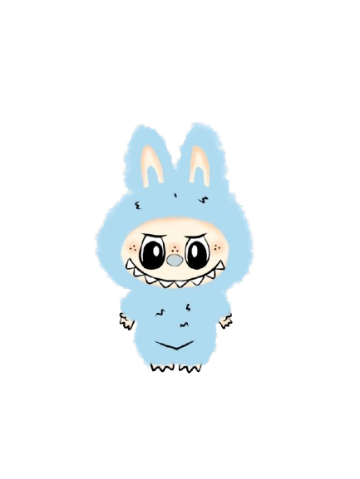
3
6
9
2
5
8
1
7
4

Slide 19
QUESTION 1: REORDER THE WORD: KEBLLATSBA
A. BASKETBALL
C. FOOTBALL
B. VOLLEYBALL
D. BADMINTON

Slide 20
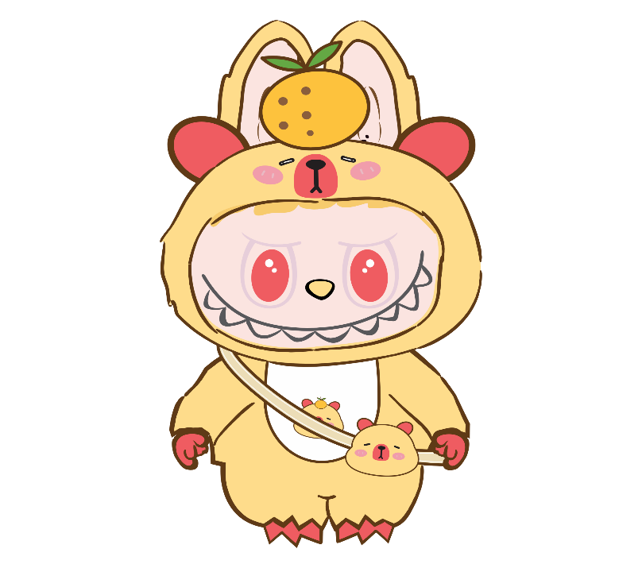
QUESTION 2: FILL IN THE BLANK:
I … word puzzles.
play
C. chat
B. do
D. am

Slide 21
QUESTION 3: REORDER THE WORDS TO MAKE A CORRECT SENTENCE.
WITH/ FRIENDS/ CHAT/ I/ MY.
A. I chat my with friends.
C. I chat with my friends.
B. I with my friends chat.
D. I my chat with friends.

Slide 22
QUESTION 4: FIND THE MISTAKE:
I do table tennis at break time.
A. table tennis
C. break time
B. at
D. do

Slide 23
QUESTION 5: CHOOSE THE ODD ONE OUT:
play volleyball
C. play basketball
B. play badminton
D. play football

Slide 24
QUESTION 6: REORDER THE WORDS TO MAKE A CORRECT SENTENCE.
do/ at/ you/ break/ What/ time?/ do
A. What do you do at time break?
C. What do you do at break time?
B. What you do at do break time?
D. What do do you at break time?

Slide 25
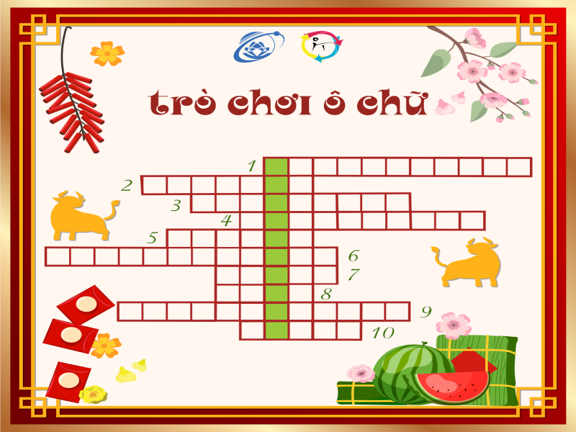
QUESTION 7: LOOK AND CHOOSE THE CORRECT ANSWER:
A. chat with my friends.
C. do word puzzles
B. play chess
D. play table tennis

Slide 26
QUESTION 8: FILL IN THE BLANKS:
I play ta_le ten_is.
d n
C. b d
B. b n
D. n b

Slide 27
QUESTION 9: Fill in the blank:
I play chess __ break time.
A. at
C. on
B. in
D. with

Slide 28
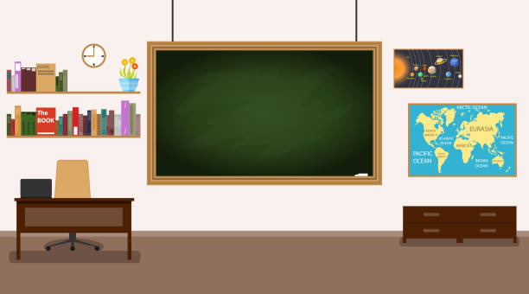
play
football
chat
with
my friends
do
word
puzzless
play
table tennis
play volleyball
play badminton
play basketball
play
chess
Notes:
T shows pictures of break time activities on the board and asks pupils to make sentences using the model structure.

Slide 29
- Retell the main points of the lesson. - Prepare for the next lesson Lesson 3 (part 1,2,3)

Slide 30
Thank you for watching!

