Slide 1
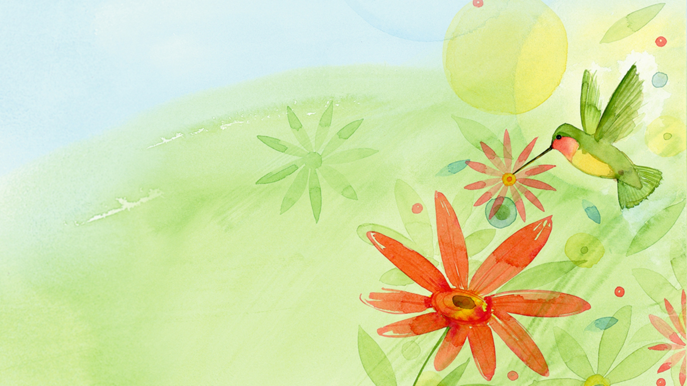
Welcome to our class
3B
TEACHER: TRINH THI HA

Slide 2
Warm-up

Slide 3
Let’s sing!

Slide 4
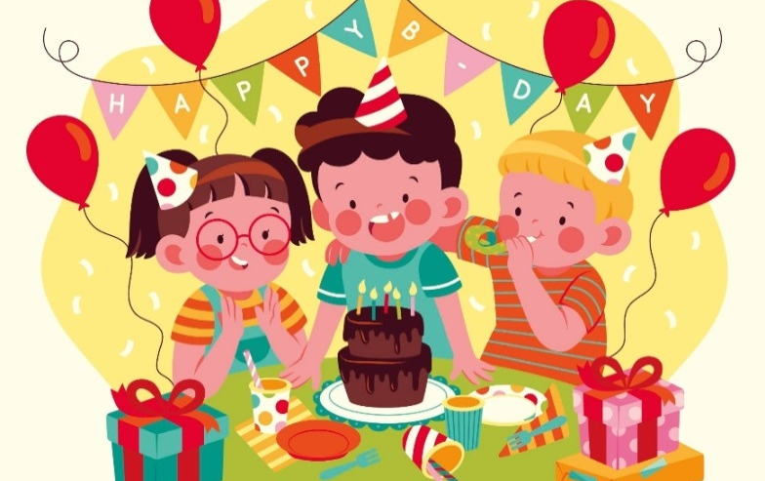
Friday, December 15th ,2024
Unit 9: Colours
Lesson 2 (1+2+3)

Slide 5
Let’s play game!

Slide 6
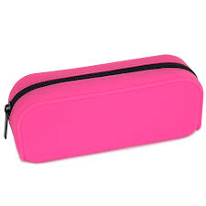
What colour is it?
black
red
pink
pink
white
green
gray
orange
yellow
Click me!

Slide 7
What colour is it?
yellow
purple
Pencil case
yellow
blue
orange
purple
red
white
Click me!

Slide 8
What colour is it?
blue
brown
yellow
red
red
colour
pink
green
gray
Click me!

Slide 9
What colour is it?
white
blue
gray
blue
black
colour
pink
black
red
Click me!

Slide 10
What colour is it?
yellow
white
red
brown
blue
gray
brown
pink
purple
Click me!

Slide 13
Friday , December 15th ,2024
UNIT 9 : COLOURS .
LESSON 2 : PART 1,2,3

Slide 14
Contents
1
2
3
Look, listen and repeat.
Listen, point and say.
Let’s talk.

Slide 15
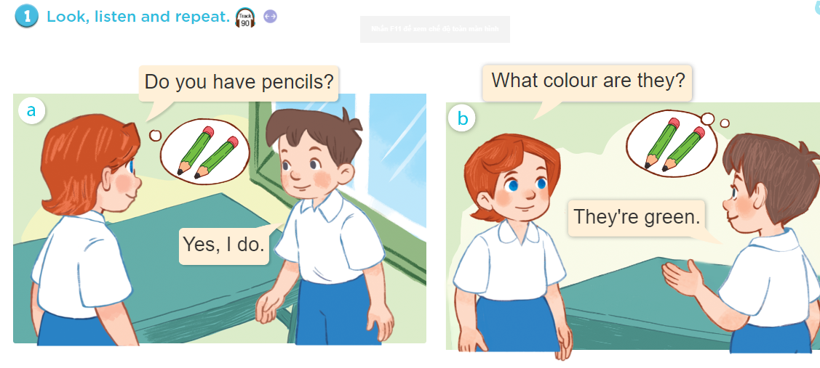

Slide 17
2
Point and say

Slide 19
Friday , December 15th ,2024
UNIT 9 : COLOURS .
LESSON 2 : PART 1,2,3

Slide 20
black

Slide 21
orange

Slide 22
white
saf

Slide 23
green

Slide 24
Friday , December 15th ,2024
UNIT 9 : COLOURS .
LESSON 2 : PART 1,2,3

Slide 25
Matching
A
1. Blue
2. White
3. Yellow
4. Brown
5. Green
6. Orange
B

Slide 26
Hỏi và đáp về màu sắc nhiều vật.
2. Point and say
What colour are they ?
colour.
They’re = They are
They’re +

Slide 28
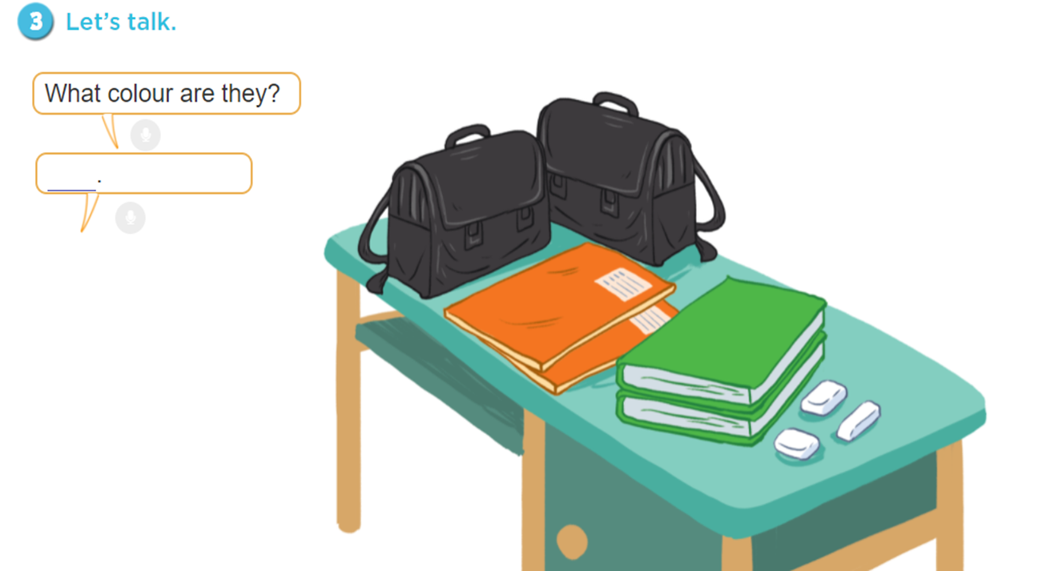

Slide 29
QUESTION 01
What colour is it?
blue
A
green
B
gray
C
yellow
D

Slide 30
QUESTION 02
what colour….they?
be
A
is
B
are
C
am
D

Slide 31
QUESTION 03
is/ My /pen/ blue/./
Is my pen blue.
A
My is pen blue.
B
Pen is my blue.
C
My pen is blue.
D

Slide 32
QUESTION 04
T what colour are they?
orange
A
white
B
black
C
nice
D

Slide 33
QUESTION 05
pencils/ What/colour/are/your/?/
A
What colour are pencils your ?
What colour are your pencils?
B
What are your pencils colour?
C
What colour are pencils your?
D

Slide 34
QUESTION 06
They are …..
blue
A
red
B
white
C
purple
D

Slide 35
QUESTION 07
O…ANGE
L
A
B
B
T
C
R
D

Slide 36
QUESTION 08
Those are my……….school bags.
green
A
black
B
orange
C
white
D

Slide 37
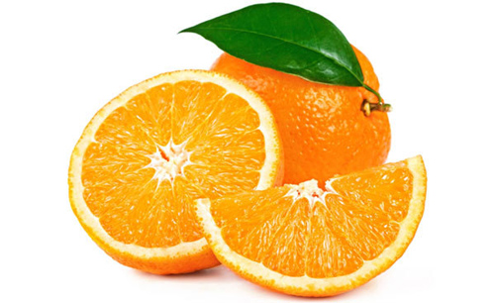

Slide 38
Homework
- Ôn từ về những màu sắc.
- Chuẩn bị : Unit 9, lesson 2, part 4,5,6

Slide 39
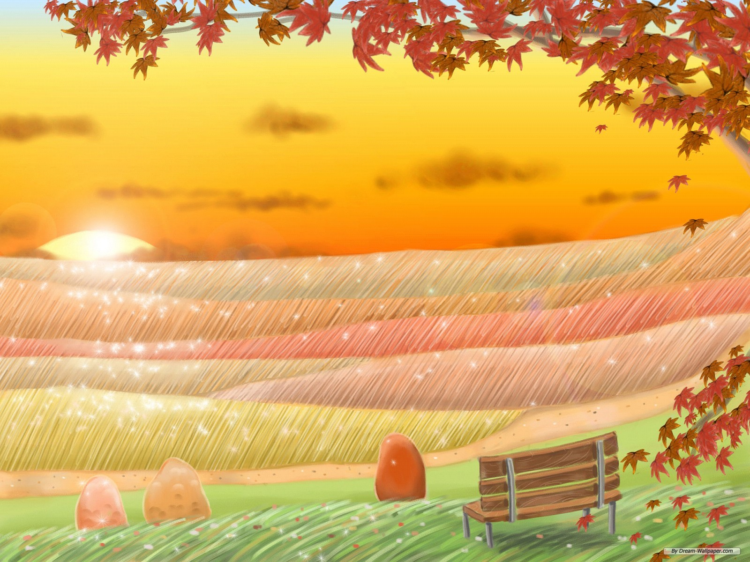
Thanks for your attention Goodbye!

