Slide 1

Unit 3: My week?
Lesson 1

Slide 2
01
Warm-up

Slide 3

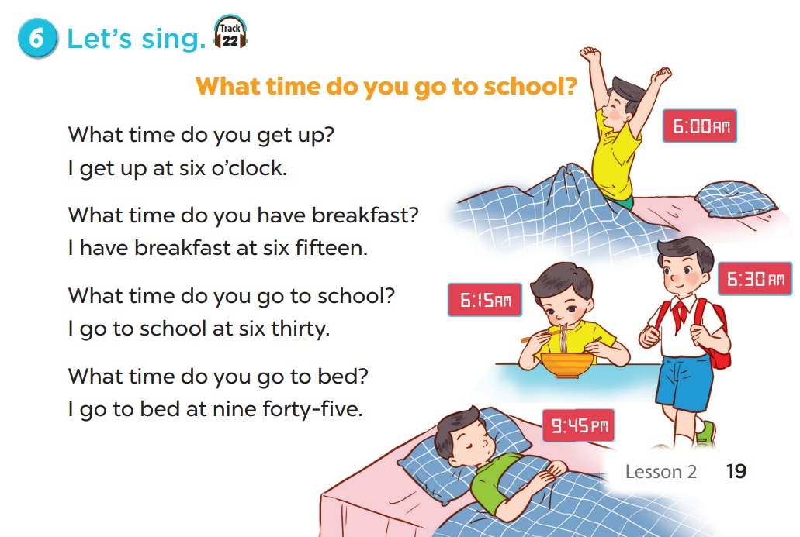
LET’S SING TOGETHER.

Slide 4
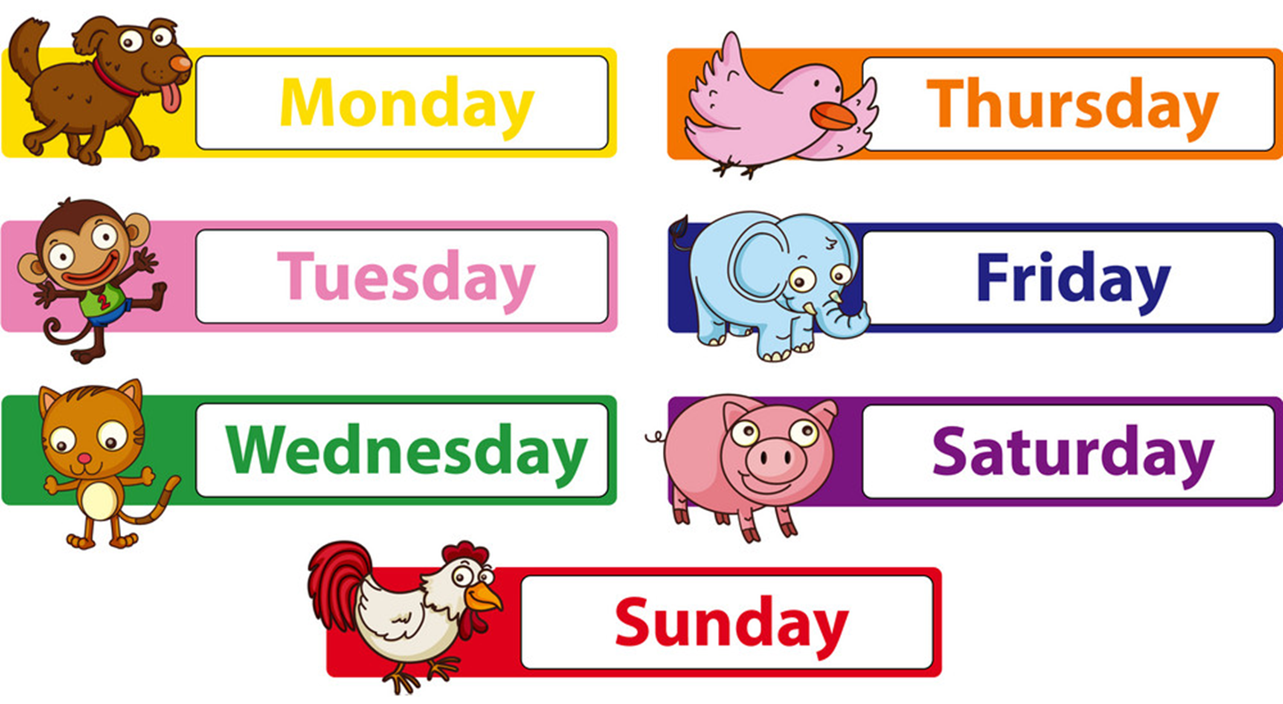
I.Vocabulary

Slide 5
II. Check the vocabulary:

Slide 6
III. Structures:
Hỏi và trả lời về ngày:
What day is it today?
It’s _______.
+ day

Slide 7
02
Activity 1 Look, listen and repeat.

Slide 8
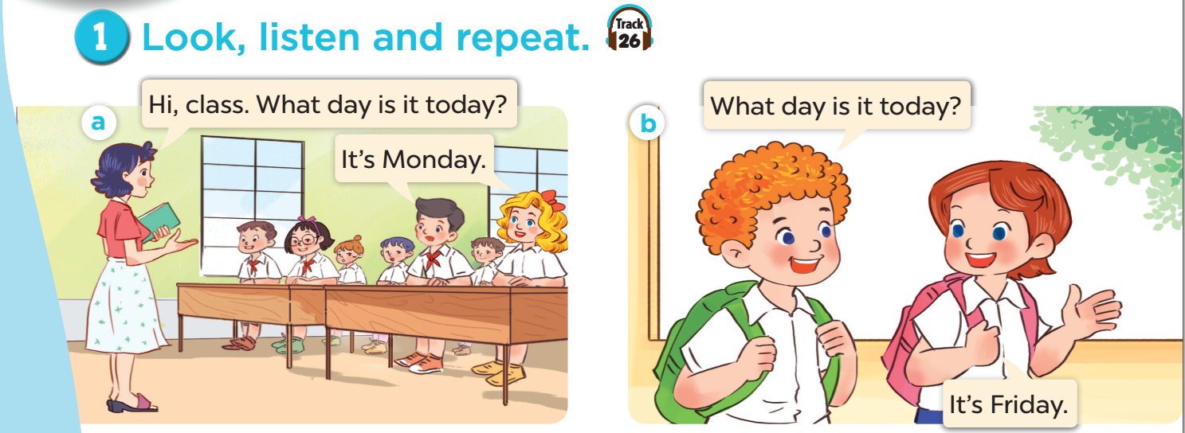

Slide 9
03
Activity 2 Listen, point and say.

Slide 10
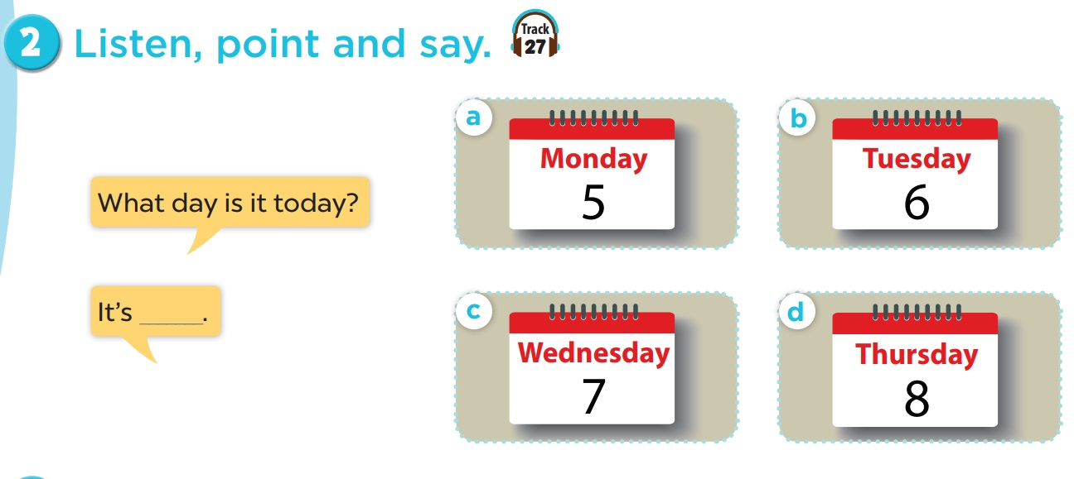

Slide 11
04
Activity 3 Let’s talk.

Slide 12
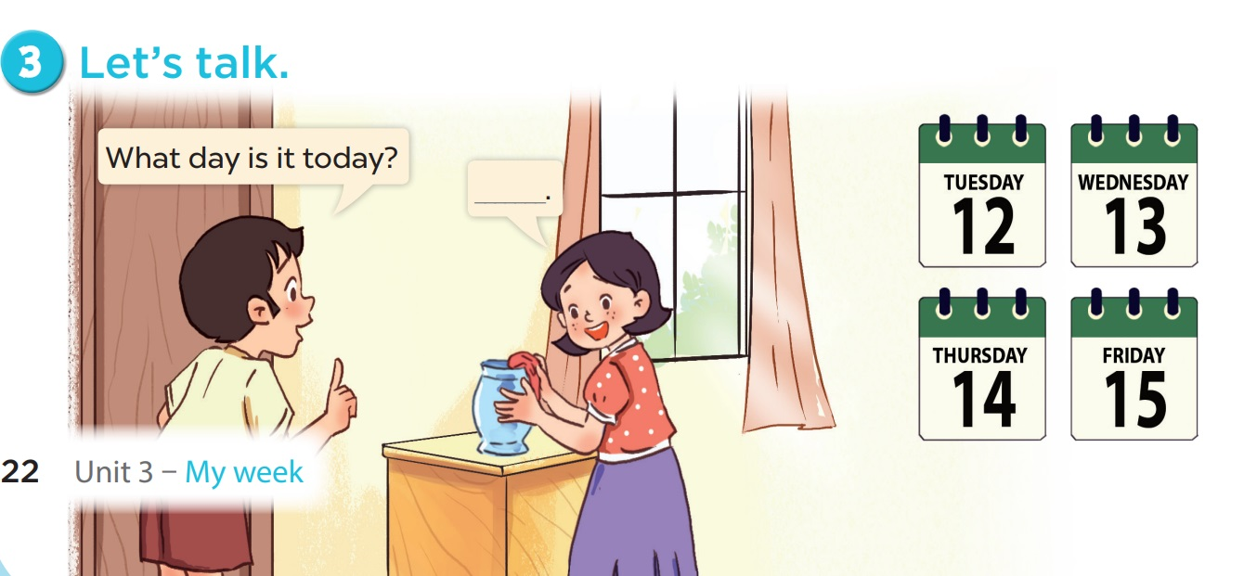

Slide 13



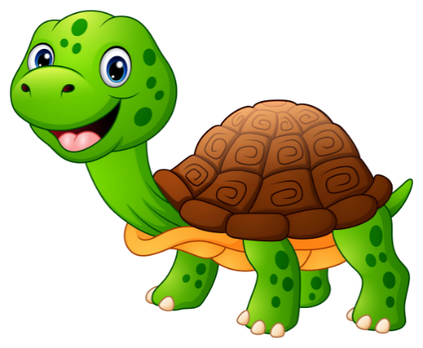


Notes:
Ms Huyền Phạm - 0936.082.789 – YOUTUBE: MsPham. Facebook: Dạy và học cùng công nghệ.

Slide 14


What day is it today?
It’s five.
It’s Wednesday.
Notes:
Ms Huyền Phạm - 0936.082.789 – YOUTUBE: MsPham. Facebook: Dạy và học cùng công nghệ.

Slide 15

What day is it today?
It’s seven.
It’s Friday.
Notes:
Ms Huyền Phạm - 0936.082.789 – YOUTUBE: MsPham. Facebook: Dạy và học cùng công nghệ.

Slide 16

What day is it today?
It’s Saturday.
It’s eight.
Notes:
Ms Huyền Phạm - 0936.082.789 – YOUTUBE: MsPham. Facebook: Dạy và học cùng công nghệ.

Slide 17

What day is it today?
It’s Friday.
It’s six.
Notes:
Ms Huyền Phạm - 0936.082.789 – YOUTUBE: MsPham. Facebook: Dạy và học cùng công nghệ.

Slide 18

What day is it today?
It’s Thursty.
It’s Thursday.
Notes:
Ms Huyền Phạm - 0936.082.789 – YOUTUBE: MsPham. Facebook: Dạy và học cùng công nghệ.

Slide 19


What day is it today?
It’s Tuesday.
It’s four.
Notes:
Ms Huyền Phạm - 0936.082.789 – YOUTUBE: MsPham. Facebook: Dạy và học cùng công nghệ.

Slide 20

It’s Thursday.
What day
is it today?
What
is it today?
Notes:
Ms Huyền Phạm - 0936.082.789 – YOUTUBE: MsPham. Facebook: Dạy và học cùng công nghệ.

Slide 21

It’s Monday.
What day
is it tomorrow?
What day
is it today?
Notes:
Ms Huyền Phạm - 0936.082.789 – YOUTUBE: MsPham. Facebook: Dạy và học cùng công nghệ.

Slide 22

Notes:
Ms Huyền Phạm - 0936.082.789 – YOUTUBE: MsPham. Facebook: Dạy và học cùng công nghệ.

