Slide 1
Unit 1 My friends
Lesson 3

Slide 2
I. OBJECTIVES
By the end of the lesson, pupils will be able to
1. Language knowledge & skills.
correctly pronounce the sounds of the letters a and ia in isolation, in the words America and Australia, and in the sentences I’m from America. and She’s from Australia. with the correct pronunciation and intonation;
- read and show understanding the sentences by deciding if the statements are true or false;
- complete a gapped text about themselves and their friends;
2. Competences.
- Communication and collaboration: work in pairs and groups to complete the learning tasks
- Self-control & independent learning: perform listening tasks
3. Attributes.
- Show pride in where they come from and great respect for where someone comes from by using appropriate gestures and intonation when asking and answering about nationality.

Slide 3
Warm-up
The Hangman Game: Country names
Notes:
Words used: Malaysia, America, Australia, Japan, England, Singapore
Setup the game by drawing a gallow and a underline for each letter in the unknown word.
As letters in the word are guessed, write them above the cooresponding underline. If a letter not in the word is guess, draw a picture of a person on the gallow–one part for each incorrect letter guess.
Most frequently, the person is drawn in 6 parts (for 6 letter guesses) in the order: head, body, left leg, right leg, left arm, right arm. If too many letters which do not appear in the word are guessed, the player is hanged (and loses).

Slide 4
01
Look, listen and repeat.

Slide 5
Australia
Look at the last letters.
a
America
They look similar.
But the sounds are different.
ia
ia
Malaysia

Slide 6
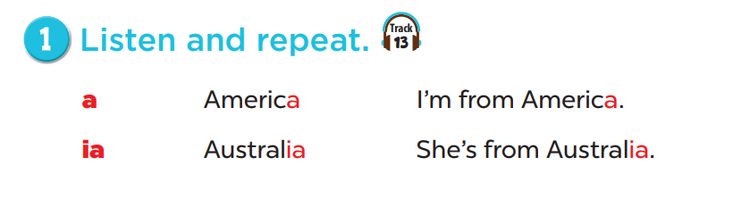

Listen and repeat.

Slide 7
Work in groups, practice.

Slide 8
02
Listen and circle.

Slide 9
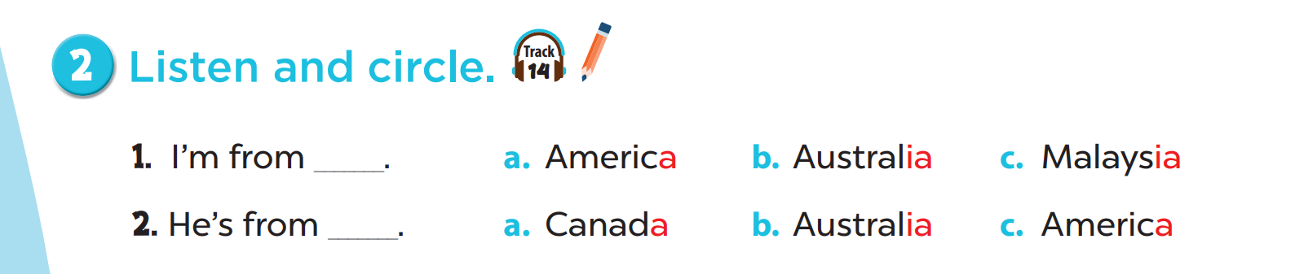

Slide 10
04
Read and tick.

Slide 11
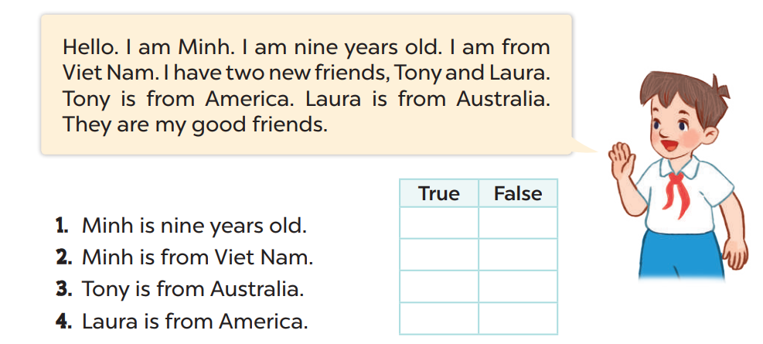

Read and tick.

Slide 12
05
Let’s write.

Slide 13
T’s name / T’s age
Teacher’s photo
My name is Ms._____. I’m _______ years old.
T’s name
T’s age

Slide 14

America / Ben
This is my friend, …...... He is from …………...
Ben
America

Slide 15
Fun time

Slide 16
More words
Country names

Slide 17
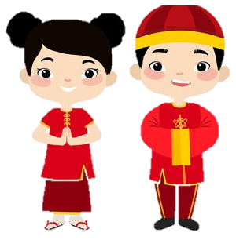


China

Slide 18


Canada

Slide 19
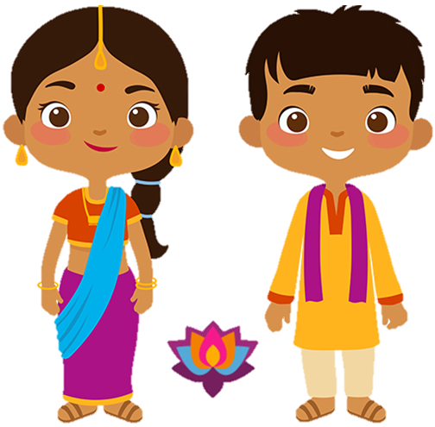


India

Slide 20
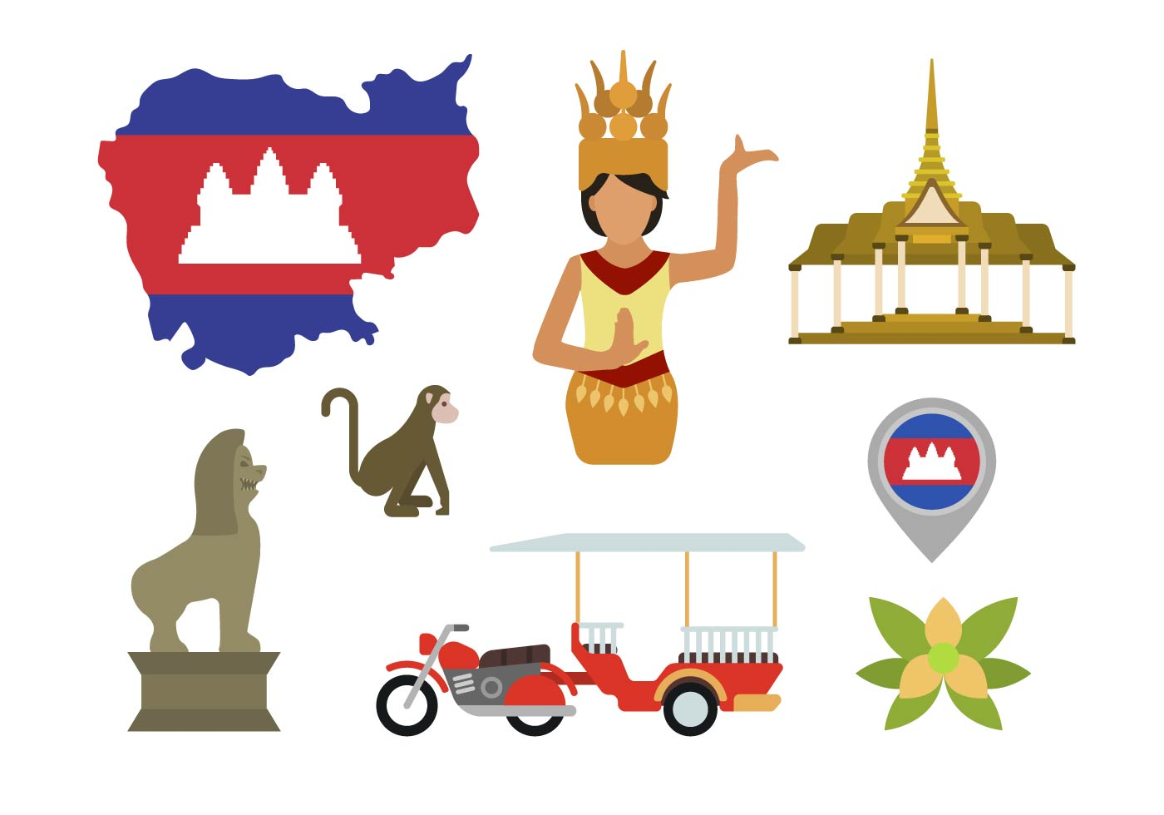

Cambodia

Slide 21
Slap the board!

Slide 22
Listen and choose.
a
ia
America

Slide 23
Listen and choose.
a
ia
Australia

Slide 24
Listen and choose.
a
ia
China

Slide 25
Listen and choose.
a
ia
Cambodia

Slide 26
Listen and choose.
a
ia
Canada

Slide 27
Listen and choose.
a
ia
India

Slide 28
Listen and choose.
a
ia
Malaysia

Slide 29








THANK YOU
Website: sachmem.vn; hoclieu.vn
Fanpage: www.facebook.com/sachmem.vn

