Slide 1

Welcome to our class!

Slide 2
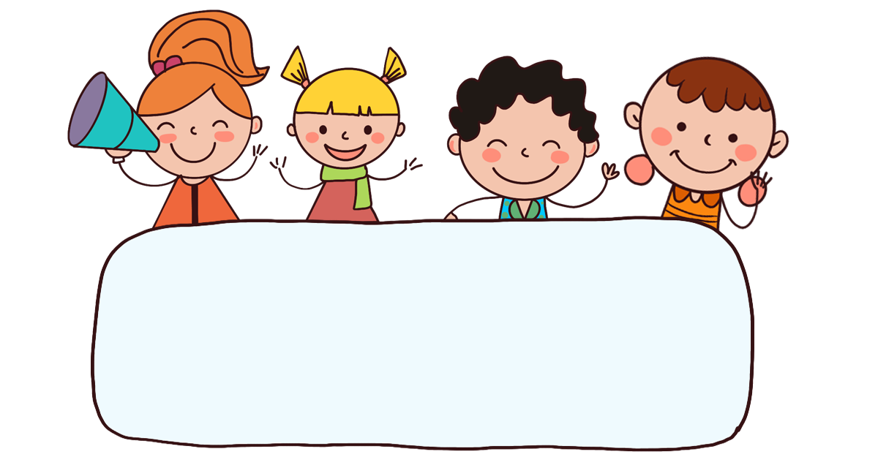
Warm-up
& review

Slide 3

PASS THE BALL
Notes:
Pass the balls. When the music stops, whoever has a ball must stand up then ask and answer the question on the PowerPoint.

Slide 4
PASS THE BALL!
STOP!

Slide 5
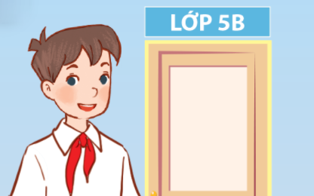
1/4
A: Can you tell me about yourself?
B: I’m in Class 5B.

Slide 6
PASS THE BALL!
STOP!

Slide 7
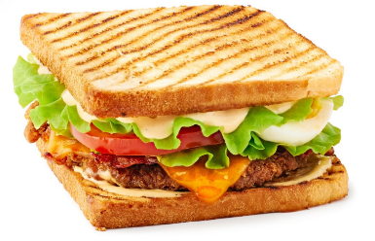
2/4
A: What’s your favourite food?
B: It’s a sandwich.

Slide 8
PASS THE BALL!
STOP!

Slide 9
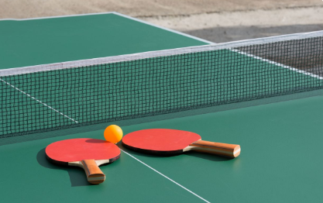
3/4
A: What’s your favourite sport?
B: It’s table tennis.

Slide 10
PASS THE BALL!
STOP!

Slide 11
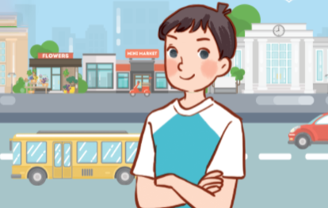

4/4
A: Can you tell me about yourself?
B: I live in the city.

Slide 12
Good job!

Slide 13
Tuesday, Sep 23rd 2025
Unit 1
All about me!
Lesson 3 (4+5+6)

Slide 14
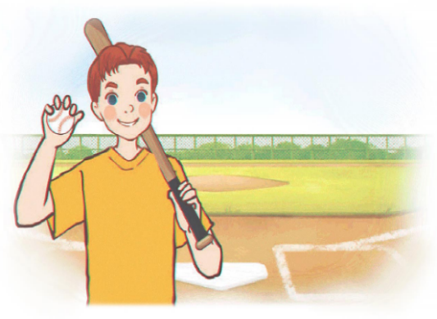
4. Read and circle.
Hi, all. Let me tell you a little bit about myself. My name’s Tom. I’m in Grade 5. I live in a big city. My favourite subject is maths. My favourite food is fish and chips. I’m a big fan of baseball. It’s really fun.
1
2
1. Tom lives in ________.
a. a big village
b. a big city
c. a big town
2. He likes ________
a. fish and rice
b. chicken and chips
c. fish and chips

Slide 15
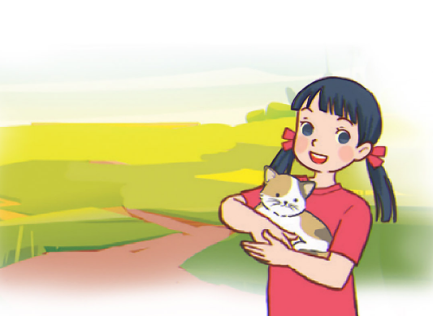
4. Read and circle.
Hello, everyone. Let me introduce myself. My full name’s Le Mai Lan. You can call me Lan. I’m in Class 5C. I live in the countryside. I love pets. I have two kittens and a rabbit. My favourite colour is pink. My favourite food is chicken pho. Yum!
3
4
3. Lan is in ________.
a. Class 4C
b. Class 5C
c. Class 3C
4. Her favourite colour is _______.
a. pink
b. green
c. blue

Slide 16
5. Let’s write.
My name is ______. I live in the ______________. I am in Class _____. My favourite sport is _______. My favourite food is ________. My favourite colour is ______. My favourite animal is _______. What about you? What are your favourite things?
countryside
Nam
5A
football
chicken
yellow
dogh

Slide 17
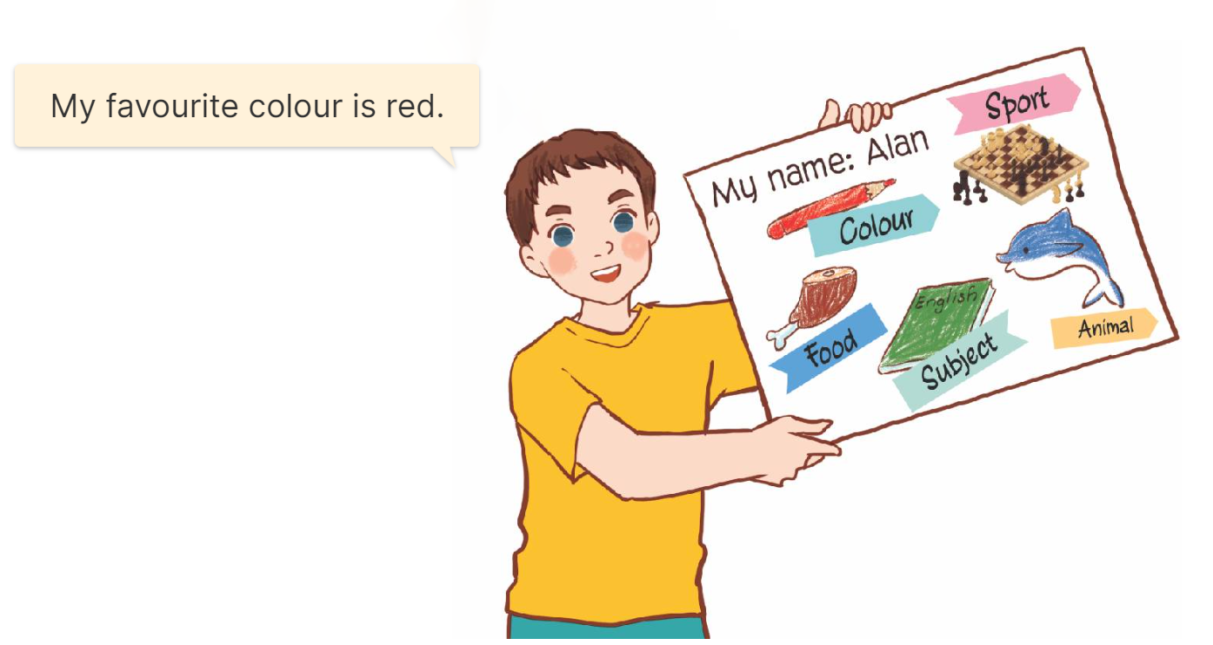
6. Project.
My favourite things

Slide 18
Fun corner
& wrap-up

Slide 19


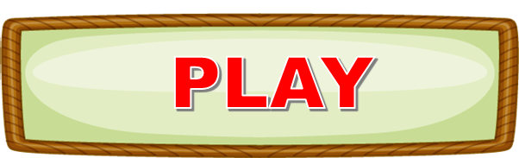

Let’s play!

Slide 20
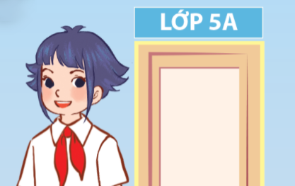

1/10
A: Can you tell me about yourself?
B: _________
I’m in Class 5A.
Answer

Slide 21
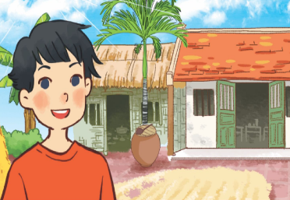
2/10
A: Can you tell me about yourself?
B: _________
I live in the countryside.
Answer

Slide 22
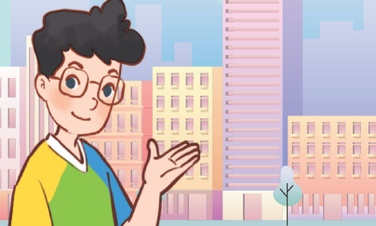
3/10
A: Can you tell me about yourself?
B: _________
I live in the city.
Answer

Slide 23
4/10
A: ___________
B: I’m in Class 5C.
Can you tell me about yourself?
Answer

Slide 24
5/10
Choose the odd one out:
countryside, table tennis
town, mountains, city
table tennis
Answer

Slide 25
6/10
A: What’s your favourite sport?
B: ______
It’s table tennis.
Answer

Slide 26
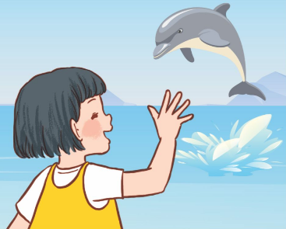
7/10
A: What’s your favourite animal?
B: ______
It’s a dolphin.
Answer

Slide 27

8/10
A: ________________
B: It’s pink.
What’s your favourite colour?
Answer

Slide 28
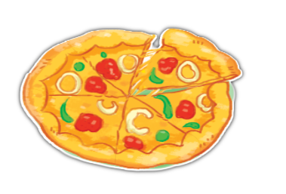
9/10
A: ________________
B: It’s pizza.
What’s your favourite food?
Answer

Slide 29
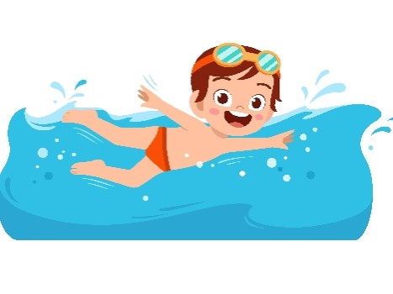
10/10
A: ________________
B: ___________
What’s your favourite sport?
It’s swimming.
Answer

Slide 30
Great!

Slide 31


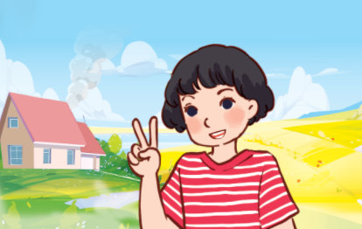
Unit 1 lesson 1
Can you tell me about yourself?
I’m in _______.
I live in the ____.
Class 5A
countryside
Class 5B
city

Slide 32



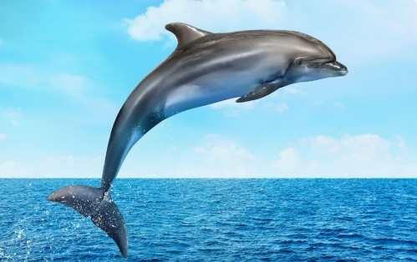
Unit 1 lesson 2
What’s your favourite _____?
It’s _______.
sport / table tennis
food / a sandwich
colour / pink
animal / a dolphin

Slide 33

Goodbye!

