Slide 1


Slide 2



19
The animal world
LESSON 1 - PERIOD 2

Slide 3
Warm-up
1
Guess the animals.

Slide 4
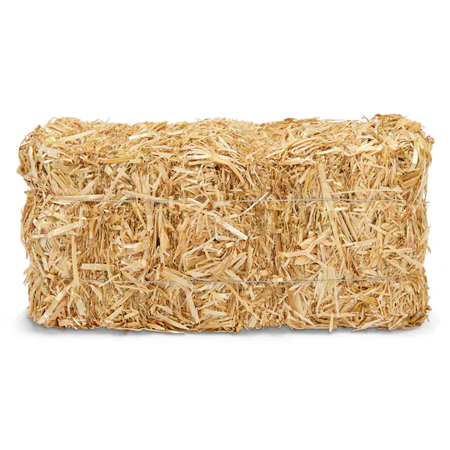

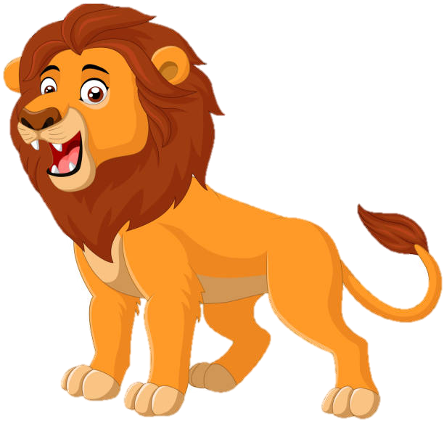

lions

Slide 5
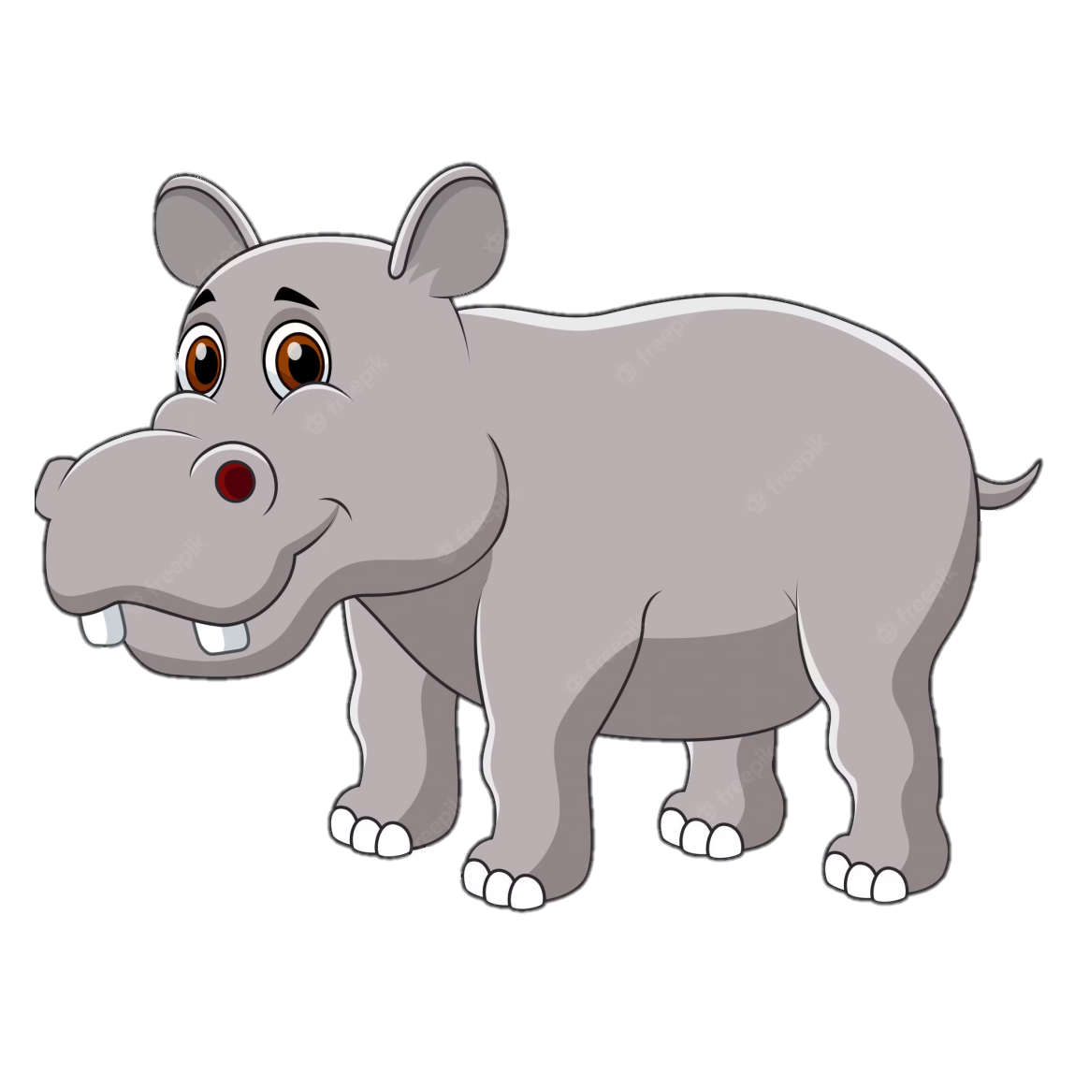
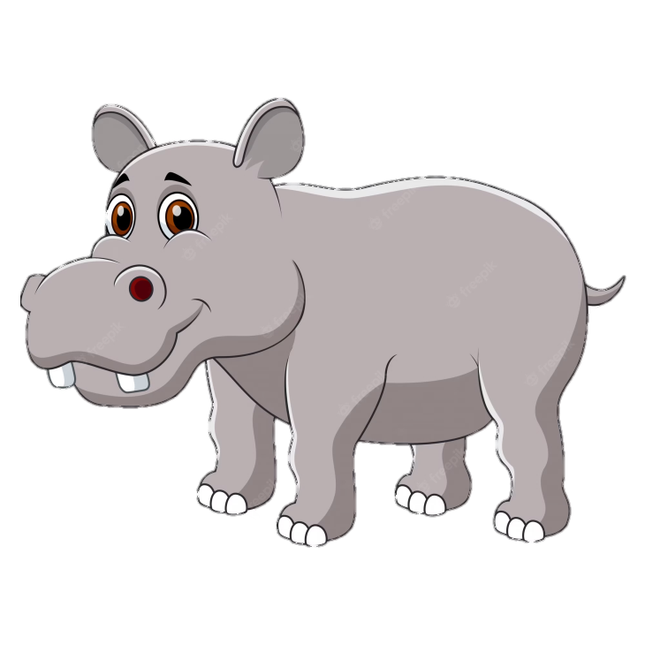
hippos

Slide 6

crocodiles

Slide 7
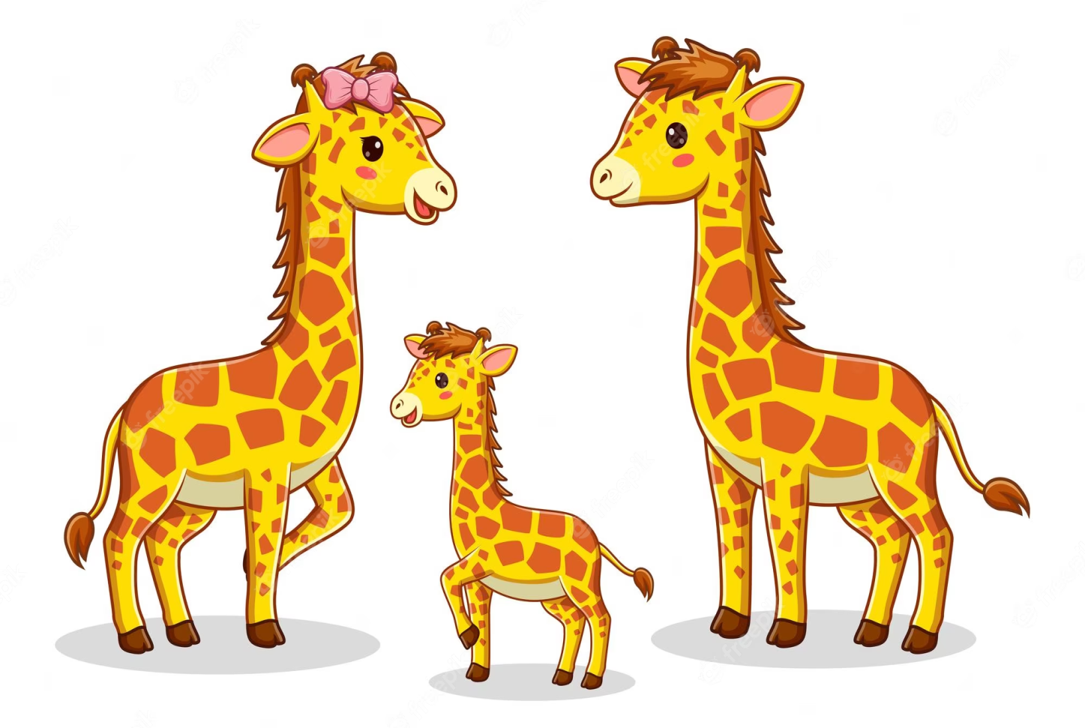
giraffes

Slide 8
Listen and number.
2

Slide 9
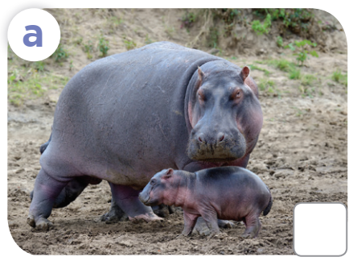
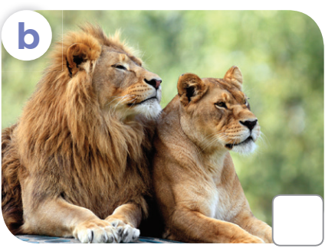
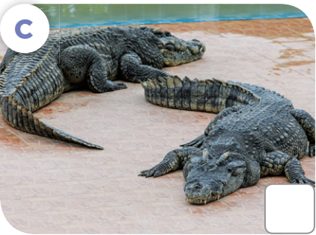
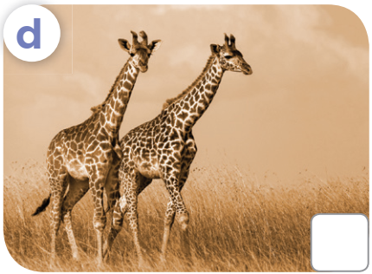
Look and answer.
What are these animals?

Slide 10
Listen and number.
Let's check!
2
3
4
1

Slide 11
Game
5

Slide 12

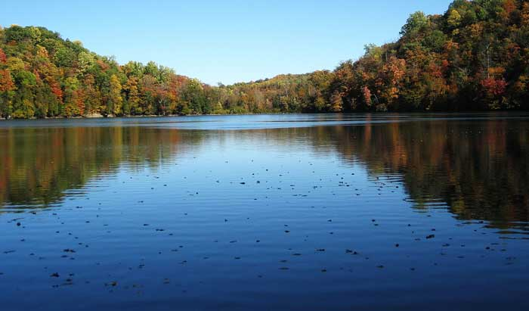
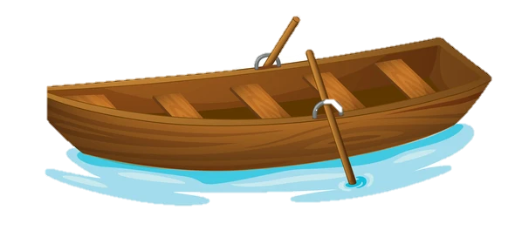
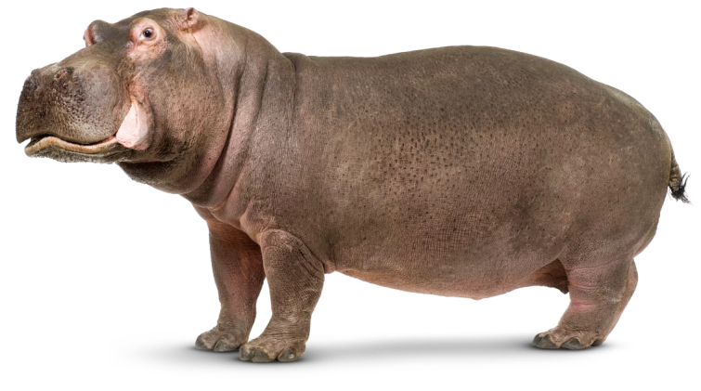

What are these animals?
A. It is a hippo.
B. They're a hippo.
C. They're hippos.
Notes:
Click 3 times to show choices
Click the object to reveal the hidden animals

Slide 13
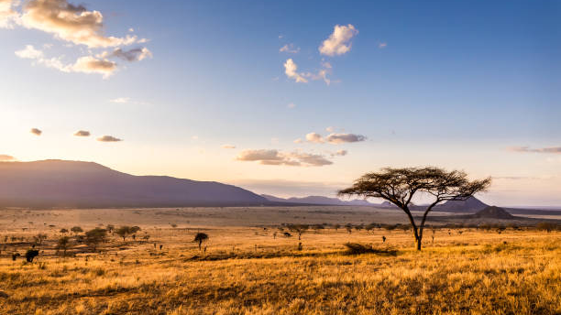

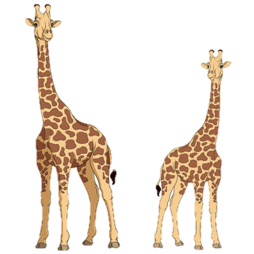
What are these animals?
A. It's a giraffe.
B. They're giraffes.
C. They're a giraffe.
Notes:
Click 3 times to show choices
Click the tree to reveal the hidden animals

Slide 14
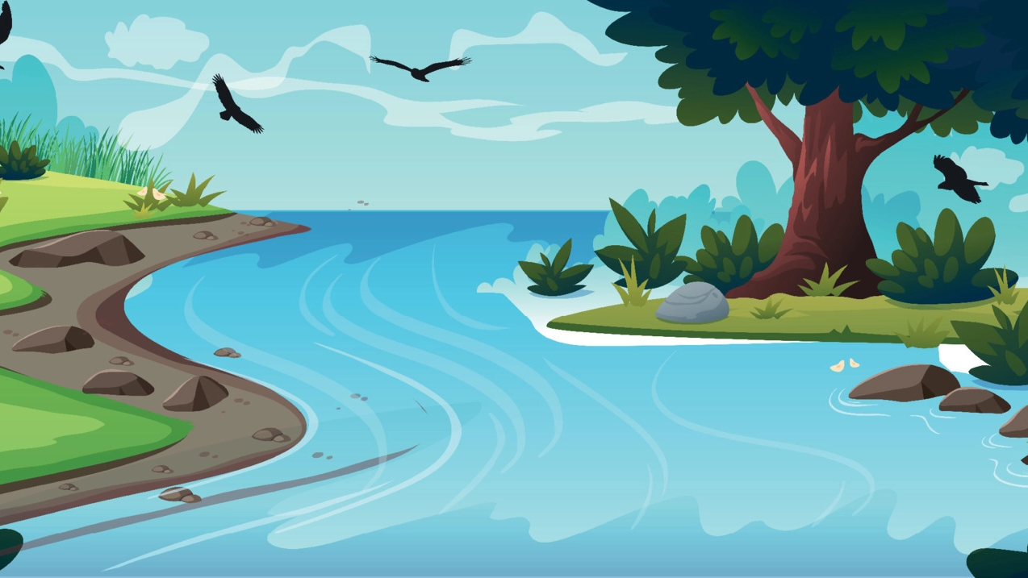

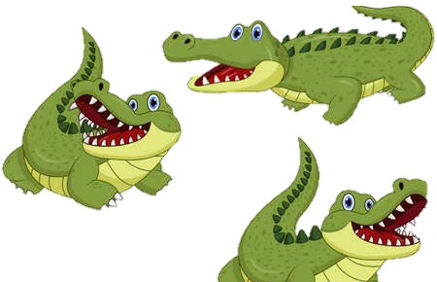
What are these animals?
A. They're hippos.
B. They're crocodiles.
C. It's a crocodile.
Notes:
Click 3 times to show choices
Click the water splash to reveal the hidden animals

Slide 15
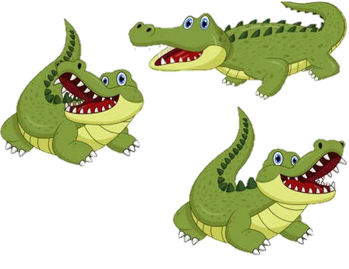
_____ are these animals?
A. Who
B. How
C. What

Slide 16
Look, complete and read.
3

Slide 17
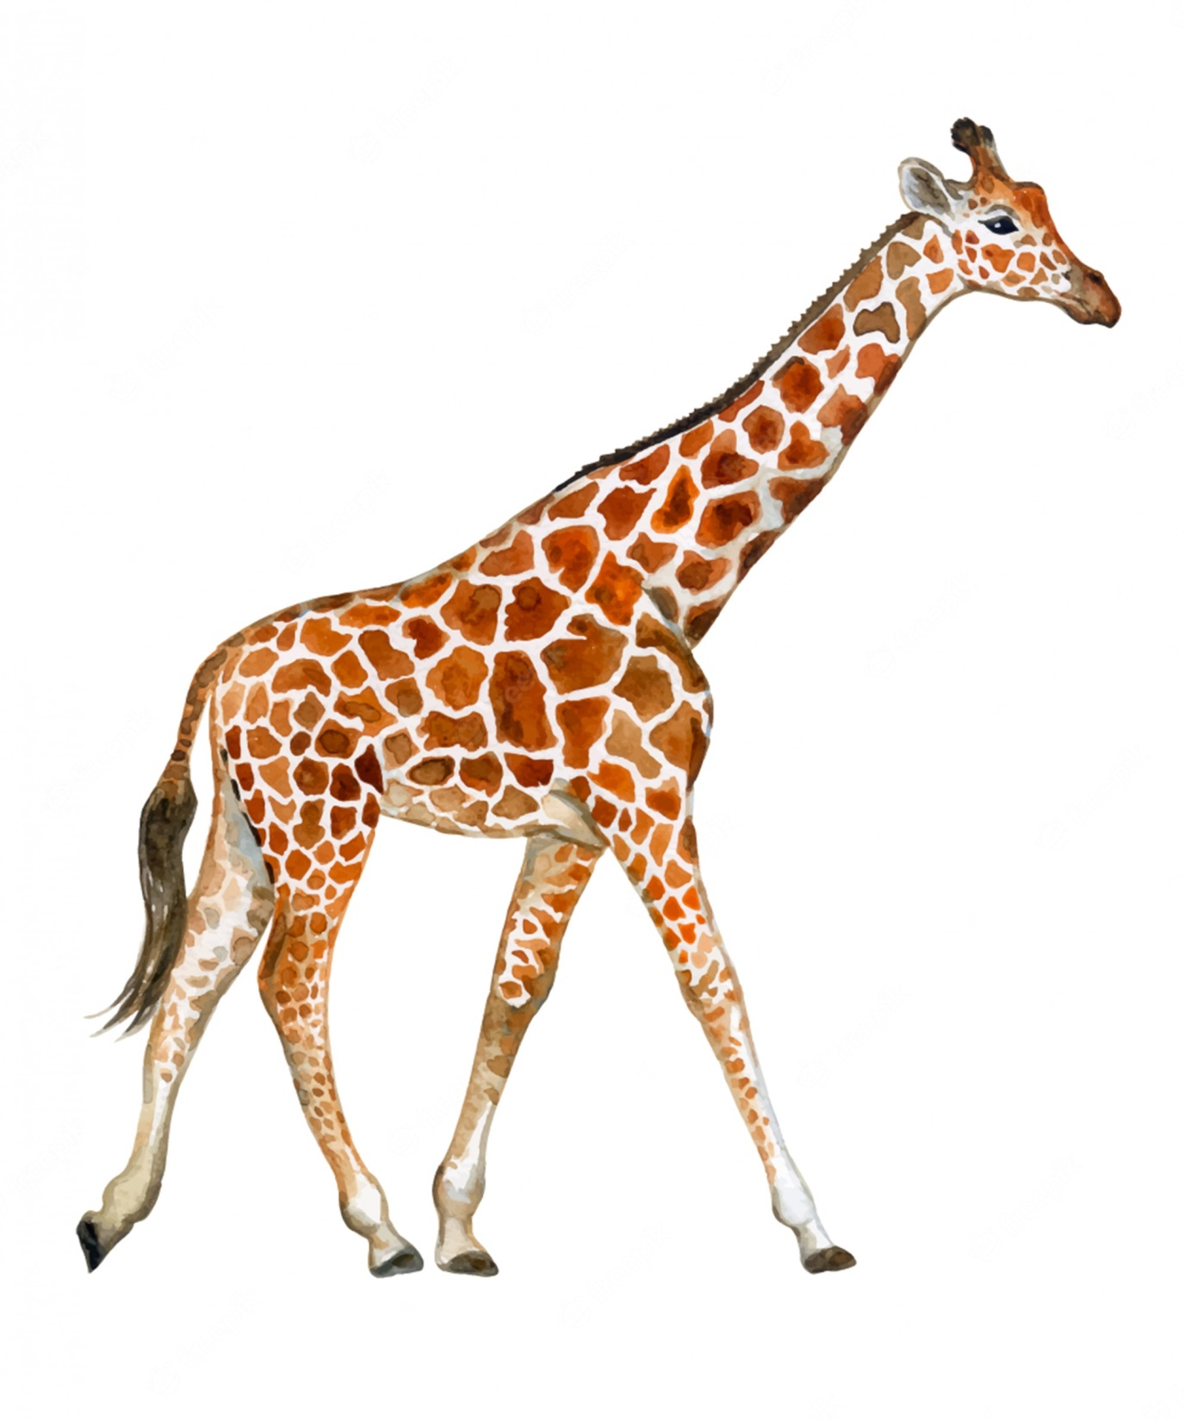
long neck

Slide 18
long legs

Slide 19

short legs

Slide 20
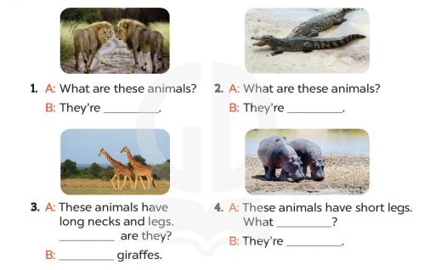
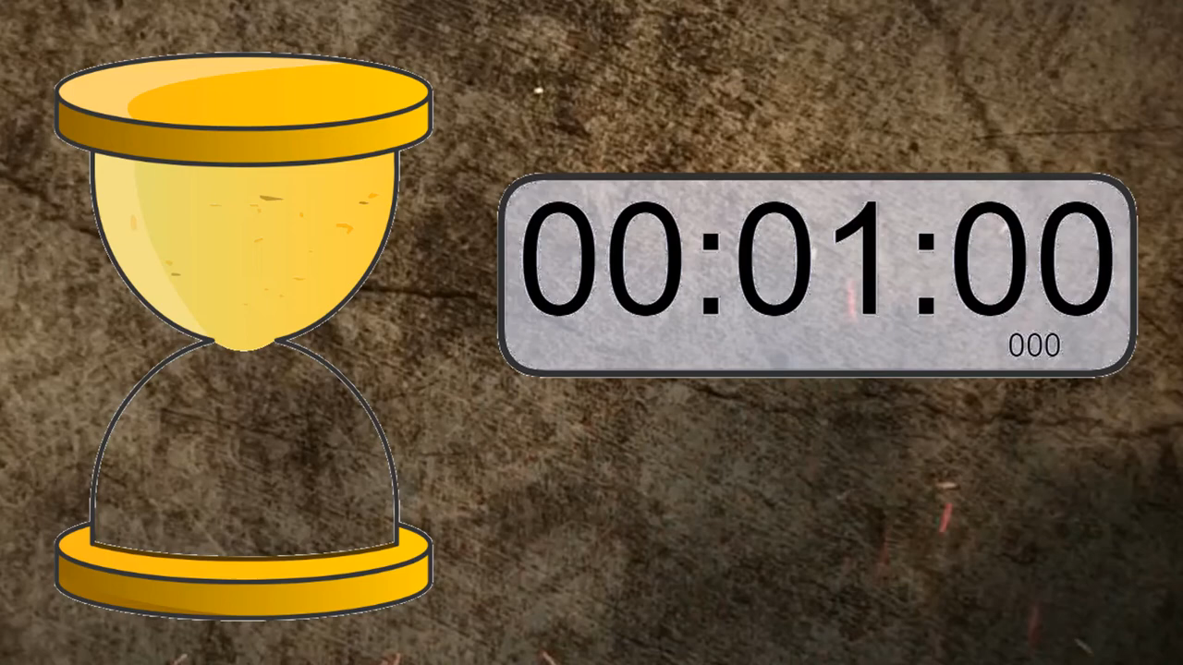

Slide 21
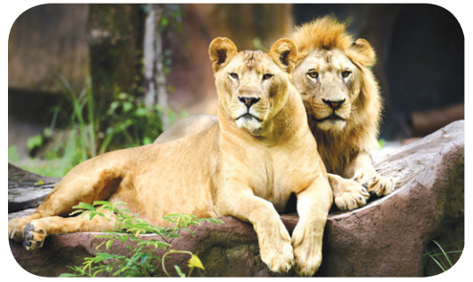
What's the missing word?
A: What are these animals?
B: They’re ______.
lions

Slide 22
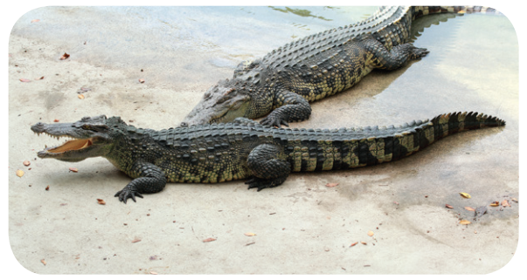
What's the missing word?
A: What are these animals?
B: They’re ___________.
crocodiles

Slide 23
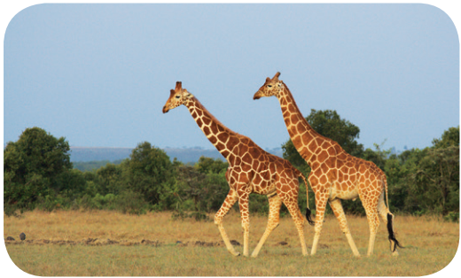
What's the missing word?
A: These animals have long necks and legs. _______ are they?
B: ________ giraffes.
What
They’re

Slide 24
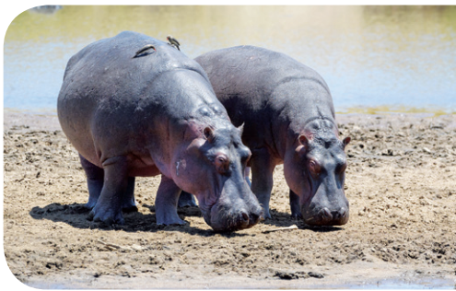
What's the missing word?
A: These animals have short legs. What _________?
B: They’re _______.
are they
hippos

Slide 25

Practise reading aloud in pairs.

Slide 26
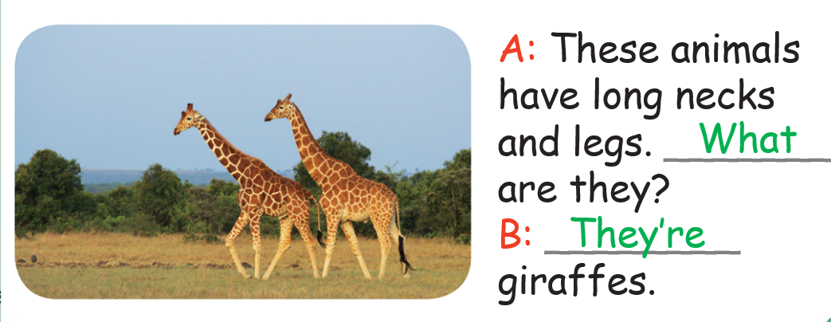

Slide 27
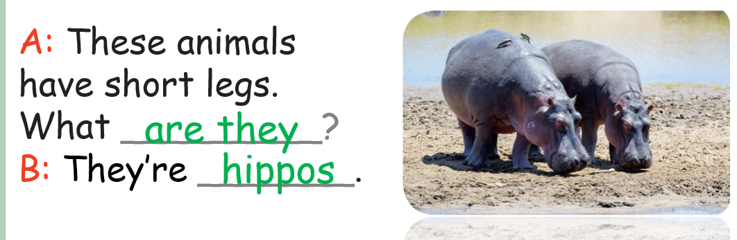

Slide 28
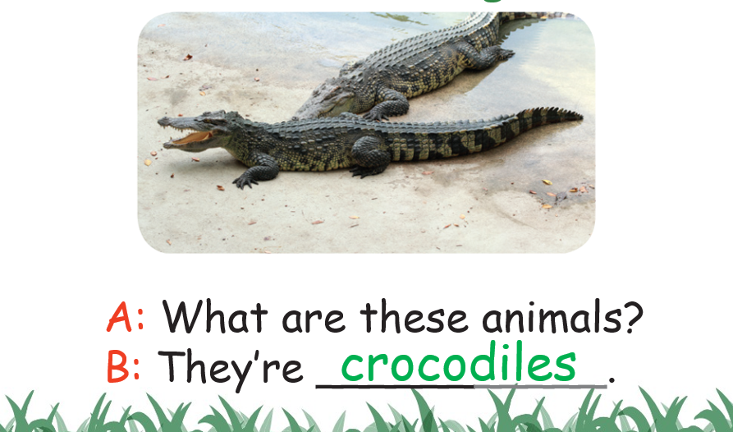

Slide 29
4
Let's sing.

Slide 30
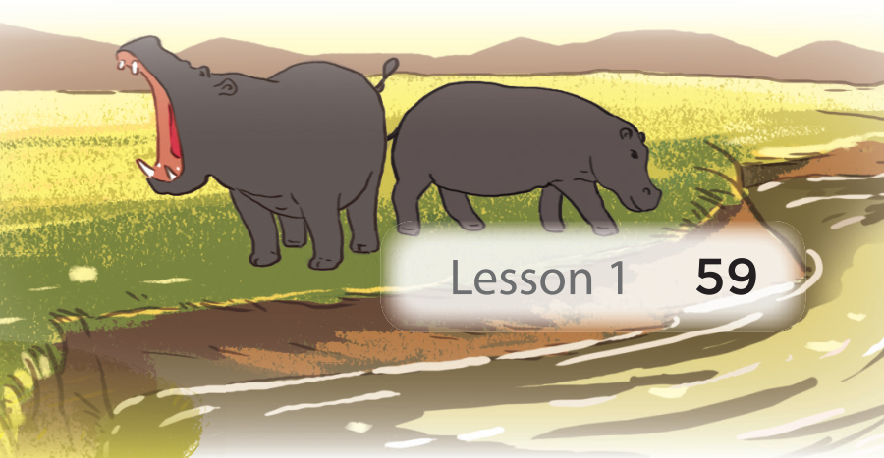
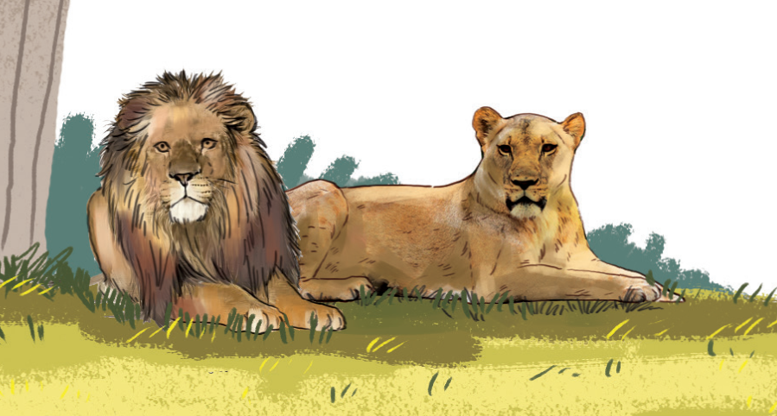
What are these animals?
Look! Look! Look!
What are these animals?
They are lions.
They look brave.
Look! Look! Look!
What are these animals?
They are hippos.
They look strong.

Slide 31


Slide 32

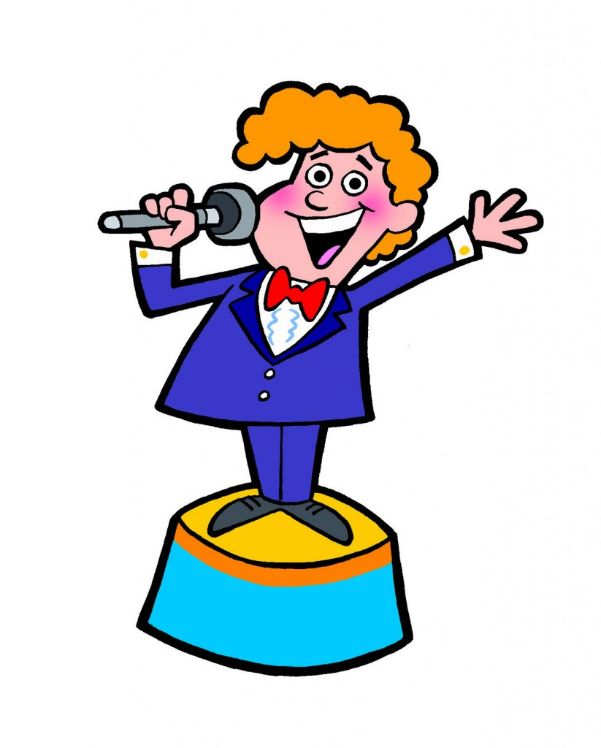
It’s time for presenting.

Slide 33



Slide 34
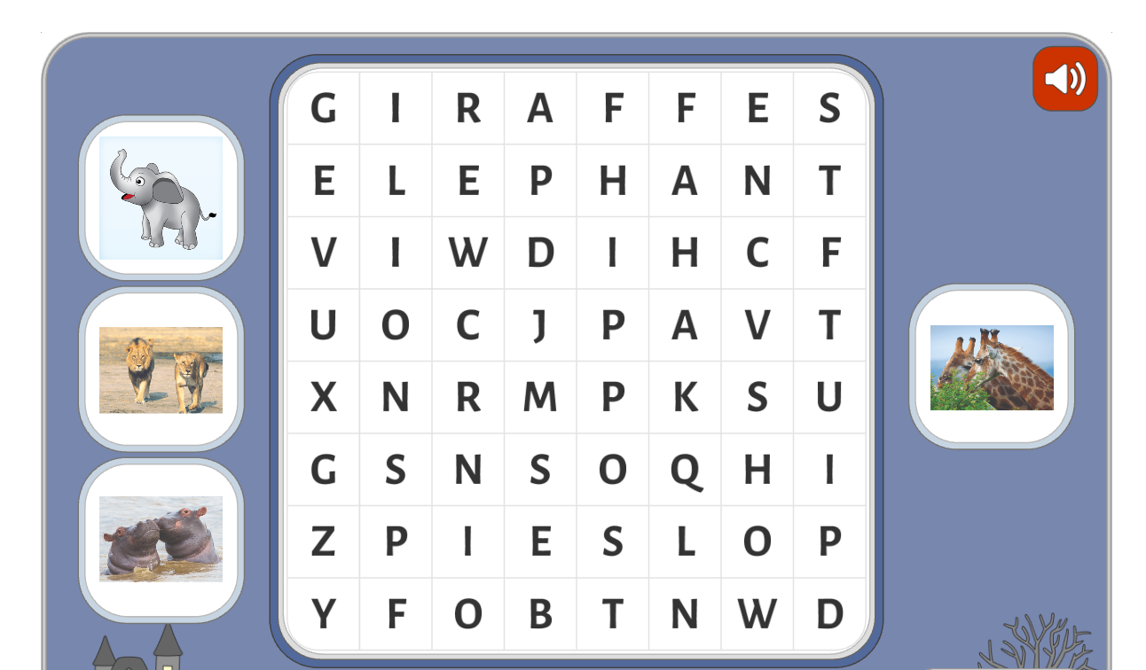

Slide 35
Educational value from this lesson.
+ Learn about animals
+ Keep them safe.
+ Be friendly with all animals.

Slide 36
Home link:
Practice model sentences at home.
Do these links:
https://bestflashcard.com/learning-english-vocabulary/sgk-tieng-anh-4-global-success-unit-19-lesson-1
https://yourhomework.net/quiz/test/000000471010

Slide 37


