Slide 1
UNIT 3:MY FRIENDS
LESSON 2: A CLOSER LOOK 1

Slide 2
WARM UP
1. This is a boy. He has glasses
2. This is a girl. She is the tallest person in our class
3. This is a thin boy. He is short
4. She studies well. She has long black hair.
5. She is a beautiful girl. She is tall and slim.

Slide 3
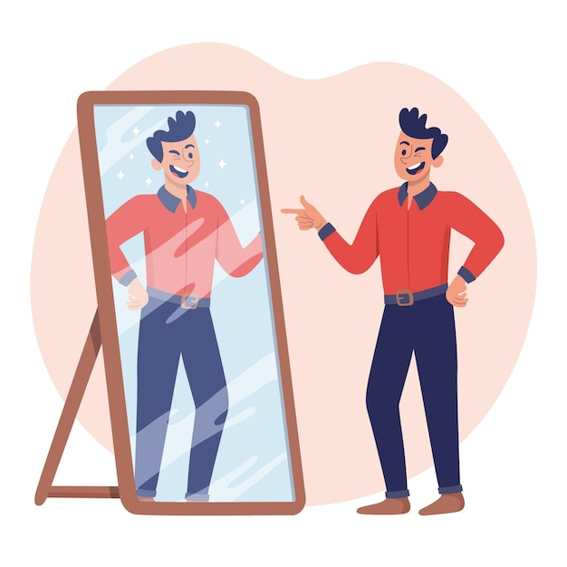
VOCABULARY
confident (adj)
/ˈkɒnfɪdənt/
tự tin

Slide 4
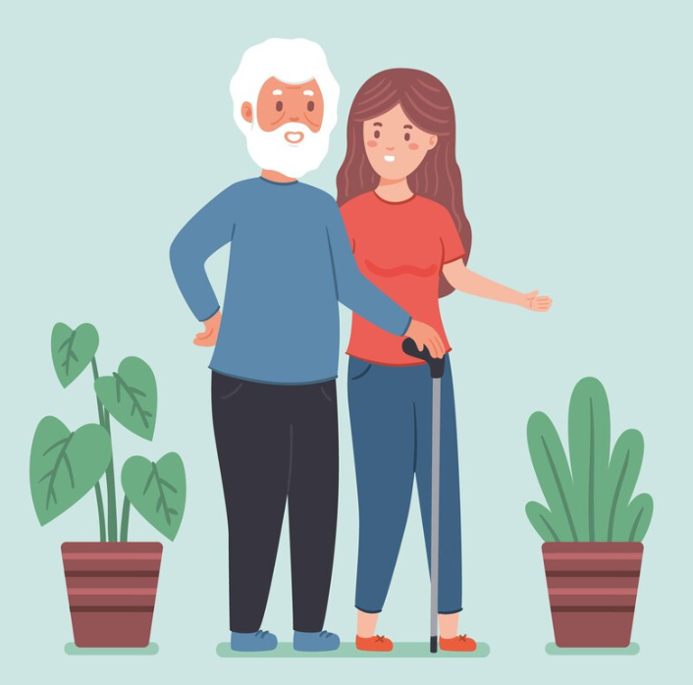
VOCABULARY
caring (adj)
/ˈkeərɪŋ/
quan tâm

Slide 5
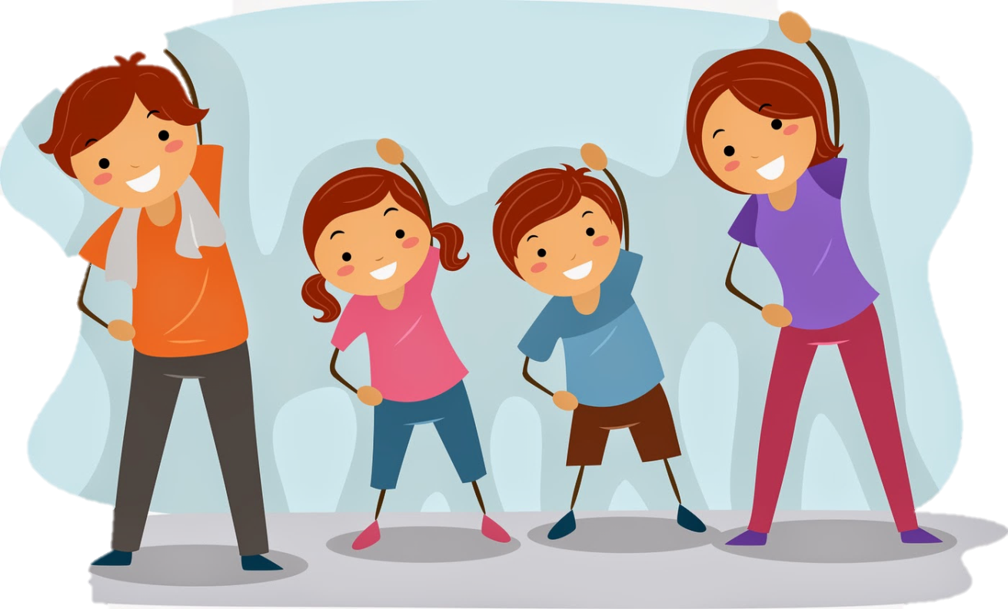
VOCABULARY
active (adj)
/ˈæktɪv/
năng động

Slide 6
VOCABULARY
careful (adj)
/ˈkeəfl/
cẩn thận

Slide 7
VOCABULARY
creative (adj)
/kriˈeɪtɪv/
sáng tạo

Slide 8
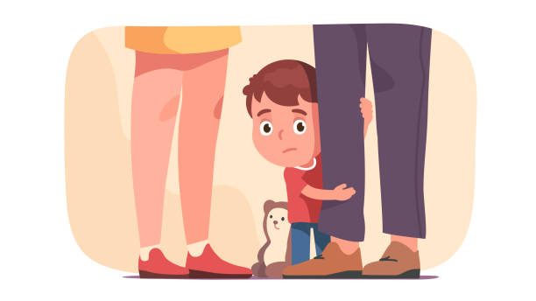
VOCABULARY
shy (adj)
/ʃaɪ/
nhút nhát

Slide 9
VOCABULARY
kind (adj)
/kaɪnd/
EX: Nam helps me to do homework. He is very kind
tốt bụng

Slide 10
VOCABULARY
clever (adj)
/ˈklevə(r)/
thông minh

Slide 11
VOCABULARY
New words | Pronunciation | Meaning
1. confident (adj) | /ˈkɒnfɪd(ə)nt/ | tự tin
2. caring (adj) | /ˈkeərɪŋ/ | quan tâm
3. active (adj) | /ˈæktɪv/ | năng động
4. careful (adj) | /ˈkeəfl/ | cẩn thận
5. creative (adj) | /kriˈeɪtɪv/ | sáng tạo
6. shy (adj) | /ʃaɪ/ | nhút nhát
7. kind (adj) | /kaɪnd/ | tốt bụng
8. clever (adj) | /ˈklevə(r)/ | thông minh

Slide 12
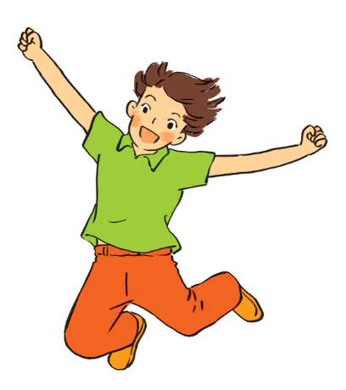
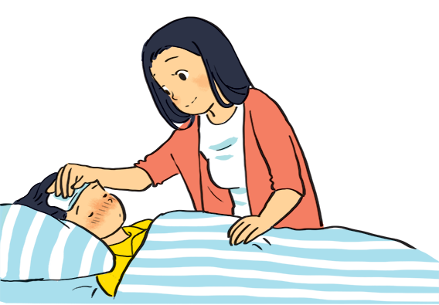
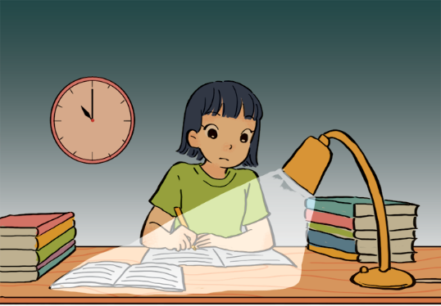
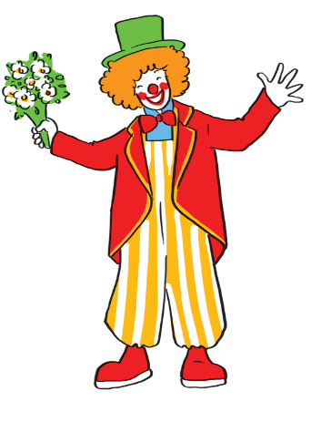
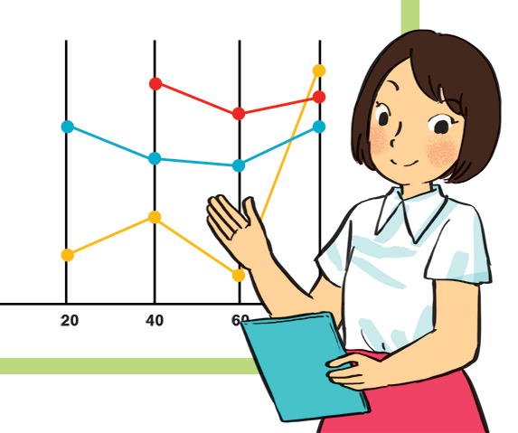
VOCABULARY
1
Match the adjectives to the pictures.
a
b
1. hard-working
4. caring
2. confident
4. caring
5. active
5. active
3. funny
c
d
e
1. hard-working
3. funny
2. confident

Slide 13
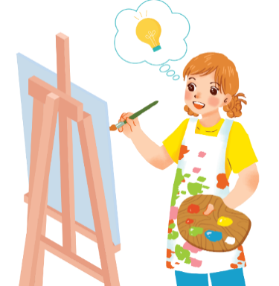
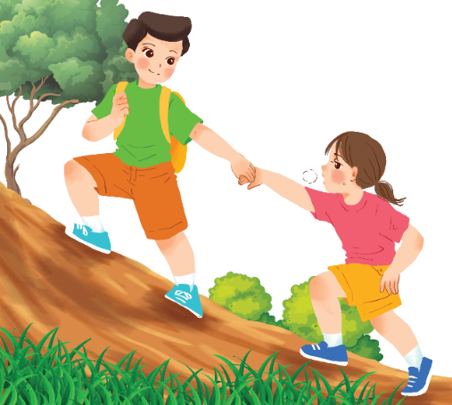
VOCABULARY
2
Use the adjectives in the box to complete the sentences.
Pay attention to the highlighted words / phrases.
careful
clever
shy
kind
creative
friendly
Mina is very _______ . She likes drawing pictures. She always has lots of new ideas.
1.
creative
kind
2.
Nam is _____ .
He likes helping his friends.

Slide 14
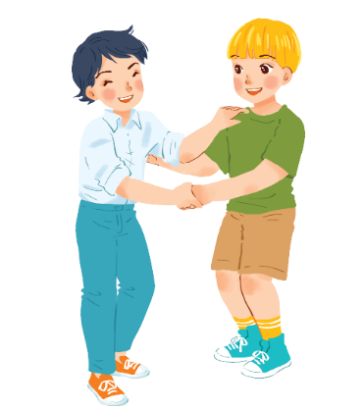
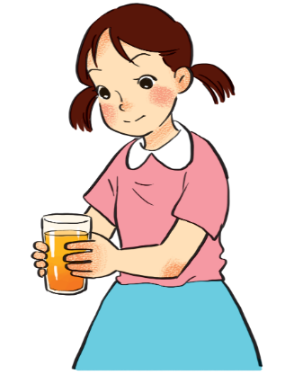
VOCABULARY
2
Use the adjectives in the box to complete the sentences.
Pay attention to the highlighted words / phrases.
careful
clever
shy
kind
creative
friendly
3.
Minh Duc is ________.
He likes meeting new people.
friendly
careful
4.
Kim is very ______ .
She pays attention to what she’s doing.

Slide 15
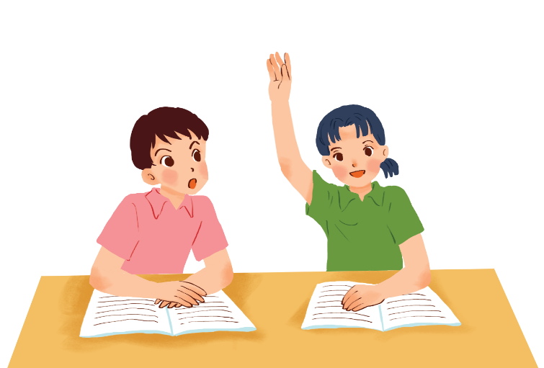
F
T
T
T
VOCABULARY
F
2
Use the adjectives in the box to complete the sentences.
Pay attention to the highlighted words / phrases.
careful
clever
shy
kind
creative
friendly
Mai is ______ .
She learns things quickly and easily.
5.
clever

Slide 16
Choose the correct answer (A, B, C or D)
1. That’s a designer. She has a lot of new ideas.
hard – working B. creative C. shy D. kind
2. Peter is so . He of ten checks his writing twice before giving it to the teacher.
shy B. creative C. lovely D. careful
3. Our teacher is very . She is always ready to help us.
A. clever B. friendly C. kind D. shy
4. They were always at school. They care much about their study.
smart B. clever C. careless D. hard – working
5. Children are usually with people they don’t know
A. funny B. shy C. careful D. kind
B
D
C
D
B

Slide 17
VOCABULARY
Friendship ﬂower.
Work in groups. Write two personality adjectives for each group member.
Minh: kind funny

Slide 18
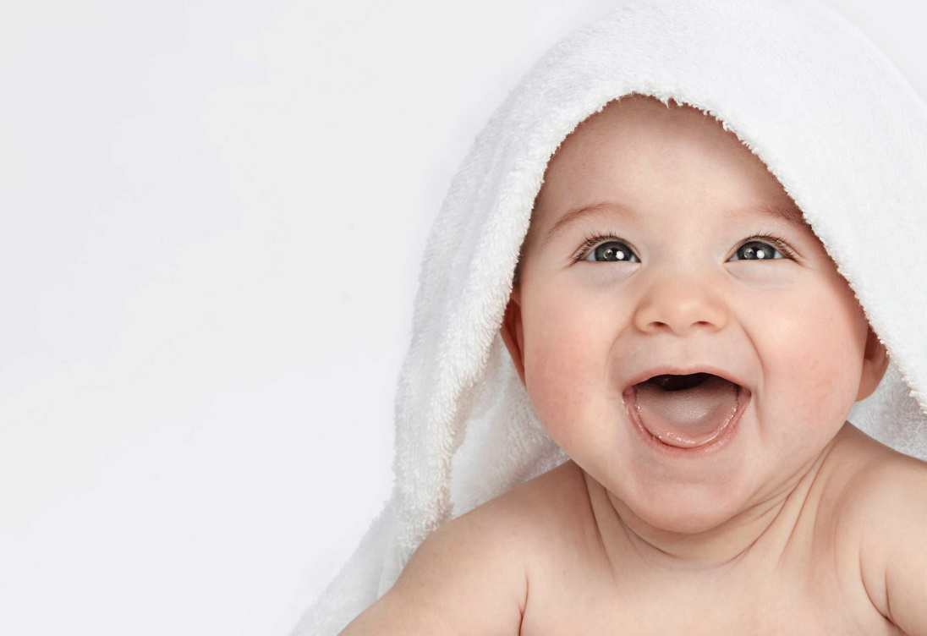
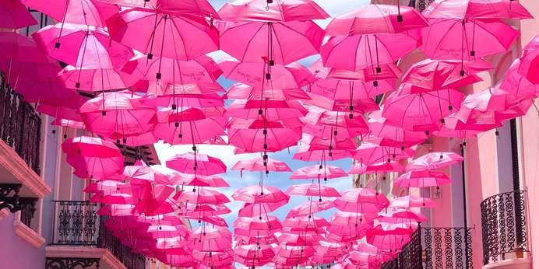
Who is this?
What color is it?
-> It’s a baby
-> It’s pink

Slide 19
PRONUNCIATION
Listen and repeat these words.
 | /b/ | /p/
1. | but | pig
2. | book | piano
3. | back | pizza
4. | baby | pet

Slide 20
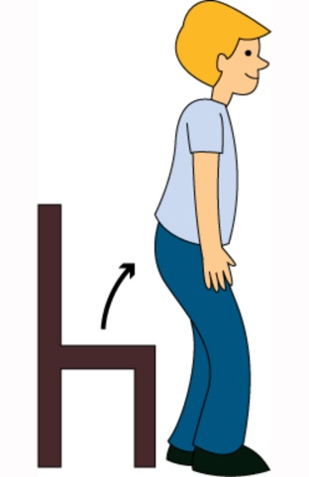
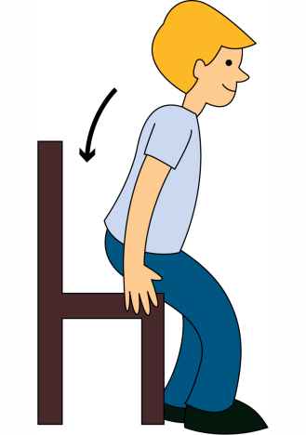
PRONUNCIATION
4
Listen and circle the words you hear. Then repeat.
 | /b/ | /p/
1. | big | pig
2. | bear | pear
3. | buy | pie
4. | robe | rope
/p/
/b/

Slide 21
PRONUNCIATION
5
Listen. Then practise the chant. Notice the rhyme.
We’re having a picnic
We’re having a picnic
Fun! Fun! Fun!
We’re bringing some biscuits
We’re bringing some biscuits
Yum! Yum! Yum!
We’re playing together
We’re playing together
Hurrah! Hurrah! Hurrah!

Slide 22
Take part in school activities
Help our friends
What should you do to become a good student?
Prepare lessons before going to school
Obey the school’s rule

Slide 23
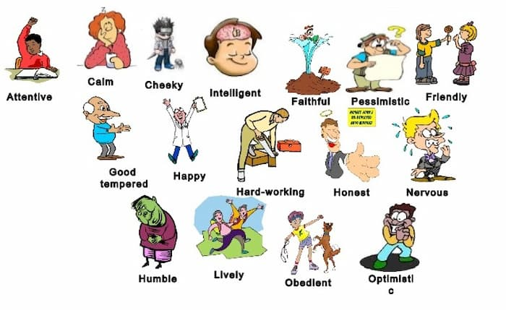
Educational factor:
Everyone has their own personalities, but we need to be a good friend, a good student.

Slide 24
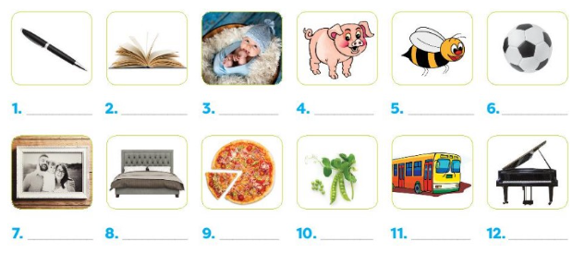
HAND OUT
1.What can you see? Label the pictures (They all begin with p or b). Then read the words aloud.

Slide 25
2. Fill each blank with a suitable word from the box.
funny is kind time cook hair
My grandma is my best friend. She is my father’s mother. This year, she (1) __________ 70 years old. She has a round face with long, white (2) __________. She teaches me to wash the dishes and (3) __________ dinner. She is (4) __________ to other people. She helps them when she can. She is (5) __________, too. She makes me laugh all the (6)__________. I love her so much.

Slide 26
Homework
- Learn the new words by heart.
- Do the exercises in the workbook.
- Do the task in hand out
- Prepare the next lesson

Slide 27
GOOD BYE!
Thank you for your attention

