Slide 1
Welcome to our class !

Slide 2
Unit
2
MY HOUSE
LESSON 7: LOOKING BACK & PROJECT
1

Slide 3
TYPES OF HOUSE
ROOMS
FURNITURE
Task 1: Fill in the correct group.
flat,
town house,
kitchen,
bedroom,
sink,
fridge,
country house,
bathroom,
living room,
dishwasher,
cupboard,
stilt house,
cottage,
guest room,
hall,
chest of drawers,
farmhouse,
microwave,
villa,…
dining room,…
stool,
air conditioner, …

Slide 4
PRACTICE
2
Complete the second sentence with the correct possessive form.
1. My teacher has a house next to our house.
Our house is next to my ___________ house.
2. My brother has a TV.
This is my __________ TV.
3. Elena has a big bookshelf in her bedroom. → There’s a big bookshelf in _______ bedroom.
teacher’s
brother’s
Elena’s

Slide 5
PRACTICE
2
Complete the second sentence with the correct possessive form.
4. My grandfather likes the kitchen the best.
The kitchen is my _________ favourite room.
5. My aunt has a daughter, Vy.
I’m ______ cousin.
grandfather’s
Vy’s

Slide 6
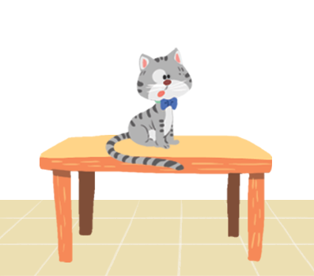
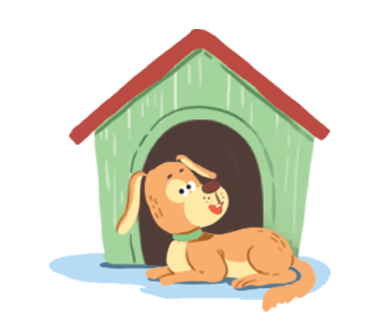
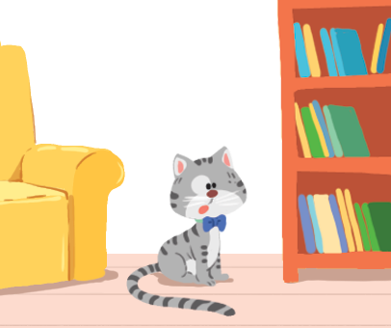
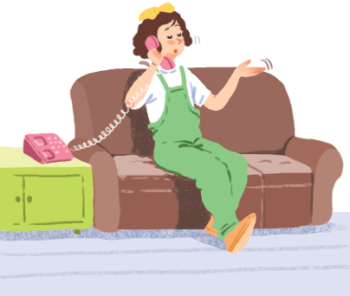
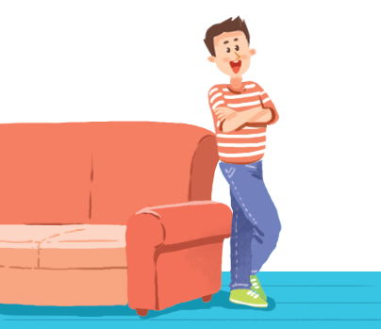
PRACTICE
3
Make sentences. Use prepositions of place.
1
2
3
4
5
6

Slide 7
PRACTICE
1. The cat _____________.
is on the table

Slide 8
PRACTICE
2. The dog _______________________.
is in front of the doghouse

Slide 9
PRACTICE
3. The cat ________________________________.
is between the sofa and the bookshelf

Slide 10
PRACTICE
4. The cat ____________________.
is behind the computer

Slide 11
PRACTICE
5. The girl _____________.
is on the sofa

Slide 12
PRACTICE
6. The boy ________________.
is next to the sofa

Slide 13
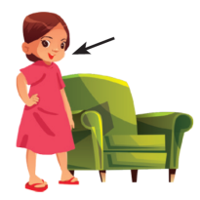
THE PREPOSITIONS OF PLACE
POSSESSIVE CASE
GRAMMAR OF UNIT 2: MY HOUSE
Describe where people or things are
Some prepositions of place: under, in front of, in, on, behind,…
Use ‘s after a proper name
Use ‘s after a singular noun
EX: The girl is next to the sofa.
EX: My brother’s shirt is nice.
EX: This is a lamp in Linh’s bedroom

Slide 14
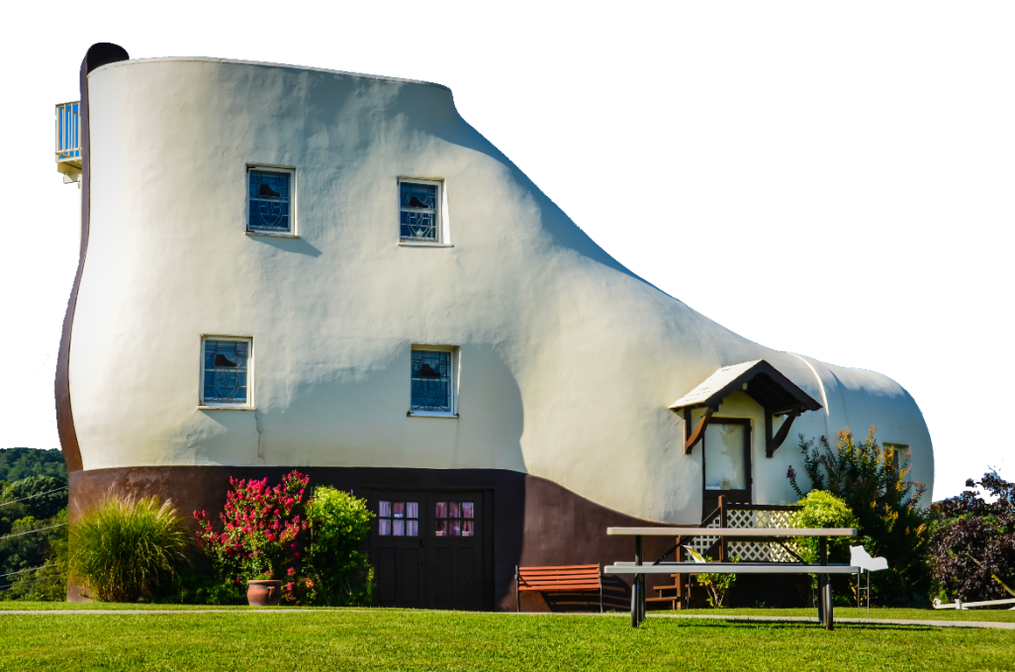
DREAM HOUSE
Present the poster about your dream house:
Introduce your group’s members
Each member from your group take turn to present in front of the class.

Slide 15
Homework
- Revise the vocabulary related to the topic: My house
- Revise the use of possessive case and preposition of place
- Practise taking about your dream house
- Prepare the next lesson: Unit 3: Lesson 1: Getting started.

Slide 16
GOOD BYE!
Thank you for your attention

