Slide 1
Teachers to visit class 9A3
Gv: Hà Thị Tuyết Linh
Trường THCS Mỹ An

Slide 2
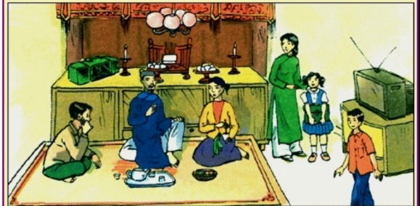
Look at the picture and list things in the past and now.
In the past | Now
radio | Mobile phone
No electicity | TV, electric lights
Oil lamp | School uniform
 | Modern dress, colorful clothes
1.What was the life in the past like?
2. How did children go to school?
3. Did people use machine to do
farming?

Slide 3
UNIT 4: REMEMBERING THE PAST
Lesson: Looking back and Project

Slide 4
A. VOCABULARY

Slide 5
Task 1: Choose the correct answer A, B, C, or D
1. In keeping with ______, we cook five-colour sticky rice on the first day of a lunar month.
A. tradition B. habit C. ritual D. practice
2. Sam is very interested in history, and he remembers a lot of historical ______and dates.
A. traditions B. events C. anniversaries D. practices
3. The fire of London in 1666 destroyed thousands of old ______ and damaged a large part of London’s centre.
A. organisations B. structures C.associations D. connections
4. This practice was more common in ______ times than it is now.
A. beginning B. antique C. historic D. ancient
5. This complex of buildings was ______ by foreign troops during the war.
A. received B. busy C. occupied D. filled

Slide 6
Task 2: Finish the sentence by completing each blank with a word. The first letter of each word is given.
1. The custom of w______ ancestors is a beautiful and rich tradition in Vietnamese culture.
orshiping
2. The custom of sending a greeting card has become a
d___________ tradition in many western countries.
eep-rooted
3. A country’s cultural h______ is a valuable resource
4. Festivals, which are handed down from one g______ to the next, are an important way to promote tourism
5. Besides the key i______, another secret to achieving the perfect fish and chips is the temperature of the oil.

Slide 7
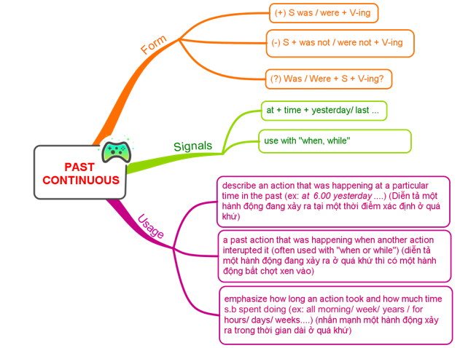
B. GRAMMAR
I. PAST CONTINUOUS

Slide 8
Task 3: Put the verb in brackets in the past continuous to complete each sentence.
1. Luckily, the sun (shine) ______________ brightly when we reached the campsite
was shining
were building
2. They (build) ______________ Ho Chi Minh Mausoleum from 1973 to 1975.
3. When their mum came home, they (not study) ____________; they (chat) _______________noisily.
weren’t studying
were chatting
Were
4. ______ they still (wait) __________ when the tour guide arrived?
waiting
5. I (think) _________________ of my grandmother for years after she died.
was thinking

Slide 9
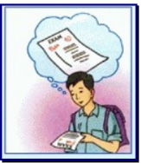
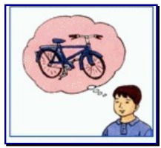
B. GRAMMAR
II. WISH + PAST SIMPLE
Form: S (wish) + S V (simple past)

Slide 10
Task 4: Rewrite the following sentences, using wish
She doesn’t have an iPhone. She’d like to have one
-> She wishes (that)_______________________________.
2. I’m sorry that I don’t have a three-month summer holiday as my grandma did
-> I wish________________________________________.
3.I want my parents to let me make my own decisions, but they don’t
-> I wish (that)___________________________________.
4. Mike wants to play musical instruments, but he can’t
-> Mike wishes ___________________________________.
5. My dad is very busy. I want him to have more time with me
-> I wish________________________________________.
she had an iPhone

Slide 11
MY ANSWERS MATTER
1. An………………castle that has been continuously lived in by the same family for centuries is hard to find .
A. well-preserved
B. ancient
C. occupied
D. modern
2. He wishes he …………………back to his grandparents’ time
A. could go
B. go
C. can go
D. went
3. Children (watch)……………….TV when their mother (come)
……………..home yesterday.
A. watched / came
B. were watching / came
C. watched / was coming
D. were watching / was coming
4. When was Ho Da Ban Historical Site recognized?
A. 2010
B. 2011
C. 2008
D. 2009

Slide 12
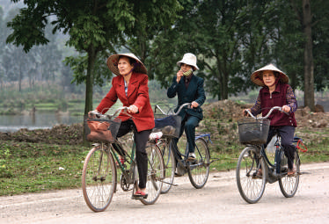
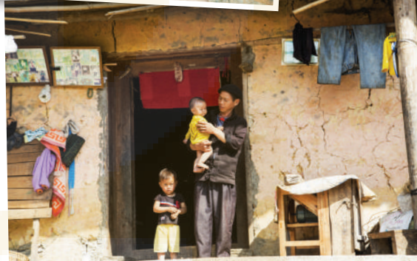
PROJECT
Life in your neighborhood
40 years ago

Slide 13
Evaluation criterias (Tiêu chí đánh giá) :
+ Project Product Form (Hình thức của sản phẩm dự án) (30%)
+ Fluent presentation, with coordination among group members (trình bày lưu loát, có sự kết hợp giữa các thành viên trong nhóm) (30%)
+ Diverse, rich content with practical connections (Nội dung đa dạng, phong phú, có liên hệ thực tế) (30%)
+ Provide solutions and future development directions (Đưa ra được giải pháp, hướng phát triển trong tương lai) (10%)

Slide 14
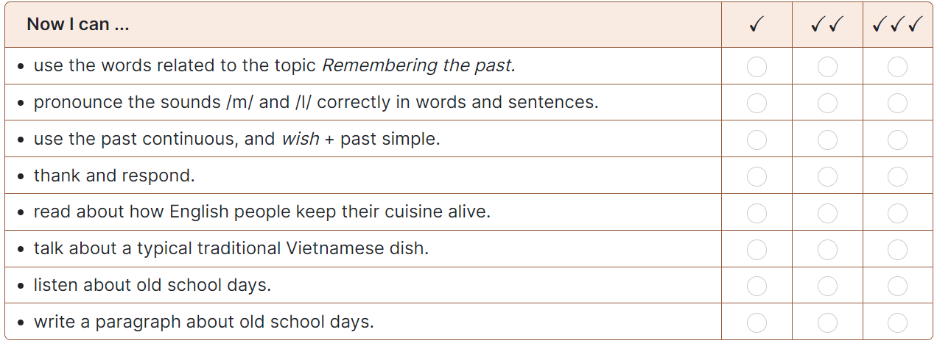
NOW I CAN...
Complete the self-assessment table.

Slide 15
Homework
-Do all exercises again and exercises in work book
- Prepare Unit5: Our experiences

Slide 16
Good bye !

Slide 17
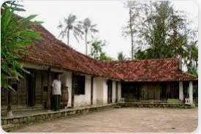
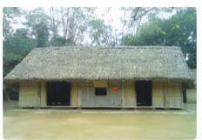

Slide 18
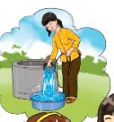
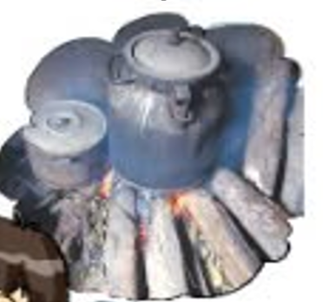

Slide 19
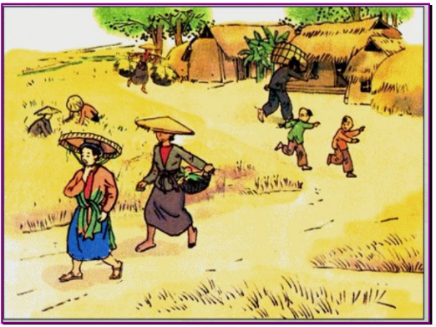

Slide 20
COMPLETE THE SENTENCES.
However
Although
frightening
comedy
........................the acting in the film was good, I didn’t like its story.
2. When we watch a ....................film, we can reduce stress.
3. The story of the film is silly........................, many people liked it.
4. Tom doesn’t like watching …………………………………. films. He always has bad dreams.

Slide 22
Tiến trình dạy:
warm up: Video dẫn vào bài: cho HS xem video yêu cầu HS đưa ra loại film -> dẫn vào bài
A.VOCABUARY
REVISION
2. PRACTICE
B. GRAMMAR
1.REVISION (dung video ngắn để đưa ra ví dụ ôn nhắc lại , có cần ghi bản ví dụ không?)
2. Practice
C. Project
HS đem các poster lên dán trên bảng, yêu cầu các nhớm lên trình bày (chỉ gọi nhóm trưởng thôi hả?)
Chuẩn bị các sticker cho HS lên dán bầu chọn poster đẹp nhất.
A | B | KEYS
1. science fiction film | a. This type of film makes you laugh | 1
2. comedy | b. This type of film has supernatural events | 2
3. horror film | c. This type of film gives us useful information about animals, science or technology | 3.
4. documentary | d. This type of film is about life in the future, robots and space travel | 4.
5. fantasy | e. This is a frightening type of film | 5.

Slide 23
Task 1: Match the types of film with their descriptions
Science fiction film
Comedy
Horror film
Documentary
Fantasy
1. This type of film makes you laugh
2. This type of film has supernatural events
3. This type of film gives us useful information about animals, science or technology
4. This type of film is about life in the future, robots and space travel
5. This is a frightening type of film

Slide 24
VOCABULARY
1. Revision
gripping
scary
interesting
violent
frightening
dull
Science fiction film
comedy
funny
moving
fantasy
Horror film
documentary

