Slide 1
Period 16- Unit 3: My Friends
Lesson 1. Getting started

Slide 2
Phuc: This is a great idea, Duong. I love picnic!
Duong: Me too, Phuc. I think Lucas likes them too. ( Dog barks )
Phuc : Ha ha. Lucas is so friendly!
Duong : Can you pass me the biscuits please?
Phuc : Yes, sure.
Duong : Thank you. What are you reading, Phuc?
Phuc : 4Teen. It’s my favourite magazine!
Duong : Oh, look! It’s Mai. And she is with someone.
Phuc : Oh, who’s that? She has glasses and she has long black hair.
Duong : I don’t know. They’re coming over.
Mai : Hi Phuc. Hi Duong. This is my friend Chau.
Phuc & Duong : Hi Chau. Nice to meet you.
Chau: Nice to meet you too.
Duong: Would you like to sit down? We have lots of food.
Mai: Oh, sorry, we can’t. It’s time to go home. This evening,
we are working on our school project.
Duong: Sounds great. I’m going to the judo club with my brother.
How about you, Phuc?
Phuc: I’m visiting my grandma and grandpa.
Chau: Ok, see you later !
Phuc & Duong: Bye !

Slide 3
a/ Put a suitable word in each blank.
1. Phuc and Duong are having a _____
2. Lucas ______ picnics.
3. Lucas is a _______ dog.
4. Phuc and Duong see ____ and _____
5. Chau has ______, and she has _____________
6. This evening, Mai and Chau are ____________

Slide 4
1/ Listen and read.
Phuc: This is a great idea, Duong. I love picnic !
Duong: Me too, Phuc. I think Lucas likes them too.
( Dog barks )
Phuc : Ha ha. Lucas is so friendly !
Duong : Can you pass me the biscuits please ?
Phuc : Yes, sure.
Duong : Thank you. What are you reading, Phuc ?
Phuc : 4Teen. It’s my favourite magazine !
Duong : Oh, look ! It’s Mai. And she is with someone.
Phuc : Oh, who’s that ? She has glasses and she has
long black hair.
Duong : I don’t know. They’re coming over.
Mai : Hi Phuc. Hi Duong. This is my friend Chau.
Phuc & Duong : Hi Chau. Nice to meet you.
Chau: Nice to meet you too.
Duong: Would you like to sit down ? We have lots of food.
Mai: Oh, sorry, we can’t. It’s time to go home. This evening, we are working on our
school project.
Duong: Sounds great. I’m going to the judo club with my brother. How about you , Phuc ?
Phuc: I’m visiting my grandma and grandpa.
Chau: Ok, see you later !
Phuc & Duong: Bye !
(a.1)
(a.2)
(a.3)
a/ Put a suitable word in each blank.
1.Phuc and Duong are having a _____
2. Lucas ______ picnics.
3. Lucas is a _______ dog.
4. Phuc and Duong see ____ and _____
5. Chau has ______ and she has _____________
6. This evening, Mai and Chau are _______________________
picnic
Likes/ loves
friendly
(a.4)
Mai
Chau
glasses
(a.5)
long black hair
working on their school project
(a.6)

Slide 5
b/ Polite requests and suggestions.
Put the words in the correct order.
* Making and responding to a request.
1. can/ pass / the / please / biscuits / you / me ?
-> Can you pass me the biscuits please?
2. Sure / yes.
- > Yes, sure.
*Making and responding to a suggestion.
sit down / like to / would / you ?
-> Would you like to sit down?
2. Sorry / oh / can’t / we.
-> Oh, sorry, we can’t.
Can you + V + ........ please?
Yes, sure
=> Ask for help
Would you like to + V + ........ please?
Yes, I’d love to.
Oh, sorry, I can’t.
=> Make a suggestion.

Slide 6
2. Game: Lucky Number
Cut 6 pieces of paper. Number them 1-6. In pairs, take turns to choose a number. Look at the grid and either ask for help or make a suggestion.
1. pass the pen
4. listen to music
2. play outside
5. turn on the lights
3. move the chair
6. have a picnic
If it is 1, 3, 5, ask for help.
Example: A: Can you __________ please?
B: Yes, sure.
If it is 2,4,6, make a suggestion.
Example: A: Would you like to _________?
B: Yes, I’d love to.
Oh, sorry, I can’t.

Slide 7
1. Pass the pen
4. Listen to music
1
4
2. Play outside
5. Turn on the lights
2
5
3. Move the chair
3
6. Have a picnic
6

Slide 8
Vocabulary
- Confident (adj):
Tự tin, tin tưởng
- Shy (adj):
Bẽn lẽn, xấu hổ
- Funny (adj):
Thú vị

Slide 9
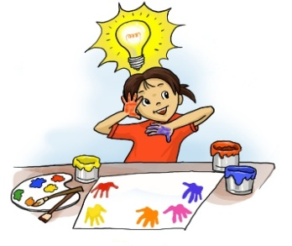
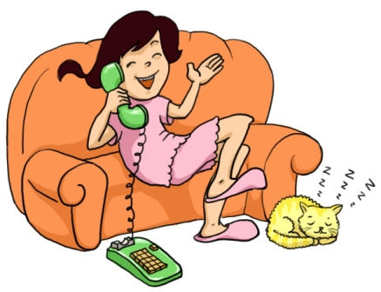
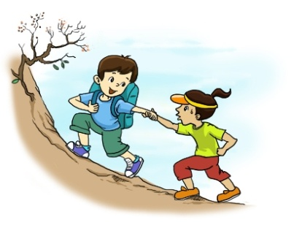
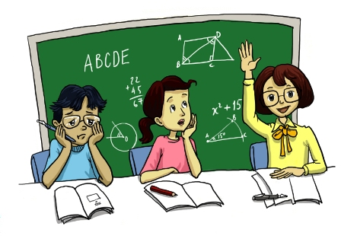
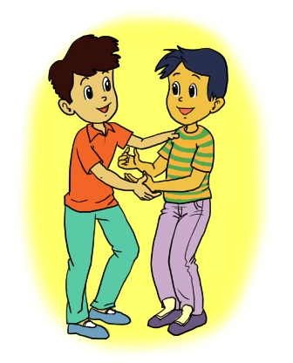
Adjectives for personality
3. Choose the adjectives in the box to complete the sentences.
Look for the highlighted words. Listen, check and repeat the words.
talkative clever boring creative shy
kind confident hardworking friendly funny
creative
1. Mina is very __________. She likes to draw pictures. She always has lots of new ideas.
talkative
4. Kim is very ___________. She’s always on the phone, chatting to friends.
kind
2. Thu is _____________. He likes to help his friends.
clever
5. Mai is ______________. She understands things quickly and easily.
confident
3. Minh Duc is _________. He isn’t shy. He likes to meet new people.

Slide 10
To be + adjective + | To be + adjective -
I’m ( am ) hard-working You’re (are) kind He’s/she’s/ it’s (is) friendly We’re/you’re/they’re (are) funny | I’m not ( am not ) hard-working You aren’t (are not ) kind He/she/it isn’t (is not ) friendly We/you/they aren’t (are not) funny
S + to be + adj
S + to be + not + adj

Slide 11
4. Complete the sentences
I _____ hard-working. ( +)
Phuc _____ kind. (+)
Chau ______ shy. (-)
We ________ creative. ( -)
My dog _____ friendly. (+)
They _______ funny. (+)
am
is
is not
are not
is
are

Slide 12
5. Game: Friendship Flower.
In groups of four/six, each member writes in the flower petal two adjectives for personalities which you like about the others. Compare and discuss which 2 words best describe each person.
Hue
hard-working
clever
Minh is kind and funny

