Slide 1



Slide 2



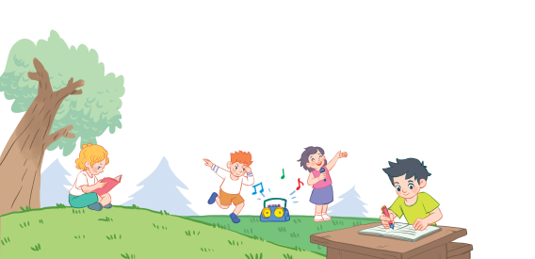
18
Period 2

Slide 3
Contents
1
Warm-up and review
2
3
4
Listen and tick.
Look, complete and read.
Let’s play.
5
Fun corner and wrap-up

Slide 4
1. Warm-up and review

Slide 5
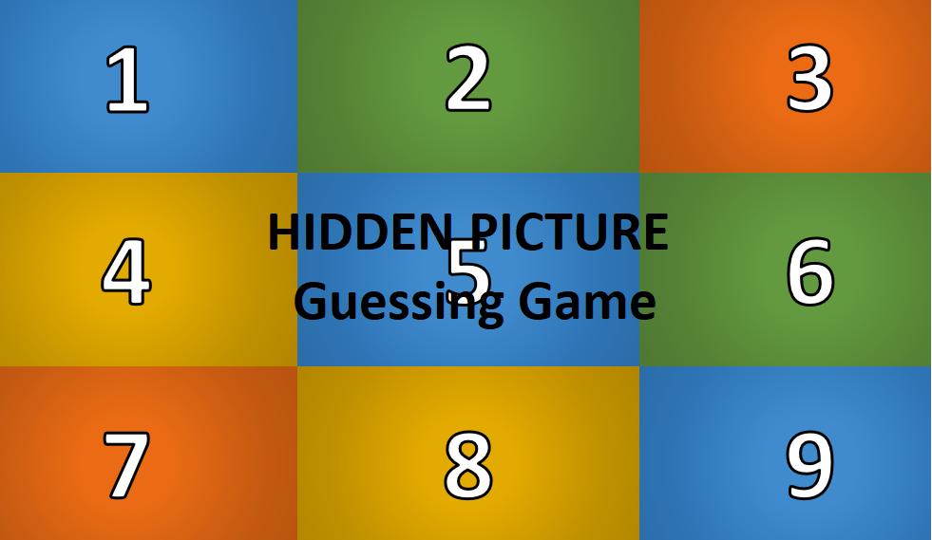
Notes:
GAME: Hidden Picture Guessing
Teacher asks pupils to choose the numbers to reveal and guess the pictures behind (words of activities in lesson 1 - period 1)

Slide 6

1
2
3
4
5
6
7
8
9
singing

Slide 7

1
2
3
4
5
6
7
8
9
reading

Slide 8

1
2
3
4
5
6
7
8
9
dancing

Slide 9

1
2
3
4
5
6
7
8
9
writing

Slide 10
2. Listen and tick.

Slide 11
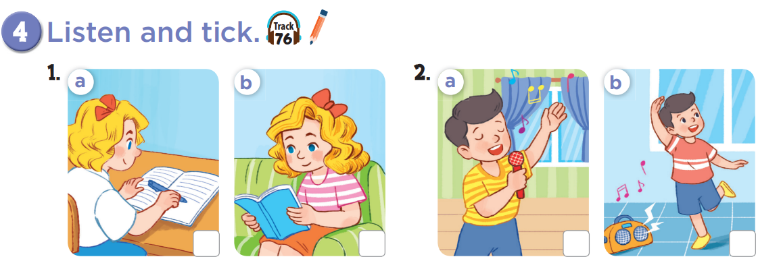


Slide 12
✓
✓

Slide 13




Game: Slap the board!
+1
I am writing.
+1
+2
+2
Notes:
Say the sentences 1 by 1 and follow the action when THE HAND pointed to each picture

Slide 14
Game: Slap the board!
+1
I am singing.
+1
+2
+2
Notes:
Say the sentences 1 by 1 and follow the action when THE HAND pointed to each picture

Slide 15
Game: Slap the board!
+1
I am dancing.
+1
+2
+2
Notes:
Say the sentences 1 by 1 and follow the action when THE HAND pointed to each picture

Slide 16
Game: Slap the board!
+1
I am reading.
+1
+2
+2
Notes:
Say the sentences 1 by 1 and follow the action when THE HAND pointed to each picture

Slide 17
3. Look, complete and read.

Slide 18
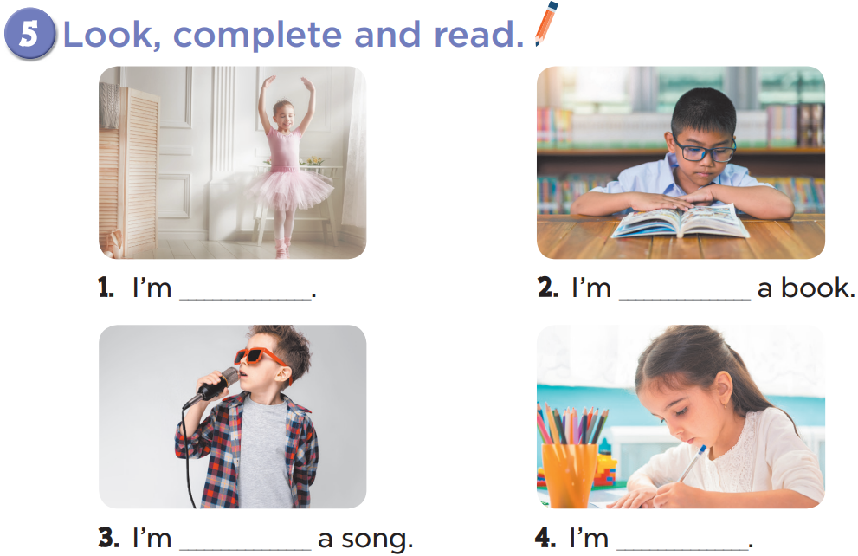

Slide 19
dancing
reading
singing
writing

Slide 20

GAME
Matching Pairs
Notes:
Game: Matching Pairs
Divide the class into two teams.
Each pupil from each team comes to the board, choose a card from the left, then choose one from the right.
If they match, he/she gets points for the team.

Slide 21





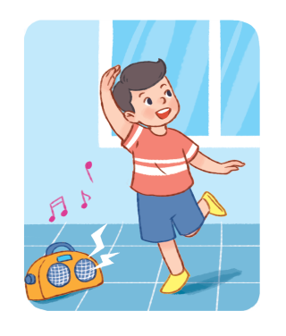
1
2
a
b
I am singing.
I am dancing.
3
4
c
d
I am writing.
I am reading.

Slide 22


You’re
You’re

Slide 23
4. Let’s play.

Slide 24
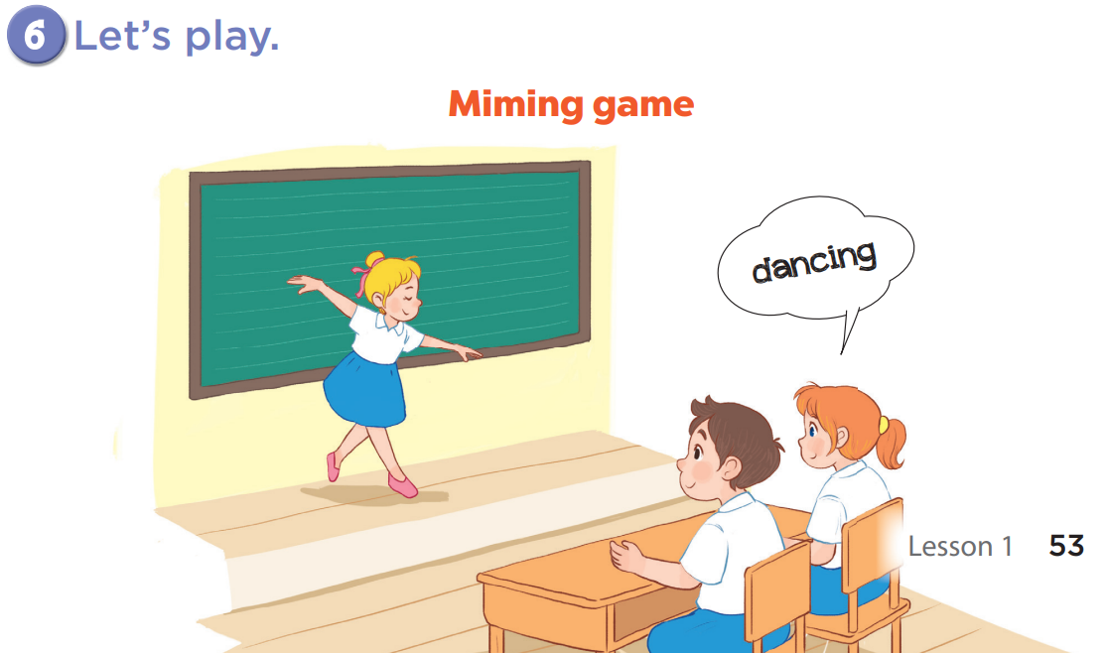

Slide 25
5. Fun corner and wrap-up

Slide 26

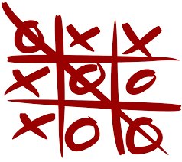
Game:
Tic-Tac-Toe
Notes:
Game: Tic Tac Toe
T divides class into 2 teams (BOYS and GIRLS).
T asks 2 members of each team to listen and write the words (activities) on the board.
The first one will choose the number and the circle or cross.

Slide 27
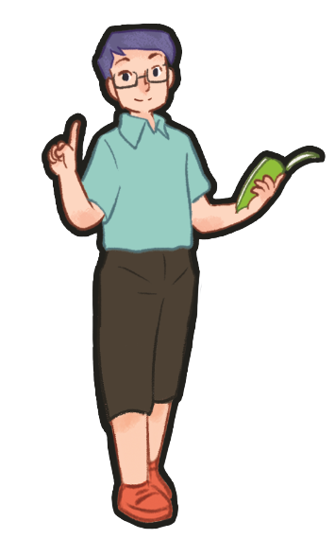
dancing
dancing
dancing

Slide 28

X
O
1
X
O
2
X
O
3
X
O
4
X
O
5
X
O
6
X
O
7
X
O
8
X
O
9
PLAY AGAIN
tekhnologic
Notes:
Click once to reveal a circle.
Click again to reveal a cross.
Click once more to show the pictures again.
Click play again to reset the board.

Slide 29

Website: hoclieu.vn
Fanpage: https://www.facebook.com/tienganhglobalsuccess.vn/

