Slide 1





CAT HANH 1 PRIMARY SCHOOL
Warmly welcome teachers to our
CLASS 3A2
Teacher: Le Tan Hung

Slide 2
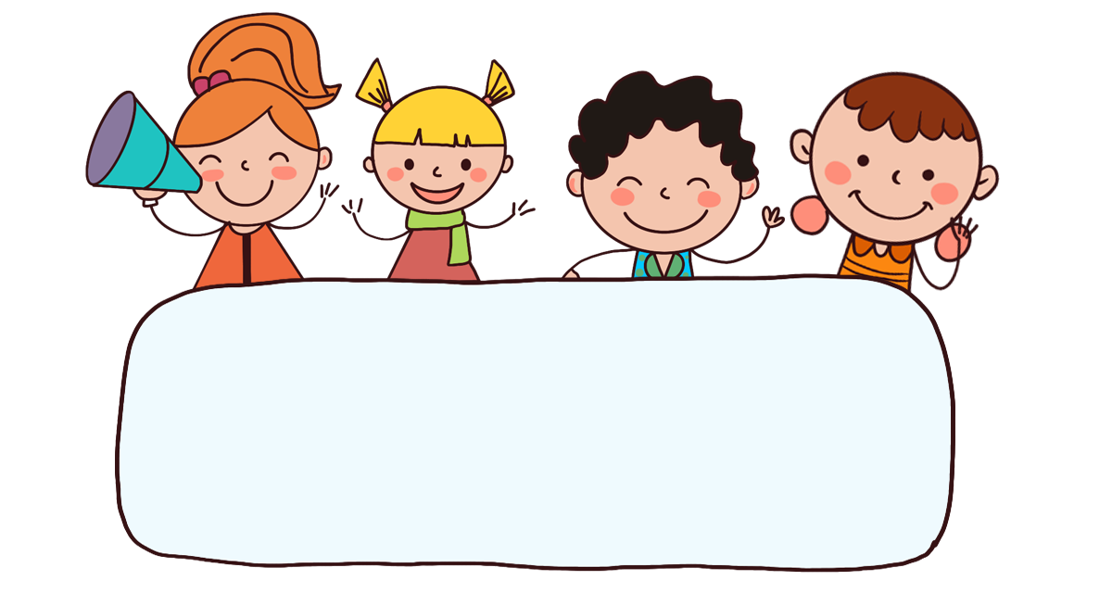
Warm-up

Slide 3



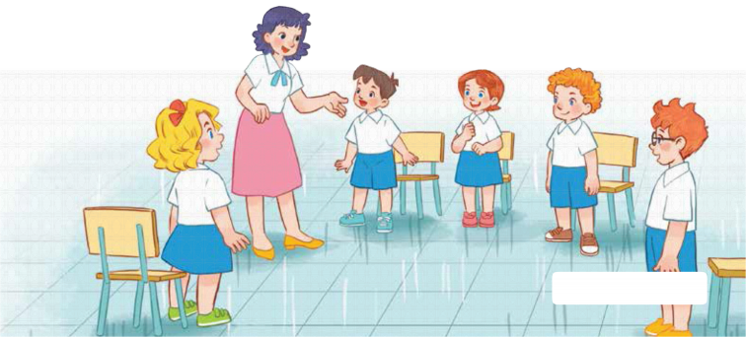
7
Classroom instructions
LESSON 1 – PERIOD 1

Slide 4
CONTENTS
Look, listen and repeat.
Let’s talk.
Listen, point and say.
Fun corner and wrap-up
Warm-up and review

Slide 5



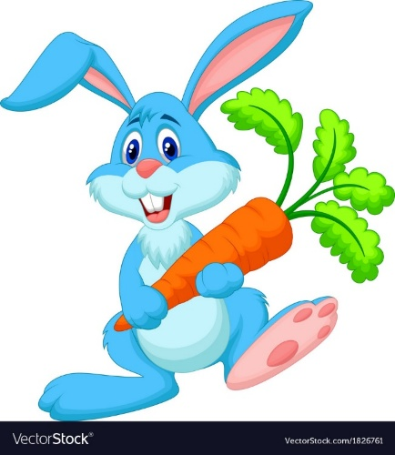

Pick the carrots
Warm-up and review
Notes:
- Divide the class into 2 teams. Each team chooses one carrot to go to the question.
- Have pupils listen and choose the right answer.
- Back to the menu for another question.
- Pupils take turns to play the game until there are no carrots left.
- The team who gets the most carrots is the winner.

Slide 6

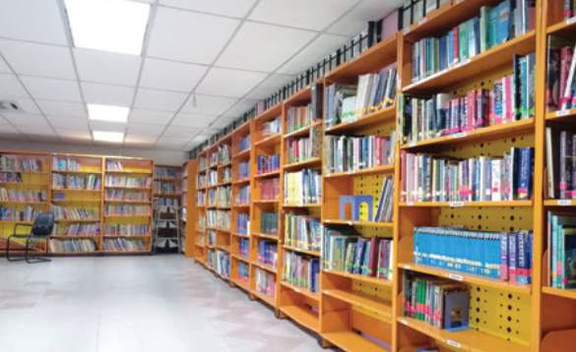
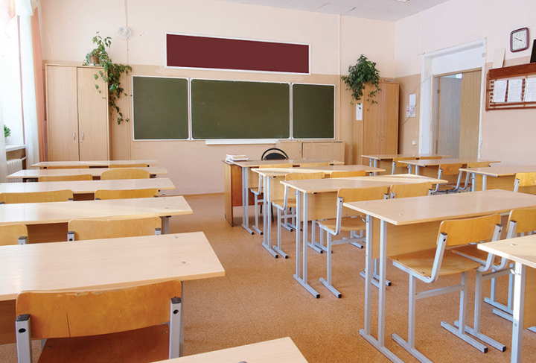
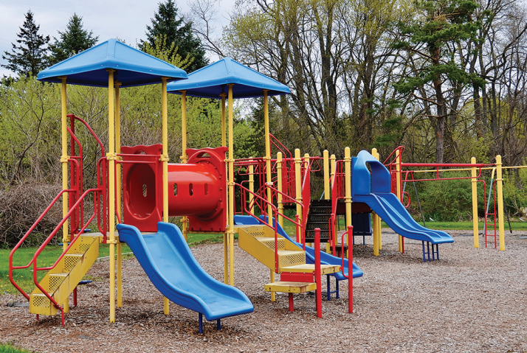
Listen and choose.
library
classroom
playground
Back
Notes:
- Click “Listen and choose” to play the audio.
- Teacher can click each answer to check.
- Click the “Back” button on the bottom right to go back to the game.

Slide 7
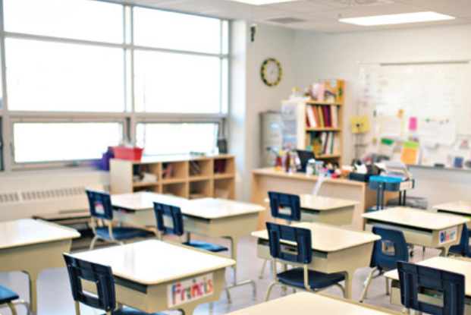
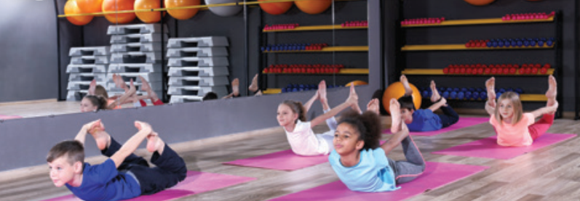
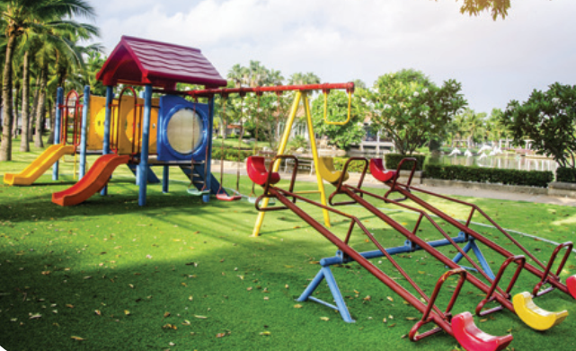
Listen and choose.
classroom
gym
playground
Back
Notes:
- Click “Listen and choose” to play the audio.
- Teacher can click each answer to check.
- Click the “Back” button on the bottom right to go back to the game.

Slide 8
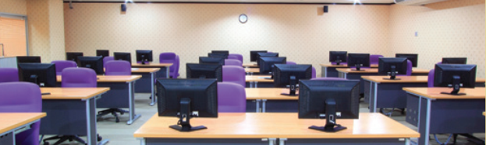
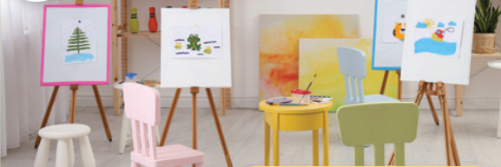
Listen and choose.
Let’s go to the _____.
OK, let’s go.
computer room
gym
art room
Back
Notes:
- Click “Listen and choose” to play the audio.
- Teacher can click each answer to check.
- Click the “Back” button on the bottom right to go back to the game.

Slide 9
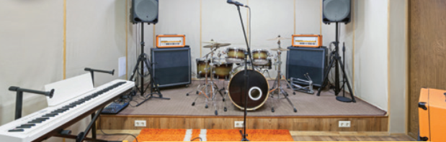
Listen and choose.
Let’s go to the _____.
OK, let’s go.
computer room
art room
music room
Back
Notes:
- Click “Listen and choose” to play the audio.
- Teacher can click each answer to check.
- Click the “Back” button on the bottom right to go back to the game.

Slide 10
Listen and choose.
Let’s go to the _____.
OK, let’s go.
music room
gym
art room
Back
Notes:
- Click “Listen and choose” to play the audio.
- Teacher can click each answer to check.
- Click the “Back” button on the bottom right to go back to the game.

Slide 11
Listen and choose.
Let’s go to the _____.
OK, let’s go.
music room
computer room
art room
Back
Notes:
- Click “Listen and choose” to play the audio.
- Teacher can click each answer to check.
- Click the “Back” button on the bottom right to go back to the game.

Slide 12
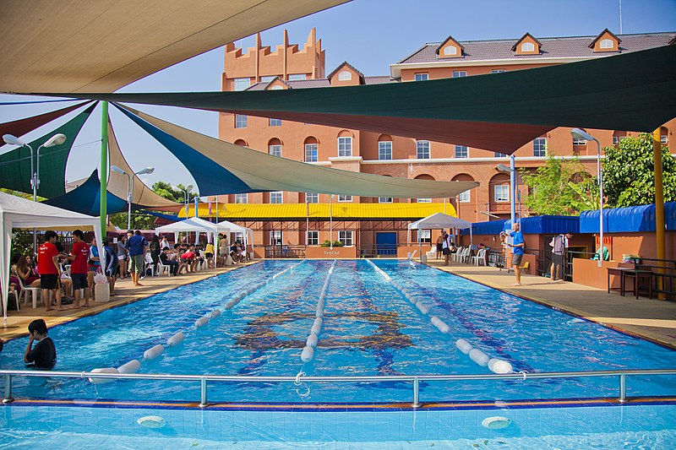
Is this our swimming pool?
Yes, it is./ No, it isn’t.
No, it isn’t.
Yes, it is.
Back
Notes:
- Teacher asks the question then show the picture.
- Ask the students if the picture is correct.

Slide 13
Is this our classroom?
Yes, it is./ No, it isn’t.
Yes, it is.
No, it isn’t.
Back
Notes:
- Teacher asks the question then show the picture.
- Ask the students if the picture is correct.

Slide 14
Is this our library?
Yes, it is./ No, it isn’t.
No, it isn’t.
Yes, it is.
Back
Notes:
- Teacher asks the question then show the picture.
- Ask the students if the picture is correct.

Slide 15
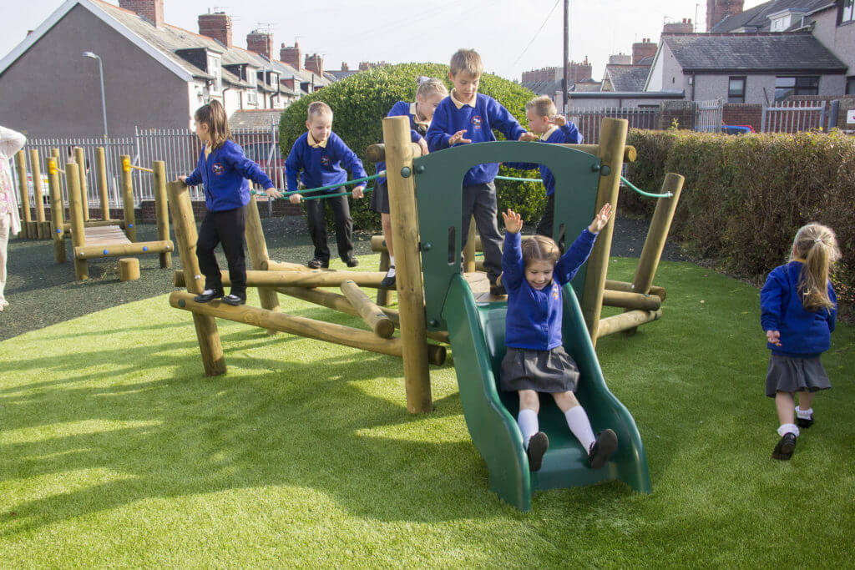
Is this our playground?
Yes, it is./ No, it isn’t.
No, it isn’t.
Yes, it is.
Back
Notes:
- Teacher asks the question then show the picture.
- Ask the students if the picture is correct.

Slide 16

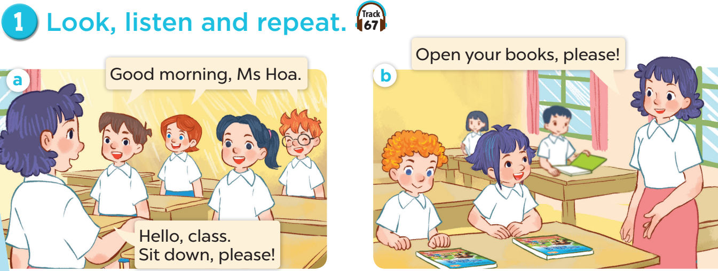

Slide 17
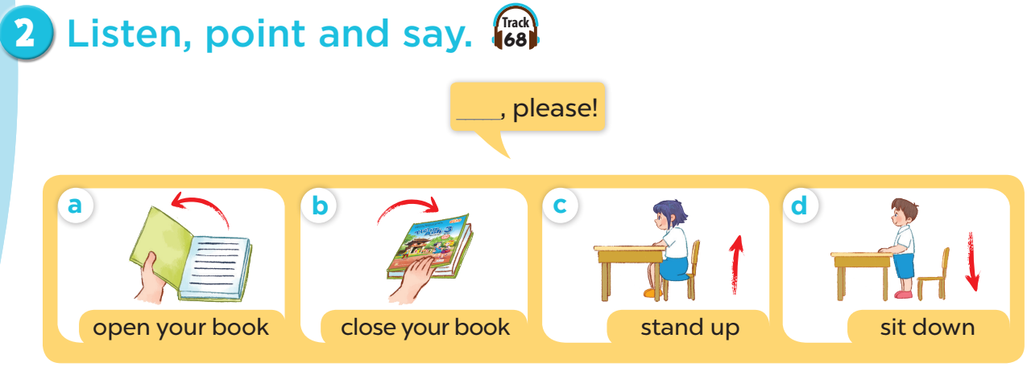

Slide 18
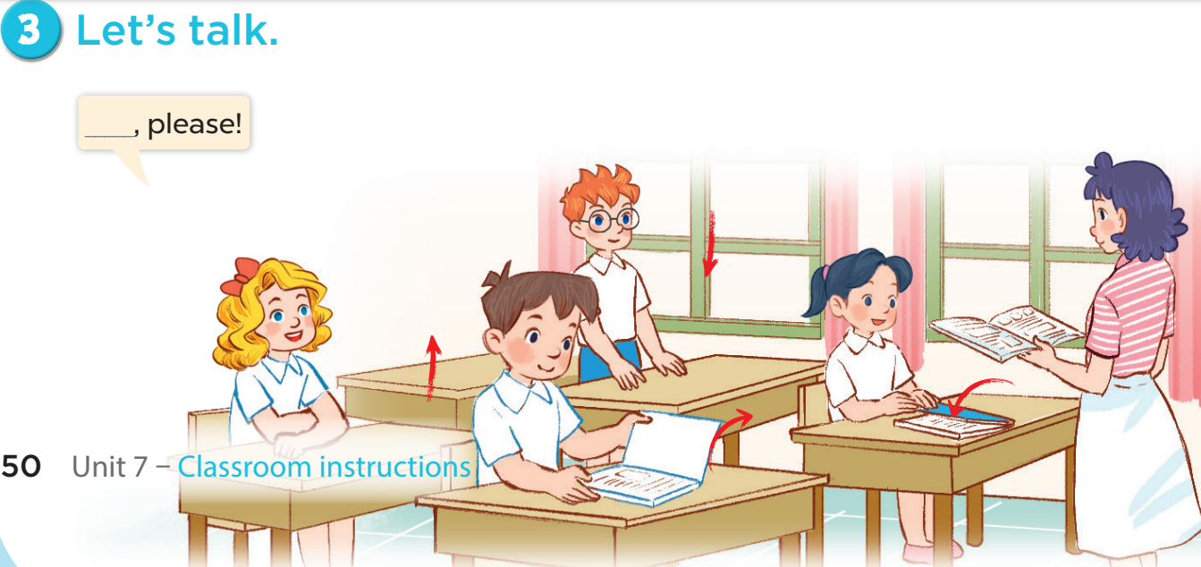


Slide 19
Fun corner and wrap-up

Slide 20






A
B
60
10
70
45
90
30
20
100
35
80
40
50
Notes:
- Divide the class into 2 teams.
- Each team chooses one umbrella to go to the question.
- Have pupils unscramble the sentences.
- Back to the menu for Wheel of Fortune.
- The pupils can spin the wheel to get points if they answer correctly.
- The team who gets more points is the winner.

Slide 21


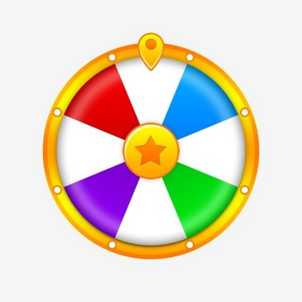

your
book,
please!
Open your book, please!
Open
CHECK
Notes:
- Click “CHECK” to check the answer.
- Click the wheel on the bottom right to go back to the wheel.

Slide 22

please!
your
book,
Close
Close your book, please!
CHECK
Notes:
- Click “CHECK” to check the answer.
- Click the wheel on the bottom right to go back to the wheel.

Slide 23
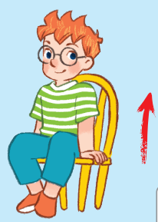
Stand up, please!
Stand
please!
up,
CHECK
Notes:
- Click “CHECK” to check the answer.
- Click the wheel on the bottom right to go back to the wheel.

Slide 24
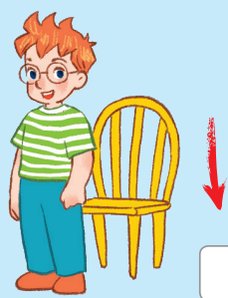
Sit down, please!
Sit
down
please!
CHECK
Notes:
- Click “CHECK” to check the answer.
- Click the wheel on the bottom right to go back to the wheel.

Slide 25
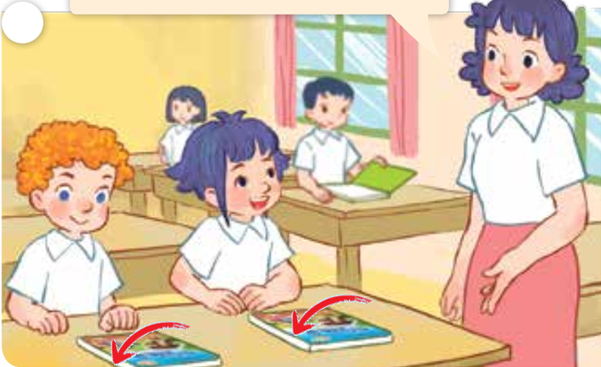
please!
Close your books, please!
Close
your
books,
CHECK
Notes:
- Click “CHECK” to check the answer.
- Click the wheel on the bottom right to go back to the wheel.

Slide 26
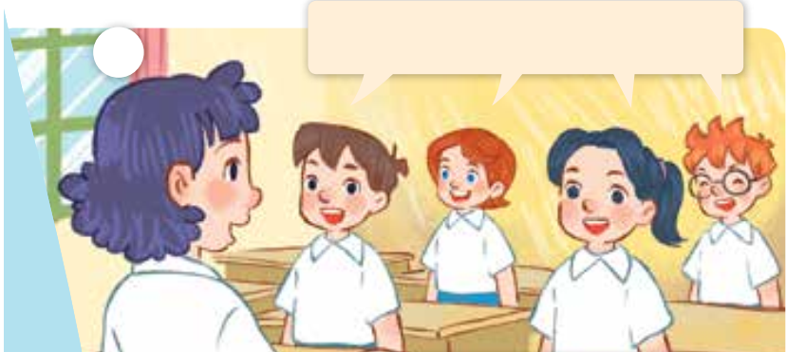
Good morning, Ms Hoa.
Good
morning,
Ms Hoa.
CHECK
Notes:
- Click “CHECK” to check the answer.
- Click the wheel on the bottom right to go back to the wheel.

Slide 27
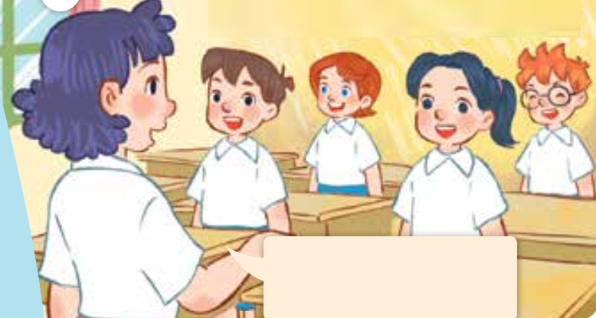
Hello, class.
Sit down, please!
Hello,
class.
Sit down,
please!
CHECK
Notes:
- Click “CHECK” to check the answer.
- Click the wheel on the bottom right to go back to the wheel.

Slide 28
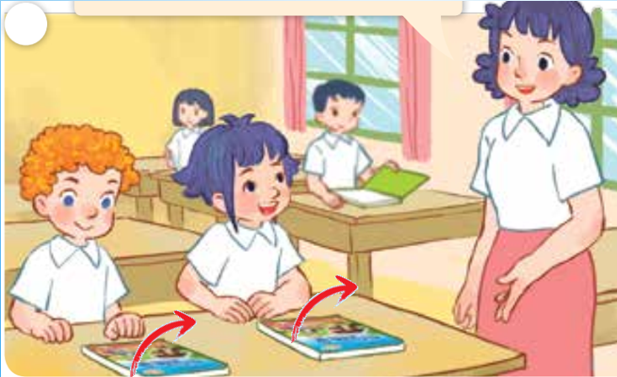
please!
Open your books, please!
Open
your
books,
CHECK
Notes:
- Click “CHECK” to check the answer.
- Click the wheel on the bottom right to go back to the wheel.

Slide 29

Website: hoclieu.vn
Fanpage: facebook.com/www.tienganhglobalsuccess.vn

