Slide 1
My week
3
LESSON 1 - PERIOD 1
SUNDAY
SUNDAY
MONDAY
TUESDAY
WEDNESDAY
THURSDAY
FRIDAY
SATURDAY

Slide 2
Table of contents
01
Warm-up
04
02
03
Let’s talk.
Look, listen and repeat.
Fun corner & wrap-up
05
Listen, point and say.

Slide 3
01
Warm-up

Slide 4
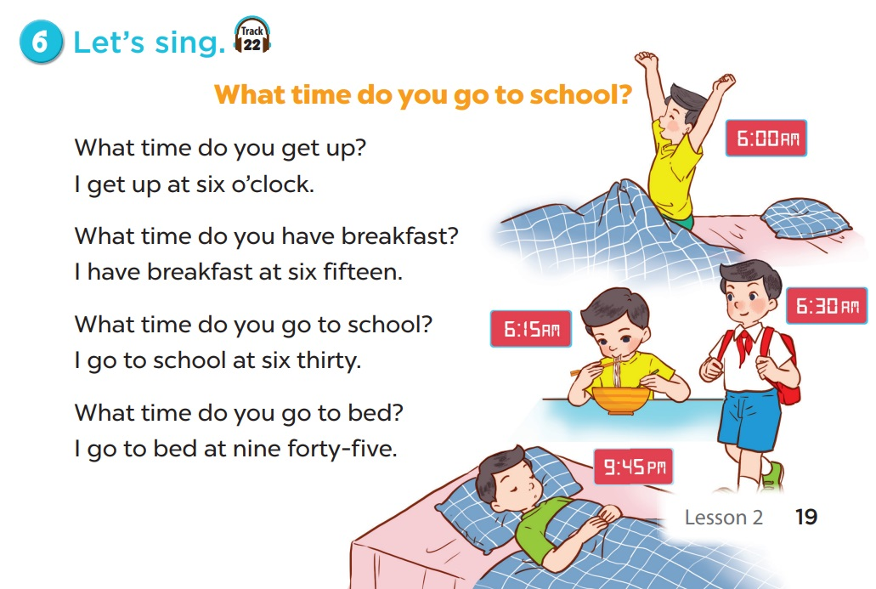
LET’S SING TOGETHER.

Slide 5
02
Activity 1 Look, listen and repeat.

Slide 7
03
Activity 2 Listen, point and say.

Slide 9
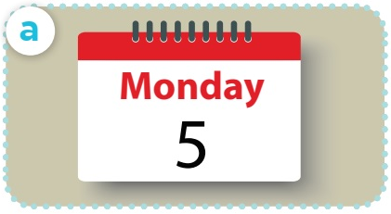
What day is it today?
It’s Monday.

Slide 10
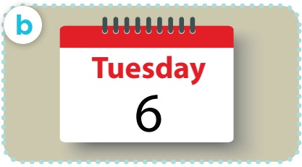
What day is it today?
It’s Tuesday.

Slide 11
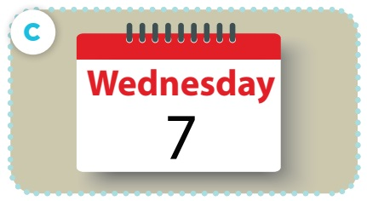
What day is it today?
It’s Wednesday.

Slide 12
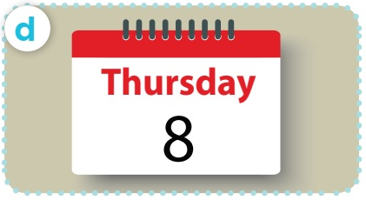
What day is it today?
It’s Thursday.

Slide 13
04
Activity 3 Let’s talk.

Slide 14
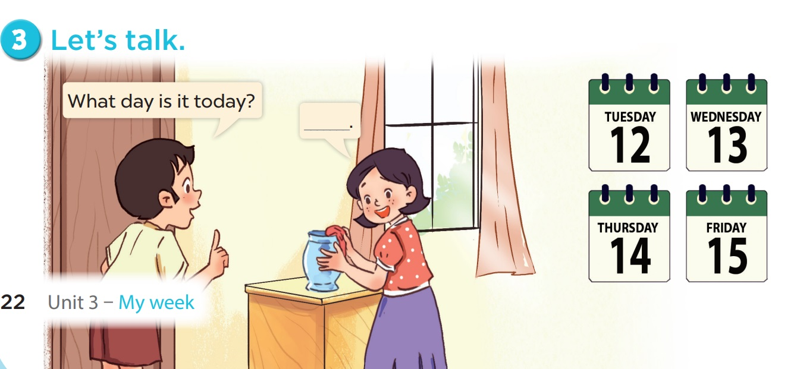

Slide 15
05
Fun corner & wrap-up

Slide 16
QUESTION 1:
FIND THE THE MISSING LETTER.
TU_SDAY
E
Notes:
Repeat the question when the letter blinks
Key: TUESDAY

Slide 17
QUESTION 2:
The 3 letters stand next to each other in all days of the week.
DAY
Notes:
DAY

Slide 18
QUESTION 3:
How many days are there except the weekend?
5
Notes:
5

Slide 19
QUESTION 4:
The day you have English lessons
Notes:
Pupils’ answer

Slide 20
QUESTION 5:
The day you can get up late
Notes:
Pupils answer.
It can be anyday when you don’t go to school/ don’t have to get up early.

Slide 21
QUESTION 6:
The days have the letter ‘s’
5 days
What are they?
Tuesday, Wednesday, Thursday, Saturday, Sunday

Slide 22
QUESTION 7:
The day with more letters than any days in a week
Wednesday
Notes:
WEDNESDAY

