Slide 1
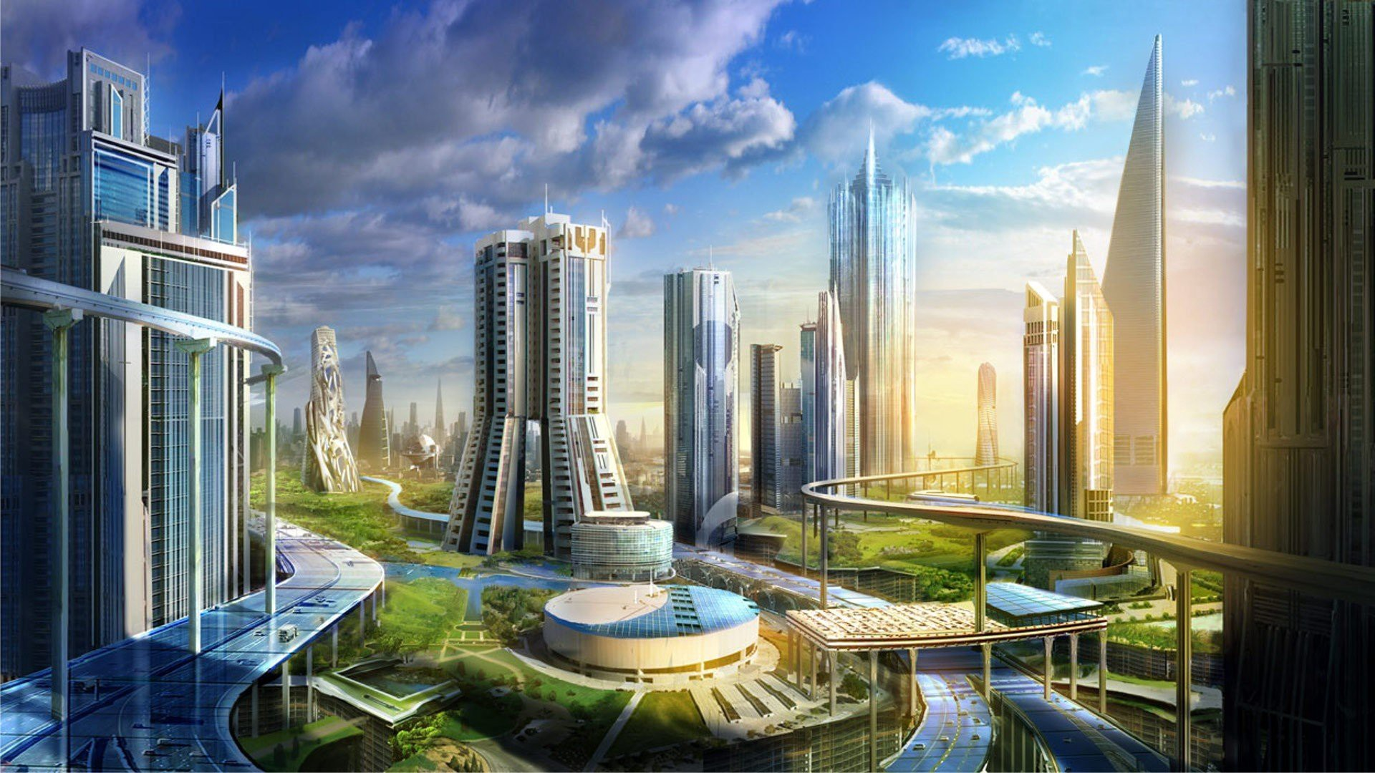
Unit 9. Cities of the future
Lesson 7.Communication and Culture

Slide 3
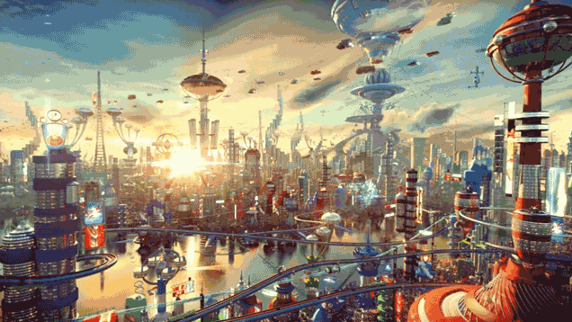
Task 1. Use the information about the cities mentioned in this unit (London, Tokyo, New York City, and Superstar City) and complete the diagram about the ideal city of the future.
Main means of transport
Public transport (eco-buses / smart underground transport networks)
Sources of energy
Renewable sources of energy: wind and sun power.
Water is treated and turned into energy or fertilizers.
Waste water is treated and turned into drinking water.
Treatment of waste
The ideal city of the future

Slide 4
Task 2. Discuss the questions in groups.
1. What will the ideal city of the future look like? You can talk about its means of transport, environmental conditions, energy sources, treatment of waste, climate, etc.
2. How do you think an ideal city should be created: by upgrading an existing one or by building a completely new one from scratch?
The ideal city of the future is the one with modern public transports which will all be run by solar energy. Environmental problems will decrease because of the government’s efforts. Renewable energy will be used widely at a low cost so that people can afford it. Waste will also be treated by a smart system and high technology.
An ideal city should be created by both upgrading an existing one and by building a completely new one from scratch.

Slide 5
Culture

Slide 6
Task 1. Read the text about Songdo, a smart city, and complete the table below.
Songdo International Business District in South Korea was started from scratch in 2005 and is still being built for the future. Its construction is based on the world’s best technologies and eco-friendly practices.
Located about 60 km southwest of Seoul, this 53.3-square-kilometre eco city has been planned around a central park and designed so that every resident can walk to work in the business district. People can enjoy walking in the city park or riding bicycles in the city.
The waste disposal system here is also innovative. There are no rubbish trucks or waste disposal bins in the streets. Instead, all household and office waste is sent directly through an underground network of tunnels to waste processing centres. The waste is then automatically sorted, deodorised and treated. The aim is to eventually convert it into renewable energy for the community.
Sensors are widely used to monitor temperature, energy use and traffic flow. These sensors can warn the local authority about any problems and allow inhabitants to control the heating systems or household devices.
High-speed Wi-Fi is provided everywhere. Government offices and schools are connected to the network. This allows office workers to use teleconferencing for meetings and students to attend classes at home.
Attracting inhabitants, however, has been slow. Five years after its launch, only about 20% of the commercial space was occupied. But the developers are very optimistic about this city of the future. By 2020, they predict that more than 65,000 people will live and work in Songdo. They believe that it is on the right track to become one of the smartest and greenest cities in the world.
Location
Area
Construction start time
Estimated population in 2020
60 km southwest of Seoul, South Korea.
53.3 square kilometres
2005
more than 65,000 people

Slide 7
Task 2. Decide whether the following statements about Songdo arc true (T), false (F)? or not given (NG). Tick the correct box.
 | T | F | NG
1. Songdo is a city developed from an existing one.
2. The most advanced technologies are used in the construction of Songdo.
3. Special bicycle lanes are designed for Songdo's inhabitants.
4. Rubbish trucks collect household and office waste and transport it to processing centres every day
5. Songdo's traffic can be controlled with the help of sensors.
6. The Wireless Internet network covers the whole city.
7. Five years after the opening of the city, most of its residential space was occupied.
☑
☑
☑
☑
☑
☑
☑

Slide 8
Task 3. Discuss with a partner
Would you live in Songdo if you had a chance?
Why or Why not?

