Slide 1
Welcome To
Our Class

Slide 2
Unit
8
1
Unit
FAMILY LIFE
NEW WAYS TO LEARN
LESSON 3
READING

Slide 3
LESSON 3
READING
Unit
GETTING STARTED
WARM-UP
Guessing game

Slide 4
WARM-UP
Game rules
- 2 teams.
3 sets of pictures (3 pictures/set)
If one team:
+ gets the correct answer after the 1st picture ➔ 3 points
+ gets the correct answer after the 2nd picture ➔ 2 points
+ gets the correct answer after the 3rd picture ➔ 1 point
- The team with more points will be the winner.

Slide 5
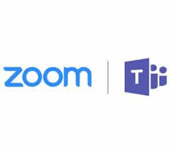
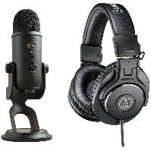
WARM-UP
Set 1
online learning

Slide 6
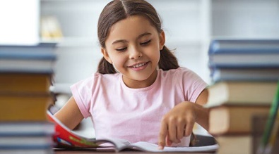
WARM-UP
Set 2
self-study

Slide 7
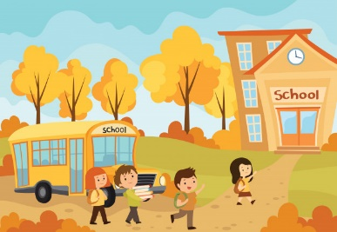
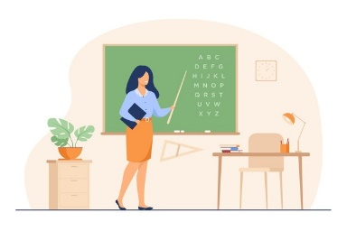
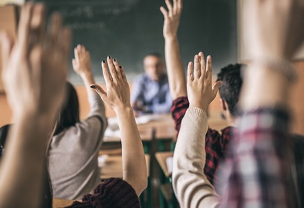
WARM-UP
Set 3
face-to-face learning

Slide 8
PRE-READING
1
Look at the photos and answer the questions.
1. How do the students learn in each photo?
2. Are you familiar with these ways of learning?
a
b

Slide 9
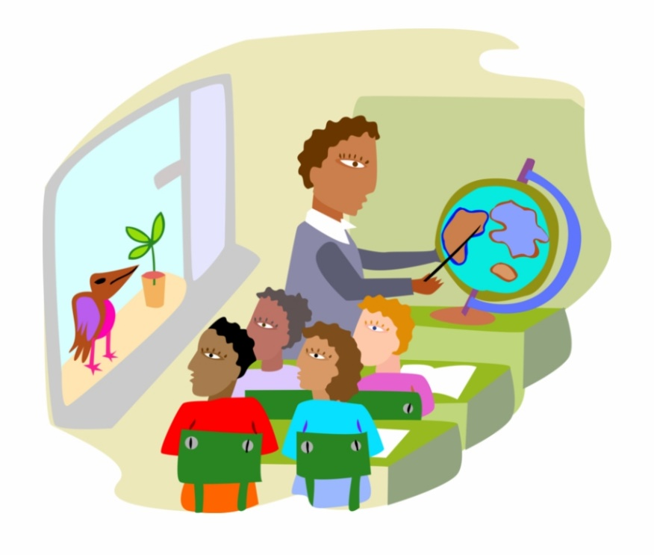
PRE-READING
distraction (n)
/dɪˈstrækʃən/
something that prevents someone from giving their attention to something else

Slide 10
PRE-READING
strategy (n)
/ˈstrætədʒi/
a way of doing something or dealing with something

Slide 11
PRE-READING
(to) exchange (v)
/ɪksˈtʃeɪndʒ/
to give something to someone and receive something from that person

Slide 12
PRE-READING
New words | Pronunciation | Meaning
distraction (n) | /dɪˈstrækʃən/ | something that prevents someone from giving their attention to something else
strategy (n) | /ˈstrætədʒi/ | a way of doing something or dealing with something
(to) exchange (v) | /ɪksˈtʃeɪndʒ/ | to give something to someone and receive something from that person

Slide 13
WHILE-READING
Fill in the blanks with suitable words or phrases to complete the steps of finding the main idea of a passage.
repetition identify first and last summarize
How to find the main idea of a passage?
- (1) _____________ the topic.
- (2) _____________ the passage in your own words.
- Check the (3) _________________ sentences.
- Look for (4) _______________ of ideas.
Identify
Summarize
first and last
repetition

Slide 14
WHILE-READING
Task 2. Read the texts. What are the two students talking about? Choose the correct answer.
Kim
A. Ways of helping students
B. Ways of learning
C. How to enjoy learning
I think face-to-face learning is better than online learning because I can communicate with teachers and other classmates immediately and directly when I have questions.
In class, I can work in groups and discuss with friends. This helps me understand the lessons better. When I have a problem, I can ask for answers or help immediately. I can’t do this in online classes. I have to email my teachers and wait for their reply. Learning in a traditional classroom also has fewer distractions than learning online. My teachers have many strategies to keep us focused on the lessons. I really enjoy my lessons and learn a lot.
Laura
I think online learning has more advantages than disadvantages. My school is trying to change from face-to-face to blended learning, so sometimes we have online classes. I don’t have to go to school, but I don’t feel I’m missing any lessons by taking online classes. Furthermore, I think I learn online as much as I learn in a traditional class. I can’t talk to my teacher and classmates, but I can email them at any time. I also have an online discussion board where I can exchange comments and ideas about my projects with my classmates. The only disadvantage is I really need to have a fast Internet connection.

Slide 15
WHILE-READING
WHILE-READING
Steps of reading for specific information:
Read the instructions.
Underline key words in the questions.
Read the passage and scan for key words or synonyms/paraphrased expressions.
Compare and decide answers.

Slide 16
WHILE-READING
3
Decide who mentions the following by putting a tick in the correct box.
This person ….
1. thinks that online learning isn’t as good as face-to-face learning.
2. gains the same knowledge in both ways of learning.
3. has more direct conversations and discussions.
4. uses emails to contact classmates
5. can pay more attention in class.
6. needs to have access to high-speed Internet.
Kim | Laura

Slide 17
WHILE-READING
Kim
1. This person thinks that online learning isn’t as good as face-to-face learning.
I think face-to-face learning is better than online learning because I can communicate with teachers and other classmates immediately and directly when I have questions.
In class, I can work in groups and discuss with friends. This helps me understand the lessons better. When I have a problem, I can ask for answers or help immediately. I can’t do this in online classes. I have to email my teachers and wait for their reply. Learning in a traditional classroom also has fewer distractions than learning online. My teachers have many strategies to keep us focused on the lessons. I really enjoy my lessons and learn a lot.
Laura
I think online learning has more advantages than disadvantages. My school is trying to change from face-to-face to blended learning, so sometimes we have online classes. I don’t have to go to school, but I don’t feel I’m missing any lessons by taking online classes. Furthermore, I think I learn online as much as I learn in a traditional class. I can’t talk to my teacher and classmates, but I can email them at any time. I also have an online discussion board where I can exchange comments and ideas about my projects with my classmates. The only disadvantage is I really need to have a fast Internet connection.

Slide 18
WHILE-READING
Kim
2. This person gains the same knowledge in both ways of learning.
I think face-to-face learning is better than online learning because I can communicate with teachers and other classmates immediately and directly when I have questions.
In class, I can work in groups and discuss with friends. This helps me understand the lessons better. When I have a problem, I can ask for answers or help immediately. I can’t do this in online classes. I have to email my teachers and wait for their reply. Learning in a traditional classroom also has fewer distractions than learning online. My teachers have many strategies to keep us focused on the lessons. I really enjoy my lessons and learn a lot.
Laura
I think online learning has more advantages than disadvantages. My school is trying to change from face-to-face to blended learning, so sometimes we have online classes. I don’t have to go to school, but I don’t feel I’m missing any lessons by taking online classes. Furthermore, I think I learn online as much as I learn in a traditional class. I can’t talk to my teacher and classmates, but I can email them at any time. I also have an online discussion board where I can exchange comments and ideas about my projects with my classmates. The only disadvantage is I really need to have a fast Internet connection.

Slide 19
WHILE-READING
Kim
3. This person has more direct conversations and discussions.
I think face-to-face learning is better than online learning because I can communicate with teachers and other classmates immediately and directly when I have questions.
In class, I can work in groups and discuss with friends. This helps me understand the lessons better. When I have a problem, I can ask for answers or help immediately. I can’t do this in online classes. I have to email my teachers and wait for their reply. Learning in a traditional classroom also has fewer distractions than learning online. My teachers have many strategies to keep us focused on the lessons. I really enjoy my lessons and learn a lot.
Laura
I think online learning has more advantages than disadvantages. My school is trying to change from face-to-face to blended learning, so sometimes we have online classes. I don’t have to go to school, but I don’t feel I’m missing any lessons by taking online classes. Furthermore, I think I learn online as much as I learn in a traditional class. I can’t talk to my teacher and classmates, but I can email them at any time. I also have an online discussion board where I can exchange comments and ideas about my projects with my classmates. The only disadvantage is I really need to have a fast Internet connection.

Slide 20
WHILE-READING
Kim
4. This person uses emails to contact classmates.
I think face-to-face learning is better than online learning because I can communicate with teachers and other classmates immediately and directly when I have questions.
In class, I can work in groups and discuss with friends. This helps me understand the lessons better. When I have a problem, I can ask for answers or help immediately. I can’t do this in online classes. I have to email my teachers and wait for their reply. Learning in a traditional classroom also has fewer distractions than learning online. My teachers have many strategies to keep us focused on the lessons. I really enjoy my lessons and learn a lot.
Laura
I think online learning has more advantages than disadvantages. My school is trying to change from face-to-face to blended learning, so sometimes we have online classes. I don’t have to go to school, but I don’t feel I’m missing any lessons by taking online classes. Furthermore, I think I learn online as much as I learn in a traditional class. I can’t talk to my teacher and classmates, but I can email them at any time. I also have an online discussion board where I can exchange comments and ideas about my projects with my classmates. The only disadvantage is I really need to have a fast Internet connection.

Slide 21
WHILE-READING
Kim
5. This person can pay more attention in class.
I think face-to-face learning is better than online learning because I can communicate with teachers and other classmates immediately and directly when I have questions.
In class, I can work in groups and discuss with friends. This helps me understand the lessons better. When I have a problem, I can ask for answers or help immediately. I can’t do this in online classes. I have to email my teachers and wait for their reply. Learning in a traditional classroom also has fewer distractions than learning online. My teachers have many strategies to keep us focused on the lessons. I really enjoy my lessons and learn a lot.
Laura
I think online learning has more advantages than disadvantages. My school is trying to change from face-to-face to blended learning, so sometimes we have online classes. I don’t have to go to school, but I don’t feel I’m missing any lessons by taking online classes. Furthermore, I think I learn online as much as I learn in a traditional class. I can’t talk to my teacher and classmates, but I can email them at any time. I also have an online discussion board where I can exchange comments and ideas about my projects with my classmates. The only disadvantage is I really need to have a fast Internet connection.

Slide 22
WHILE-READING
Kim
6. This person needs to have access to high-speed Internet.
I think face-to-face learning is better than online learning because I can communicate with teachers and other classmates immediately and directly when I have questions.
In class, I can work in groups and discuss with friends. This helps me understand the lessons better. When I have a problem, I can ask for answers or help immediately. I can’t do this in online classes. I have to email my teachers and wait for their reply. Learning in a traditional classroom also has fewer distractions than learning online. My teachers have many strategies to keep us focused on the lessons. I really enjoy my lessons and learn a lot.
Laura
I think online learning has more advantages than disadvantages. My school is trying to change from face-to-face to blended learning, so sometimes we have online classes. I don’t have to go to school, but I don’t feel I’m missing any lessons by taking online classes. Furthermore, I think I learn online as much as I learn in a traditional class. I can’t talk to my teacher and classmates, but I can email them at any time. I also have an online discussion board where I can exchange comments and ideas about my projects with my classmates. The only disadvantage is I really need to have a fast Internet connection.

Slide 23
POST-READING
Game: Running Dictation

Slide 24
POST-READING
Game: Running Dictation
I prefer face to face learning to online learning. Because, in class, I can communicate with teachers and other classmates directly , which helps me understand the lessons better. Besides, my teachers often make me focus on the lesson so I can enjoy my lessons and learn a lot.

Slide 25
CONSOLIDATION
2
Homework
Do exercises in the workbook
Prepare for the next lesson: Speaking

Slide 26
Thank you for your attention !

