Slide 2
Unit 1
Life stories we admire
LESSON 5
LISTENING
The father of Mickey Mouse

Slide 3
LESSON 5
LISTENING
WARM-UP
Lucky song
PRE-LISTENING
Task 1: Solve the crossword.
Vocabulary
Task 2: Listen and number.
Task 3: Choose the correct answer.
WHILE-LISTENING
POST-LISTENING
Task 4: ﻿Work in pairs and discuss.
CONSOLIDATION
Wrap-up
Homework

Slide 4

WARM-UP
Lucky song
1
2
3
4
5
6
7
8

Slide 5
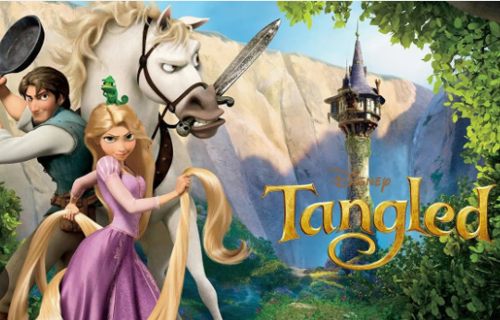

WARM-UP
Question 1:
I see the light
Tangled OST

Slide 6

WARM-UP
Question 2:
Beauty and the beast
Beauty and the beast OST

Slide 7
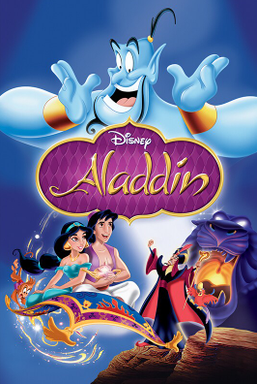
WARM-UP
Question 3:
A whole new world
Aladdin OST

Slide 8
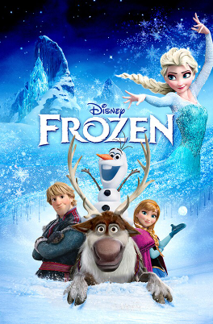
WARM-UP
Question 4:
Let it go
Frozen OST

Slide 9
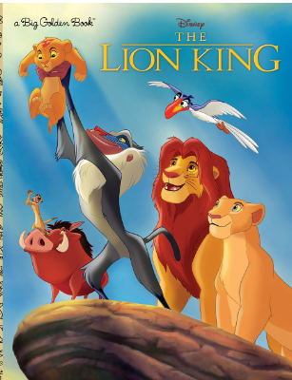
WARM-UP
Question 5:
Can you feel the love tonight?
Lion King OST

Slide 10

WARM-UP

Slide 11

PRE-LISTENING
I. New words:
profitable (adj)
/ˈprɒfɪtəbl/
that makes or is likely to make money
có lợi nhuận

Slide 12
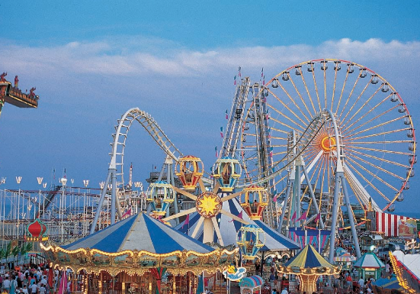
PRE-LISTENING
theme park (np)
/ˈθiːm pɑːk/
a large park where people go to enjoy themselves, for example by riding on large machines such as roller coasters, and where much of the entertainment is connected with one subject or idea
Công viên giải trí

Slide 13
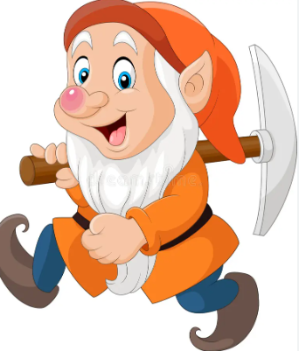
PRE-LISTENING
dwarf (n)
/dwɔːf/
(in stories) a creature like a small man, who has magic powers and who is usually described as living and working under the ground, especially working with metal
Chú lùn

Slide 14

PRE-LISTENING
inspire (v)
/ɪnˈspaɪə(r)/
to give somebody the desire, confidence or enthusiasm to do something well
Truyền cảm hứng

Slide 15
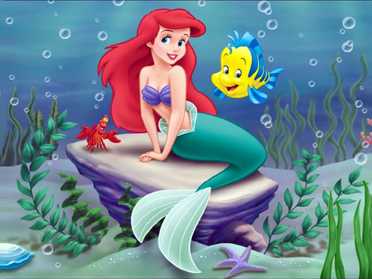
PRE-LISTENING
mermaid (n)
/ˈmɜːmeɪd/
(in stories) a creature with a woman’s head and body, and a fish’s tail instead of legs
Nàng tiên cá

Slide 16

PRE-LISTENING
creator (n)
/kriˈeɪtə(r)/
a person who has made or invented a particular thing
Người sáng tạo

Slide 17
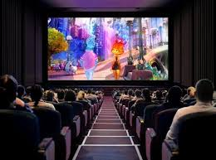
PRE-LISTENING
release (v)
/rɪˈliːs/
to make a film, recording or other product available to the public
Phát hành

Slide 18
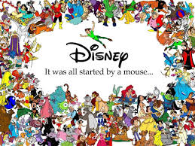
PRE-LISTENING
character (n)
/ˈkærəktə(r)/
a person or an animal in a book, play or film
Nhân vật

Slide 19

PRE-LISTENING
record (n)
/ˈrekɔːd/
the best result or the highest or lowest level that has ever been reached, especially in sport.
Thành tích, kỉ lục

Slide 20
PRE-LISTENING
magic (n)
/ˈmædʒɪk/
Ma thuật, phép màu, điều thần kì
the secret power of appearing to make impossible things happen by saying special words or doing special things.
=> magical (adj)
/ˈmædʒɪkl/
Thuộc ma thuật,
có phép màu
containing or used in magic; like magic

Slide 21
PRE-LISTENING
Set up (phr.v)
/set ʌp /
Thành lập, thiết lập
to create something or start it
Go on (phr.v)
/ɡəʊ ɒn/
Tiếp tục
Film industry (n.phr)
Công nghiệp điện ảnh

Slide 22
PRE-READING
Form | Pronunciation | Meaning | Vietnamese equivalent
1.profitable (adj) | /ˈprɒfɪtəbl/ | that makes or is likely to make money | có lợi nhuận
2. theme park | /ˈθiːm pɑːk/ | a large park where people go to enjoy themselves, for example by riding on large machines such as roller coasters, and where much of the entertainment is connected with one subject or idea | công viên giải trí
3. dwarf (n) | /dwɔːf/ | (in stories) a creature like a small man, who has magic powers and who is usually described as living and working under the ground, especially working with metal | chú lùn
4. inspire (v) | /ɪnˈspaɪə(r)/ | to give somebody the desire, confidence or enthusiasm to do something well | truyền cảm hứng

Slide 23
I. New words:
1. profitable (adj) /ˈprɒfɪtəbl/ có lợi nhuận
2. theme park /ˈθiːm pɑːk/ công viên giải trí
3. dwarf (n) /dwɔːf/ chú lùn
4. inspire (v) /ɪnˈspaɪə(r)/ truyền cảm hứng
5. mermaid (n) /ˈmɜːmeɪd/ nàng tiên cá
6. creator (n) /kriˈeɪtə(r)/ người sáng tạo, nhà sáng tạo
7. release (v) /rɪˈliːs/ phát hành
8. character (n) /ˈkærəktə(r)/ nhân vật
9. record (n) /ˈrekɔːd/ thành tích, kỉ lục
10. magic (n) /ˈmædʒɪk/ ma thuật, phép màu, điều thần kì
-> magical (adj) /ˈmædʒɪkl/ thuộc ma thuật, có phép màu
11. set up (phr.v) /set ʌp / thành lập, thiết lập
12. go on (phr.v) /ɡəʊ ɒn/ tiếp tục
13. film industry (n.phr) /fɪlm ˈɪndəstri/ công nghiệp điện ảnh
14. beast /bi:st/ (n) thú vật

Slide 24

PRE-LISTENING
1
Solve the crossword to reveal the secret name.
NAME THE STORY CHARACTERS!

Slide 25
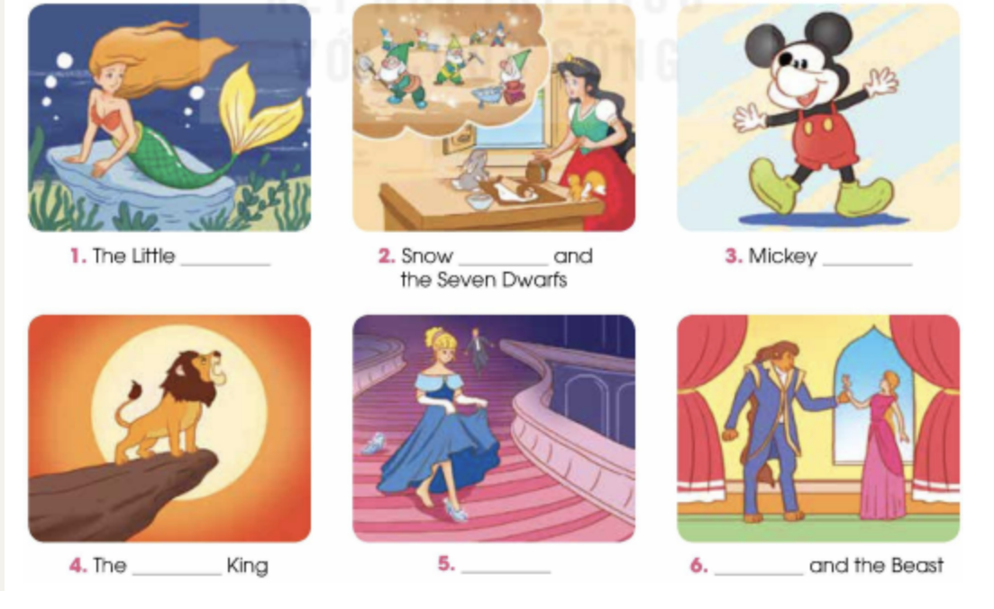
PRE-LISTENING
1
Solve the crossword to reveal the secret name.
NAME THE STORY CHARACTERS!
Mermaid
White
Mouse
Lion
Cinderella
Beauty

Slide 26
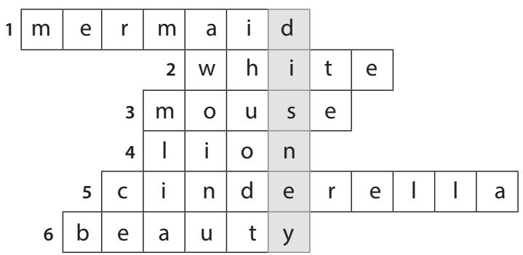
PRE-LISTENING
1
Solve the crossword to reveal the secret name.
NAME THE STORY CHARACTERS!

Slide 27
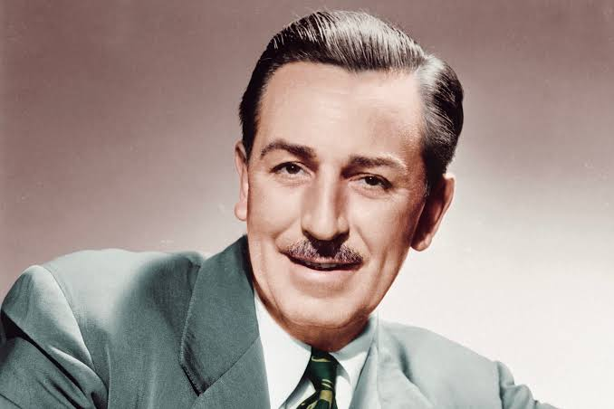
PRE-LISTENING
1
Solve the crossword to reveal the secret name.
Walter Elias Disney was an American animator, movie producer, and entrepreneur. A number of his films have been enshrined in the National Film Registry by the Library of Congress and several of them have been recognized as among the greatest films ever by the American Film Institute. Renowned for his remarkable cartoons like Snow White and the Seven Dwarfs, Cinderella, and The Lion King,... Walt Disney received multiple Academy Awards in recognition of his contributions to the film industry.
Walt Disney

Slide 28
PRE-LISTENING
Walter Elias Disney (December 5, 1901 – December 15, 1966) was an American animator, film producer, voice actor, and entrepreneur. A pioneer of the American animation industry, he introduced several developments in the production of cartoons. As a film producer, he holds the record for most Academy Awards earned and nominations by an individual. He was presented with two Golden Globe Special Achievement Awards and an Emmy Award, among other honors. Several of his films are included in the National Film Registry by the Library of Congress and have also been named as some of the greatest films ever by the American Film Institute.
Born in Chicago in 1901, Disney developed an early interest in drawing. He took art classes as a boy and took a job as a commercial illustrator at the age of 18. He moved to California in the early 1920s and set up the Disney Brothers Studio (now The Walt Disney Company) with his brother Roy. With Ub Iwerks, he developed the character Mickey Mouse in 1928, his first highly popular success; he also provided the voice for his creation in the early years. As the studio grew, he became more adventurous, introducing synchronized sound, full-color three-strip Technicolor, feature-length cartoons and technical developments in cameras. The results, seen in features such as Snow White and the Seven Dwarfs (1937), Pinocchio, Fantasia (both 1940), Dumbo (1941), and Bambi (1942), furthered the development of animated film. New animated and live-action films followed after World War II, including the critically successful Cinderella (1950), Sleeping Beauty (1959) and Mary Poppins (1964), the last of which received five Academy Awards.
Walter Elias Disney

Slide 29
WHILE-LISTENING
Listen to a talk about Walt Disney’s life. Number the events in the order they are mentioned.
2
2
1
5
3
4
6
A. A difficult beginning
B. An introduction to Walt Disney
C. Creating the world’s most popular tourist attraction
D. The birth of Mickey Mouse
E. The success of Snow White and the Seven Dwarfs
F. The continued success of The Walt Disney Studios

Slide 30
WHILE-LISTENING
3
Listen to the talk again. Choose the correct answer A, B, or C
1. Walt Disney moved to Hollywood because _______.
A. his parents moved to work there
B. he wanted to start his career again
C. his company became very successful
2. Which is true about Mickey Mouse?
A. It was based on a real pet.
B. It was first voiced by a famous actor.
C. It was not very popular.

Slide 31
WHILE-LISTENING
3
Listen to the talk again. Choose the correct answer A, B, or C
3. What is NOT mentioned as an achievement of Snow White and the Seven Dwarfs?
A. It earned more than 400 million dollars.
B. It won several Oscars.
C. It was the best movie in the film industry.
4. What is true about Disney’s achievements?
A. He created the first animated cartoon.
B. He holds the record for the most Oscars in history.
C. He designed all the Disneyland theme parks.

Slide 32
WHILE-LISTENING
3
Listen to the talk again. Choose the correct answer A, B, or C
5. Why did he create Disneyland theme parks?
A. So that visitors can share their magical stories with Disney characters.
B. So that fans can see Disney characters live on stage and interact with them.
C. So that visitors can learn to make animated films.

Slide 33
WHILE-LISTENING
Walt Disney was one of the most admired people in the film industry. Many of the films created by his company are very popular with both children and adults.
However, success did not come early for Disney. When he set up his own film company, it was not very profitable. So, Disney chose to move to Hollywood to start a new career.
There, he developed a character based on a pet mouse he once had, under the name of Mickey Mouse. He even gave the mouse his own voice. Soon, Mickey Mouse became the world's most popular cartoon character and Disney was very popular worldwide.
But Disney did not stop there. He went on to produce his first feature-length animated film Snow White and the Seven Dwarfs. The film became a huge success, earning more than 400 million dollars since its release and eight Oscars, the top award in the film industry. Throughout his career, Disney won or received 26 Oscars - a record in history.
Besides making films, Disney was also the creator of the first Disneyland theme park which opened in 1955. Nowadays, there are 12 Disney parks around the world where people can meet Disney cartoon characters and see live shows of their magical stories.
After his death, The Walt Disney Studios continued to make high-quality live-action and animated films, such as The Little Mermaid, Beauty and the Beast, and The Lion King. His films continue to inspire both adults and children to follow their dreams.
3

Slide 34
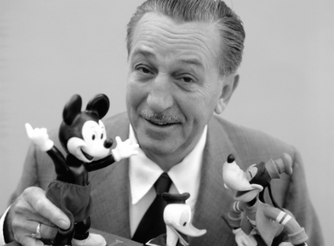
POST-LISTENING
3
Work in pairs. Discuss the question.
What do you think is most impressive about Walt Disney’s life and achievements?

Slide 35
CONSOLIDATION
1
Wrap-up
What have you learnt today?
An overview about Walt Disney’s life;
Listening skills for general ideas and for specific information

Slide 36
CONSOLIDATION
2
Homework
Do exercises in the workbook.
Prepare for Lesson 6 - Writing.

Slide 37
Website: hoclieu.vn
Fanpage: facebook.com/www.tienganhglobalsuccess.vn

