Slide 1
Review 3
Lesson 3.1: Listening, Reading
& Vocabulary
Page: 88

Slide 2
Lesson Outline
Warm-up
Listening
Reading
Vocabulary
Consolidation
Wrap-up

Slide 3
By the end of this lesson, students will be able to…
- practice listening and reading for specific information.
- practice test-taking skills.
- consolidate and practice vocab. presented in units 6-8.

Slide 4
WARM UP

Slide 5
LEAVE ME OUT
Identify the spelling error and correct it.
1. heritaged
2. kayakking
3. unikque
4. unsused
5. ecologicall
6. campuss
7. independeant
8. assignmment
1. heritage
2. kayaking
3. unique
4. unused
5. ecological
6. campus
7. independent
8. assignment
ANSWER

Slide 6
Listening

Slide 7
Pre - Listening
Read the instruction quickly. What are we going to do?
Listen and write the correct answer.

Slide 8
While - Listening
Listen and write the correct answer.
The podcast is for people who've just moved into their own place, or who have recently (1) _____________. Even if you can't cook, it's easy to learn some (2) _____________. You can find a lot of good recipes (3) _____________. When young people go to university, they have to (4) _____________ a lot of things. If you don't have a vehicle, you can still use (5) _____________.

Slide 9
While - Listening
Listen and choose the correct answer.
Show answer
The podcast is for people who've just moved into their own place, or who have recently (1) _____________.
started university
Show script
Hello, and welcome to TeenCast. Today, we're going to talk about becoming more independent. If you've just moved into your own place, recently started university, this is the podcast for you.

Slide 10
While - Listening
Listen and choose the correct answer.
Show answer
healthy recipes
Even if you can't cook, it's easy to learn some (2) _____________. You can find a lot of good recipes (3) _____________.
online
Show script
First of all, let's talk about food. Everyone enjoys their favorite food. We know food is important for our health. However, it's cooking the food which a lot of young people find difficult. Actually, it's easy to learn some healthy recipes, and it's very useful, too. I recommend people start with something simple like chicken salad. Then, try some more difficult recipes. You can find hundreds of great recipes online.

Slide 11
While - Listening
Listen and choose the correct answer.
Show answer
When young people go to university, they have to (4) _____________ a lot of things.
pay for
Show script
Another problem for many young people is money. When you move out or go to university, you'll be surprised by how many things you have to pay for! Lots of young people get part-time jobs. It's also really helpful to set a budget. A budget will help you to plan how to spend and save your money.

Slide 12
While - Listening
Listen and choose the correct answer.
public transportation
Show answer
If you don't have a vehicle, you can still use (5) _____________.
Show script
And finally, young people need transportation. Having your own car or motorbike can give you a lot of freedom. However, not everybody can afford one. If you don't have your own vehicle, you can still be independent by using public transportation!

Slide 13
Extra Practice
WB, Page 67
You will hear two friends talking about a trip. What did the girl enjoy more?
A. the caves
B. the karst landscapes
C. rock climbing
Show answer
Show script
Logan: Did you go rock climbing? That was my favorite thing about the park.
Emma: Yeah, the rock climbing was really good!
Logan: I know. The karst landscapes are really good for rock climbing.
Emma: Yeah, but it was the caves that I really loved. It's like walking into a different world!

Slide 14
Extra Practice
WB, Page 67
2. You will hear two people talking about an old statue. What does the man think should be done?
knock the statue down
prevent people from touching the statue
clean the statue
Show answer
Show script
Sandra: Well, they should stop kids from touching it.
Edward: I'm not so sure about that. How will they stop them?
Sandra: Well, what do you think should be done?
Edward: I think they should just knock it down.

Slide 15
Extra Practice
WB, Page 67
3. You will hear a phone call between two friends. What food does the boy like the most?
curry
sushi
pizza
Show answer
Show script
Kate: I'm going to the new sushi restaurant. Do you want to come?
James: No, thanks. I don't really like sushi.
Kate: How about curry? We could go to the Indian restaurant.
James: Hmm … No. Curry is OK, but it's pizza that I really like.

Slide 16
Reading

Slide 17
Pre - Reading
Read the instruction quickly. What are we going to do?
Read and choose the best answer.

Slide 18
While - Reading
Hi, Jenny! Thanks again for the fun trip. You're right, the sightseeing was fun, but it was shopping with you that I really enjoyed!
– Barbara
Barbara didn't enjoy the sightseeing.
Barbara enjoyed sightseeing more than shopping.
Barbara enjoyed shopping more than sightseeing.

Slide 19
While - Reading
Wigley Castle
• Do not climb on the castle walls
• Put trash in the trash cans
• Do not remove any part of the castle
Visitors are not allowed to touch the castle walls.
Visitors must not leave any trash on the floor.
Visitors can take pieces of the castle home as souvenirs.

Slide 20
While - Reading
Attention All Hotel Guests
Please make sure that you close all of the doors at the end of the day. Recently, animals have been coming into the hotel at night and damaging the furniture and floors. Thank you.
The animals are still coming into the hotel at night.
The animals are always in the hotel.
The animals have stopped coming into the hotel.

Slide 21
While - Reading
Oldtown University – Free workshops for new students
• Ice-breaker: Get to know your classmates
• Budgeting skills: Learn to manage your money
• Cooking class: Learn to prepare delicious meals
Students can learn to manage their emotions here.
Students need money for these workshops.
Students can make new friends here.

Slide 22
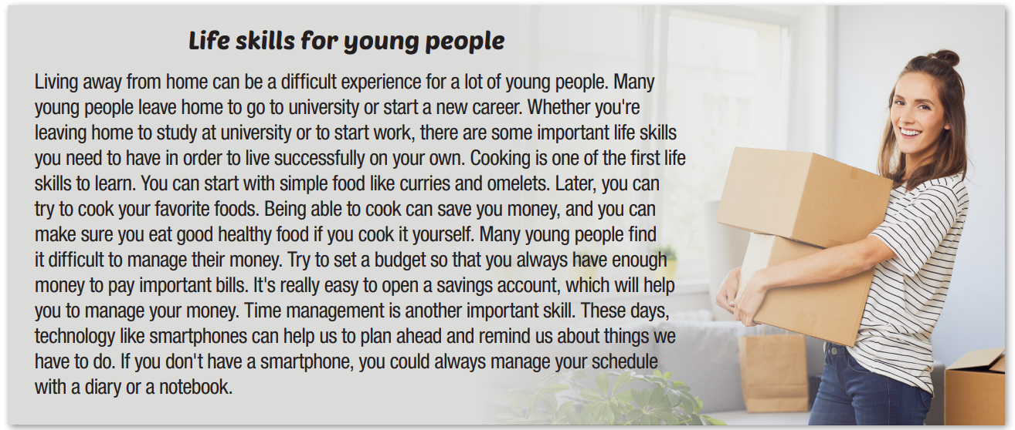
Extra Practice
WB, Page 69
For each question, choose the correct answer.

Slide 23
Extra Practice
WB, Page 69
For each question, choose the correct answer.
Living away from home can be a difficult experience for a lot of young people. Many young people leave home to go to university or start a new career. Whether you're leaving home to study at university or to start work, there are some important life skills you need to have in order to live successfully on your own.
Why do people need to learn life skills?
A. to live on their own
B. to start a career
C. to study at university

Slide 24
Extra Practice
WB, Page 69
For each question, choose the correct answer.
Cooking is one of the first life skills to learn. You can start with simple food like curries and omelets. Later, you can try to cook your favorite foods. Being able to cook can save you money, and you can make sure you eat good healthy food if you cook it yourself.
2. How can people start learning to cook?
A. take a cooking class
B. cook simple food
C. cook their favorite foods

Slide 25
Extra Practice
WB, Page 69
For each question, choose the correct answer.
Many young people find it difficult to manage their money. Try to set a budget so that you always have enough money to pay important bills. It's really easy to open a savings account, which will help you to manage your money.
3. What do many young people find it difficult to do?
A. open a savings account
B. manage their time
C. manage their money

Slide 26
Extra Practice
WB, Page 69
For each question, choose the correct answer.
Many young people find it difficult to manage their money. Try to set a budget so that you always have enough money to pay important bills. It's really easy to open a savings account, which will help you to manage your money.
4. What can help people manage their money?
A. a savings account
B. a smartphone
C. a notebook

Slide 27
Extra Practice
WB, Page 69
For each question, choose the correct answer.
Time management is another important skill. These days, technology like smartphones can help us to plan ahead and remind us about things we have to do. If you don't have a smartphone, you could always manage your schedule with a diary or a notebook.
5. What can a notebook help people to do?
A. set a budget
B. pay important bills
C. manage their schedule

Slide 28
Vocabulary

Slide 29
Fill in the blanks with words from the box.
There is one extra word which you do not need to use.
rare responsible rely on endangered species native threat
If I learn to drive, I won't have to ___________ my parents to take me to university each day.
These animals are damaging the ecosystem because they aren't ___________ to this country.
CO2 emissions are a serious ___________ to the environment.
___________ tourists do not damage old buildings or throw trash on the floor.
It is very ___________ to see a gorilla in the wild.
rely on
native
threat
Responsible
rare

Slide 30
CONSOLIDATION

Slide 31
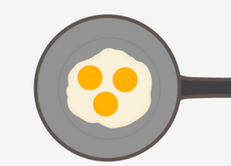
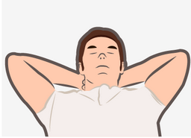
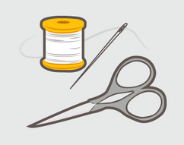
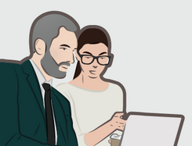
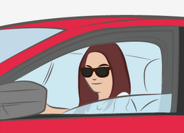
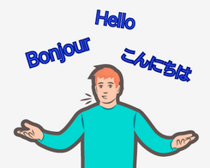
List 3 life skills that you think is important and say why

Slide 32
WRAP-UP

Slide 33
Today’s lesson
Listening:
- Listening for specific information.
Reading:
- Reading for specific information.

Slide 34
Homework
Review vocabulary from units 6-8.
Do the exercises: Review 3 (page 68 – WB).
Prepare: Review 3 – Grammar, Pronunciation, Speaking & Writing (page 89 – SB).
Play the consolidation games on www.eduhome.com.vn

Slide 35
Lesson 3
Stay positive and have a nice day!

