Slide 1

Unit 10: Cities of the Future
Lesson 3.2: Speaking & Writing
Page: 109

Slide 2
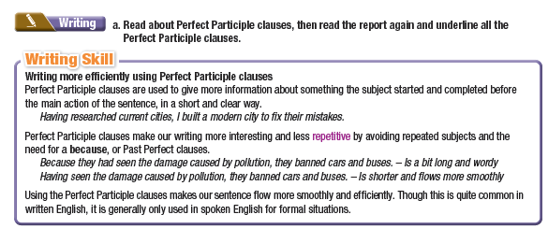
Lesson Outline
Warm-up
Speaking
Writing
Consolidation
Wrap-up

Slide 3

By the end of this lesson,
students will be able to:
- practice writing more efficiently using Perfect Participle clauses
- write a report about a "city of the future"
- talk about problems of cities and things that could improve them

Slide 4



Slide 5
Before and After
Put the phrases/sentences into correct order Aspect-Before-After on city improvements:
Aspect | Before | After
Housing
Aspect: Transportation/Housing/Environmental Sustainability
Before & After: - People saw how congested many cities are.
- People used 3D printers to build affordable apartments.
- People heard about the high house prices in many cities.
- People put solar panels on the sides of every building.
- People introduced new subways and self-driving taxis.
- People understood the environmental effects of fossil fuels.
Notes:
Option 2

Slide 6
Before and After city improvements
Another way to say it!
Having heard about the high house prices in many cities, people used 3D printers to build affordable apartments.
People heard about the high house prices in many cities.
People used 3D printers to build affordable apartments.
Aspect | Before | After
Housing | People heard about the high house prices in many cities. | People used 3D printers to build affordable apartments.
Transportation | People saw how congested many cities are. | People introduced new subways and self-driving taxis.
Environmental Sustainability | People understood the environmental effects of fossil fuels. | People put solar panels on the sides of every building.

Slide 7

Writing

Slide 8
Read about Perfect Participle clauses, then read the report again and underline all the Perfect Participle clauses.
Having spent a long time researching current cities, ...
Having heard about the high house prices in many cities, ...
Having seen how congested many cities are, ...
Having understood the environmental effects of fossil fuels, ...

Slide 9

Writing more efficiently using
Perfect Participle clauses
Aspect | Use | Result
Writing Efficiency | Using Perfect Participle clauses (Having PP) | More concise and interesting writing, avoiding repetition
Grammar | Using Perfect Participle clauses | Avoiding the need for "because" or Past Perfect clauses
 |  | Smooth and efficient sentence flow
Writing Style | Using Perfect Participle clauses | Smooth and efficient sentence flow
Formality | Using Perfect Participle clauses | Commonly used in written English, and in formal spoken situations.

Slide 10
Perfect Participle Clauses vs. Perfect Gerunds
Aspect | Perfect Participle Clauses | Perfect Gerunds
Function | adjectives | noun phrases
Form | HAVING V3/ed (PP)
Position | at the beginning of the sentence | in the middle or at the end of the main clause (after a verb)
Example | Having researched current cities, I built a modern city to fix their mistakes. | He denied having stolen from his company.

Slide 11
Rewrite the sentences using Perfect Participle clauses.
Because I had researched a lot about plastic pollution, I banned single-use plastic.
2. Because she had read lots about crime before, she had some useful ideas.
3. Because the major had learned about energy sources, the major knew exactly what to do.
Having researched a lot about plastic pollution, I banned single-use plastic.
Having read lots about crime before, she had some useful ideas.
Having learned about energy sources, the major knew exactly what to do.

Slide 12
Rewrite the sentences using Perfect Participle clauses.
4. As Joey had heard of robot cleaners, Joey bought several of them for his home.
5. Because Ultratown researched how dangerous they were, Ultratown stopped people driving cars in the city.
Having heard of robot cleaners, Joey bought several of them for his home.
☞ Having researched how dangerous they were, Ultratown stopped people driving cars in the city.

Slide 13

Speaking

Slide 14


Speaking
Work in pairs
Discuss common problems in cities and potential solutions to these problems.
Complete the table below.
PROBLEMS | SOLUTIONS
What do you think are
problems in current cities?
I think congestion is a
big problem.
How could it be
improved?
I think having more public
transportation would help.

Slide 15

Speaking
Work in pairs
Discuss common problems in cities and potential solutions to these problems.
Complete the table below. (suggested ideas)
PROBLEMS | SOLUTIONS
Traffic congestion | Better public transportation systems
Air pollution | Renewable energy sources, electric cars
Overcrowding | Building more affordable housing
High cost of living | Offering more job opportunities, affordable services
Crime | Better community policing, more security cameras

Slide 16

Production:
Writing

Slide 17
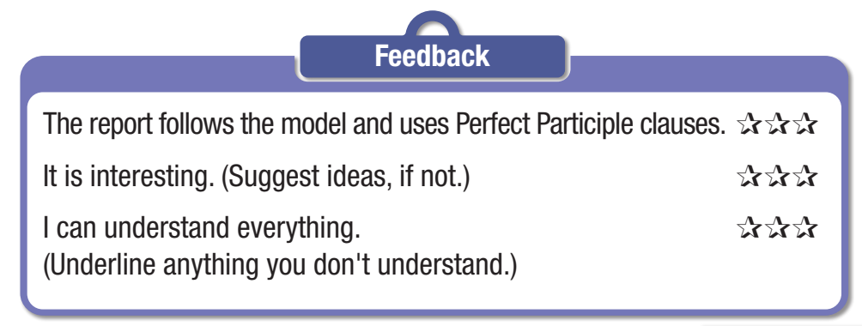
Writing
Now, think about three particular problems of big cities. Design a city which can solve these problems. Write a report of your designed city. Use the Writing Skill box, the
reading model, and your speaking notes to help you. Write 150–180 words.

Slide 18
Suggested writing
Ultratown
The city I created is called Ultratown. It uses some amazing technology and is really eco-friendly. Having researched a lot about current cities, I made a great city.
The first thing that makes Ultratown so good is that it is very high-tech and safe. Having seen the problems with crime in other cities, I introduced robot police officers in my city. Everyone will feel much safer in Ultratown.

Slide 19
Suggested writing
The next great thing is that it uses the best energy sources. Having learned about pollution, I had Ultratown use only solar and hydroelectric power. These energy sources are good for the environment and they will save the city's money. I think solar panels look cool, too.
Another great thing is how safe it is. Having learned from other cities, I banned cars and buses. They cause lots of traffic accidents. Everyone will ride bicycles in Ultratown. It will be safer to walk on the streets and the air will be cleaner, too.
I think Ultratown will be a great place for everyone!

Slide 20
How to write a clear and effective report?
Focus on:
• report structure
• main idea and focus
• sentence fluency
• word choice
• spelling and punctuation

Slide 21

CONSOLIDATION

Slide 22
Work in pairs
Rewrite the sentences using Perfect Participle clauses
1. Because they had seen the damage caused by pollution, they banned cars and buses.
2. After I had seen the problems with crime in other cities, I introduced robot police officers in my city.
3. I have built many parks and forests throughout the city after I had noticed that most cities have very few green spaces.

Slide 23
Rewrite the sentences using Perfect Participle clauses
Key
Having seen the damage caused by pollution, they banned cars and buses.
Having seen the problems with crime in other cities, I introduced robot police officers in my city.
Having noticed that most cities have very few green spaces, I have built many parks and forests throughout the city.

Slide 24

WRAP-UP

Slide 25
Today’s lesson
Writing:
Write a report about a city of the future
Writing Skill: Writing more efficiently using Perfect Participle clauses
Speaking:
- Discuss common problems in cities and potential solutions
to these problems.

Slide 26


Slide 27
- Finish the writing part.
- Do the exercises in WB: Writing (page 61).
Play the consolidation games in Tiếng Anh 11 i-Learn Smart World DHA App on www.eduhome.com.vn
- Prepare: Unit 10 – Review – page 110.

Slide 28

Lesson 3
Stay positive and have a nice day!

