Slide 1
Review 4.1: Listening, Reading & Vocab
Pages: 120 & 121

Slide 2
Lesson Outline
Warm-up
Listening
Reading
Vocabulary
Wrap-up

Slide 3
By the end of this lesson, students will be able to…
- practice listening and reading for specific information.
- practice test-taking skills.
- consolidate and practice vocabulary presented in units 9-10.

Slide 4
WARM-UP

Slide 5
Competition Time: Two Truths, One Lie

Slide 6
HOW TO PLAY
- Divide the class into groups of 4-5.
- Each group prepares three statements about themselves. Two of these statements should be true, and one should be a lie.
- Choose one group to start. They will say their three statements out loud. The other groups discuss quickly and vote on which statement they think is the lie.
- Which groups guess correctly get one point.
- The procedure repeats with other groups. The group with the most points at the end of the game wins.

Slide 8
You will hear an interview with an expert on AI named Professor Sanders. For each question, choose the correct answer (A, B, or C).

Slide 9
Pre-listening
Test-taking skills for the PET Listening Part 4.
1. Quickly skim through the questions and answer choices to get what information you need to listen for.
2. Pay attention to keywords in the questions that might help you predict possible answers and focus on the relevant parts of the recording.
3. Listen for key information such as names, dates, numbers, and other specific details that might answer the questions.

Slide 10
Pre-listening
Test-taking skills for the PET Listening Part 4.
4. Listen for signal words or phrases that indicate important information such as ‘the main reason is …’, ‘firstly…secondly…’, or ‘for example…’
5. Use the context of what is being said to help understand unfamiliar words or phrases.
6. If you miss a piece of information, don’t panic. Keep listening because you might still catch the information later.

Slide 11
Pre-listening
Read and underline key words in the questions and answer choices.
1. Professor Sanders thinks that AI will _______.
worry people
create jobs
destroy jobs

Slide 12
Pre-listening
Read and underline key words in the questions and answer choices.
2. He says that AI _______.
need human operators.
can develop itself.
is a human-like robot.
3. How will AI help people soon?
make them think about data.
make decisions for them.
make their lives easier.

Slide 13
Pre-listening
Read and underline key words in the questions and answer choices.
4. For personal finance, many people _______.
have lots of bills.
aren’t good at saving.
could benefit from AI’s help.

Slide 14
Pre-listening
Read and underline key words in the questions and answer choices.
5. What does Professor Sanders think about flying cars?
We have the technology to make them.
They can do complex tasks.
We might have them in 15 years.

Slide 15
Pre-listening
Read and underline key words in the questions and answer choices.
6. He thinks that AI _______.
will make life better.
could make life better.
won’t make life better.

Slide 16
While-listening
Now, listen and choose the correct answer (A, B, or C).
1. Professor Sanders thinks that AI will _______.
worry people
create jobs
destroy jobs

Slide 17
while-listening
Now, listen and choose the correct answer (A, B, or C).
2. He says that AI _______.
need human operators.
can develop itself.
is a human-like robot.
3. How will AI help people soon?
make them think about data.
make decisions for them.
make their lives easier.

Slide 18
While-listening
Now, listen and choose the correct answer (A, B, or C).
4. For personal finance, many people _______.
have lots of bills.
aren’t good at saving.
could benefit from AI’s help.

Slide 19
While-listening
Now, listen and choose the correct answer (A, B, or C).
5. What does Professor Sanders think about flying cars?
We have the technology to make them.
They can do complex tasks.
We might have them in 15 years.

Slide 20
While-listening
Now, listen and choose the correct answer (A, B, or C).
6. He thinks that AI _______.
will make life better.
could make life better.
won’t make life better.

Slide 21
Script:
Interviewer: Professor Sanders, do you think AI is a good thing?
Prof. Sanders: I know some people are worried that AI will take over their jobs. However, AI will actually create more jobs than it'll destroy.
Interviewer: Really?
Prof. Sanders: Yes. Let's remember that AI needs humans to maintain and develop it. We won’t have human-like robots walking around the streets, doing our shopping for us, or looking after our children for some time.

Slide 22
Interviewer: So, what will AI do for people?
Prof. Sanders: In the short term, AI will make daily chores a lot easier in many different areas of our lives. It's also really useful when people need to use data to make good decisions.
Interviewer: Could you give us an example?
Prof. Sanders: Yes. Consider personal finance. Many people are too busy to keep track of monthly bills, or they find it boring, so they develop financial problems. This is where AI can really help organize and improve our lives.

Slide 23
Interviewer: Great. What about flying cars? Our listeners want to know about them.
Prof. Sanders: People always do. I'm sure we’ll have flying cars. However, we need much more advanced technology to deal with such a complex task. It's still a long time away. Perhaps in fifteen years.
Interviewer: So, do you think AI is a good thing?
Prof. Sanders: I think that AI could make life on Earth better. However, humans need to be careful not to let AI create more problems. If it isn't managed correctly, the world could become a difficult place to live.
Interviewer: Thank you, Professor Sanders.

Slide 24
Post-listening
In groups: discuss a question: do you think AI will make life easier or more complicated? Why?
Example:
I believe that AI will make life easier in many ways. AI can manage our schedules, answer questions, and even control smart home devices.

Slide 25
Share your ideas with the class.
………………………………….

Slide 27
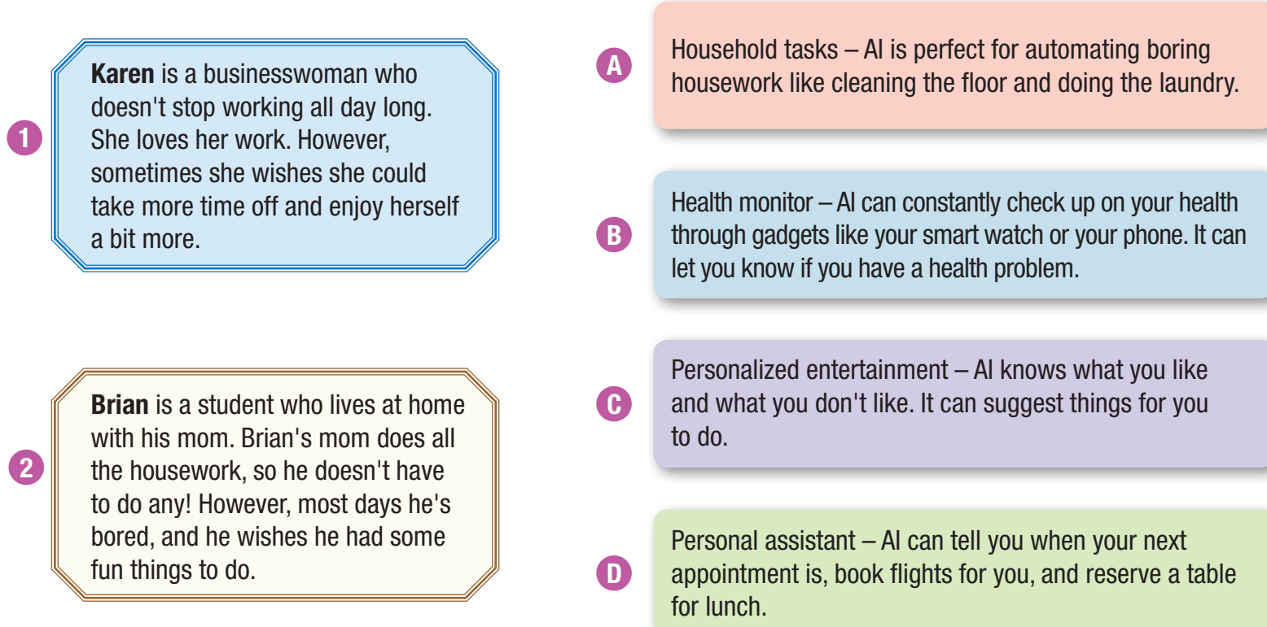
Karen and Brian would benefit from AI in different ways. Read the descriptions and decide which feature (A–D) each of them would like the most.
This is the format of the PET Part 2 Matching task.

Slide 28
Test-taking skills for the PET Part 2 Matching task.
1. Read the descriptions of the people first. Underline any key words or expressions like days, dates, etc.
2. Read the 4 texts and try to identify those that match the people. To begin with, you may find more than one that seems to match because a word appears in both texts.

Slide 29
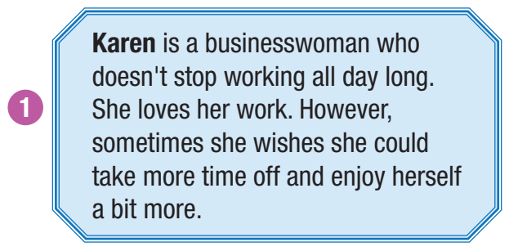
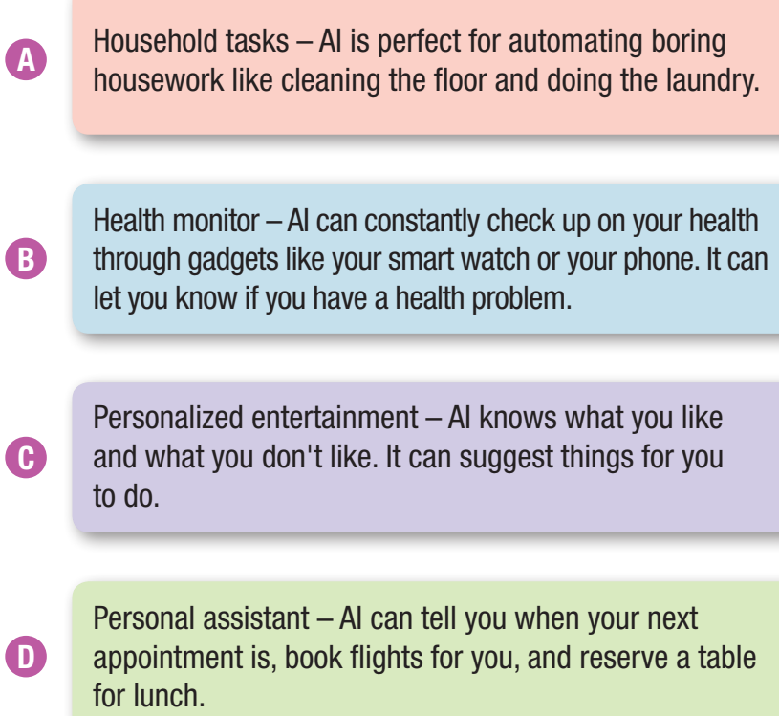
Now, Read number 1, underline key words, and match it with A-D.
She loves her work but wants to have more time to enjoy life. It means she needs entertainment or personal assistant to help her out.
→ The answer can be C or D.

Slide 30
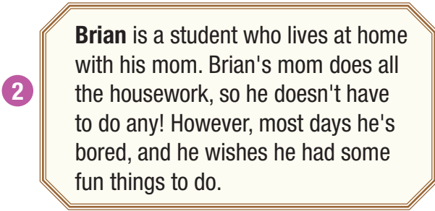
Now, Read number 2, underline key words, and match it with A-D.
The description mentions ‘housework’ and ‘he’s bored’
→ The answer can be A or C.

Slide 31
Test-taking skills for the PET Part 2 Matching task.
3. Read the texts again and focus on detail. Pay attention to any synonyms (words with a similar meaning) as this might indicate the option could be correct.
4. Look out for anything that indicates the answer is wrong such as days, prices, or any other issues that make the answer wrong.

Slide 32
Now, read number 2 again and eliminate the wrong answer.
The word ‘housework’ is one distractor that makes you choose the wrong answer because Brian doesn’t do any housework. So, he doesn’t need AI to do it for him. Eliminate text A.
→ The answer is C because he is bored and wants to do something fun, and AI can suggest things for him to do.

Slide 33
Now, read number 1 again and eliminate the wrong answer.
→ The answer is D because she needs a personal assistant AI to help her work and has more free time to enjoy herself.

Slide 35
a. Fill in each blank with a word from Units 9 and 10. The first letter is already there.
1. AI can sound very friendly and polite, so it will do customer service jobs. However, it won't do counseling work because it doesn't have human e_____________________.
2. Due to o_____________________, the fish population in the sea has gone down sharply in recent years.

Slide 36
3. They should give more i_____________________ to businesses for being environmentally friendly.
4. Some people are worried that AI will r_____________________ human workers in most jobs.
5. Humans sometimes make bad decisions in very stressful situations. AI will be good for high-pressure jobs because it always makes l_____________________ decisions.

Slide 37
Identify the part of speech (noun, verb, adj, adv, etc.) of the missing words in the sentences.
1. AI can sound very friendly and polite, so it will do customer service jobs. However, it won't do counseling work because it doesn't have human e_____________________.
2. Due to o_____________________, the fish population in the sea has gone down sharply in recent years.
noun
noun/gerunds

Slide 38
3. They should give more i_____________________ to businesses for being environmentally friendly.
4. Some people are worried that AI will r_____________________ human workers in most jobs.
5. Humans sometimes make bad decisions in very stressful situations. AI will be good for high-pressure jobs because it always makes l_____________________ decisions.
noun
verb
adj
→ Now, review vocabulary in units 9-10 in the word list.

Slide 39
a. Fill in each blank with a word from Units 9 and 10.
1. AI can sound very friendly and polite, so it will do customer service jobs. However, it won't do counseling work because it doesn't have human _____________________.
2. Due to _____________________, the fish population in the sea has gone down sharply in recent years.
emotions
overfishing

Slide 40
3. They should give more _____________________ to businesses for being environmentally friendly.
4. Some people are worried that AI will _____________________ human workers in most jobs.
5. Humans sometimes make bad decisions in very stressful situations. AI will be good for high-pressure jobs because it always makes _____________________ decisions.
incentives
replace
logical

Slide 41
b. Fill in the blanks with the words from the box. There is one extra word which you do not need to use.

Slide 42
Identify the part of speech (noun, verb, adj, adv, etc.) of the given words in the box.
tedious basic sensitive complicated artificial obsolete
adj
adj
adj
adj
adj
adj
→ The part of speech of the words in the box is an adjective. It means you have to consider the meaning that each blank needs.

Slide 43
Now underline key words in the sentences and fill in the blanks.
1. I think I need to change my job because it is so ________________. I do the same task all day, every day. 2. Many products contain ________________ coloring and flavoring. These are unnatural and could be unhealthy.
3. A counselor needs to be ________________ when listening to people's personal problems.
tedious
artificial
sensitive

Slide 44
Now underline key words in the sentences and fill in the blanks.
4. Computers are becoming more and more ________________ as technology advances.
5. When new technologies start being used, some jobs become ________________ and only machines do them.
complicated
obsolete

Slide 45
WRAP-UP

Slide 46
Today’s lesson
Listening & Reading
- practice listening and reading for specific information.
- practice test-taking skills.
Vocabulary:
- consolidate and practice vocabulary presented in units 9-10.

Slide 47
Homework
Review and use vocabulary to make sentences.
Do the exercises on page 70 WB.
Play the consolidation games on www.eduhome.com.vn.

Slide 48
Lesson 3
Stay positive and have a nice day!

