Slide 1
Unit 10: Cities of the Future
Lesson 1.1: Vocab & Listening
Pages: 100 & 101

Slide 2
Lesson Outline
Warm-up
Vocabulary
Listening
Consolidation
Wrap-up

Slide 3
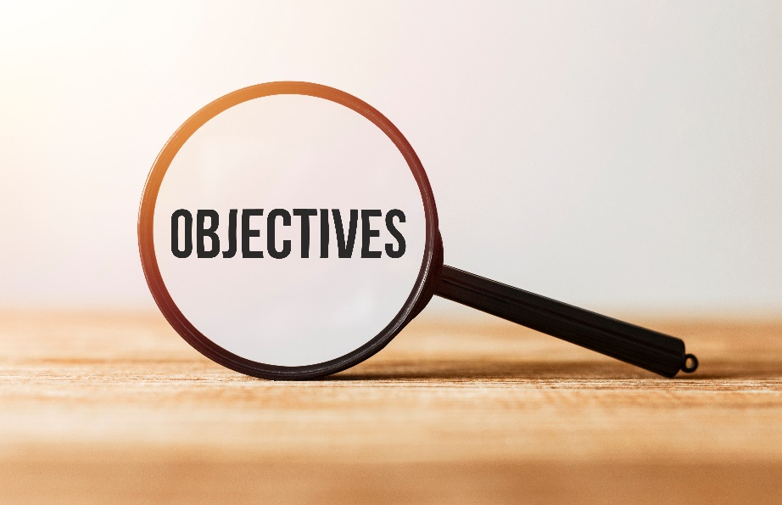
By the end of this lesson,
students will be able to:
- practice and learn vocabulary related to cities of the future
- practice listening for specific information
- practice functional English (Reaching agreement)

Slide 4
New words
fare
commuter
congestion
downtown
speed limit
efficient
self-driving

Slide 5
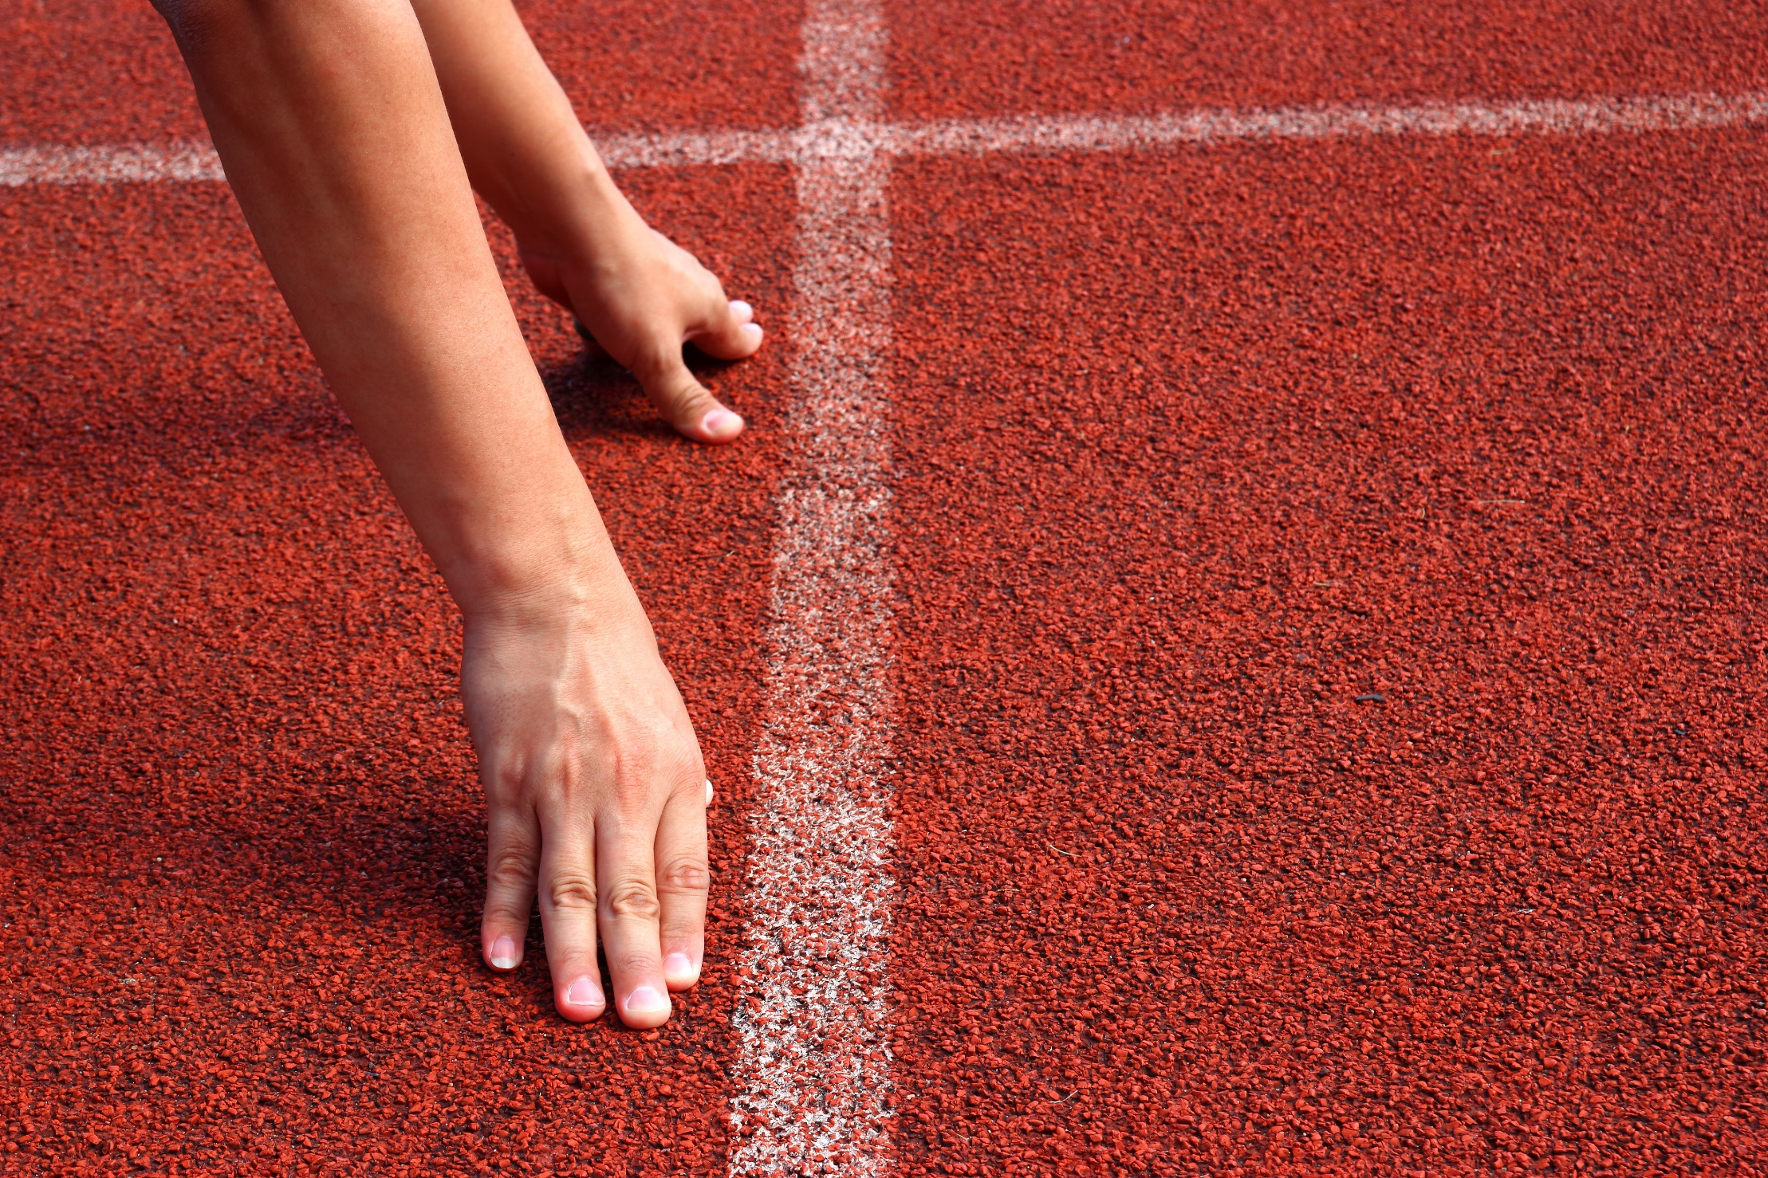

Slide 6
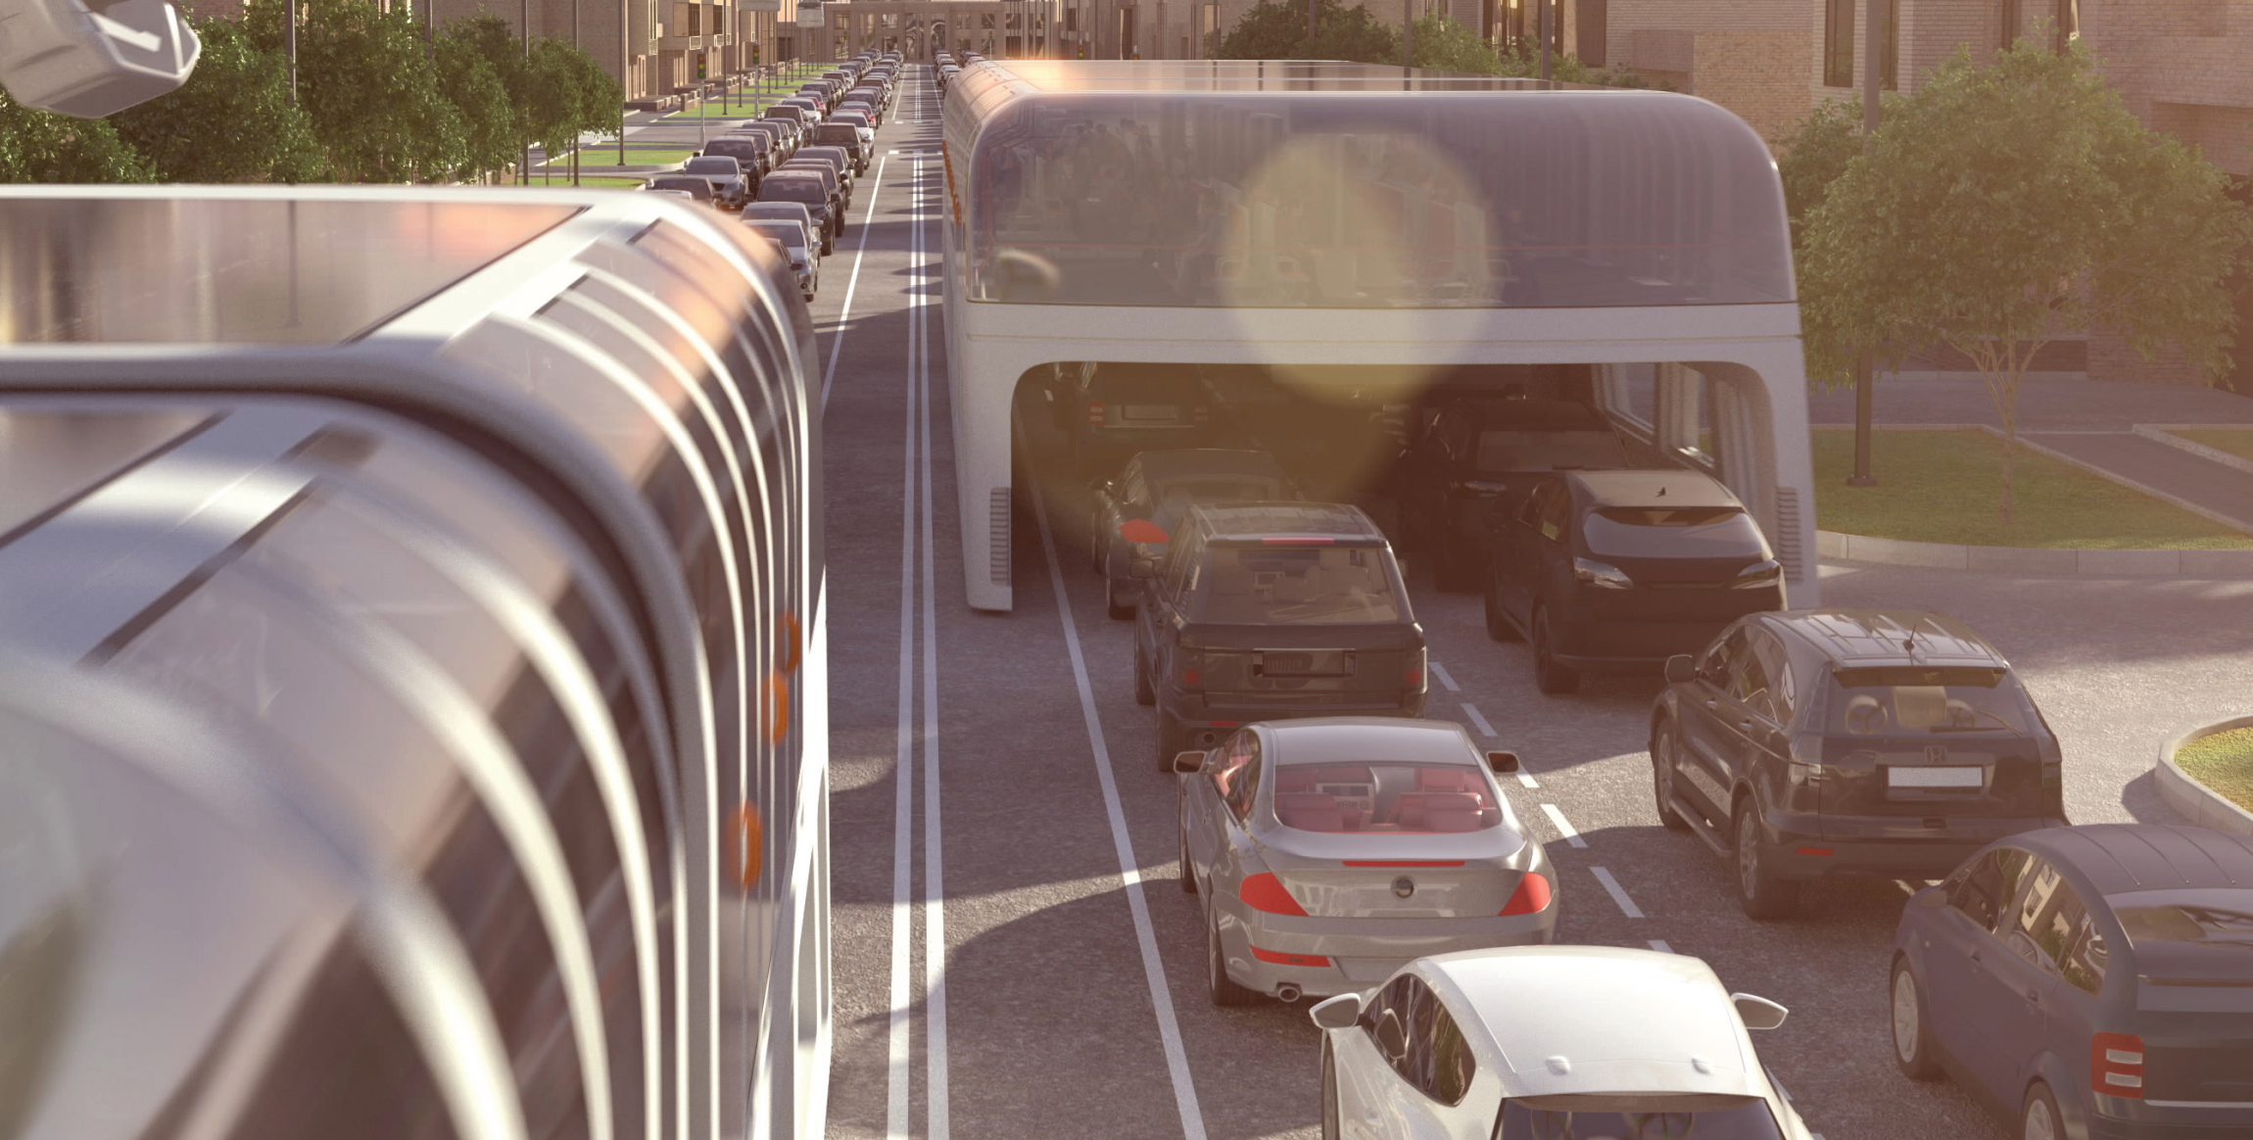
Option 1
In pairs. Look at the picture. Discuss the questions.
What's the problem in the picture? Do you use public transportation? Why (not)?

Slide 7
Watch a video and answer the questions.
Option 2
Is life in 2050 significantly different from life today?
What will life be like in 2050?

Slide 8
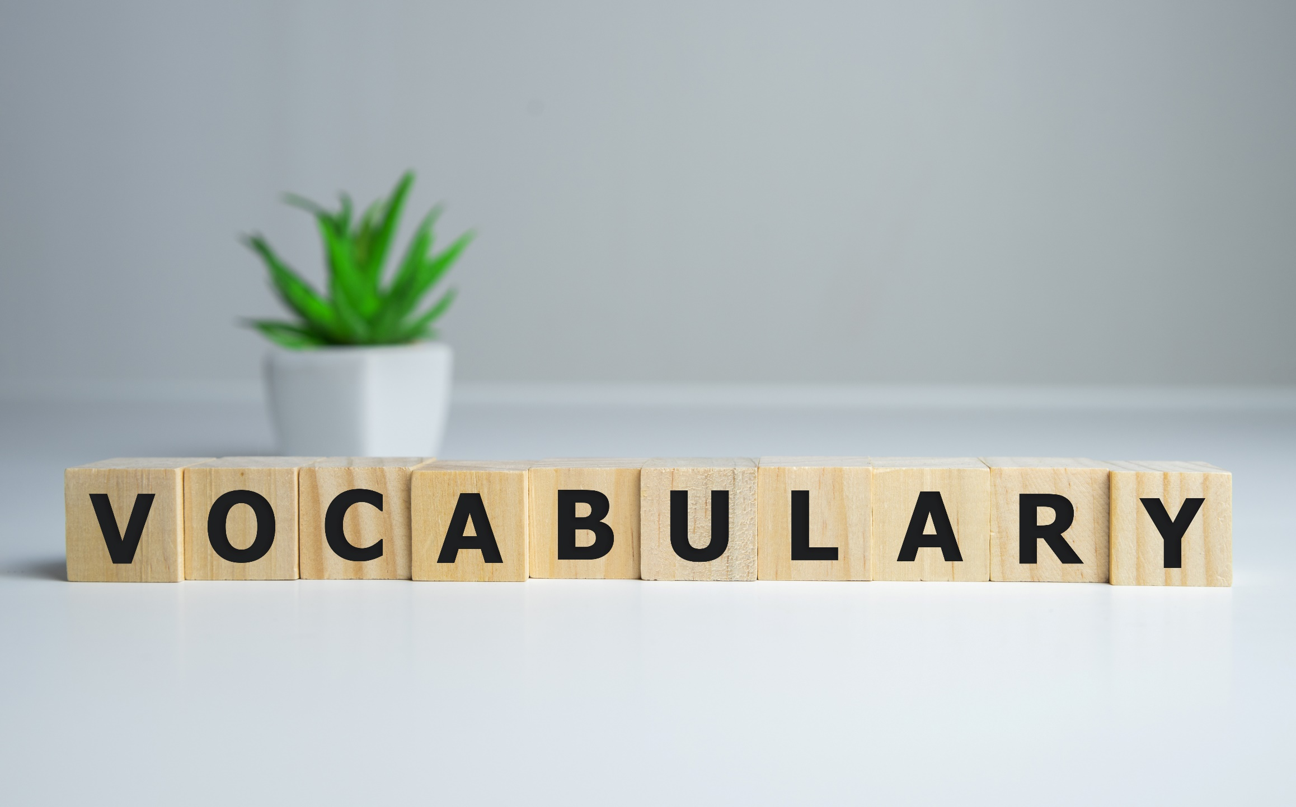

Slide 9
Listen and repeat. Click each phrase to hear the sound.
fare (n) /fer/ tiền vé (đi xe, tàu…)
commuter(n) /kəˈmjuːtər/ người đi làm thường xuyên di chuyển từ nhà đến chỗ làm
congestion (n) /kənˈdʒestʃən/ sự ùn tắc giao thông
downtown (adv) /ˈdaʊntaʊn/ ở khu trung tâm thành phố
speed limit (np) /spiːd ˈlɪmɪt/ giới hạn tốc độ
efficient (a) /ɪˈfɪʃənt/ hiệu quả
self – driving (a) /ˌself ˈdraɪvɪŋ/ chỉ phương tiện tự lái
Notes:
GV click vào từng cụm nghe âm thanh

Slide 10
Find the words from the passage that match the definitions below. Listen and repeat.
1. ________: in or towards the main business area of a city 2. ________: people on their way to work 3. ________: traffic jams 4. ________: done in a way that doesn't waste time,
energy, or money
downtown
commuters
congestion
efficient
Many people live on the outskirts but work in the city center. They travel downtown to their offices. These commuters often have to spend a lot of time in traffic because of congestion. If their vehicles aren't efficient in fuel use, they’ll waste a lot of fuel and money, too. The city should really improve its public transportation system. It should increase the number of buses and reduce the fare. It's still a bit expensive to travel by bus.

Slide 11
Find the words from the passage that match the definitions below. Listen and repeat.
5. ________: the money you pay to travel by bus, plane, or taxi 6. ________: driven by a computer instead of a person 7. ________: a rule about how fast vehicles can travel
fare
self-driving
speed limit
(continued) The city should really improve its public transportation system. It should increase the number of buses and reduce the fare. It's still a bit expensive to travel by bus.
In the future, self-driving cars will make driving safer because they won’t go over the speed limit. However, the traffic might become even worse. Driving will become safer and more pleasant, but there will be more cars on the street.

Slide 12
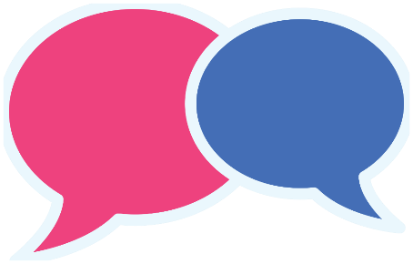
In pairs: Talk about the public transportation where you live, or in a place you know.

Slide 13
Listening

Slide 14
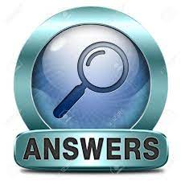
While-listening
Read the instruction quickly. Underline the key words. Focus on the overall context and the speakers' viewpoints and tones.
Pay attention to the first exchanges and conclusion.
What are we going to do?
Listen to city planners talking about a new form of public transportation. Do they all think it will have more advantages or disadvantages?
advantages
Evidence:
So, let's discuss these new flying buses.
Flying buses can avoid traffic jams downtown, so they travel much faster.
They're definitely faster than our old buses, and they're much safer, too.
If we increase tourism, it'll benefit everyone.
Fantastic, that's it, so we all agree.

Slide 15
Now, listen and match. Click on the numbers under the table to listen.
probably | faster than the old buses
2. probably won't | b) increase the number of visitors
3. definitely | c) be very expensive
4. possibly | d) use the new buses
John: First of all, they’ll probably cost a lot of money.
John: They probably won't use the flying buses, either.
Susan: They're definitely faster than our old buses…
Susan: I think they could possibly encourage more people to visit our city, too.

Slide 16
Post - listening
Read the Conversation Skill box. Then, listen and repeat.

Slide 17
d. Now, listen again and circle the phrases you hear.
Do you agree? Does everyone agree? Fantastic, that's it, so we all agree.

Slide 18
Post - listening
Work in pairs.
Would this type of transportation improve
your town or city? Why (not)?
Suggested answer:
- Yes, the new flying buses could improve the town or city. They are faster and safer than the old buses, and they can avoid traffic jams downtown.
- No, they are likely to cost a lot of money, which could burden taxpayers. Furthermore, people don't use the current buses in the city, and it's possible that they won't use the flying buses either.

Slide 19
Susan: Good morning, John, Michael. So, let's discuss these new flying buses. Should we use them in our city? John, what do you think?
John: Well, Susan, I don't like them. First of all, they'll probably cost a lot of money.
Susan: OK John. Anything else?
John: Yeah. Our city already has buses, but people don't use them! They probably won't use the flying buses, either.
Susan: I see. Maybe you're right. Michael, what do you think?
Michael: I don't agree with John. Lots of people have said that they don't use our buses because of traffic congestion. They just move too slowly. Flying buses can avoid traffic jams downtown, so they travel much faster.
Susan: Yes, that's right Michael. They're definitely faster than our old buses, and they're much safer, too.
John: I see. That sounds good, but I'm still worried about the cost.
Susan: Michael, you look like you want to say something.
Michael: Yes, Susan. Actually, it's about the cost. If the fare isn't too expensive, I think lots of commuters will want to fly every day. I think our city will collect a lot of money from this.
Susan: That's right. I think they could possibly encourage more people to visit our city, too. If we increase
tourism, it'll benefit everyone. So, John, do you agree?
John: Hmm. Yes, I see your point. OK, then.
Susan: Fantastic, that's it, so we all agree.

Slide 20
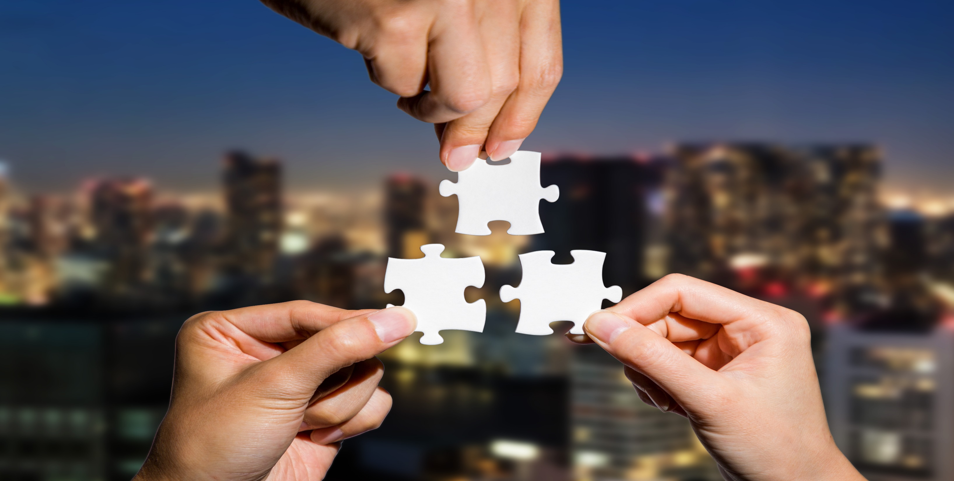
Consolidation

Slide 21
Fill in the blanks with the words given:
speed limit self-driving commuters
1. I think that in the future, all city buses will probably be _____. 2. They will be controlled by computers so that they don't break the _____. 3. _____ definitely won't be driving gasoline-driven cars in the future.
Answer:
1. self-driving 2. speed limit 3. Commuters

Slide 22
WRAP-UP

Slide 23
Today’s lesson
New words
fare
commuter
congestion
downtown
speed limit
efficient
self-driving

Slide 24
Today’s lesson
Vocabulary:
- practice and learn vocabulary related to cities of the future
- practice functional English (Reaching an agreement)
Listening:
- practice listening for specific information.

Slide 26
- Learn the new words.
- Practice talking about future cities.
- Do the exercises in WB: Vocabulary and Listening (page 56).
Play the consolidation games in Tiếng Anh 11 i-Learn Smart World DHA App on www.eduhome.com.vn
- Prepare: Lesson 1.2 – Grammar (pages 101 & 102 – SB).

Slide 27
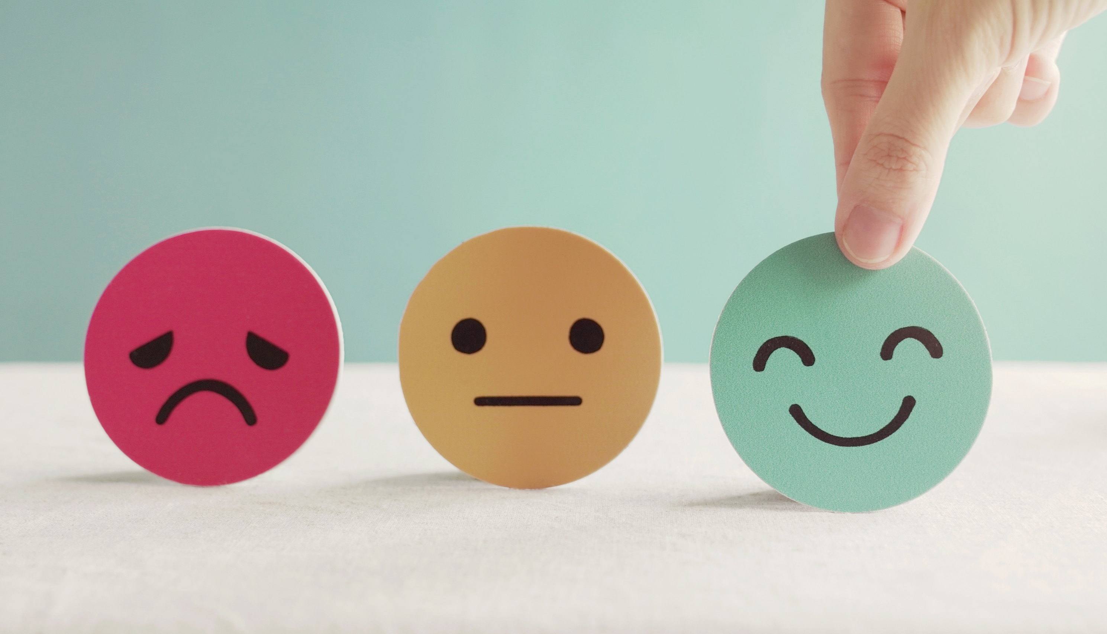
Lesson 3
Stay positive and have a nice day!

