Slide 1
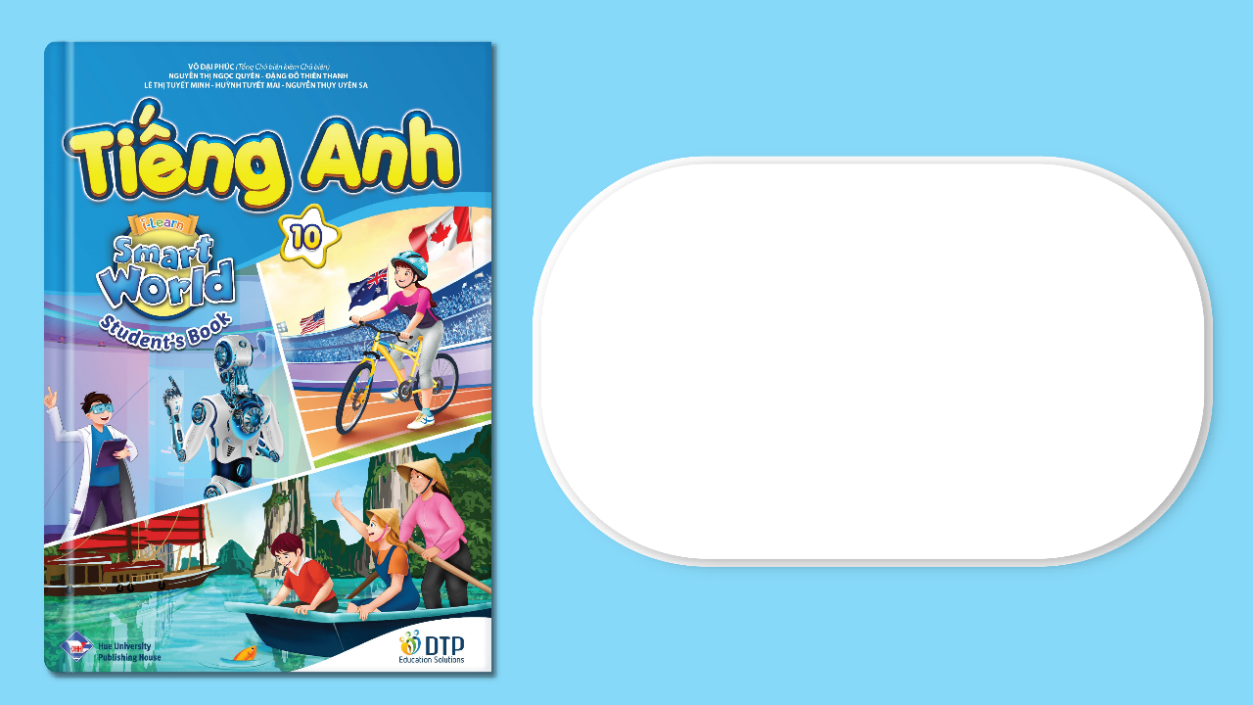
UNIT 9: TRAVEL AND TOURISM
Lesson 1.1 – Vocabulary & Reading
Page 74

Slide 2
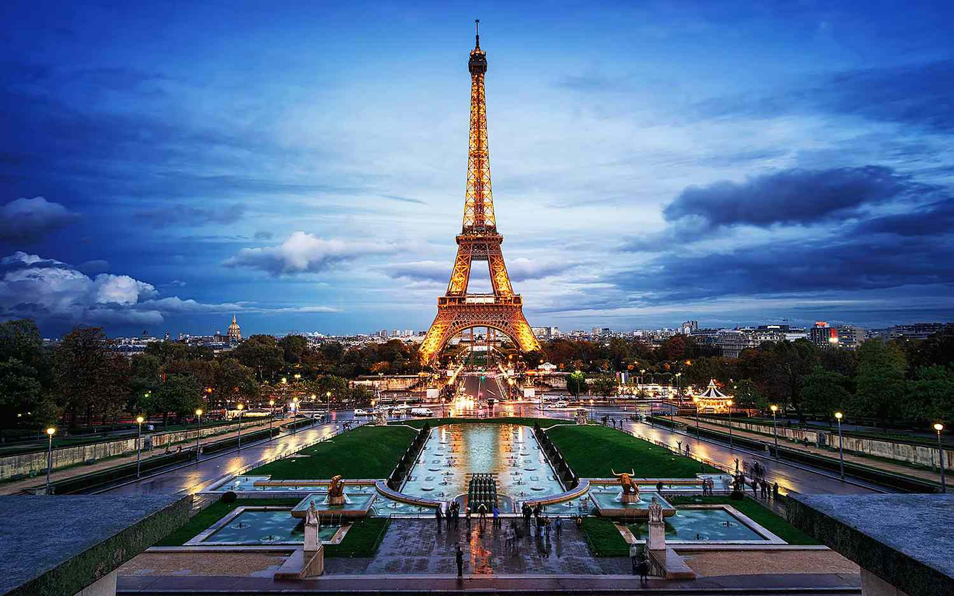

Slide 3
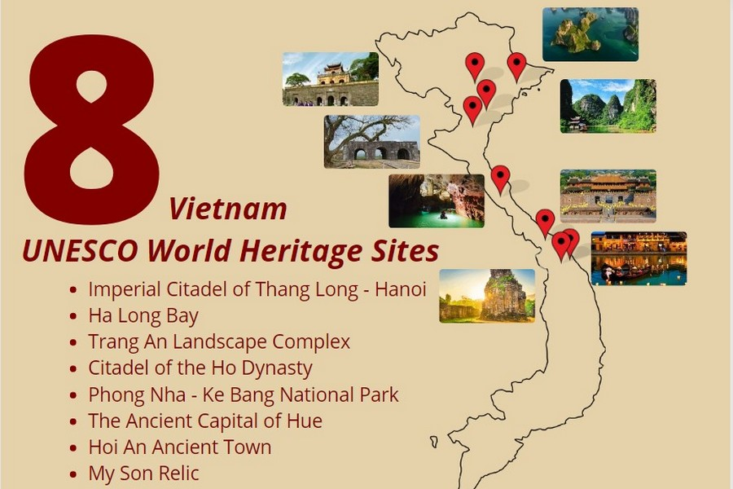

Slide 4
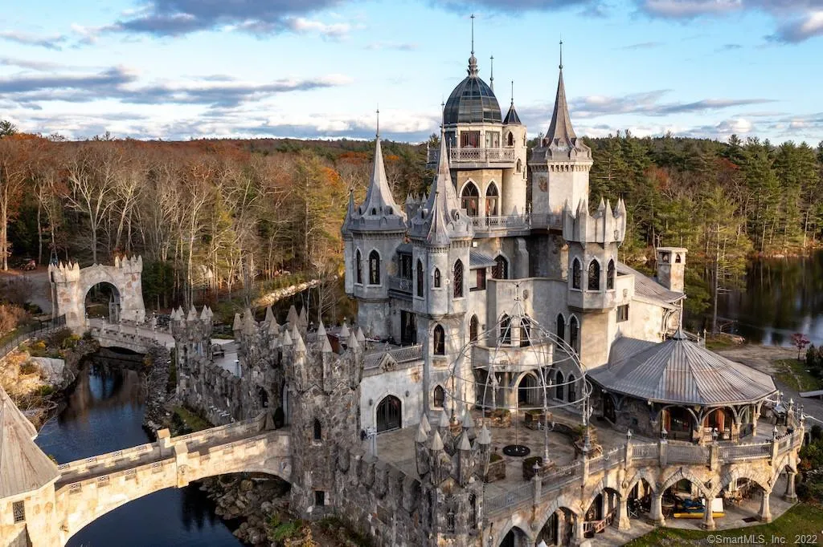

Slide 5


Match the words with the descriptions. Listen and repeat.
1. sightseeing
2. tower
3. view
4. World Heritage site
5. castle
6. national park
a. a place that is said to be very important by UNESCO
b. visiting interesting places, especially by people on vacation
c. a natural area that is protected by the government
d. a tall narrow building that can be part of another building or stand by itself
e. what you can see from a place
f. a large, strong building that is often built to protect people
Notes:
Please, click on each phrase to hear the sound

Slide 6
Listen and repeat.
1. sightseeing (n) /ˈsaɪtsiːɪŋ/ việc tham quan
2. tower (n) /ˈtaʊər/ tòa tháp
3. view (n) /vjuː/ tầm nhìn, quang cảnh
4. World Heritage site (n)
/ˌwɜːrld ˈherɪtɪdʒ saɪt/ di sản thế giới
5. castle (n) /ˈkæsl/ lâu đài
6. national park ( n) /ˈnæʃənl pɑːrk/ vườn quốc gia
Notes:
Please, click on each phrase to hear the sound

Slide 7
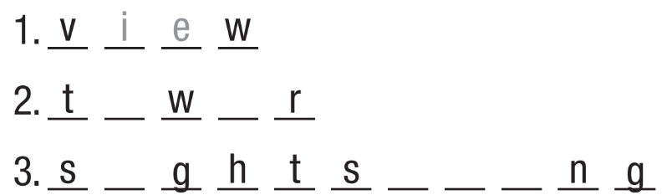
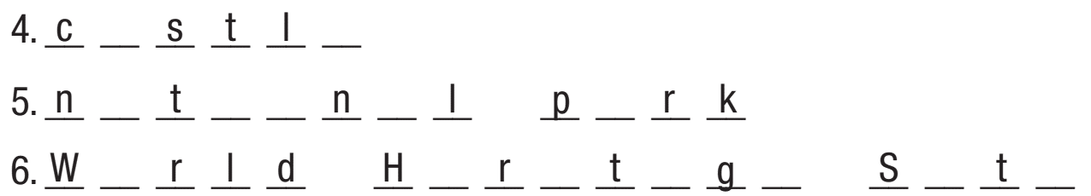
More Practice
WB, P. 50
o
e
i
e
e
i
a
e
a
i
o
a
a
o
e
i
a
e
i
e
Notes:
Taken from TA 10 i-Learn Smart World WB, page 44, New Words, activity a

Slide 8
More Practice
WB, P. 50
b. Fill in the blanks using the following words
view, tower, sightseeing, castle, national park, World Heritage site
Many people enjoy going ___________ when they go on vacation.
UNESCO says which place can be a __________________ . The Palace of Versailles and the Eiffel Tower are famous examples of them in France.
Nelson Lakes______________ is a popular place to visit in New Zealand. You can go hiking and camping there.
sightseeing
World Heritage site
National Park
Notes:
Taken from TA 10 i-Learn Smart World WB, page 44, New Words, activity b

Slide 9
More Practice
WB, P. 50
b. Fill in the blanks using the following words
view, tower, sightseeing, castle, national park, World Heritage site
4. If you go to the top of the Tokyo Sky Tree, you can enjoy a great ______ of the city.
5. The Sears ______ in Chicago used to be the highest building in the world.
6. Framlingham ______ was built in the 12th century and has high walls and 13 towers.
view
Tower
Castle
Notes:
Taken from TA 10 i-Learn Smart World WB, page 44, New Words, activity b

Slide 10

b. In pairs: Use the new words to talk about places in your country.?
Example:
I really enjoy sightseeing
I visited a beautiful national park

Slide 11



Slide 12
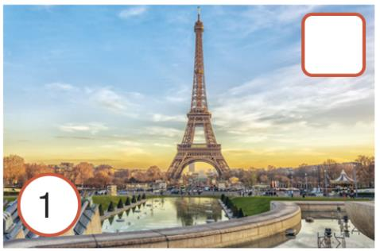
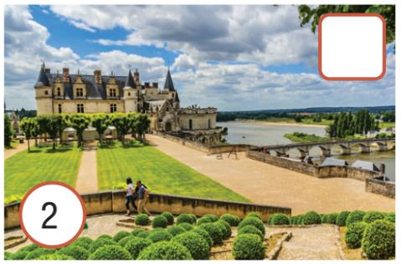
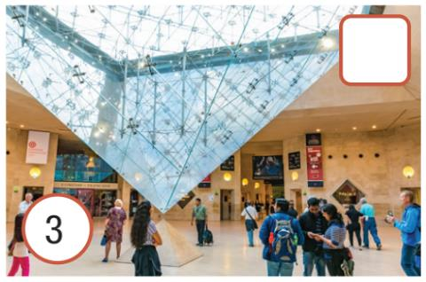
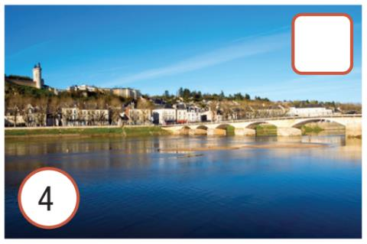
Pre - Reading
Run through each picture.
What can you see in each picture?

Slide 13
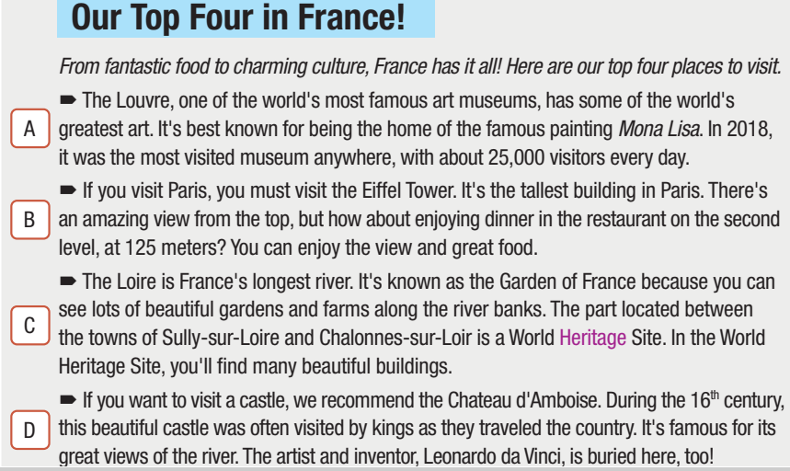
While - Reading
a. Read the article about visiting France. Match the paragraphs with the pictures.

Slide 14
While - Reading
D
B
a. Read the article about visiting France. Match the paragraphs with the pictures.
A
C

Slide 15
While - Reading
a. Read the article about visiting France. Match the paragraphs with the pictures
3
1
4
2

Slide 16
While-Reading
b. Now read and answer the questions.
1. When was the Louvre the world's most popular museum?
2. What can you do on the second level of the Eiffel Tower?
3. What can you see between the towns of Sully-sur Loire and Chalonnes-sur-Loire?
4. For what reasons is Chateau d'Amboise famous?
in 2018
enjoy the view, eat dinner
many beautiful buildings
great views of the river, Leonardo da Vinci is buried here

Slide 17
While - Reading
b. Now read and answer the questions.
1
2
3
4

Slide 18

Post-Listening
e. In pairs:
Would you like to visit France?
Which of the places in the article would you like to visit most?
Why?

Slide 19

Consolidation

Slide 20
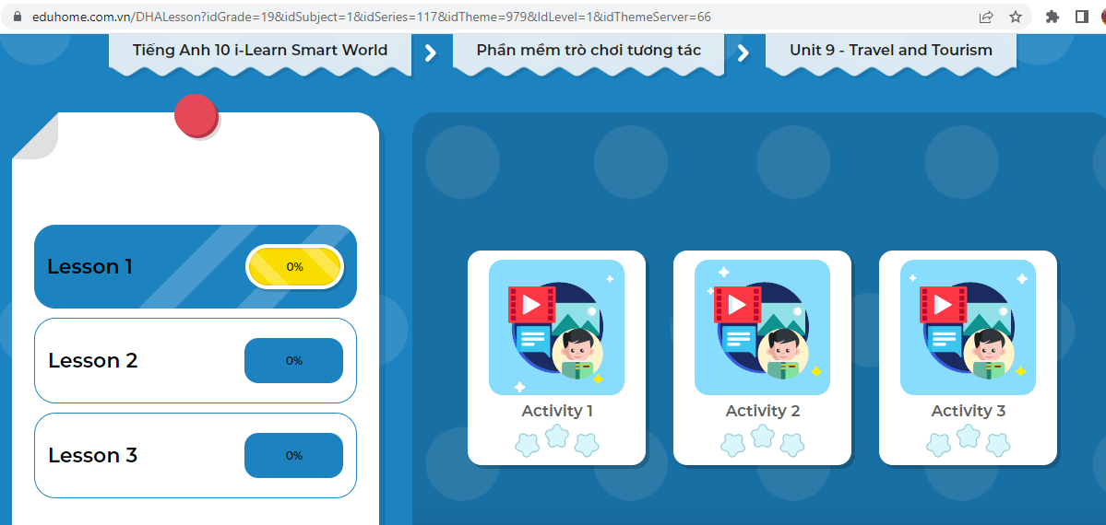
LET’S PLAY!
Click here to play the game!

Slide 21
Wrap-up
Today’s lesson
Vocabulary: sightseeing, tower, view, World Heritage Site, castle, national park
Reading: Read for main ideas and specific information about Vacation.

Slide 22
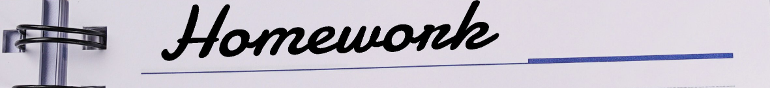
Write a paragraph to describe a place of interest in your local area.
Do the exercises in workbook on page 50.
Practice vocabulary in the Tiếng Anh 10 i-Learn Smart World Notebook page 50.
Prepare the next lesson: Lesson 1.2 – Grammar (page 75).

