Slide 1


Slide 2


MY HOBBY
THE POSITIVES AND NEGATIVES OF A HOBBY

Slide 3
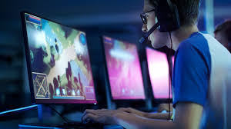
Gaming hobby
What is a hobby?
How important a hobby is?
reviews about our group hobby.
Description of our hobby
The reason why we chose this hobby.
Personal growth by hobby.
Physical or mental health benefits.
Social impact.
Personal bad effects
Detrimental effect to society.

Slide 4

Introduction
WHAT IS A HOBBY?
A hobby is an activity that we do regularly in our breaking time for pleasure. It helps us to wander our minds, learn new skills, and explore our interests.
CONTINUE

Slide 5
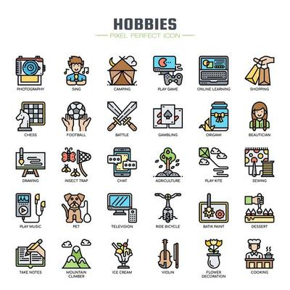
Introduction
HOW IMPORTANT A HOBBY IS?
Hobbies provide a break from daily routines, reduce stress if using on the right purpose, improve creativity and knowledge about new history and language. Moreover, it could make we be more confident and create more challenges to make our life be more delightful.
CONTINUE

Slide 6
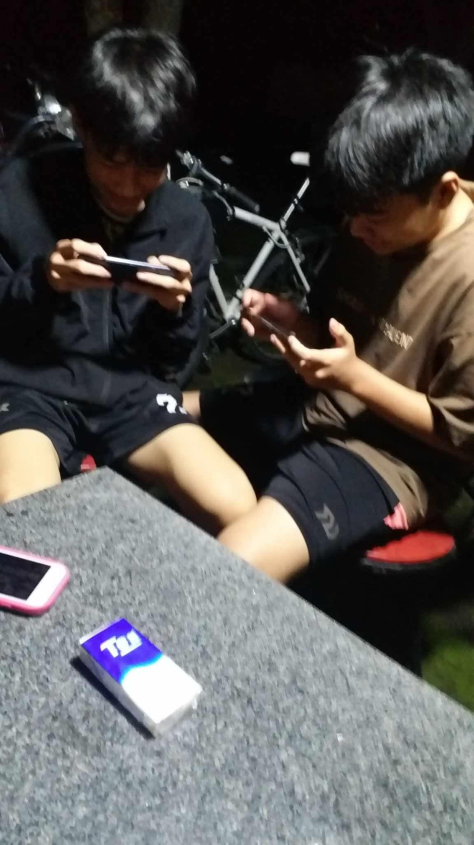
Our hobby
Our group has several types of hobby options for choice but we decided to choose gaming hobby. A hobby that spread rapidly around the world these days as a disease. Moreover, gaming can be seen as an industry.

Slide 7
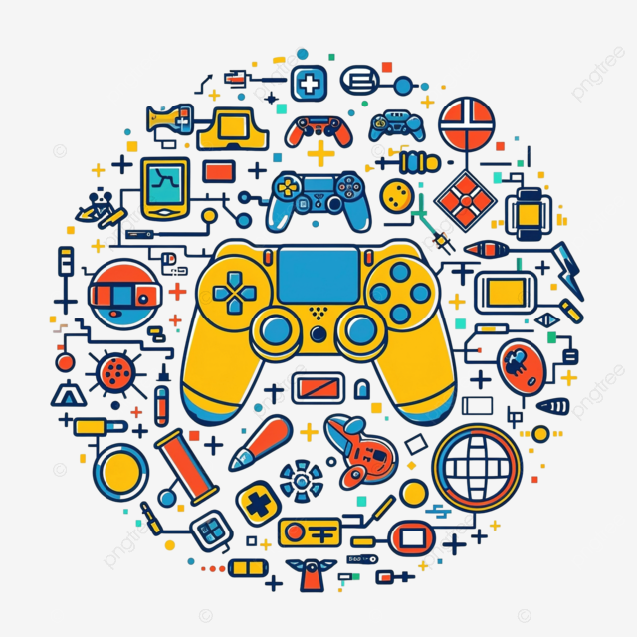

Decription of my hobby
Hobbies involved gaming exploring different genres, authors and topics.
We always play games as a habit together after school time and that sparked a hobby.
We try a lot of game categories such as: adventure, sports, fighting, tactics,.... on school or at a member house.

Slide 8
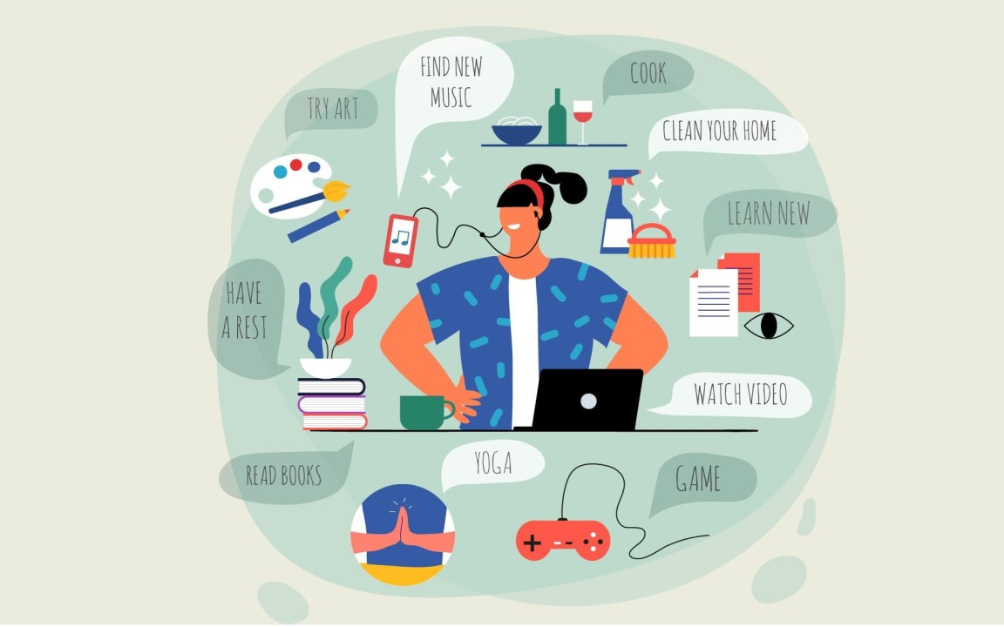
The reason why our group chose this hobby.
hobbies of gaming in particular and all hobbies in general are necessary for anyone to have a hobby because it have many benefits for us in especially in these days

Slide 9
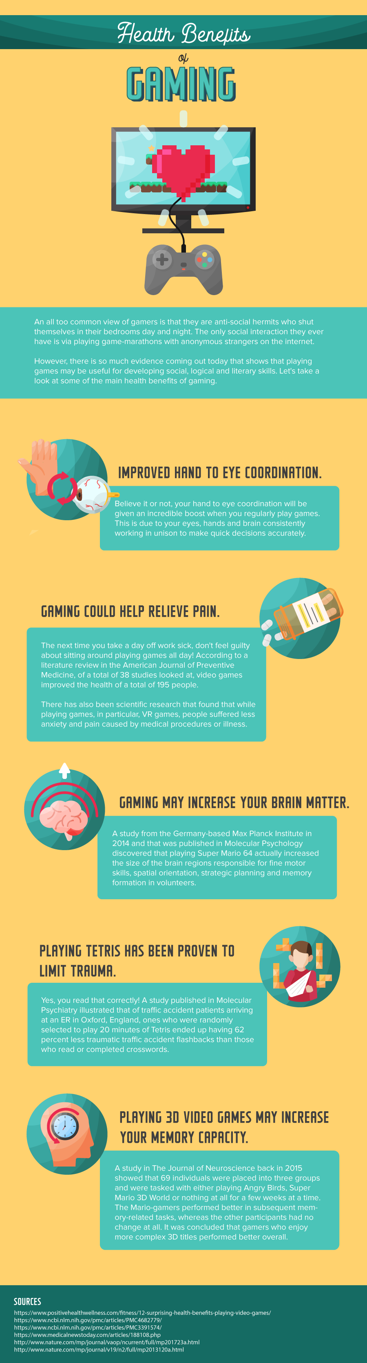
Benefits of gaming
01.
02.
03.
Personal growth
Mental effects
Social impact
It improves our skills regularly such as your responsible speed. Rise your memory ability. The most important benefit is to make you have more creative imagines and practice your group work solution skills.
Gaming could reduce your stress rapidly and relax your self as a bounty in your free time. As a matter of facts, playing game enough would enhance concentration and your focusing.
Gaming is a way how i connect with others who have the same interests. As a result, our online relationships would be improve. Therefore, it open many oppotunities for me to join club and communities.

Slide 10
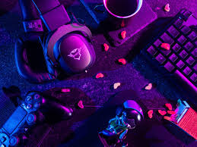
DRAWBACKS
Physical detriments
Obesity rates
Visual impairment
According to studies, reseachers agree that playing game to much could bring out the obesity for players. Because of, inactivity while playing game.
Looking intently in a long time would cause pressures for your eyes. Screen lights from computer is one of the most worst effects for your eyes.

Slide 11
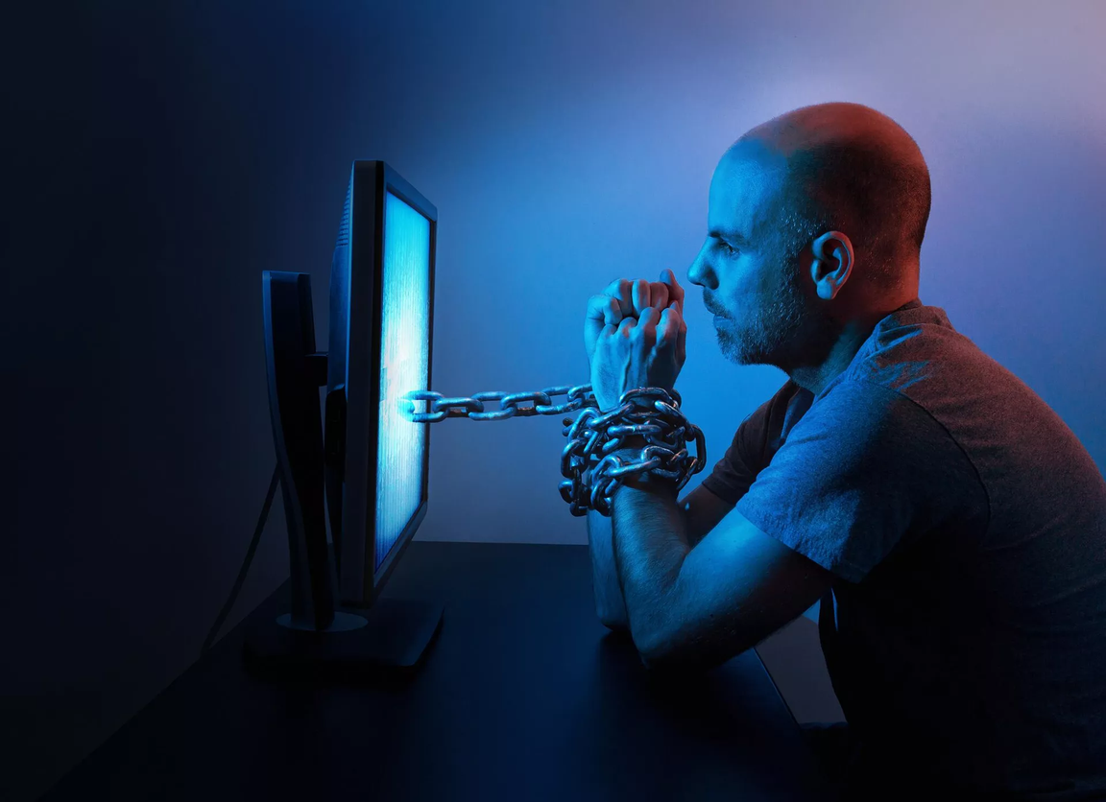
Other detriments of playing games
Affecting to mental health
Playing game for a long time cause
tense, worriness and sleeplessness. players will rely on virtual world
and leave out real world for avoid facing with issues in life. This could . damage mental health and cause l several bad problems.
Bad effects of social nexus
Addiction and lack of time control
The social relationships could be effect by the way use game. Gamers be more isolate, alienate friend and . family. Therefore, the quality of life
...... be decline.
People can easily be addicted by the attraction and interests of diverse game types. Losing control and spending too much time on is one of the drawbacks of gaming.

Slide 12
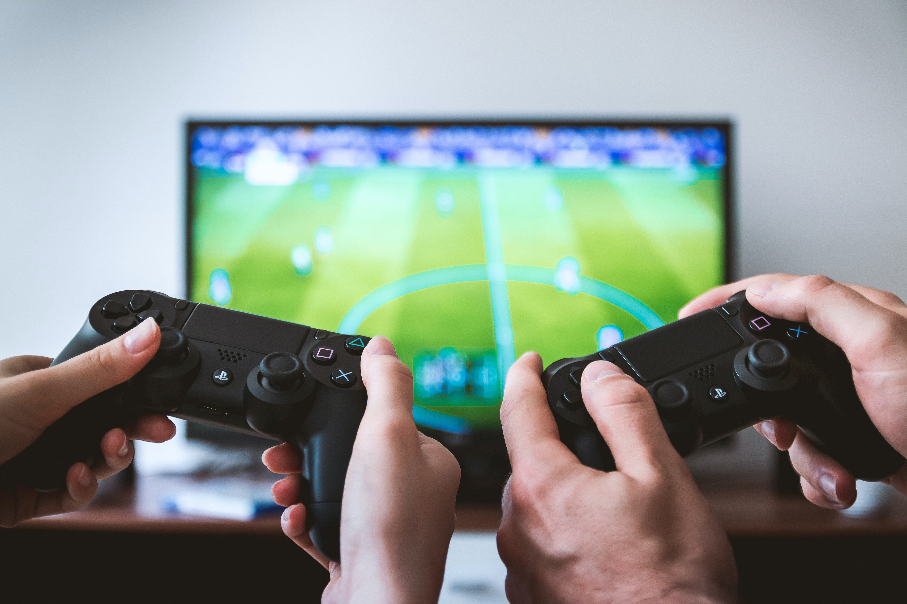
Solutions
Setting your gaming goals.
Practising to control your time.
Rising knowlegde about harmful effects of gaming.
Making more conversation for communication.
Fixing relationships.
Joining in more physical activities.

Slide 13


