Slide 1

Unit 10: Cities of the Future
Lesson 2.1: Vocab & Reading
Pages: 104 & 105

Slide 2

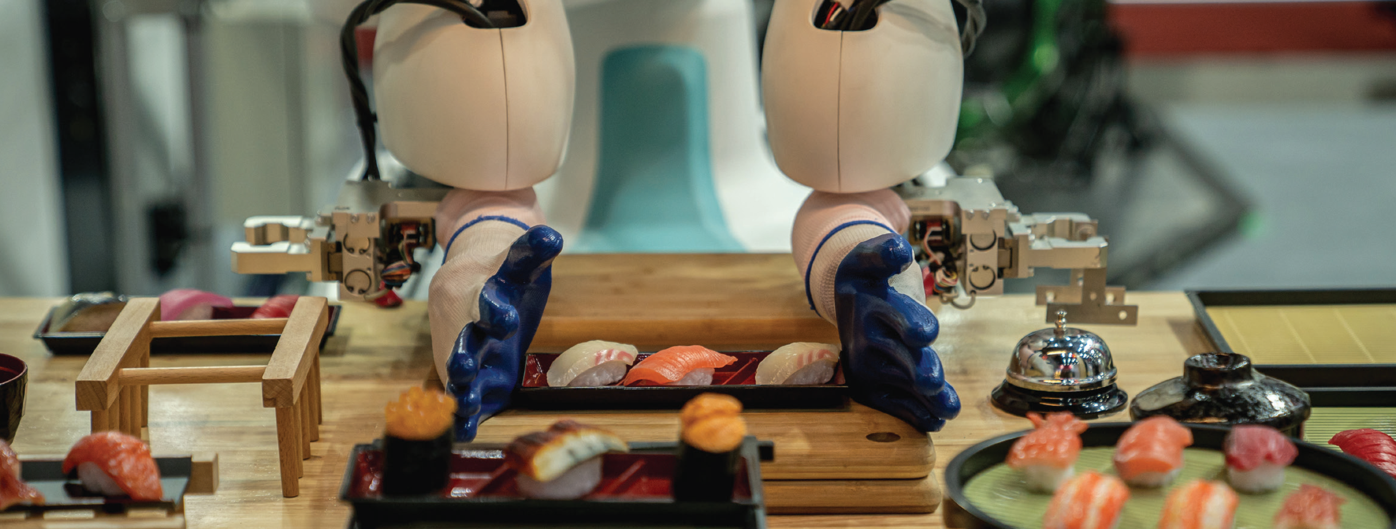
Work in pairs.
Look at the picture. Discuss the questions.
What is happening in the picture?
What tasks do you think robots could perform in a restaurant?
Do you think your city or town will ever have a restaurant like this? Why (not)?

Slide 3

Pre – Reading:
Vocabulary

Slide 4
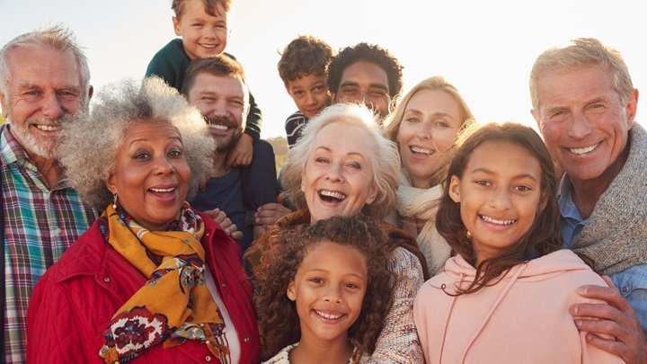
human (n) /ˈhjuːmən/
con người
Notes:
GV click vào từng cụm nghe âm thanh

Slide 5

by hand (idm) /ˈbaɪ ˌhænd/
bằng tay, làm thủ công

Slide 6
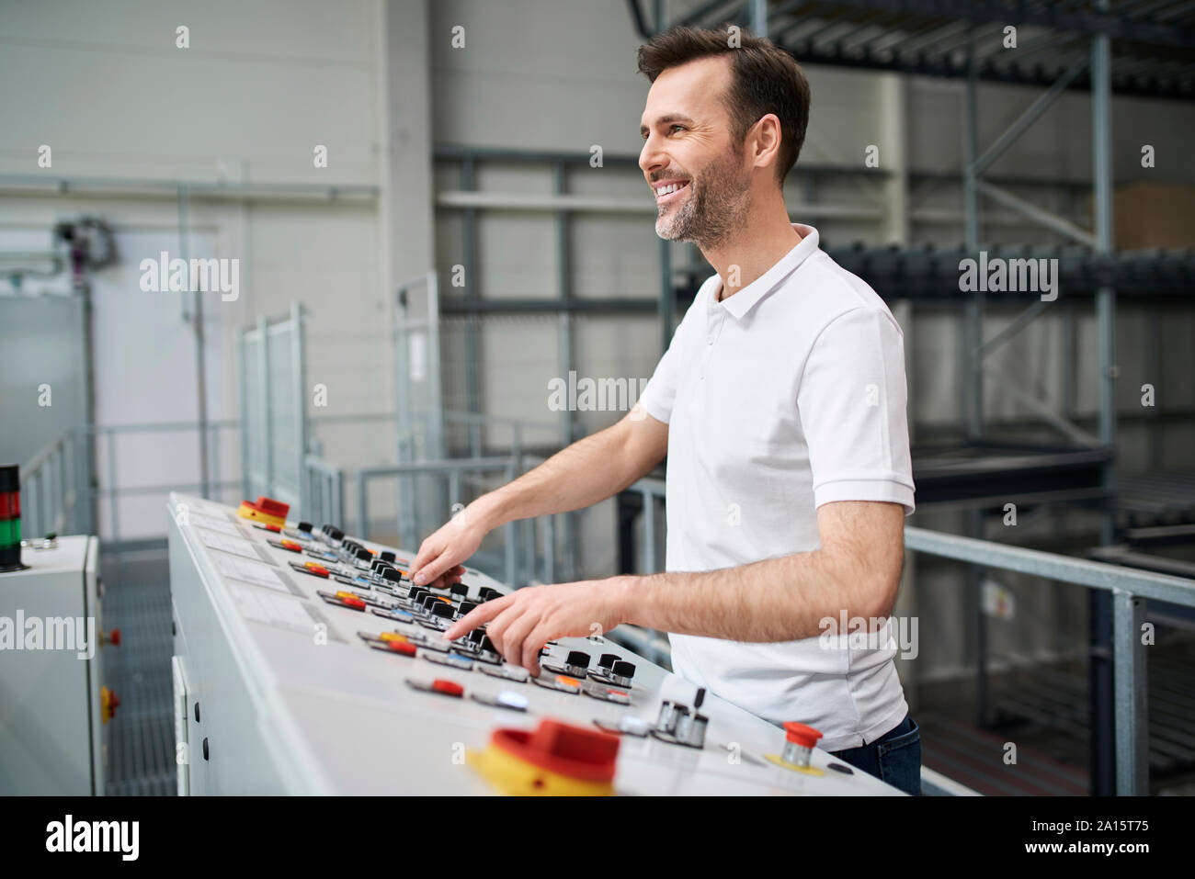

control (v) /kənˈtroʊl/
điều khiển

Slide 7
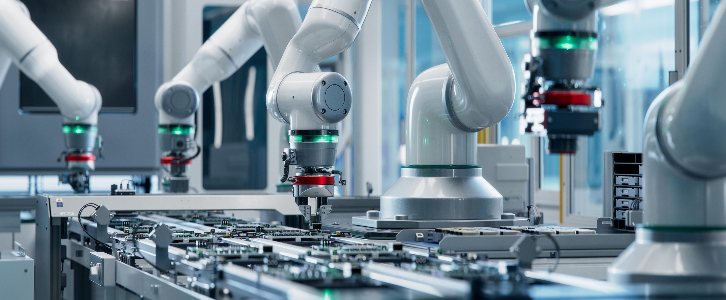
automated (adj) /ˈɑːtəmeɪtɪd/
tự động hóa

Slide 8
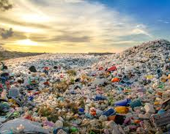
waste (n) /weɪst/
rác thải

Slide 9
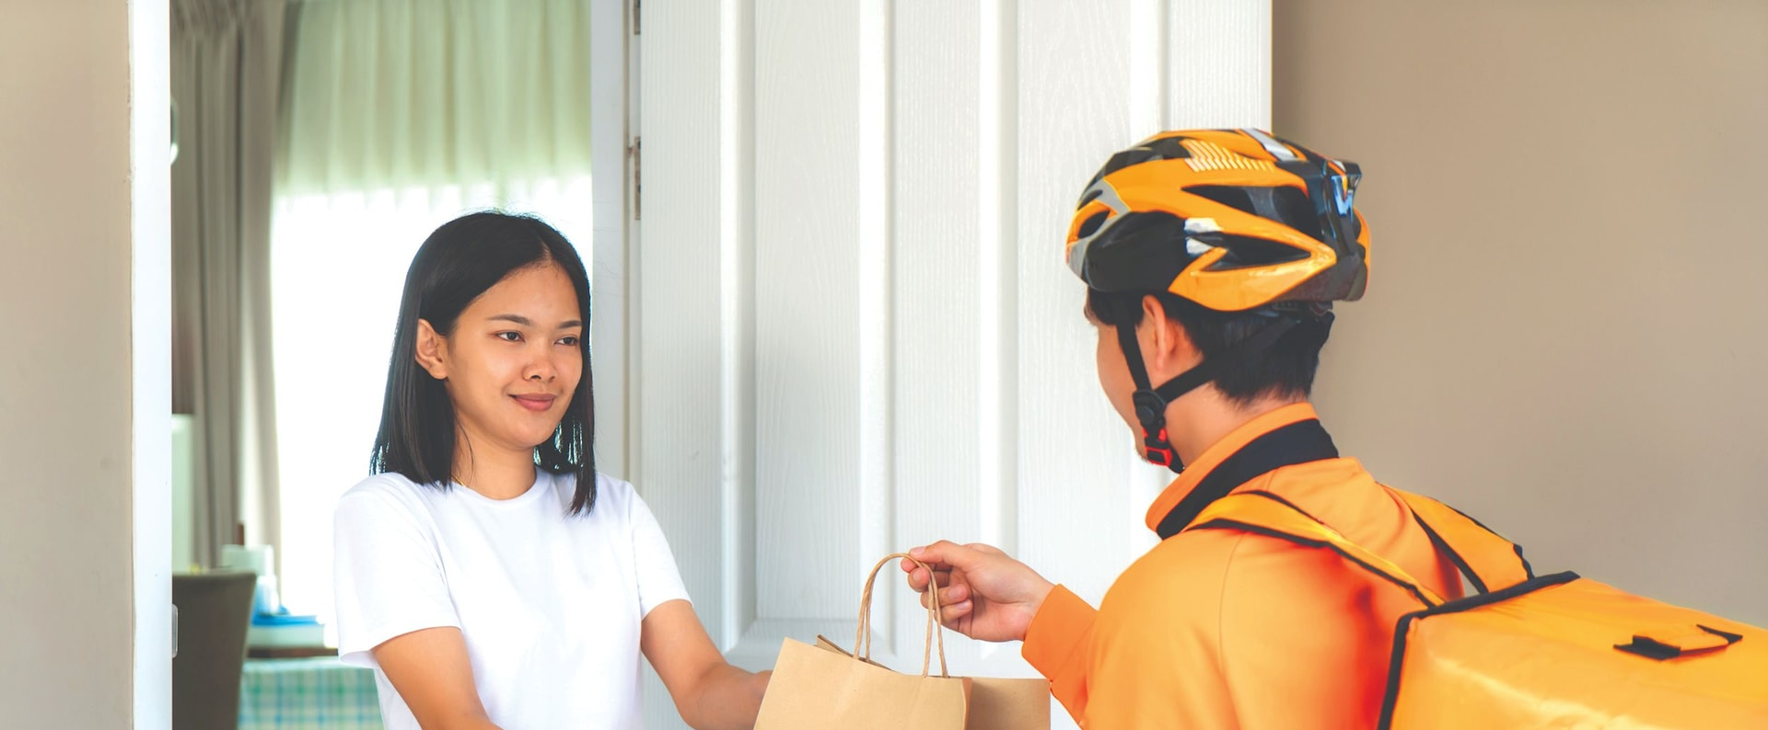
delivery (n) /dɪˈlɪvəri/
sự giao hàng

Slide 10
Listen and repeat.
human (n) /ˈhjuːmən/ con người
by hand (idm) /ˈbaɪ ˌhænd/ bằng tay, làm thủ công
control (v) /kənˈtroʊl/ điều khiển
automated (adj) /ˈɑːtəmeɪtɪd/ tự động hóa
waste (n) /weɪst/ rác thải
delivery (n) /dɪˈlɪvəri/ sự giao hàng
Notes:
GV click vào từng cụm nghe âm thanh

Slide 11
TASK a. Match the underlined words to the definitions.
1. I don't like online customer service. I prefer talking to a human.
2. I like playing with my drone. I can control it with my smartphone.
3. Many years ago, people made all of their clothes by hand.
4. I'm too busy to cook, so I order food from a delivery service.
5. Families create a lot of waste, which is bad for the environment.
6. The coffee maker is automated. Just press the button and wait.
a. a person ______
b. have a machine do a person's job _________
c. tell a machine what to do ______
d. done by a person not a machine _______
e. materials that are thrown away _____
f. taking things to the people they have been sent to _______
human
automated
control
by hand
waste
delivery
Listen and repeat.

Slide 12


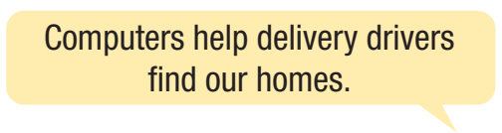
Work in pairs.
What chores at home do you do by hand?
What things do machines and computers help people do?

Slide 13

Reading

Slide 14

Task a
Read the instruction quickly. Underline the key words. What are we going to do?
Read the magazine interview. Choose the correct answer.
What effect will automation have on cities?

Slide 15
Look at the topic sentence and find clues to answer the question ‘What effect will automation have on cities?
Dr. Amanda Hall is a science and robotics expert. In this issue of Teen
Tech Weekly, we're talking to her about automation. Read on to find out how it will improve life in the cities of the future.
What is automation? Automation is when machines and computers
do things instead of humans. Some people think that this is something
that will happen in the future. Actually, it's happening all the time. The
washing machine is one of my favorite examples. Washing clothes by
hand takes a lot of time. We save a lot of time and energy when we use
a washing machine.

Slide 16
Look at the topic sentence and find clues to answer the question ‘What effect will automation have on cities?
What will be automated in the next five years? Fast food restaurants are already being automated. You order your hamburger and a drink using a touchscreen menu at some places. I think that soon, the food will be prepared by robot chefs. Deliveries will be automated, too. We buy a lot of things online these days. They often arrive late, or at the wrong time of day. Sometimes, they even go to the wrong place! In a few years, everything will be delivered by drones. This will be faster, cheaper, and more reliable than sending human drivers.

Slide 17
Look at the topic sentence and find clues to answer the question ‘What effect will automation have on cities?
What else will be automated in the cities of the future? I think
that in the future, almost everything will be automated. Everyone will live in smart cities. Their home security will be controlled by a computer. Household waste will be recycled automatically. Even the streets will be kept clean by robots!
So, there you have it. Automation has already begun, and it will make our cities better places to live!

Slide 18
Read and choose the correct answer.
What effect will automation have on cities?
1. They will be less expensive and quieter.
2. They will be cleaner and safer.
“This will be faster, cheaper, and more reliable than sending human drivers.”
“Their home security will be controlled by a computer. Household waste will be recycled automatically.”
“Even the streets will be kept clean by robots!”

Slide 19
Task b
Now, read and answer the questions. Underline key words.
1. The word it in paragraph 1 refers to ____. a. robot b. automation c. life
2. What example of automation helps people with the housework today?
3. What might cook some of our meals in the future?
4. What will deliver things to us in the future?
5. What will keep our homes safe in the future?

Slide 20
Look at the topic sentence and find clues to answer the question ‘What effect will automation have on cities?
Dr. Amanda Hall is a science and robotics expert. In this issue of Teen
Tech Weekly, we're talking to her about automation. Read on to find out how it will improve life in the cities of the future.
1. The word it in paragraph 1 refers to ____. a. robot b. automation c. life

Slide 21
Look at the topic sentence and find clues to answer the question ‘What effect will automation have on cities?
What is automation? Automation is when machines and computers
do things instead of humans. Some people think that this is something
that will happen in the future. Actually, it's happening all the time. The
washing machine is one of my favorite examples. Washing clothes by
hand takes a lot of time. We save a lot of time and energy when we use
a washing machine.
2. What example of automation helps people with the housework today?
The washing machine

Slide 22
What will be automated in the next five years? Fast food restaurants are already being automated. You order your hamburger and a drink using a touchscreen menu at some places. I think that soon, the food will be prepared by robot chefs. Deliveries will be automated, too. We buy a lot of things online these days. They often arrive late, or at the wrong time of day. Sometimes, they even go to the wrong place! In a few years, everything will be delivered by drones. This will be faster, cheaper, and more reliable than sending human drivers.
3. What might cook some of our meals in the future?
robot chefs
4. What will deliver things to us in the future?
drones

Slide 23
What else will be automated in the cities of the future? I think
that in the future, almost everything will be automated. Everyone will live in smart cities. Their home security will be controlled by a computer. Household waste will be recycled automatically. Even the streets will be kept clean by robots!
So, there you have it. Automation has already begun, and it will make our cities better places to live!
5. What will keep our homes safe in the future?
computer

Slide 24
Task b
Now, read and answer the questions. Underline key words.
1. The word it in paragraph 1 refers to ____. a. robot b. automation c. life
2. What example of automation helps people with the housework today?
3. What might cook some of our meals in the future?
4. What will deliver things to us in the future?
5. What will keep our homes safe in the future?
The washing machine
robot chefs
drones
computer

Slide 25
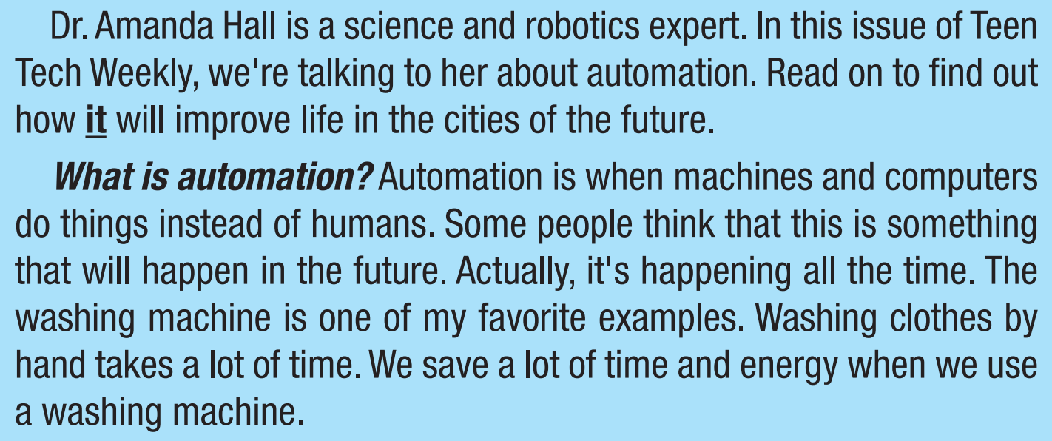
Task c
Listen and read.

Slide 26

Post - Reading

Slide 27


Work in pairs.
Do you think cities in the future will be good places to live?
Why (not)?
Suggested answer
The automation of cities will make them better places to live in the future. With the help of machines and computers, things will be done more efficiently and faster, such as deliveries by drones, the preparation of fast food by robot chefs, and waste recycling.

Slide 28

Consolidation

Slide 29
Fill in the gap with one word in the following sentences.
1. More and more jobs are being _____________. They can just get a machine or software to do the job.
2. The amount of household _____________ in cities is increasing because people buy and throw away more food.
3. This app is great. I can _____________ my music, TV, and speakers all on phone.
4. I don't know how a restaurant could only have robots. I want my waiter to be a _____________.
automated
waste
control
human

Slide 30

- Learn the new words.
- Practice talking about automation.
- Do the exercises in WB: New words and Reading (pages 58 & 59).
- Play the consolidation games in Tiếng Anh 11 i-Learn Smart World DHA App on www.eduhome.com.vn
- Prepare: Lesson 2.2 – Grammar (pages 105 & 106 – SB).

Slide 31

Lesson 3
Stay positive and have a nice day!

