Slide 1
Unit 9: Education in the Future
Lesson 2.2: Grammar
Pages: 95 & 96

Slide 2
WARM UP

Slide 3
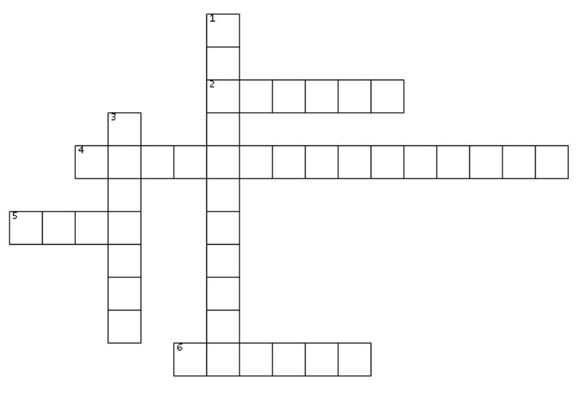
Read the clues and do the crossword puzzle.
ACROSS
2. You do this to make sure that your device has electricity and is ready to use.
4. This is a type of online chat that allows you to send messages with someone else who is also using it at the same time.
5. You do this to put a comment, photo, or article onto the internet.
6. This is a small computer that is easy to carry, with a large touchscreen and no keyboard.
DOWN
1. They are websites and software used for connecting with people on the internet.
3. You do this after downloading a program to use it on your computer.
S
O
C
H
A
R
G
E
I
I
I
N
S
T
A
N
T
M
E
S
S
A
G
E
S
S
L
P
O
S
T
M
A
E
L
D
L
I
T
A
B
L
E
T

Slide 4
Presentation

Slide 5
Modals and semi-modals of obligation and prohibition
Read the sentences and complete the rules.
Students must bring their tablets to class.
Students must not play online games in class.
We have to bring our tablets to class.
We can't play online games in class.
We don't have to bring lunch, we can buy it.
 | Obligation | Prohibition | Not limited to rules
Write
Talk
Must
Mustn’t
Can
Don’t have to
Have to
Can’t

Slide 6
Notes
Students should be allowed to wear sneakers at school.
We shouldn't have to wait in line at the cafeteria.
- We can suggest new rules with should or shouldn’t.
- We can’t use should with other modal verbs like must or can.

Slide 7
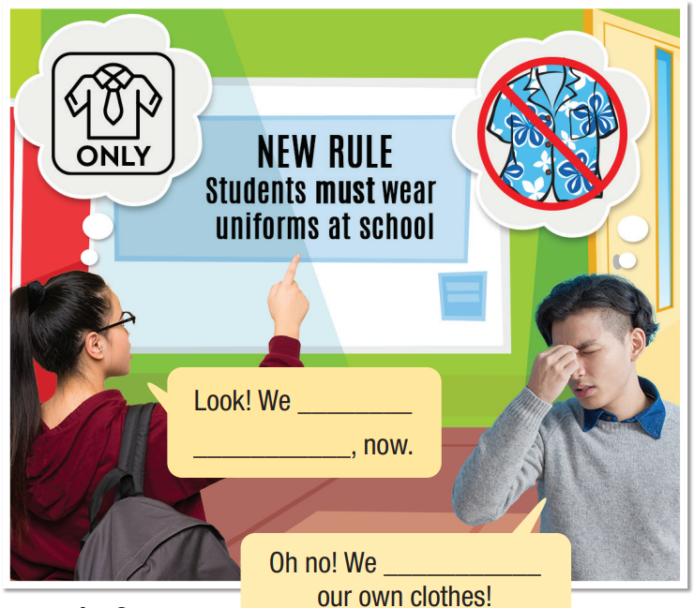
Task a
Look at the picture. What do you think the girl and boy are saying?
Task b
Listen and check your ideas.
have to
Task c
wear uniform
Listen and repeat.
can’t wear

Slide 8
PRACTICE
Practice

Slide 9
Task a
Unscramble the sentences.
1. take/care/of/tablets./Students/must/their
______________________________________
2. drink/Can/or/we/in/eat/class?
______________________________________
Students must take care of their tablets.
Can we eat or drink in class?

Slide 10
3. lesson./We/have/tablets/bring/to/our/every/to
______________________________________
4. have/charge/doesn't/at/her/tablet/home./Kate/to
______________________________________
5. can/games/Students/tablets./their/install/on
______________________________________
We have to bring our tablets to every lesson.
Kate doesn't have to charge her tablet at home.
Students can install games on their tablets.

Slide 11
Circle the sentence with the similar meaning.
1. Students must charge their tablets before class.
"We are allowed to charge our tablets during class."
"We have to charge our tablets before class."
c. "We don't have to charge our tablets before class."
d. "We shouldn't have to charge our tablets before class."

Slide 12
2. "We can't post mean things on social media."
Students must post mean things on social media.
Students shouldn't be allowed to post mean things on social media.
c. Students don't have to post mean things on social media. d. Students mustn't post mean things on social media.

Slide 13
3. Students must not play online games in class.
"We can't play online games in class."
"We should be allowed to play online games in class."
c. "We shouldn't have to play online games in class."
d. "We don't have to play online games in class."

Slide 14
Further practice Exercise a, WB p.53
Circle the correct words.
1. Students must/mustn't charge their tablets and return them after school. No student is allowed to bring their tablet home.
2. Students can/can't use 3D printers for their projects. However, they must/mustn't ask for permission from teachers.
3. My sister has to/doesn't have to wear a uniform. Her school lets students wear regular clothes.

Slide 15
4. "I told you! We have to/must submit our assignments before classes! It's in the Student Handbook!”
5. Notice for all students. No phones are allowed in the classroom. All students have to/must put their phones in their lockers during class.
6. When using the school's computers, students mustn't/don't have to install any software on the computers.
7. Teachers must/mustn't upload their lessons online. Sometimes students can't go to school or need to look at the material a second time at home.

Slide 16
Further practice Exercise a, WB p.53
Fill in the blanks with the correct modals or semi-modals of obligation and prohibition.
1. Students ___________ (not) send instant messages during class.
2. "I ___________ do a presentation in each subject at the end of the semester."
3. Our school doesn't have a rule about attending class in person. We ___________ (not) go to school every day. We can sometimes just study online.
mustn’t
have to
don’t have to

Slide 17
4. Students ___________ have a teacher's permission before using the school lab or computer room.
5. Students ___________ (not) bring food or drink into class.
6. We ___________ (not) use our tablets outside of class. The school has a rule about it.
7. Teachers ___________ (not) wear suits to school, but their clothes must look clean and professional.
must
mustn’t
can’t
don’t have to

Slide 18
In pairs: Use modals and semi-modals to talk about the rules at your school.
We can't be late for class,
and we have to bring a pen.
We mustn’t use smart phones in class and we have to ask for teachers’ permission to go out.

Slide 19
CONSOLIDATION

Slide 20
Write four sentences about the rules at your school, using must, have to, mustn’t, don’t have to, can’t.
For example:
We have to wear uniform to school.
Girls have to wear ao dai on Mondays.
We mustn’t smoke at school.
We can’t leave early without teachers’ permission.

Slide 21
WRAP-UP

Slide 22
Today’s lesson
Grammar
Modals and semi-modals of obligation and prohibition
Speaking
Talking about school rules.

Slide 23
Homework
Learn by heart the grammar structure and make sentences using it.
Do the exercises on page 53 WB.
Prepare the next lesson (pages 96 & 97 SB)
Play the consolidation games on www.eduhome.com.vn

