Slide 2
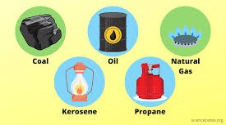
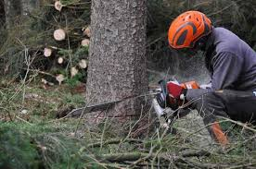
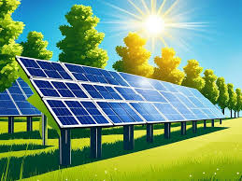
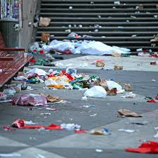
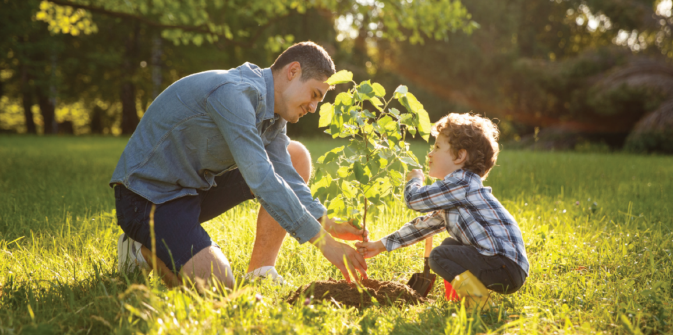
Match the picture with its description.
Planting trees
Solar energy
Littering on streets
Cutting down trees
Fossil fuels

Slide 3
Unit 4: Global warming
Lesson 2.1: Vocab. & Reading
Pages: 40 & 41

Slide 4
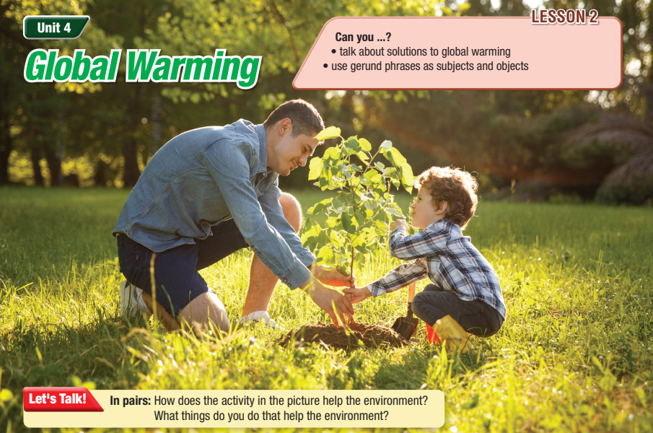

Slide 6
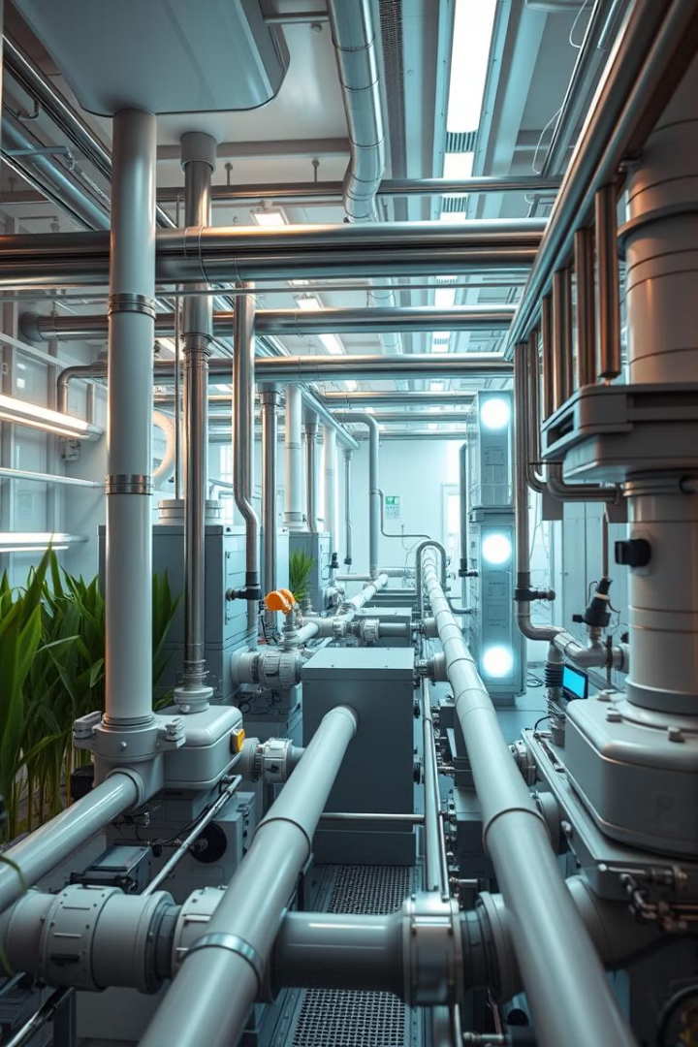
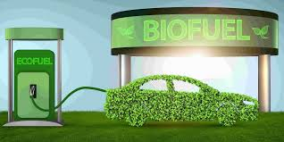
Biofuel
Renewable energy source from
organic matter.

Slide 7
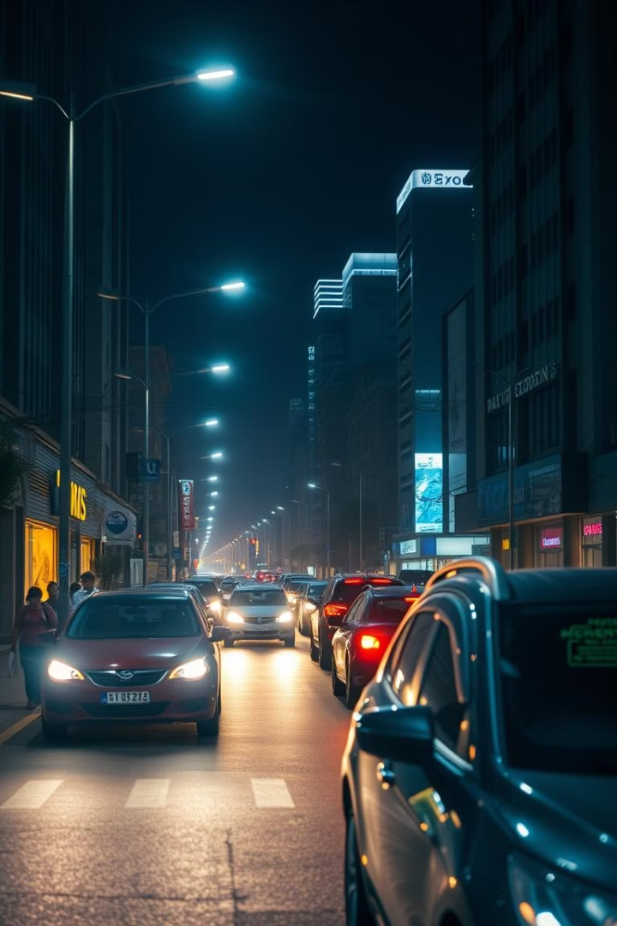
Consume
To use up resources or energy.

Slide 8
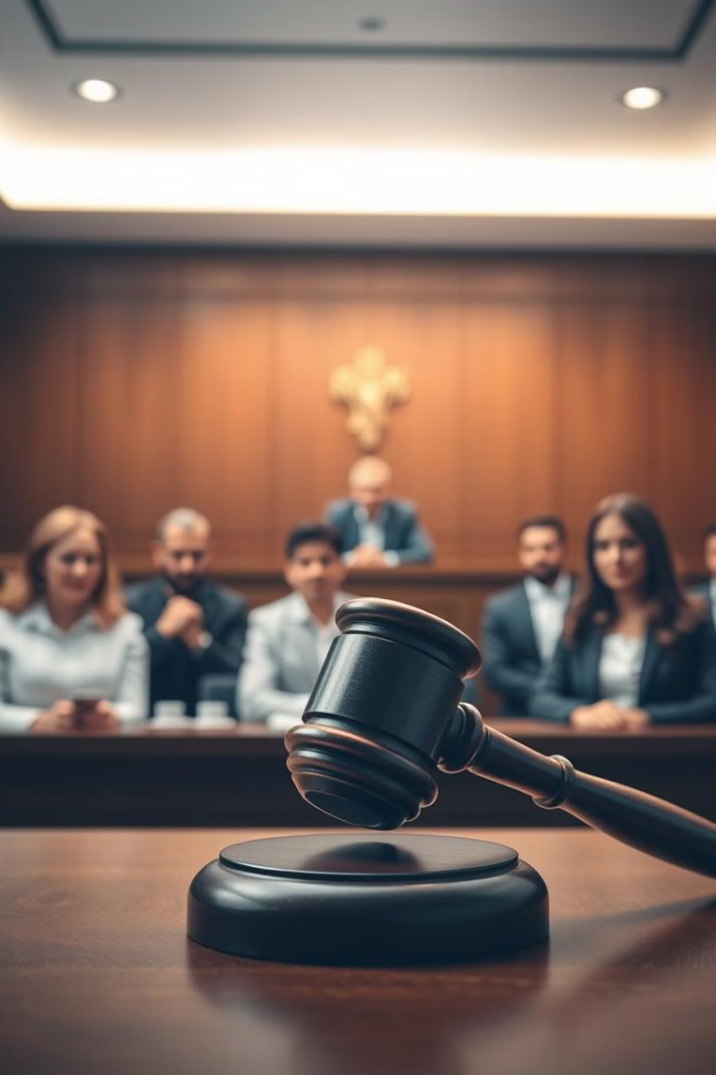
Law
A rule created and enforced by a government.

Slide 9
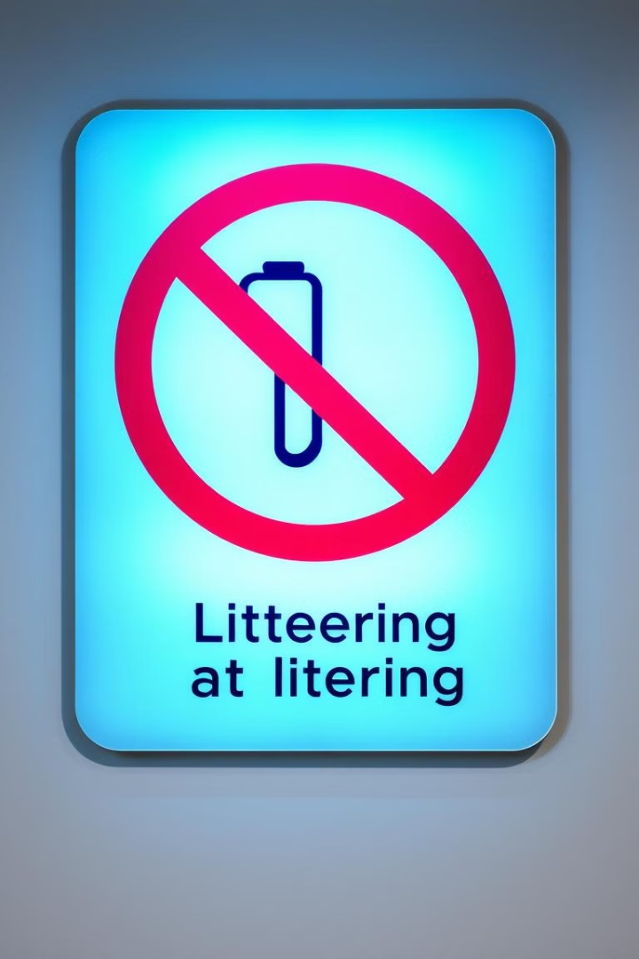
Prohibit
To forbid or ban something.

Slide 10
Sustainable

Slide 11
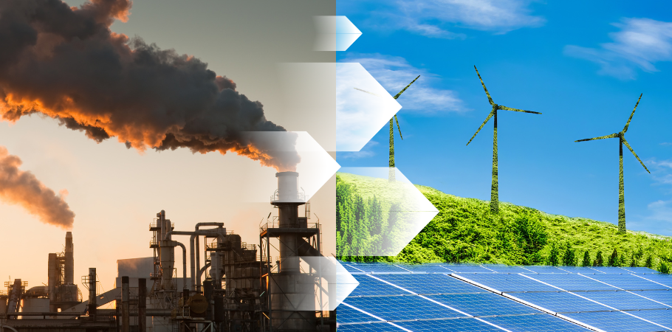
SWITCH from fossil fuels to renewable energy

Slide 12
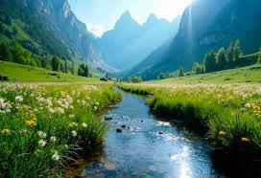
natural (adj)
not made or caused by humans

Slide 13
remove (v)

Slide 14
VOCABULARY
biofuel | (n) | /ˈbaɪəʊfjuːəl/ | nhiên liệu sinh học
consume | (v) | /kənˈsuːm/ | tiêu thụ
prohibit | (v) | /prəˈhɪbɪt/ | cấm
sustainable | (adj) | /səˈsteɪnəbl/ | bền vững
switch | (v) | /swɪtʃ/ | chuyển, thay đổi
tax | (n) | /tæks/ | thuế
law | (n) | /lɔː/ | luật
natural | (adj) | ˈnætʃrəl/ | tự nhiên
remove | (v) | /rɪˈmuːv/ | loại bỏ

Slide 15
1. Governments should prohibit farmers from destroying forests to step deforestation. | a. Use something, usually in large amounts
2. We can switch from oil to solar power. | b. Energy made from living things
3. Governments should increase the tax on gas to make it more expensive. | c. Part of the money that we earn or spend, which goes to the government
4. Biofuels are much cleaner than fossil fuels. | d. Stop something by using a rule or law
5. If we continue consume fossil fuels, global warming will get worse. | e. Change to something different
6. Wind and solar energy are more sustainable than fossil fuels. | f. Using natural products and energy that doesn’t damage the environment

Slide 16
PLAY GAME: https://kahoot.it/

Slide 17
1. Governments should prohibit farmers from destroying forests to step deforestation. | a. Use something, usually in large amounts
2. We can switch from oil to solar power. | b. Energy made from living things
3. Governments should increase the tax on gas to make it more expensive. | c. Part of the money that we earn or spend, which goes to the government
4. Biofuels are much cleaner than fossil fuels. | d. Stop something by using a rule or law
5. If we continue consume fossil fuels, global warming will get worse. | e. Change to something different
6. Wind and solar energy are more sustainable than fossil fuels. | f. Using natural products and energy that doesn’t damage the environment
1. d 2. e 3. c 4. b 5. a 6. f

Slide 18
b. In pairs: talk about things that can be done to help the environment where you live.

Slide 19
Reading

Slide 20
Read & underline the key words.
Pre-reading

Slide 21
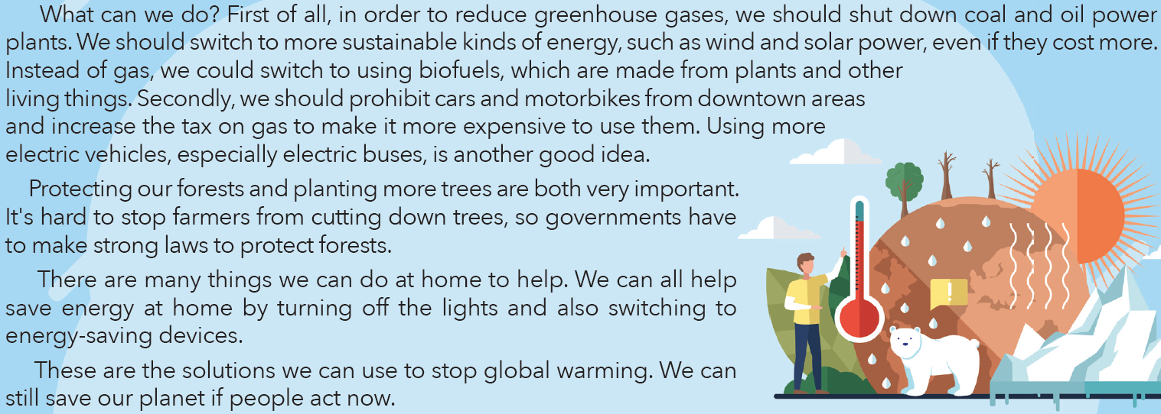

Slide 22
While-reading
Read & answer the questions
1. What is the main idea of the magazine article?
a. the effects of global warming
b. ways to stop global warming
2. What creates sulfur dioxide?
3. The word consume in paragraph 1 is closest in meaning to _________.
a. eat b. use c. destroy
4. What could we replace gas with?
5. What should we stop using in the busy parts of towns?
6. What should the governments make to protect forests?
7. How can people save energy at home?

Slide 23
You are given 8 pieces of a secret shape
In groups, you match the question (in bold) with its answer (smaller size) to get the final shape.
Note: We have 7 questions.
After finishing the shape, please post your result on the padlet given in the group.
The fastest group having the correct shape will be the winner

Slide 25
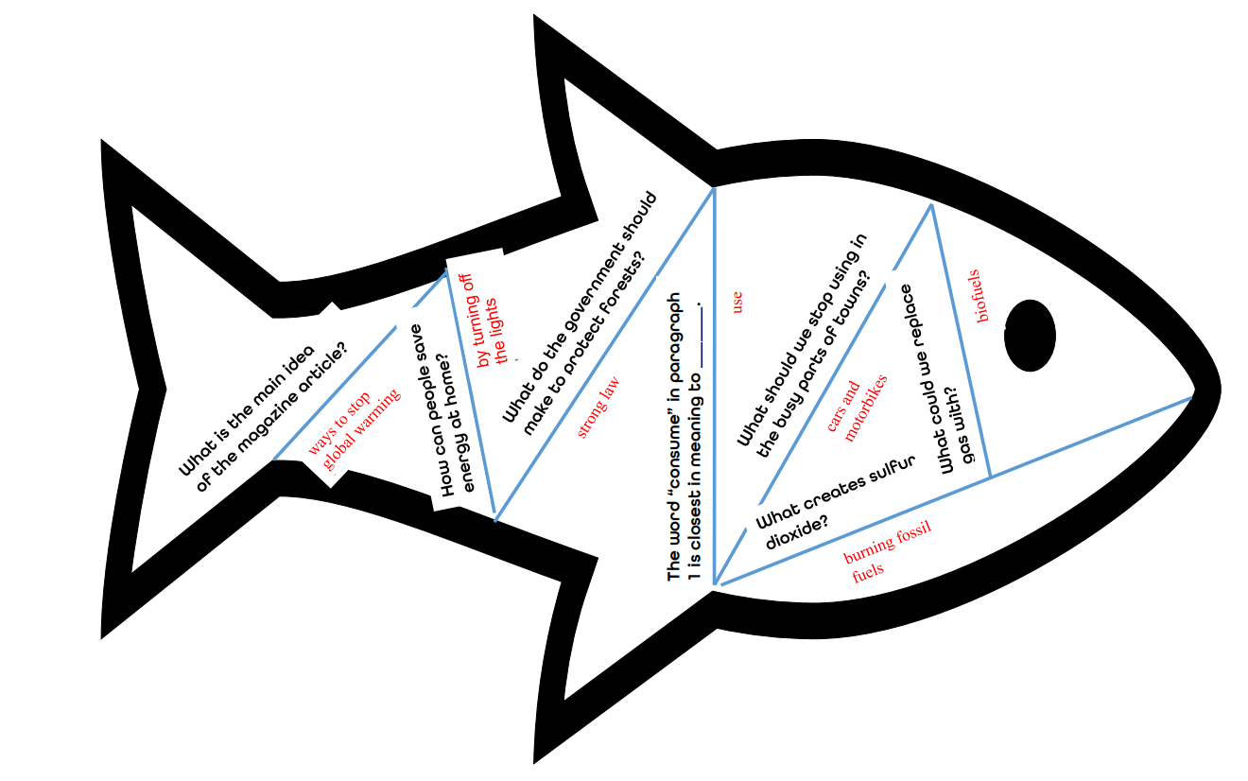

Slide 26
While-reading
Read & answer the questions
1. What is the main idea of the magazine article?
a. the effects of global warming
b. ways to stop global warming
2. What creates sulfur dioxide? Burning fossil fuels
3. The word consume in paragraph 1 is closest in meaning to _____.
a. eat b. use c. destroy
4. What could we replace gas with? biofuels
5. What should we stop using in the busy parts of towns? Cars and motorbikes
6. What should the governments make to protect forests? Strong laws
7. How can people save energy at home? By turning off the lights

Slide 27
Post-reading
c. Listen and read
d. In pairs:
+ Do you remember to switch off the lights?
+ How else do you save electricity?

Slide 28
THE SUN’S BURNIN’ HOTTER, THE SKIES ARE
The sun’s burnin' hotter, the skies are turning gray, Oceans rising higher, there's no time to delay. We’re takin’ what we need, but we don't think twice, We’re consuming all our Earth, now we’re payin' the price.
If we don't switch, if we don't change, The world we knew will be rearranged. It's time to act, the truth’s in sight, We’ve gotta fight for what’s right. We gotta prohibit the waste, stop the greed, Switch to a world where we plant new seeds. Tax the damage that we've done, Invest in biofuels, the change has just begun. Consume with care, let’s take a stand, For a sustainable future, hand in hand. Remove the poisons, let the Earth breathe free, It's the natural way for you and me

