Slide 1
NGO LE TAN HIGH SCHOOL
Unit 3: GREEN LIVING
Lesson: READING
Teacher: Thai Thi Phuong Lan
Period: 20 Class: 12A7

Slide 2
Unit 3
GREEN LIVING
LESSON 3
READING
Going green with plastics

Slide 3
LESSON 3
READING
WARM-UP
Video watching
Task 1: Solve the quiz.
Vocabulary
PRE-READING
Task 2: Matching.
Task 3: Complete the summary notes.
Task 4: Match the information with the names.
WHILE-READING
POST-READING
Task 5: Discussion.
CONSOLIDATION
Wrap-up
Homework

Slide 4
WARM-UP
Notes:
Link: https://www.youtube.com/watch?v=_6xlNyWPpB8

Slide 5
PRE-READING
1
Work in pairs to solve the quiz.
1. It takes about _____ years for one plastic bottle to decompose in the ground.
A. 4.5 B. 45 C. 450
2. Around _____ plastic bottles are thrown away every year.
A. 13 thousand B. 13 million C. 13 billion

Slide 6
PRE-READING
1
Work in pairs to solve the quiz.
3. Plastic bags and other plastic waste kill around _____ sea animals every year.
A. 100 million B. 10 million C. 1 million
4. Nearly _____ of plastic ever made still exists today.
A. 100% B. 50% C. 10%

Slide 7
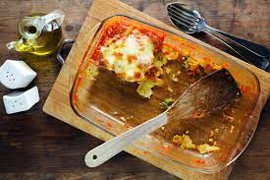
PRE-READING
leftover (n)
/ˈleftəʊvə/
remaining after all the rest has been used, taken, or eaten

Slide 8
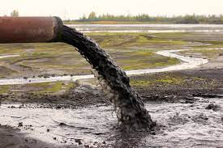
PRE-READING
contaminated (adj)
/kənˈtæmɪneɪtɪd/
poisonous or not pure

Slide 9
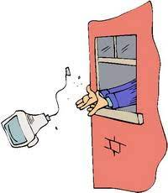
PRE-READING
get rid of
/ɡet rɪd əv/
to throw away or destroy something you do not want anymore

Slide 10
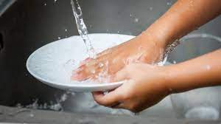
PRE-READING
rinse (v)
/rɪns/
to wash something with clean water only, not using soap

Slide 11
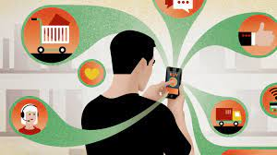
PRE-READING
convenience (n)
/kənˈviːniəns/
the quality of being useful, easy or suitable for somebody

Slide 12
Form | Pronunciation | Meaning | Vietnamese equivalent
1. leftover (n) | /ˈleftəʊvə / | remaining after all the rest has been used, taken, or eaten | đồ ăn thừa
2. contaminated (adj) | /kənˈtæmɪneɪtɪd/ | poisonous or not pure | ô nhiễm
3. get rid of | /ɡet rɪd əv/ | to throw away or destroy something you do not want anymore | loại bỏ
4. rinse (v) | /rɪns/ | to wash something with clean water only, not using soap | tráng qua
5. convenience (n) | /kənˈviːniəns/ | the quality of being useful, easy or suitable for somebody | sự thuận tiện

Slide 13
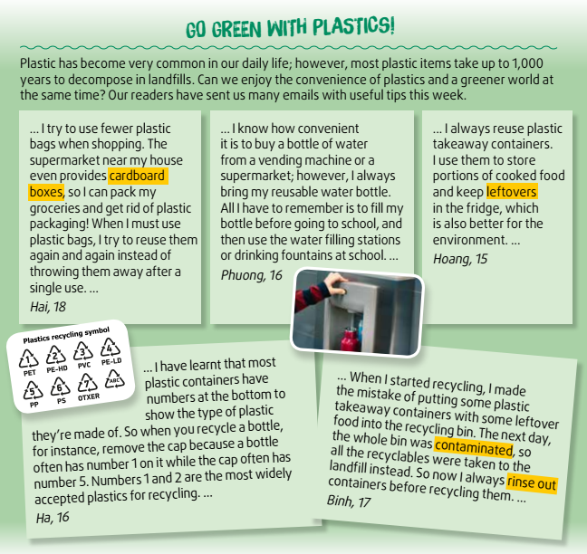
WHILE-READING
2
Match the highlighted words and phrases with the pictures.

Slide 14
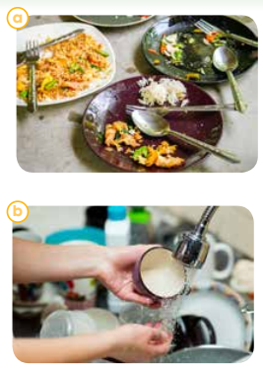
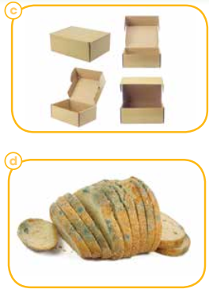
WHILE-READING
2
Match the highlighted words and phrases with the pictures.
1. cardboard boxes
2. leftovers
3. contaminated
4. rinse out

Slide 15
WHILE-READING
3
Complete the summary notes.
Single-use plastics can be: | Tips
reduced | • use (1) ______________ instead of plastic packaging • bring a (2) _________ water bottle
reused | • reuse (3) ___________ many times • reuse single-use plastic containers
recycled | • avoid plastics with (4) _________ that are hard to recycle • (5) _________ containers before recycling
cardboard boxes
reusable
plastic bags
numbers
rinse out

Slide 16
WHILE-READING
4
Match the information with the right names.
1. This person has learnt from a past mistake how to recycle things properly.
2. This person’s green lifestyle is supported by a local business.
3. This person has learnt the recycling symbols to help the recycling process.
4. This person’s green habit depends on local drinking water facilities.
5. This person tries to reuse plastic takeaway containers.
a. Hai
b. Phuong
c. Hoang
d. Ha
e. Binh

Slide 17
POST-READING
5
Discuss the following questions.
Which of the green habits in task 2 have also become your habits?
Which one would you like to develop in the future?

Slide 18
CONSOLIDATION
1
Wrap-up
What have you learnt today?
Some lexical items about green living
Reading for specific information

Slide 19
CONSOLIDATION
2
Homework
Do exercises in the workbook.
Write a paragraph about what green habits you would like to develop in the future.
Prepare materials for the project in Lesson 8.

Slide 20
Thank for your attention!

