Slide 1
Unit 3
GREEN LIVING
LESSON 2
LANGUAGE
Period: 19 – Class: 12A9
Teacher: Thai Thi Phuong Lan
NGO LE TAN HIGH SCHOOL

Slide 2
LESSON 2
LANGUAGE
WARM-UP
Kim’s game
Task 1: Listen and repeat.
Task 2: Underline the words.
PRONUNCIATION
Task 1: Match each word with its meaning.
Task 2: Complete the sentences.
VOCABULARY
Task 1: Complete the sentences.
Task 2: Combine the sentences.
Task 3: Talk about green things.
GRAMMAR
CONSOLIDATION
Wrap-up
Homework

Slide 3
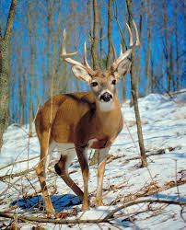
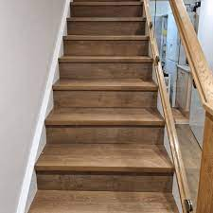
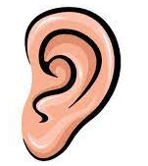
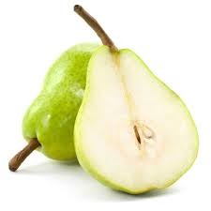

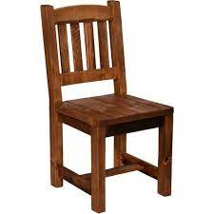
WARM-UP
KIM’S GAME

Slide 4

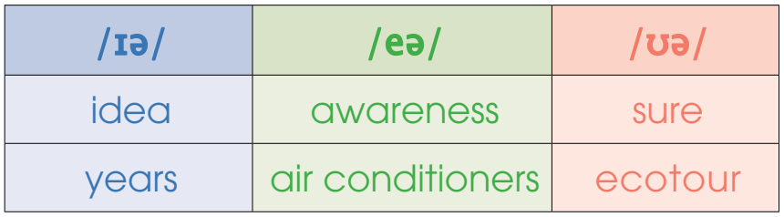
PRONUNCIATION
1
Listen and repeat. Then practise saying the words.

Slide 5
PRONUNCIATION
2
Underline the words that contain the /ɪə/, /eə/ and /ʊə/ sounds.
1. There are many volunteers here to help clean up the beach.
2. Ecotourism encourages tourists to develop
eco-friendly habits when travelling.
3. It is clear that not all people are aware of the negative impact of their daily habits on the environment.

Slide 6
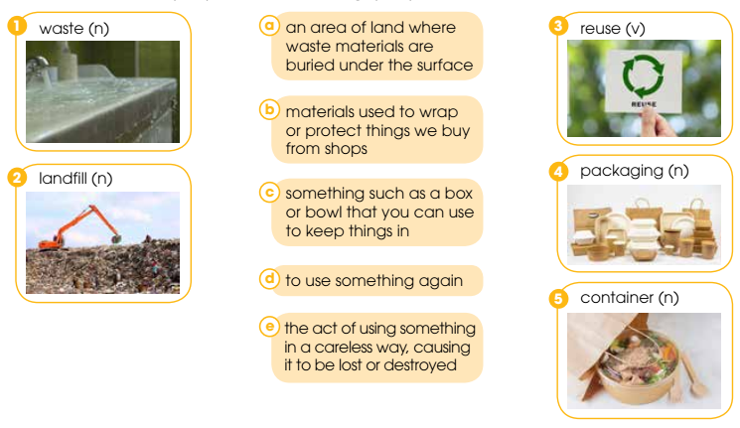
VOCABULARY
1
Match each word with its meaning.
1. e
2. a
3. d
4. b
5. c

Slide 7
VOCABULARY
2
Complete the following sentences.
1. We should fix the leaking tap. It’s a ______ of clean water!
2. Takeaway food includes a lot of unnecessary _________ such as single-use containers and plastic bags.
3. We always try to buy food packed in recyclable _________.
4. A creative way to _______ old greeting cards is to make gift tags and bookmarks.
5. The waste in open ________ sites can release harmful gases into the atmosphere.
waste
packaging
containers
reuse
landfill

Slide 8
GRAMMAR
VERBS WITH PREPOSITIONS
1. V + prep. + O: The meaning of these two words is usually very similar to the original meaning of the verb. | - V + about: ask, care, talk, think, learn,… - V + for: ask, apply, apologize, wait, prepare,… - V + to: introduce, refer, respond, listen, explain,…
2. V + prep = a phrasal verb The meaning of a phrasal verb is often very different from the original meaning of the main verb. Phrasal verbs use adverbs as well as prepositions. | work out, carry out, turn on, turn off, look for, look after, look up,…

Slide 9
GRAMMAR
RELATIVE CLAUSES REFERRING TO A WHOLE SENTENCE
We use a non-defining relative clause to refer to all the information in the previous clause. This type of clause is introduced with the relative pronoun which. | Eg: More and more people are interested in recycling nowadays, which is good for the environment.

Slide 10
GRAMMAR
1
Complete the sentences with the suitable prepositions.
1. Many people have now started to care _________ the environment.
2. The future of our planet depends _________ how we deal with climate change.
3. We should work _________ some solutions to reducing plastic pollution.
4. My sister is responsible for looking _________ the plants at home.
about
on
out
after

Slide 11
GRAMMAR
2
Combine the sentences using relative clauses.
1. Plastic takes hundreds of years to decompose in the ground. This explains why it is harmful to the environment.
→ Plastic takes hundreds of years to decompose in the ground, ___________________________
_______________________________________.
which (explains why it) is harmful
to the environment

Slide 12
GRAMMAR
2
Combine the sentences using relative clauses.
2. Public transport does not pollute the air as much as private vehicles. That’s why more people should consider using it.
→ Public transport does not pollute the air as much as private vehicles, ___________________________
__________________________________________.
which is why more people
should consider using it.

Slide 13
GRAMMAR
2
Combine the sentences using relative clauses.
3. All students work very hard to help clean up the school. The teacher encourages this.
→ All students work very hard to help clean up the school, ___________________________________
_________________________________________.
which is encouraged by the teacher/
the teacher encourages.

Slide 14
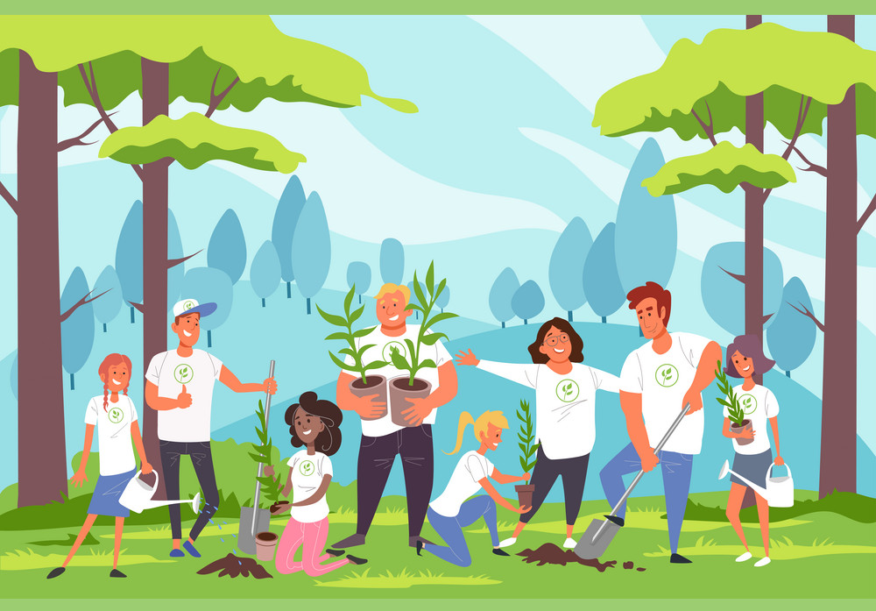
GRAMMAR
2
Talk about green things and activities you and your family often do. Use verbs with prepositions or phrasal verbs, and relative clauses referring to the whole sentence.

Slide 15
CONSOLIDATION
1
Wrap-up
What have you learnt today?
Diphthongs /ɪə/, /eə/ and /ʊə/
Some lexical items about green living
Verbs with prepositions
Relative clauses

Slide 16
CONSOLIDATION
2
Homework
Do exercises in the workbook.
Prepare for Lesson 3 - Reading.

Slide 17

Thank for your attention!

