Slide 1
Unit 12: Career Choices
Lesson 4: Communication

Slide 2
Objectives
By the end of this lesson, Ss will be able to:
01. Know how to express hope and respond.
02. Talk about future jobs.

Slide 3
01
How to express hope and respond

Slide 4

Everyday English
1. Listen and read the conversations below. Pay attention to the highlighted parts.
Minh: I’ve filled in the registration form. Hopefully, I’ll be a member of the science club.
Duong: I hope so, too.
Student: Here’s my teacher’s reference letter. I hope I’ll get the job.
Staff: Thank you. Good luck.

Slide 5
Structures:
Express hope
Hopefully,… I hope …
Respond
I hope so, too. Thank you.

Slide 6
Everyday English
2. Work in pairs. Make similar conversations with the following situations.
Situation 1: A friend has just taken part in a design competition. She is looking forward to the result.
Situation 2: A teacher is asking a student to give a teacher-parent conference invitation to his / her parents. She hopes that the parents will come.

Slide 7
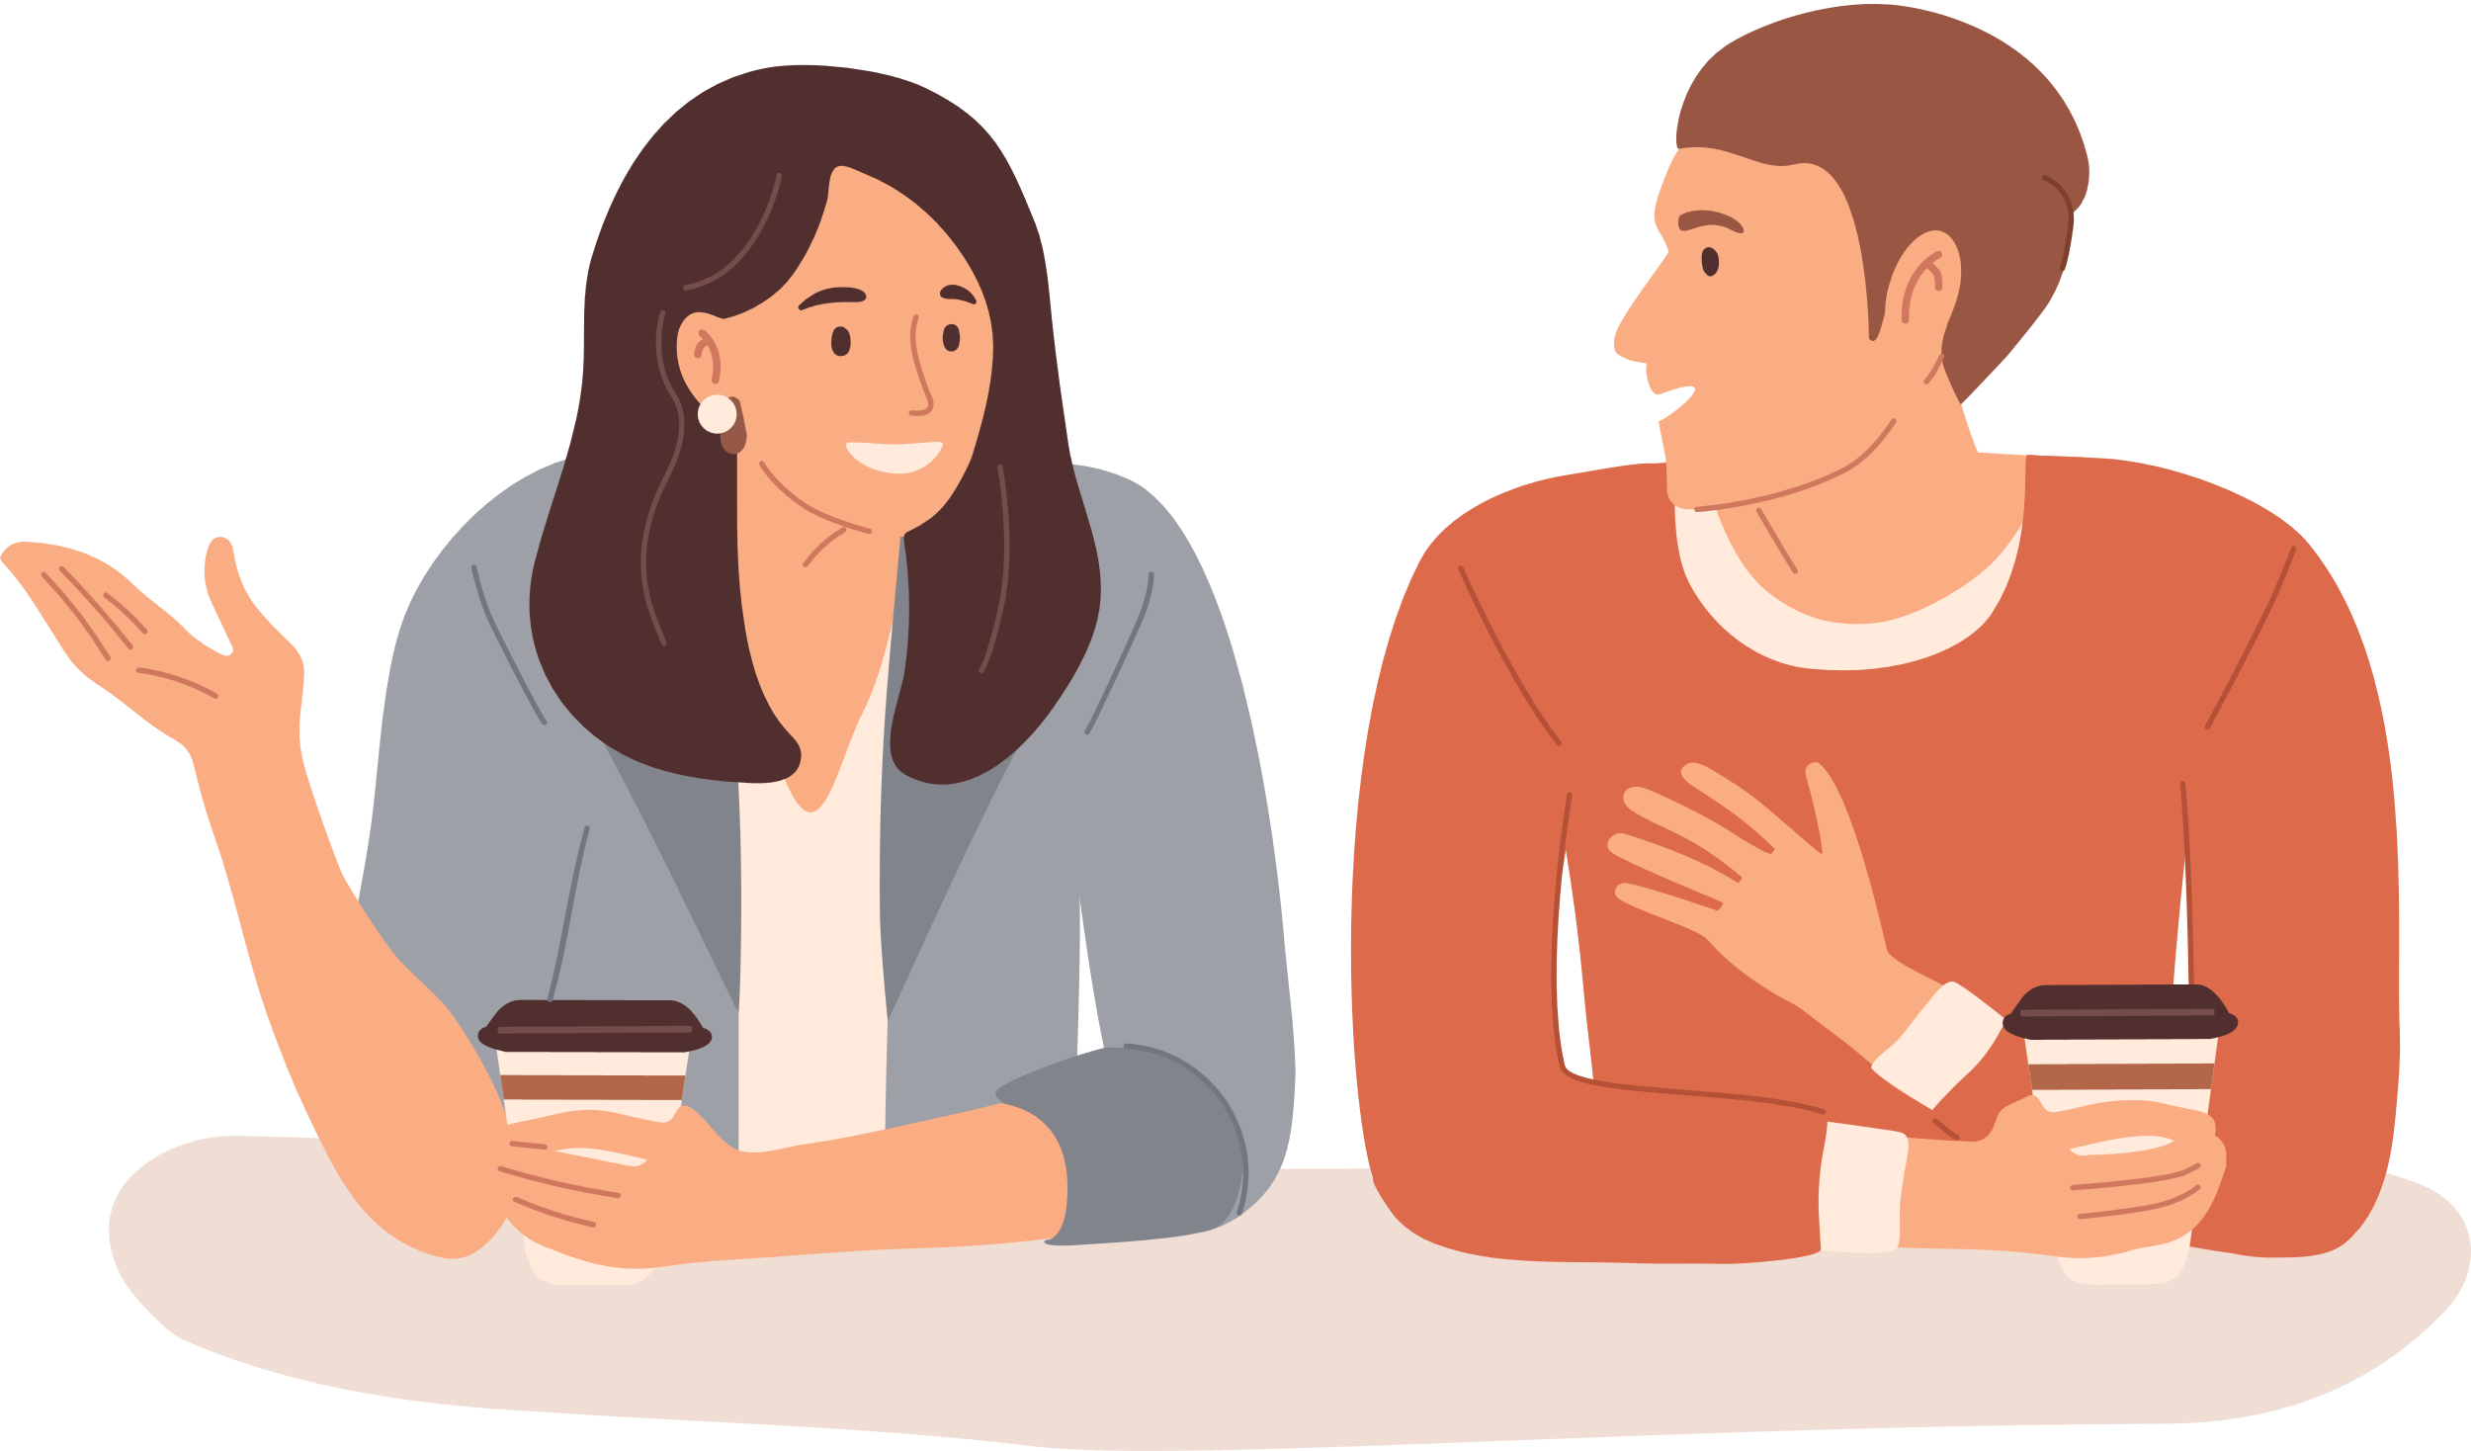
Situation 1: A friend has just taken part in a design competition. She is looking forward to the result.
A: I’ve just taken part in a design competition. Hopefully, I’ll get a good result.
B: I hope so, too

Slide 8
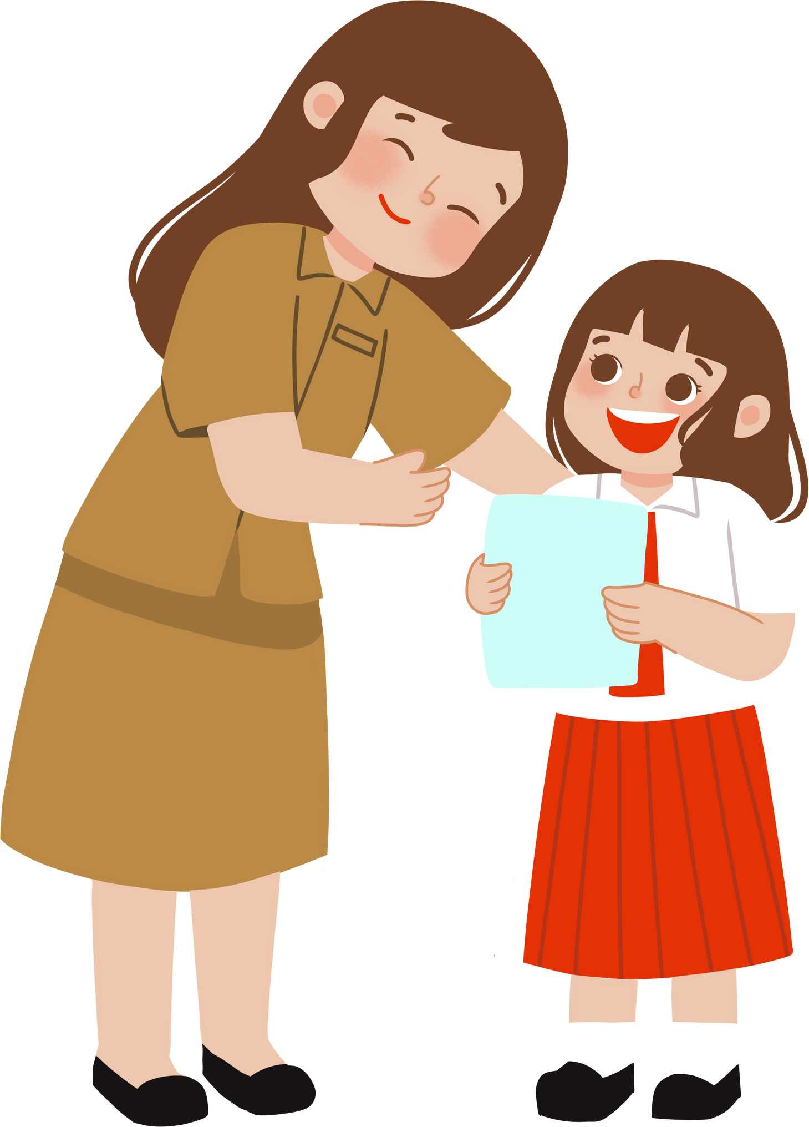
Situation 2: A teacher is asking a student to give a teacher-parent conference invitation to his / her parents. She hopes that the parents will come.
Student: Thank you.
I hope they will, too.
Teacher: Here’s the invitation to the teacher-parent conference. I hope your parents will come.

Slide 9
What’s your future job?
02

Slide 10
3. Work in pairs. Read about the jobs that Khang and An want to do. Then complete the summary table.
Khang: I’ve always dreamt of this job. I’ll enter a medical university. This seems to be a suitable job for me because I have good hand-eye coordination. Besides, I’m calm and decisive, so I can lead a surgical team.
An: I hope I can do this job as soon as possible. I’ve got hands-on training on how to use the scanner and calculator. I can do this job well because I have good basic math's skills. I’m patient and helpful to customers even when the store is busy.

Slide 11
 | Training | Skills | Personal qualities
Khang | (1) ________ degree | hand-eye coordination | (2) _____ and decisive
An | (3) _________ training | using some equipment having basic (4) __________ | patient and (5) _______
medical
calm
Khang: I’ll enter a medical university.
Khang: Besides, I’m calm and decisive, so I can lead a surgical team.

Slide 12
 | Training | Skills | Personal qualities
Khang | (1) ________ degree | hand-eye coordination | (2) _____ and decisive
An | (3) _________ training | using some equipment having basic (4) __________ | patient and (5) _______
medical
calm
hands-on
helpful
math's skills
An: I’ve got hands-on training on how to use the scanner and calculator.
An: I can do this job well because I have good basic math's skills.
An: I’m patient and helpful to customers even when the store is busy.

Slide 13
4. Work in pairs. Look at the jobs below. Which job might be appropriate for each person in 3? Explain your choice.
1. surgeon
2. mechanic
3. nurse
4. cashier
An
Khang

Slide 14
4. Work in pairs. Look at the jobs below. Which job might be appropriate for each person in 3? Explain your choice.
1. surgeon
2. mechanic
3. nurse
An
4. cashier
Khang
An will be a cashier because she mentions using a scanner and calculator, which are commonly used in supermarkets and stores. She also says she has basic math's skills and is patient with customers, qualities not typically needed for a mechanic.

Slide 15
Ex 4: Work in pairs. Look at the jobs below. Which job might be appropriate for each person in 3? Explain your choice.
2. mechanic
3. nurse
An
4. cashier
1. surgeon
Khang
Khang wants to be a surgeon because he says he'll study at a medical university and plans to lead a surgical team. It's clear a nurse wouldn't lead such a team.

Slide 16

5. Work in groups. Think of a job that you like or know well. Discuss the type of training, skill(s), and personal qualities which are necessary for it. Now present your group’s ideas and have the class guess the job you are describing.
Example: Florist
This job requires informal training. You can take a short course to learn the basic skills. In order to do the job well, you need to have skilful hands and a creative mind. You need to know the characteristics and meaning of different flowers. You should be patient and helpful to the customers.

Slide 17
Wrap-up
What have we learnt in this lesson?
01. Know how to express hope and respond.
02. Talk about future jobs.

Slide 18
Homework
01
02
03
Practice expressing and responding to hope
Talking about your future job
Prepare for the next lesson

Slide 19
Thank You!
Do you have any questions?

