Slide 1
WELCOME TO OUR CLASS

Slide 2
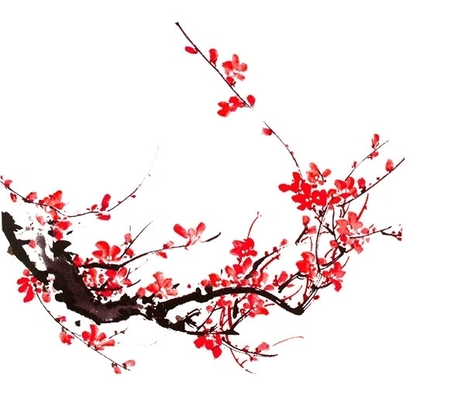
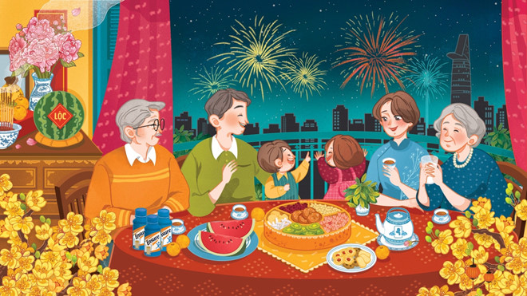
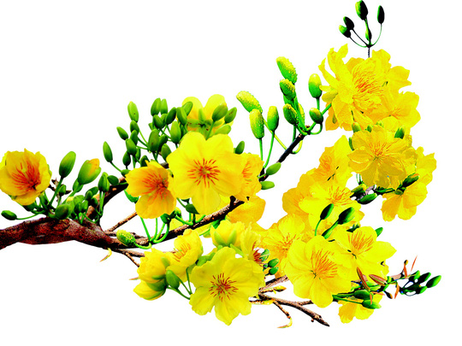
Unit 6: oUR TET HOLIDAY

Slide 3
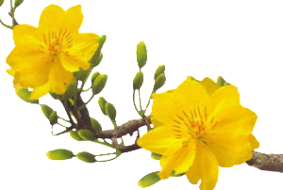
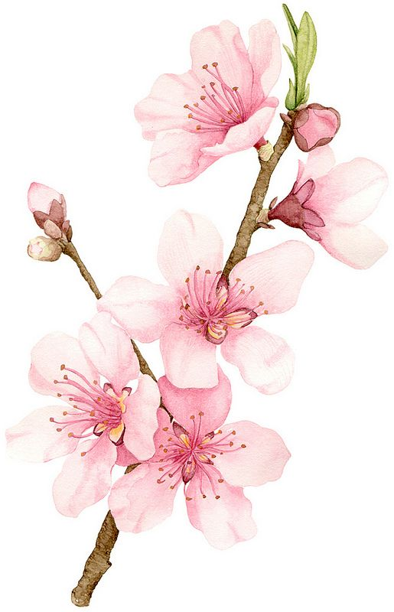
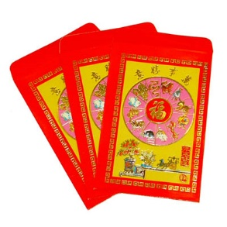
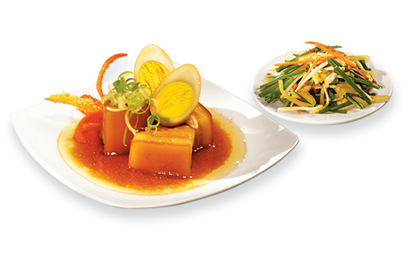
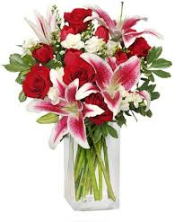
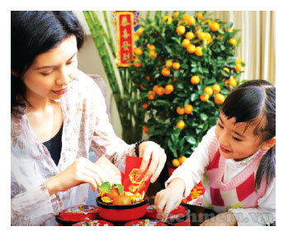
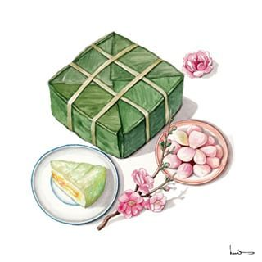
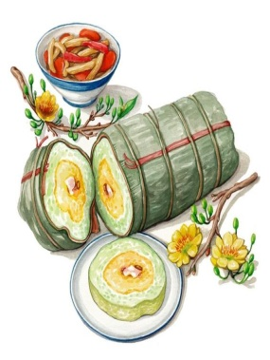
NETWORK
apricot blossoms
lucky money
peach blossoms
TET HOLIDAY
Things for Tet
great food
fireworks
flowers
house decorations
Banh Chung and Banh Tet

Slide 4
Unit 6: oUR TET HOLIDAY
LESSON 2

Slide 5
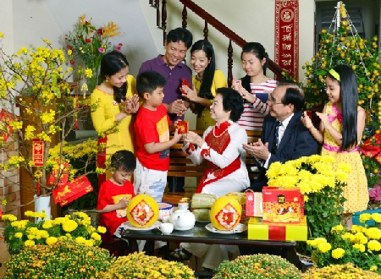
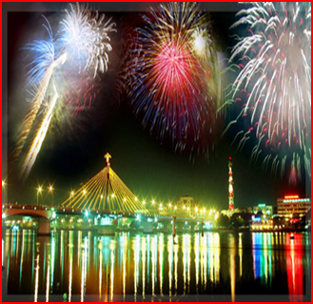
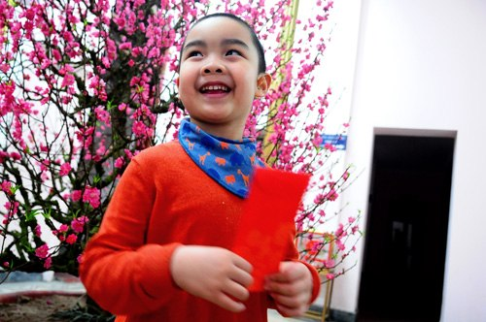
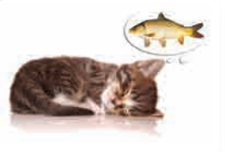
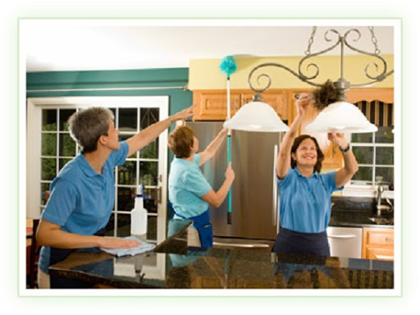
* Vocabulary
- visit relatives:
thăm họ hàng
- watch fireworks
xem pháo hoa
- Wish (v/n):
ước, điều ước
- give lucky money
cho tiền lì xì
- Furniture (n):
đồ đạc

Slide 6
* Checking words:
What and Where
wish
watch
fireworks
give
lucky money
Tet holiday
visit relatives
furniture

Slide 7
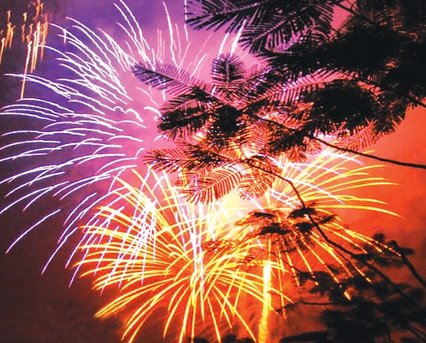
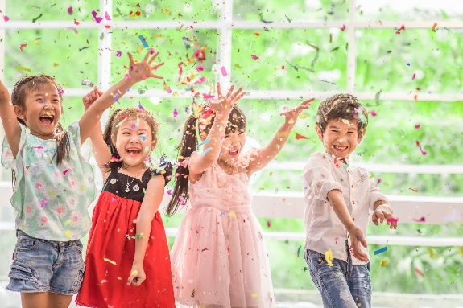
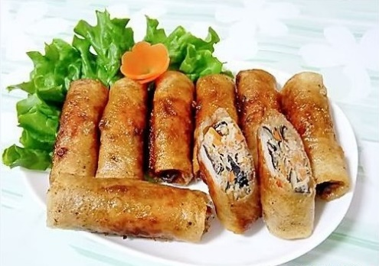
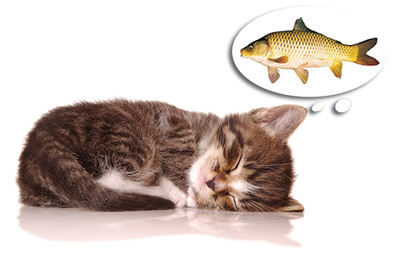
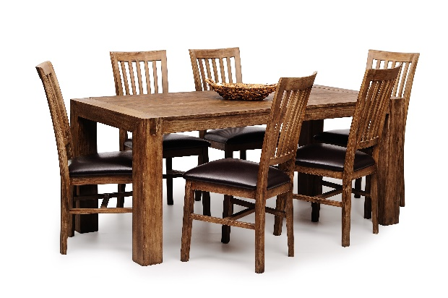
Write the words / phrases in the box under the pictures.
wish
fun
fireworks
special food
furniture
1.
fireworks
2.
special food
3.
fun
4.
wish
5.
furniture

Slide 8
Match the verbs with the nouns.
Verbs
Nouns
a. a wish
1. have
f. fun
e. relatives
2. visit
b. fireworks
d. lucky money
3. give
c. the furniture
4. make
d. lucky money
a. a wish
5. clean
e. relatives
c. the furniture
f. fun
6. watch
b. fireworks

Slide 9
Complete the sentences with the words in the box.
shopping
celebrate
clean
food
peach
1.
In Viet Nam, we
celebrate
Tet in January or February.
2.
At Tet, we decorate our houses with
peach
flowers.
3.
Children should help their parents to
clean
their houses.
4.
People do a lot of
shopping
before Tet.
food
5.
My mother usually cooks special
during Tet.

Slide 10
* Pronunciation
/s/ and /ʃ/
Listen and repeat the words.
shopping
special
rice
spring
wish
celebrate

Slide 11
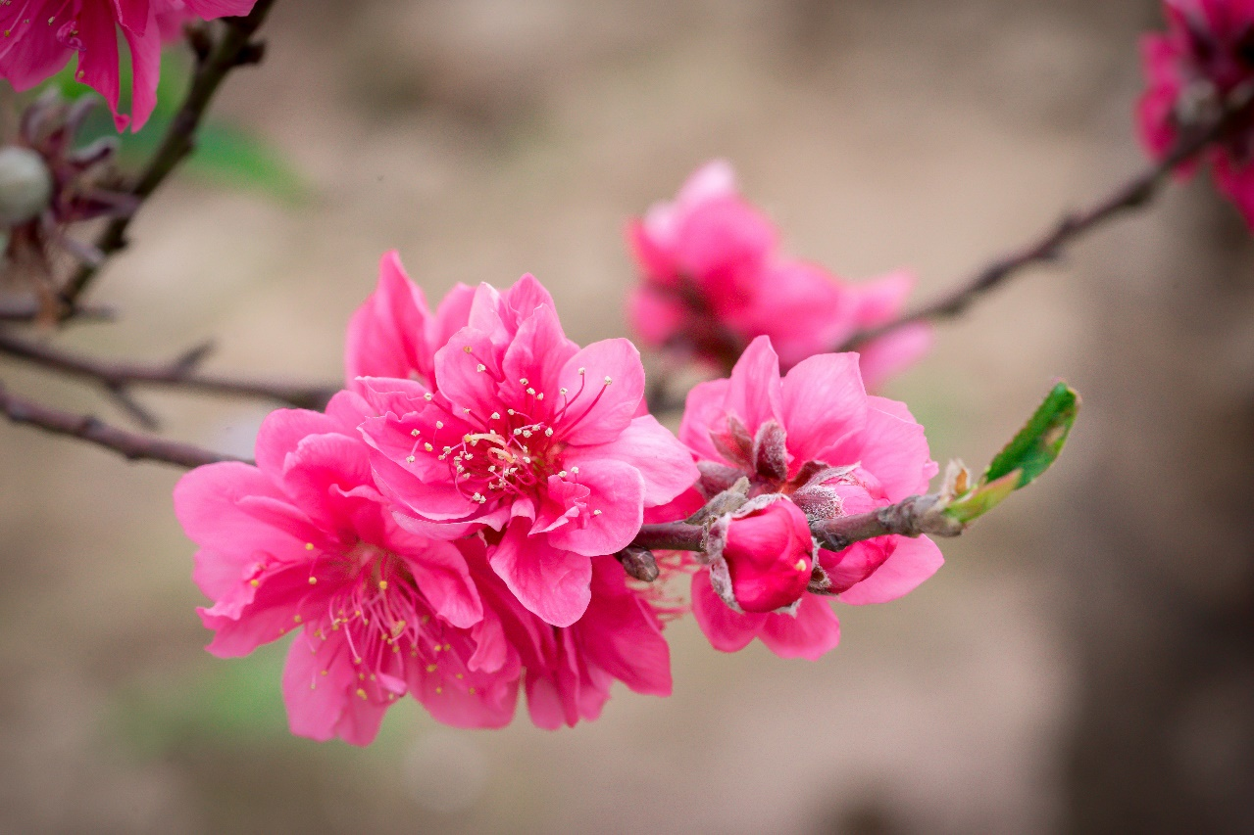
Listen and repeat the poem. Pay attention to the sounds /s/ and /ʃ/ in the underlined words.
Spring is coming!
Tet is coming!
She sells peach flowers.
Her cheeks shine.
Her eyes smile.
Her smile is shy.
She sells peach flowers.

Slide 12
* Production
EX1. Practise saying the following sentences with a focus on the underlined words
1. The policeman showed me the way to the centre.
2. Do you have peach flowers during summer?
3. Children shouldn’t eat too much ice cream.
4. Most countries celebrate the New Year.
5. When Tet comes, everybody makes a wish.

Slide 13
Game: Sentence race
The tongue twister: Seashells
She sells sea shells by the sea shore.
The shells she sells are surely seashells.
So if she sells shells on the seashore.
I'm sure she sells seashore shells.

Slide 14
A. PHONETICS
I. Choose the word whose underlined part is pronounced di¤erently.
1. A. sea | B. sugar | C. sand | D. such
2. A. city | B. office | C. delicious | D. nice
3. A. please | B. some | C. sister | D. see
4. A. spring | B. visit | C. present | D. season
5. A. dance | B. voice | C. race | D. precious

Slide 15
B. VOCABULARY AND GRAMMAR
I. Choose A, B, C, or D to complete the sentences.
1. Viet Nam _________ Tet according to the lunar calendar.
A. decorates B. celebrates C. makes D. does
2. Would your sister like_______to make banh chung?
A. to learn B. learning C. learn D. learns
3. _________ colours like blue and yellow can make people feel happy.
A. A lot B.Any C.Some D. A
4. I always________ my parents a long and happy life.
A. make B.wish C.celebrate D. have
5. Would you like to invite your_______ to the New Year’s party?
A. cousins B. self C.wishes D.pets
6. I don’t have_________ homework to do at Tet.
A. a little B. many C.a D. any
7. At Tet, we _________ our homes with trees and flowers.
A. paint B. decorate C.celebrate D. hang
8. Trang An in Ninh Binh is a popular tourist ________ of North Viet Nam.
A. attraction B. beauty C. attention D. attentively
9. __________ is very useful when you go camping overnight.
A. sleeping bag B. A compass C. Suncream D. Medicine

Slide 16
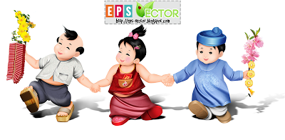
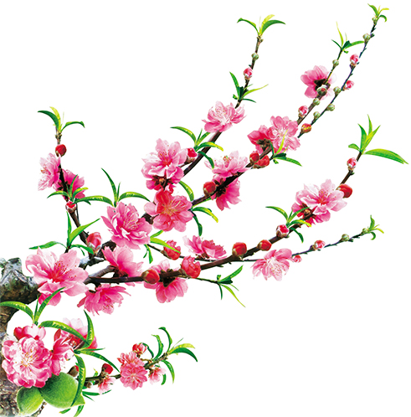
Homework
Learn by heart all new words.
Do exercises on workbook.
Prepare A closer look 2.

Slide 17
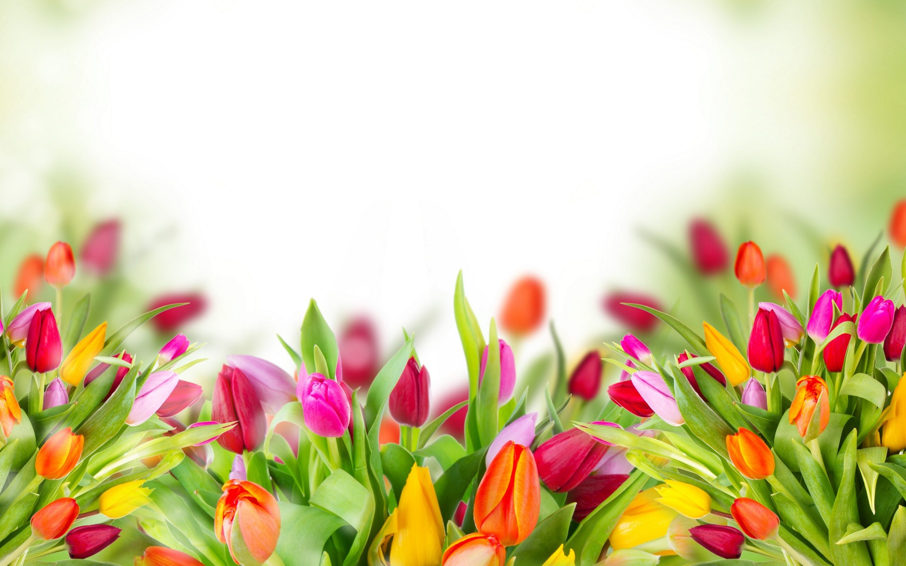
Thank you!
Have a nice day!

