Slide 2
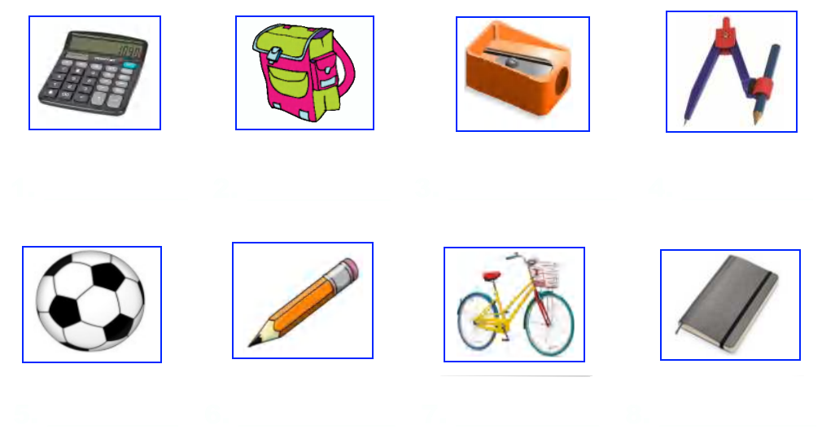
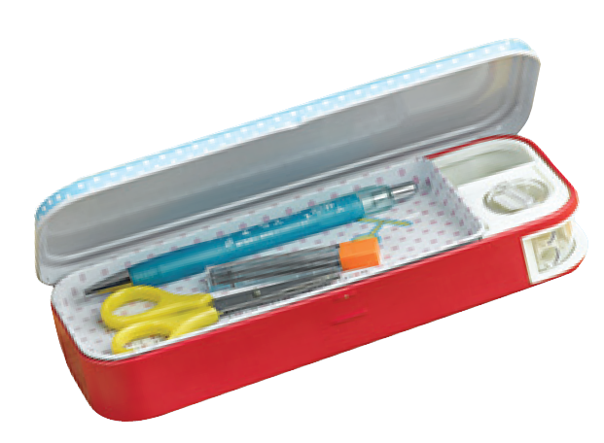
WARM-UP:
Give the names of school things in the pictures.
calculator
schoolbag
pencil-sharpener
compass
pencil case
pencil
bicycle
notebook

Slide 3
UNIT 1: MY NEW SCHOOL
LESSON 2:

Slide 4
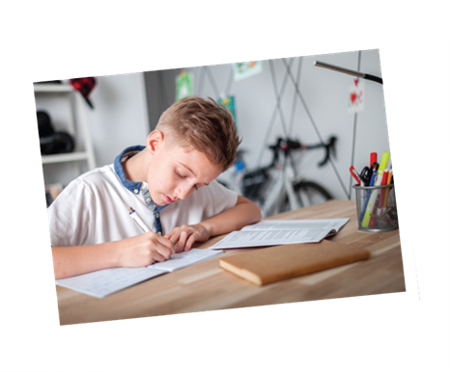
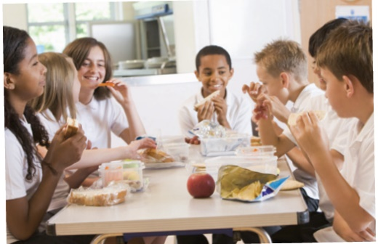
* Vocabulary
- exercise (n):
bài tập
- history (n):
lịch sử
- lesson (n) :
bài học
- science (n) :
môn khoa học
- school lunch :
bữa trưa ở trường

Slide 5
Checking Vocabulary:
Rub out and remember
(n): bài tập, tập thể dục
(n) : lịch sử
(n) : bài hoc
(n): bữa trưa ở trường
(n) : môn khoa học
exercise
history
lesson
school lunch
science

Slide 6
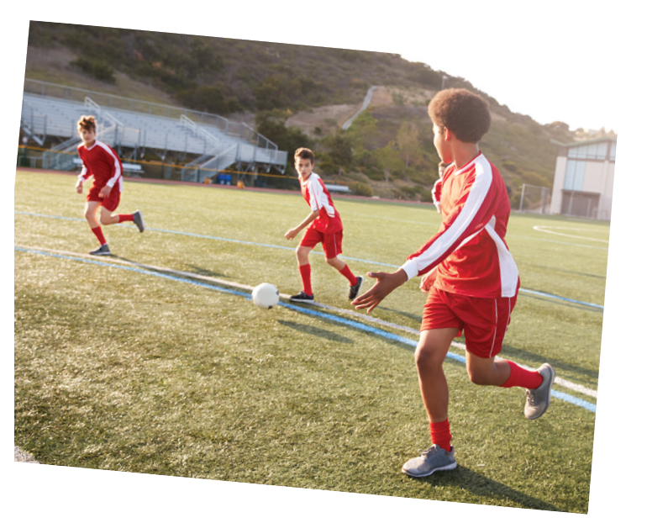
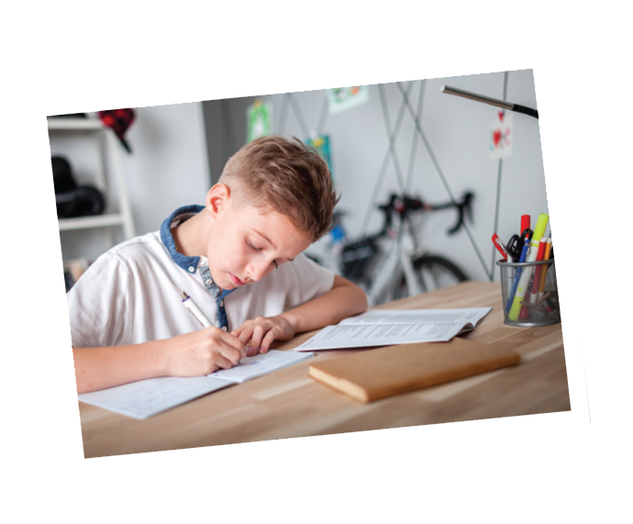
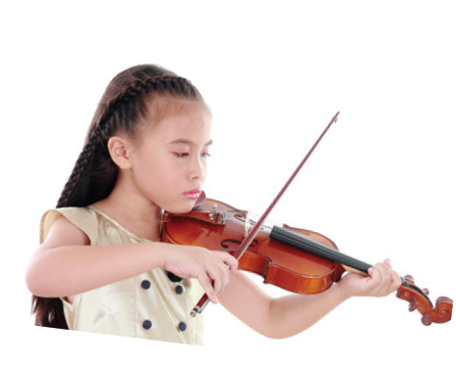
Listen and repeat the words.
Vocabulary
school lunch
exercise
English
science
history
football
homework
lessons
music

Slide 7
NOTES:
1 – DO: Kết hợp với các danh từ chỉ các hoạt động giải trí hoặc các môn thể thao trong nhà, không liên quan tới trái bóng, thường mang tính cá nhân và không mang tính chiến đấu, ganh đua.
Ví dụ: do yoga, karate, judo, exercise…
2 – PLAY: Kết hợp với các danh từ chỉ môn thể thao liên quan đến trái bóng hoặc một vật tương tự trái bóng như trái cầu/ quả cầu; nhạc cụ (musical instument). Ví dụ: play football, volleyball, tennis, guitar, piano…
3 – STUDY: Đứng trước các danh từ chỉ một môn học, một lĩnh vực, một đề tài nghiên cứu.
Ví dụ: study Math, English, literature, chemistry…
4 – HAVE: Trước các danh từ để diễn đạt sự sở hữu. Ví dụ: have a car, a book, a shirt, a house…

Slide 8
Work in pairs. Put the words in 1 in the correct columns.
football
school lunch
history
football
school lunch
history
science
homework
science
English
homework
English
music
lessons
music
exercise
lessons
exercise
play | do | have | study
football
homework
school lunch
English
music
exercise
lessons
history
science
volleyball
The housework
A new uniform
IT
Can you add more
words to each column?

Slide 9
Put one of these words in each blank.
* GAME:
WHO’S FASTER
lessons
science
homework
football
exercise
1.
Vy and I often do our after school.
2.
Nick plays for the school team.
3.
Mrs Nguyen teaches all my history .
4.
They are healthy. They do every day.
5.
I study maths, English and on Mondays.

Slide 10
3
4
5
6
2
1
7
WHO’S FASTER ?

Slide 11
homework
1. Vy and I often do our ……………….after school.

Slide 12
football
2. Nick plays ……………….for the school team.

Slide 13
lessons
3. Mrs Nguyen teaches all my history…………….

Slide 14
exercise
4. They are healthy. They do ………….every day.

Slide 15
science
5. I study maths, English and………….on Mondays.

Slide 16
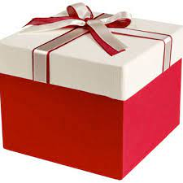
LUCKY apple
YOU GET A GIFT

Slide 17
LUCKY apple
YOU GET A GIFT

Slide 18
Put one of these words in each blank.
lessons
science
homework
football
exercise
homework
1.
Vy and I often do our after school.
Nick plays for the school team.
2.
football
lessons
3.
Mrs Nguyen teaches all my history .
They are healthy. They do every day.
4.
exercise
5.
I study maths, English and on Mondays.
science

Slide 19
* Pronunciation
/ɑ:/ and /ʌ/
Listen and repeat. Pay attention to the sounds /ɑ:/ and /ʌ/.
1
/ɑ:/
2
/ʌ/
smart
subject
art
study
carton
Monday
class
compass

Slide 20
Listen and repeat. Then listen again and underline the words with the sounds /ɑ:/ and /ʌ/.
1.
My brother has a new compass.
/ʌ:/
/ʌ:/
2.
Our classroom is large.
/a:/
/a:/
3.
They look smart on their first day at school.
/a:/
4.
The art lesson starts at nine o’clock.
/a:/
/a:/
5.
He goes out to have lunch every Sunday.
/ʌ:/
/ʌ:/

Slide 21
* Production: Write sentences about yourself using some verbs above.
Suggestion:
Hi, everybody! I am Huy. I study at Tran Hung Dao Secondary School. At school I have many subjects: English, Maths, Physics, History, Science and Music. I love English and I study English well. I have English on Monday, Wednesday and Friday. When I have free time, I usually play football with my friends.

Slide 22
HOMEWORK
- Learn the new words by heart.
- Practice pronunciation “əʊ”, “ʌ” again.
- Do exercises in workbook.
- Prepare for Unit 1: A closer look 2.
+

Slide 23
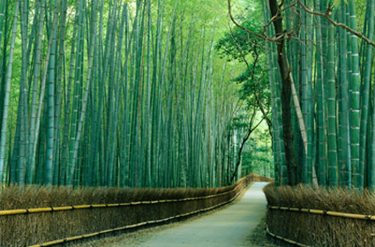
THANKS FOR YOUR ATTENTION!
Goodbye!
See you again!

Slide 24
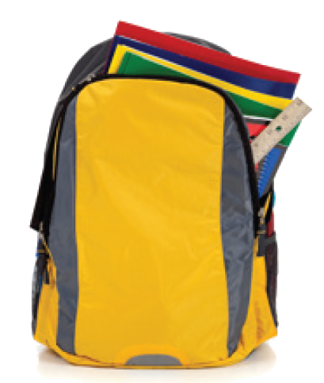
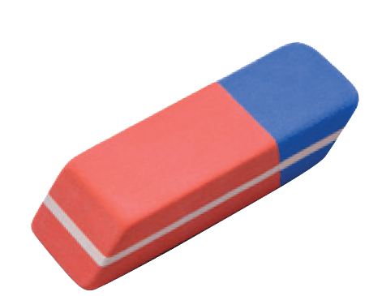
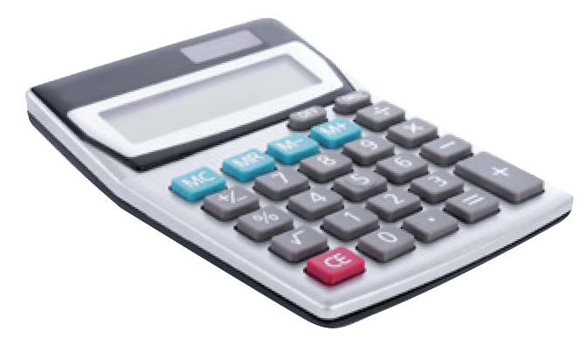
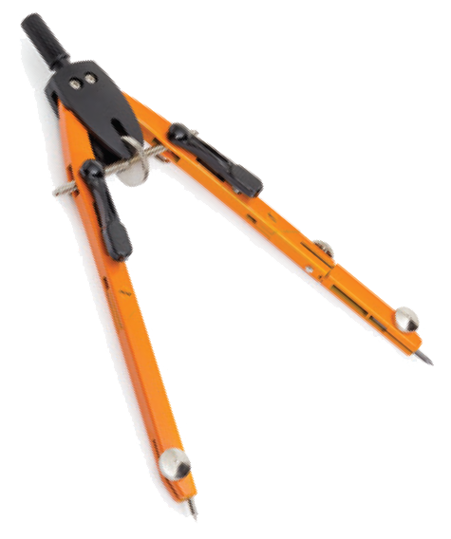
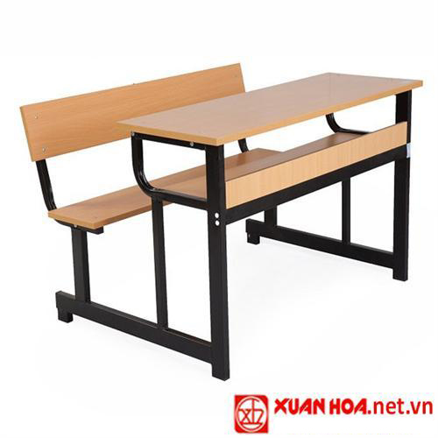
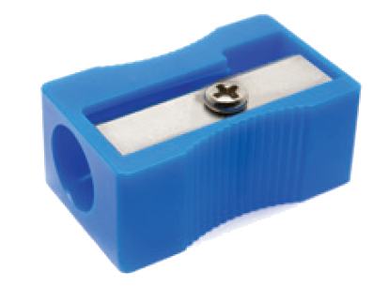
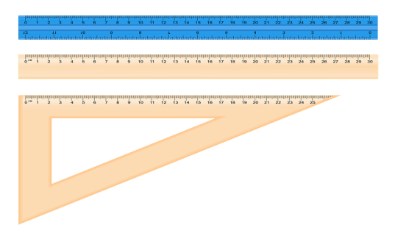
Warm up:
Kim’s game
School things

Slide 25
School-bag
rubber
Pencil case
pencil
School things
School things
caculator
book
compass
ruler
Pencil sharpener
desk

