Slide 1

WELCOME TO
OUR CLASS!
Presented by: ……………..

Slide 2
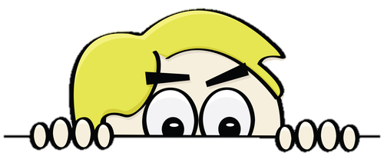
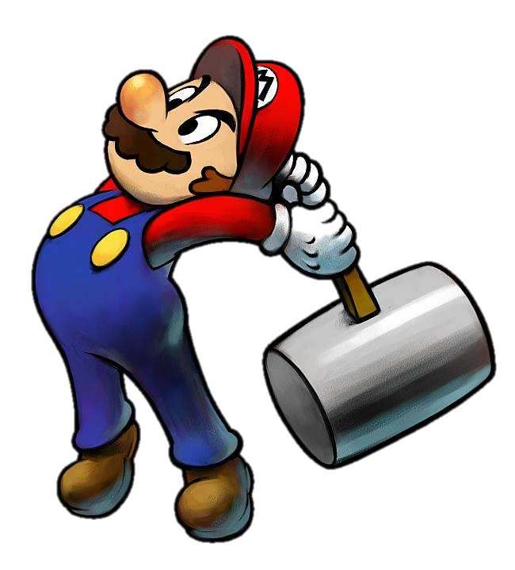
START
What activity is behind the wall?
BRICKS DOWN

Slide 3
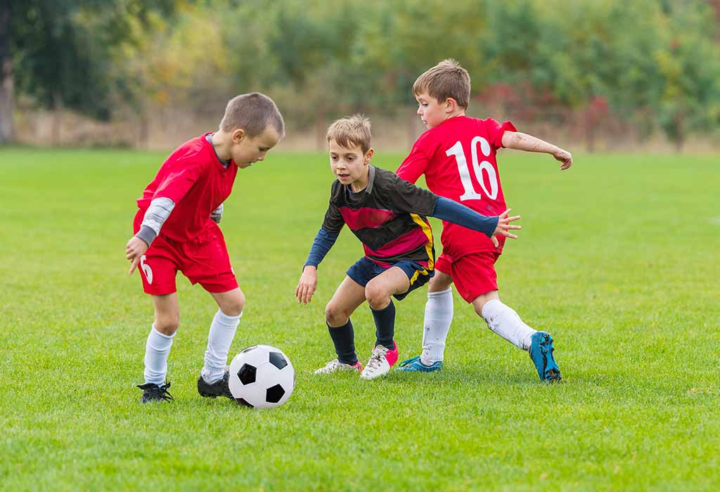
CHECK
NEXT
playing football
Click on the bricks

Slide 4
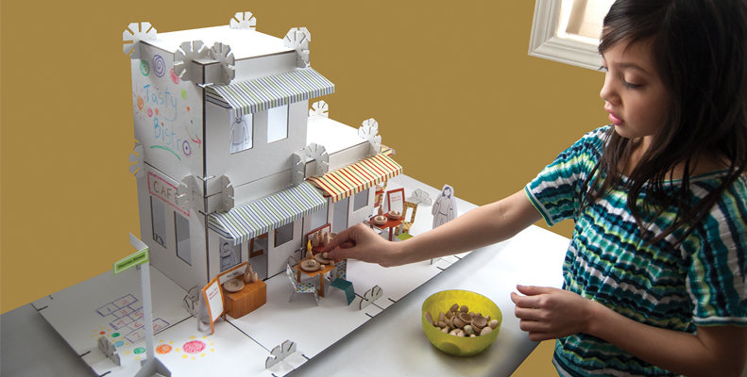
CHECK
NEXT
building dollhouse
Click on the bricks

Slide 5
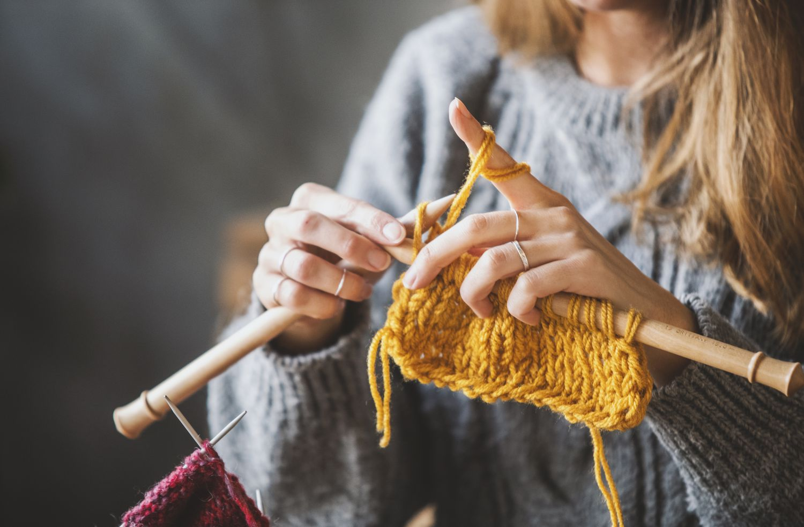
knitting
CHECK
NEXT
Click on the bricks

Slide 6
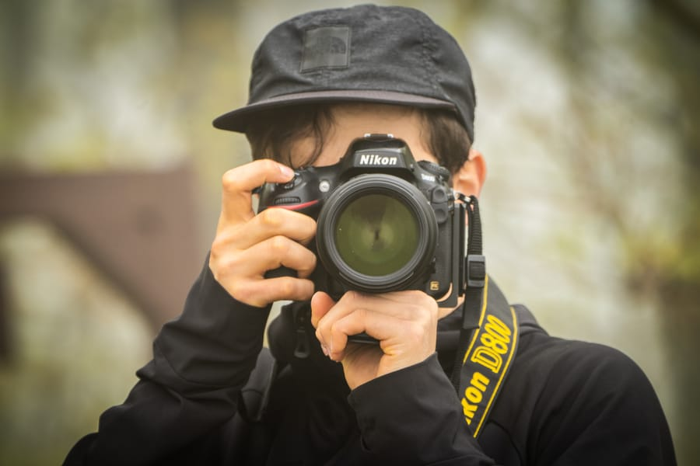
taking photos
CHECK
NEXT
Click on the bricks

Slide 7
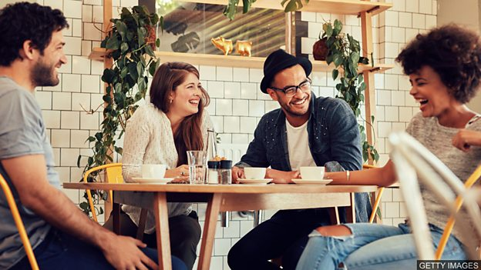
hanging out
CHECK
NEXT
Click on the bricks

Slide 8
……………, September …., 2025
Unit 1:
LEISURE TIME
Lesson 5: Skills 1

Slide 9
VOCABULARY

Slide 10
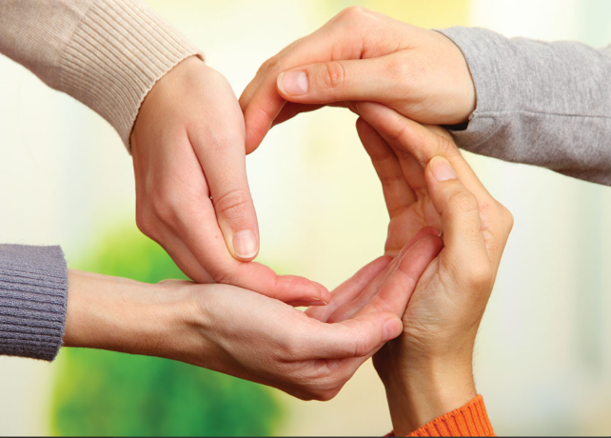

VOCABULARY
connect (v)
/kəˈnekt/
kết nối

Slide 11
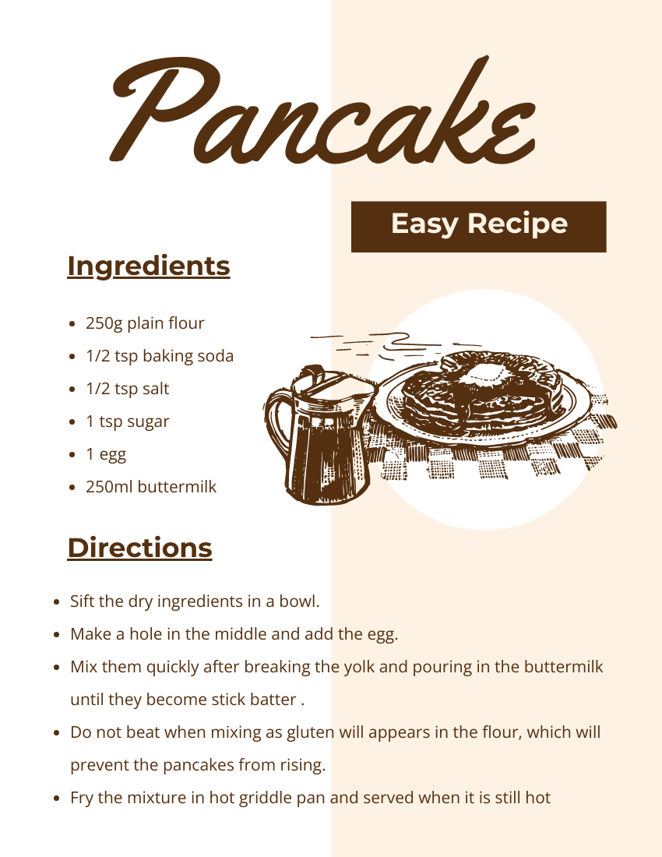
VOCABULARY
recipe (n)
/ˈresəpi/
công thức

Slide 12
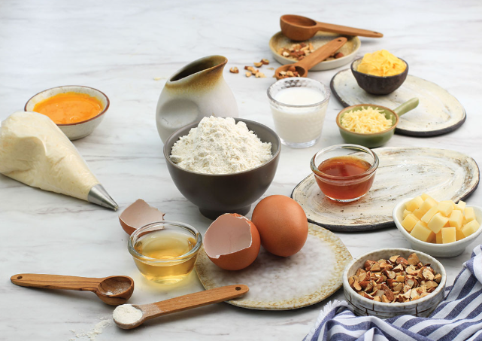
VOCABULARY
ingredient (n)
/ɪnˈɡriːdiənt/
nguyên liệu

Slide 13
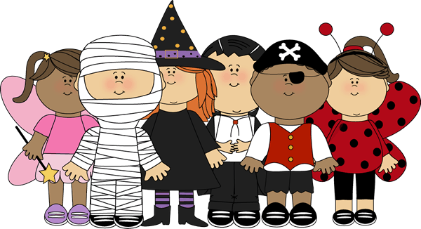
VOCABULARY
costume (n)
/ˈkɒstʃuːm/
trang phục

Slide 14
VOCABULARY
- connect (v) | /kəˈnekt/ | kết nối
- recipe (n) | /ˈresɪpi/ | công thức
- ingredient (n) | /ɪnˈɡriːdiənt/ | nguyên liệu
- costume (n) | /ˈkɒstʃuːm/ | trang phục

Slide 15
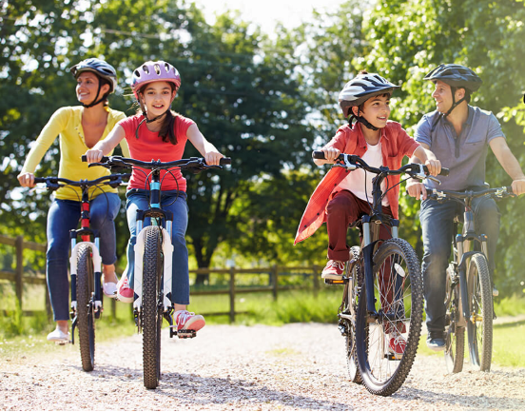
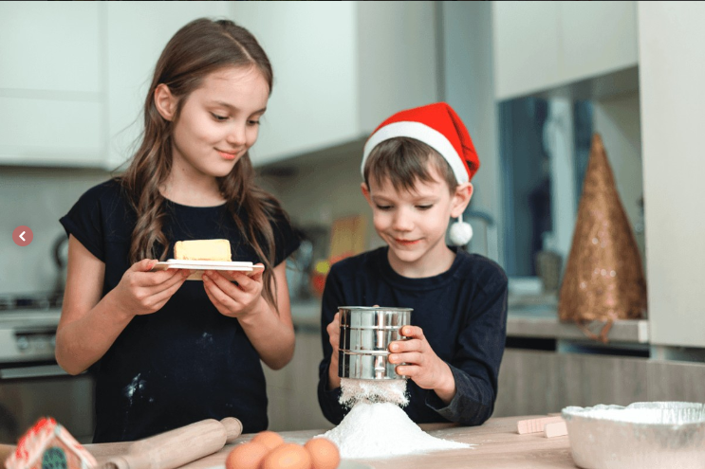
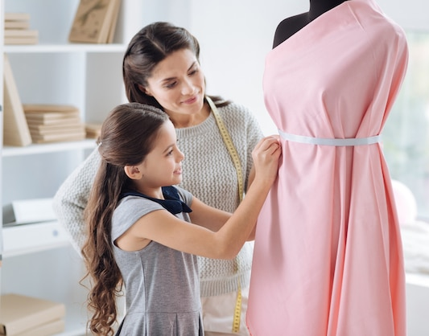
1. Look at the pictures. What activities can you see?
riding a bike/ cycling
cooking
making a dress
LEISURE ACTIVITIES

Slide 16
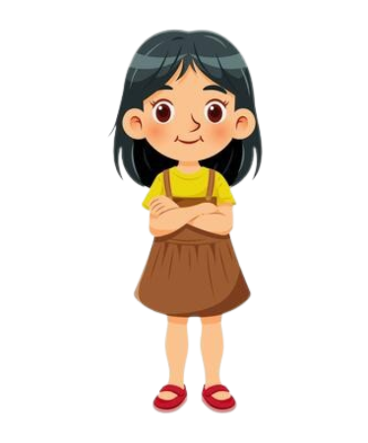
TRANG’S LEISURE ACTIVITIES
TRANG

Slide 17
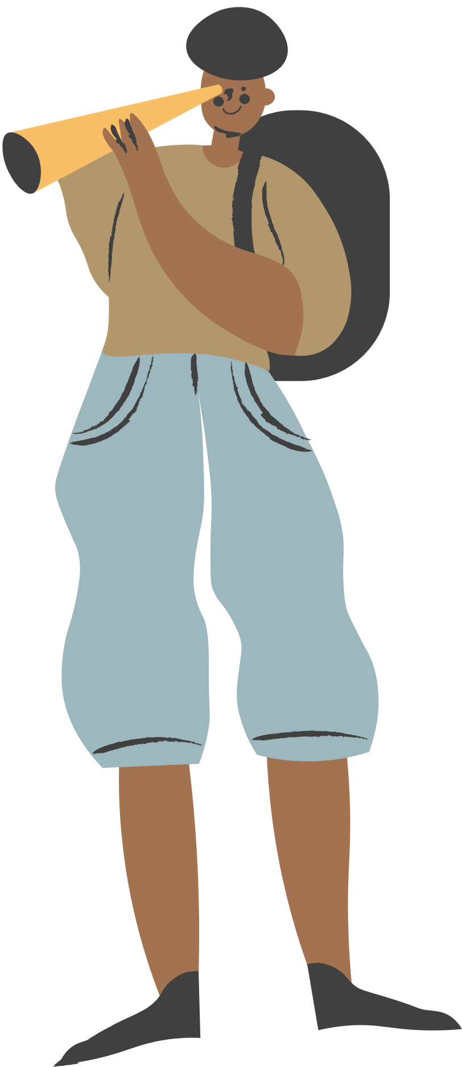
2. Read about Trang’s leisure activities. Choose the correct answer.
1. The text is about Trang’s leisure activities ______.
A. in the past
B. with her friends
C. with her family
2. The word “connect” is closest in meaning to ______.
A. join with something
B. better understand someone
C. speak to someone by phone
Some teenagers enjoy spending free time with their friends. Others prefer doing leisure activities with their family members. I love spending time with my family because it’s a great way to connect with them.
At the weekend, we usually go for a bike ride. We cycle to some nearby villages to enjoy the fresh air. We take photos and look at them later. My big brother and I are also into cooking. My brother looks for easy recipes. After that, we prepare the ingredients and cook. Sometimes, the food is good, but sometimes it isn’t; nevertheless, we love whatever we cook. The leisure activity I like the most is doing DIY projects with my mum. She teaches me to make my own dresses and doll clothes. On special occasions, we make special dresses together. Once I won the first prize in a costume contest at my school.

Slide 18
Check the answers
Some teenagers enjoy spending free time with their friends. Others prefer doing leisure activities with their family members. I love spending time with my family because it’s a great way to connect with them.
1. The text is about Trang’s leisure activities ______.
A. in the past
B. with her friends
C. with her family

Slide 19
Check the answers
Some teenagers enjoy spending free time with their friends. Others prefer doing leisure activities with their family members. I love spending time with my family because it’s a great way to connect with them.
2. The word “connect” is closest in meaning to ______.
A. join with something
B. better understand someone
C. speak to someone by phone

Slide 20
3. Read the text again and answer the questions.
1. What does Trang do with her family members at the weekend?
2. Who looks for recipes when Trang and her brother cook?
3. Which leisure activity does she love the most?
4. What does Trang’s mum teach her to do?
5. What did she win?
Notes:
GROUP DISCUSSION

Slide 21

Check the answers
Some teenagers enjoy spending free time with their friends. Others prefer doing leisure activities with their family members. I love spending time with my family because it’s a great way to connect with them.
At the weekend, we usually go for a bike ride. We cycle to some nearby villages to enjoy the fresh air. We take photos and look at them later. My big brother and I are also into cooking. My brother looks for easy recipes. After that, we prepare the ingredients and cook. Sometimes, the food is good, but sometimes it isn’t; nevertheless, we love whatever we cook. The leisure activity I like the most is doing DIY projects with my mum. She teaches me to make my own dresses and doll clothes. On special occasions, we make special dresses together. Once I won the first prize in a costume contest at my school.
1. What does Trang do with her family members at the weekend?
She goes for a bike ride, cooks, and does DIY projects.

Slide 22
Check the answers
Some teenagers enjoy spending free time with their friends. Others prefer doing leisure activities with their family members. I love spending time with my family because it’s a great way to connect with them.
At the weekend, we usually go for a bike ride. We cycle to some nearby villages to enjoy the fresh air. We take photos and look at them later. My big brother and I are also into cooking. My brother looks for easy recipes. After that, we prepare the ingredients and cook. Sometimes, the food is good, but sometimes it isn’t; nevertheless, we love whatever we cook. The leisure activity I like the most is doing DIY projects with my mum. She teaches me to make my own dresses and doll clothes. On special occasions, we make special dresses together. Once I won the first prize in a costume contest at my school.
2. Who looks for recipes when Trang and her brother cook?
Her brother does.

Slide 23
Check the answers
Some teenagers enjoy spending free time with their friends. Others prefer doing leisure activities with their family members. I love spending time with my family because it’s a great way to connect with them.
At the weekend, we usually go for a bike ride. We cycle to some nearby villages to enjoy the fresh air. We take photos and look at them later. My big brother and I are also into cooking. My brother looks for easy recipes. After that, we prepare the ingredients and cook. Sometimes, the food is good, but sometimes it isn’t; nevertheless, we love whatever we cook. The leisure activity I like the most is doing DIY projects with my mum. She teaches me to make my own dresses and doll clothes. On special occasions, we make special dresses together. Once I won the first prize in a costume contest at my school.
3. Which leisure activity does she love the most?
She loves doing DIY projects with her mum the most.

Slide 24
Check the answers
Some teenagers enjoy spending free time with their friends. Others prefer doing leisure activities with their family members. I love spending time with my family because it’s a great way to connect with them.
At the weekend, we usually go for a bike ride. We cycle to some nearby villages to enjoy the fresh air. We take photos and look at them later. My big brother and I are also into cooking. My brother looks for easy recipes. After that, we prepare the ingredients and cook. Sometimes, the food is good, but sometimes it isn’t; nevertheless, we love whatever we cook. The leisure activity I like the most is doing DIY projects with my mum. She teaches me to make my own dresses and doll clothes. On special occasions, we make special dresses together. Once I won the first prize in a costume contest at my school.
4. What does Trang’s mum teach her to do?
Her mum teaches her to make her own dresses and doll clothes.

Slide 25
Check the answers
Some teenagers enjoy spending free time with their friends. Others prefer doing leisure activities with their family members. I love spending time with my family because it’s a great way to connect with them.
At the weekend, we usually go for a bike ride. We cycle to some nearby villages to enjoy the fresh air. We take photos and look at them later. My big brother and I are also into cooking. My brother looks for easy recipes. After that, we prepare the ingredients and cook. Sometimes, the food is good, but sometimes it isn’t; nevertheless, we love whatever we cook. The leisure activity I like the most is doing DIY projects with my mum. She teaches me to make my own dresses and doll clothes. On special occasions, we make special dresses together. Once I won the first prize in a costume contest at my school.
5. What did she win?
She won the first prize in a costume contest at her school.

Slide 26
Look at the answer again.
1. She goes for a bike ride, cooks, and does DIY projects.
2. Her brother does.
3. She loves doing DIY projects with her mum the most.
4. Her mum teaches her to make her own dresses and doll clothes.
5. She won the first prize in a costume contest at her school.

Slide 27
SPEAKING

Slide 28
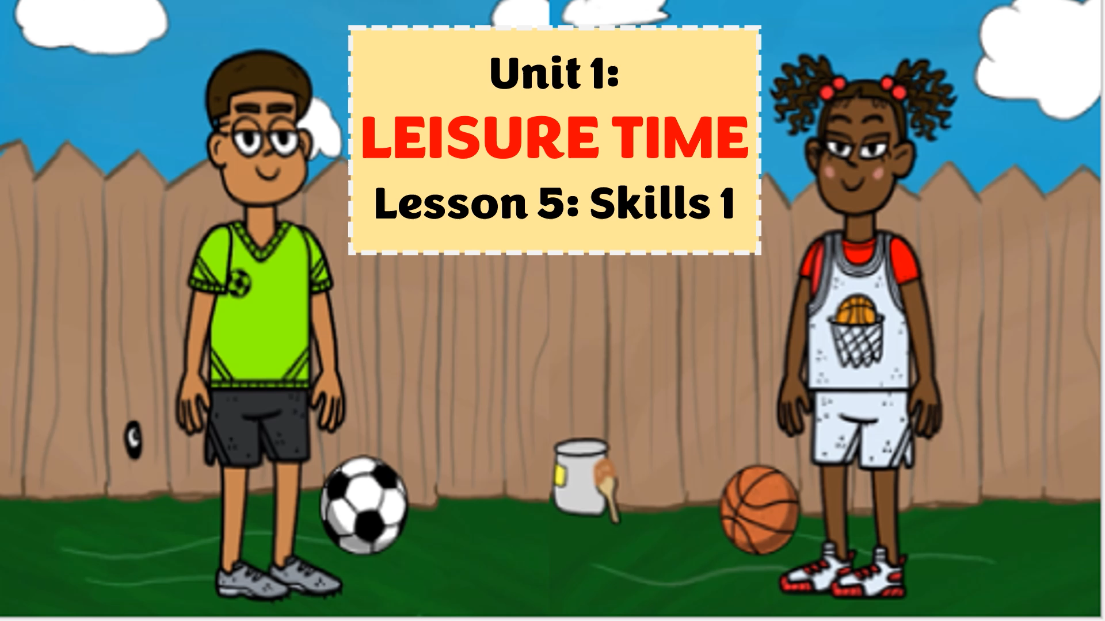
What are they talking about?

Slide 29
4. Work in groups. Take turns to ask and answer the questions. Record your friends’ answer in the table below.
1. What leisure activities do you usually do with your family?
2. Which one do you like the most? Why?
3. How do you feel when you spend time with your family members?
Friends’ name | Questions 1 | Questions 2 | Questions 3

Slide 30
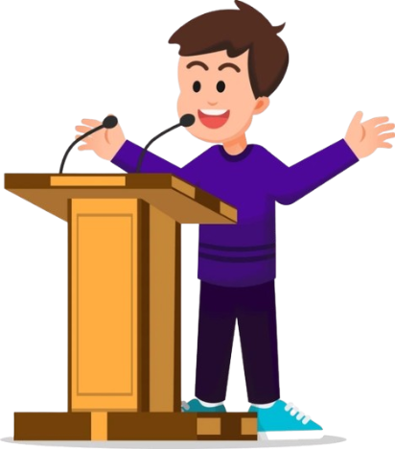
5. Report your group members’ answers to the class. What activities are the most common?
The most common activities is …………

Slide 31


Slide 32
Wrap up
What have you learnt in this lesson?
Read for Trang’s leisure activities
Talk about friends’ leisure activities

Slide 33
HOMEWORK
Learn by heart vocabulary
Talk about your friends’ leisure activities
Prepare: Skills 2

Slide 34
THANK YOU!

