Slide 1
Unit 10 Energy Sources
Lesson 2. A closer look 1

Slide 2
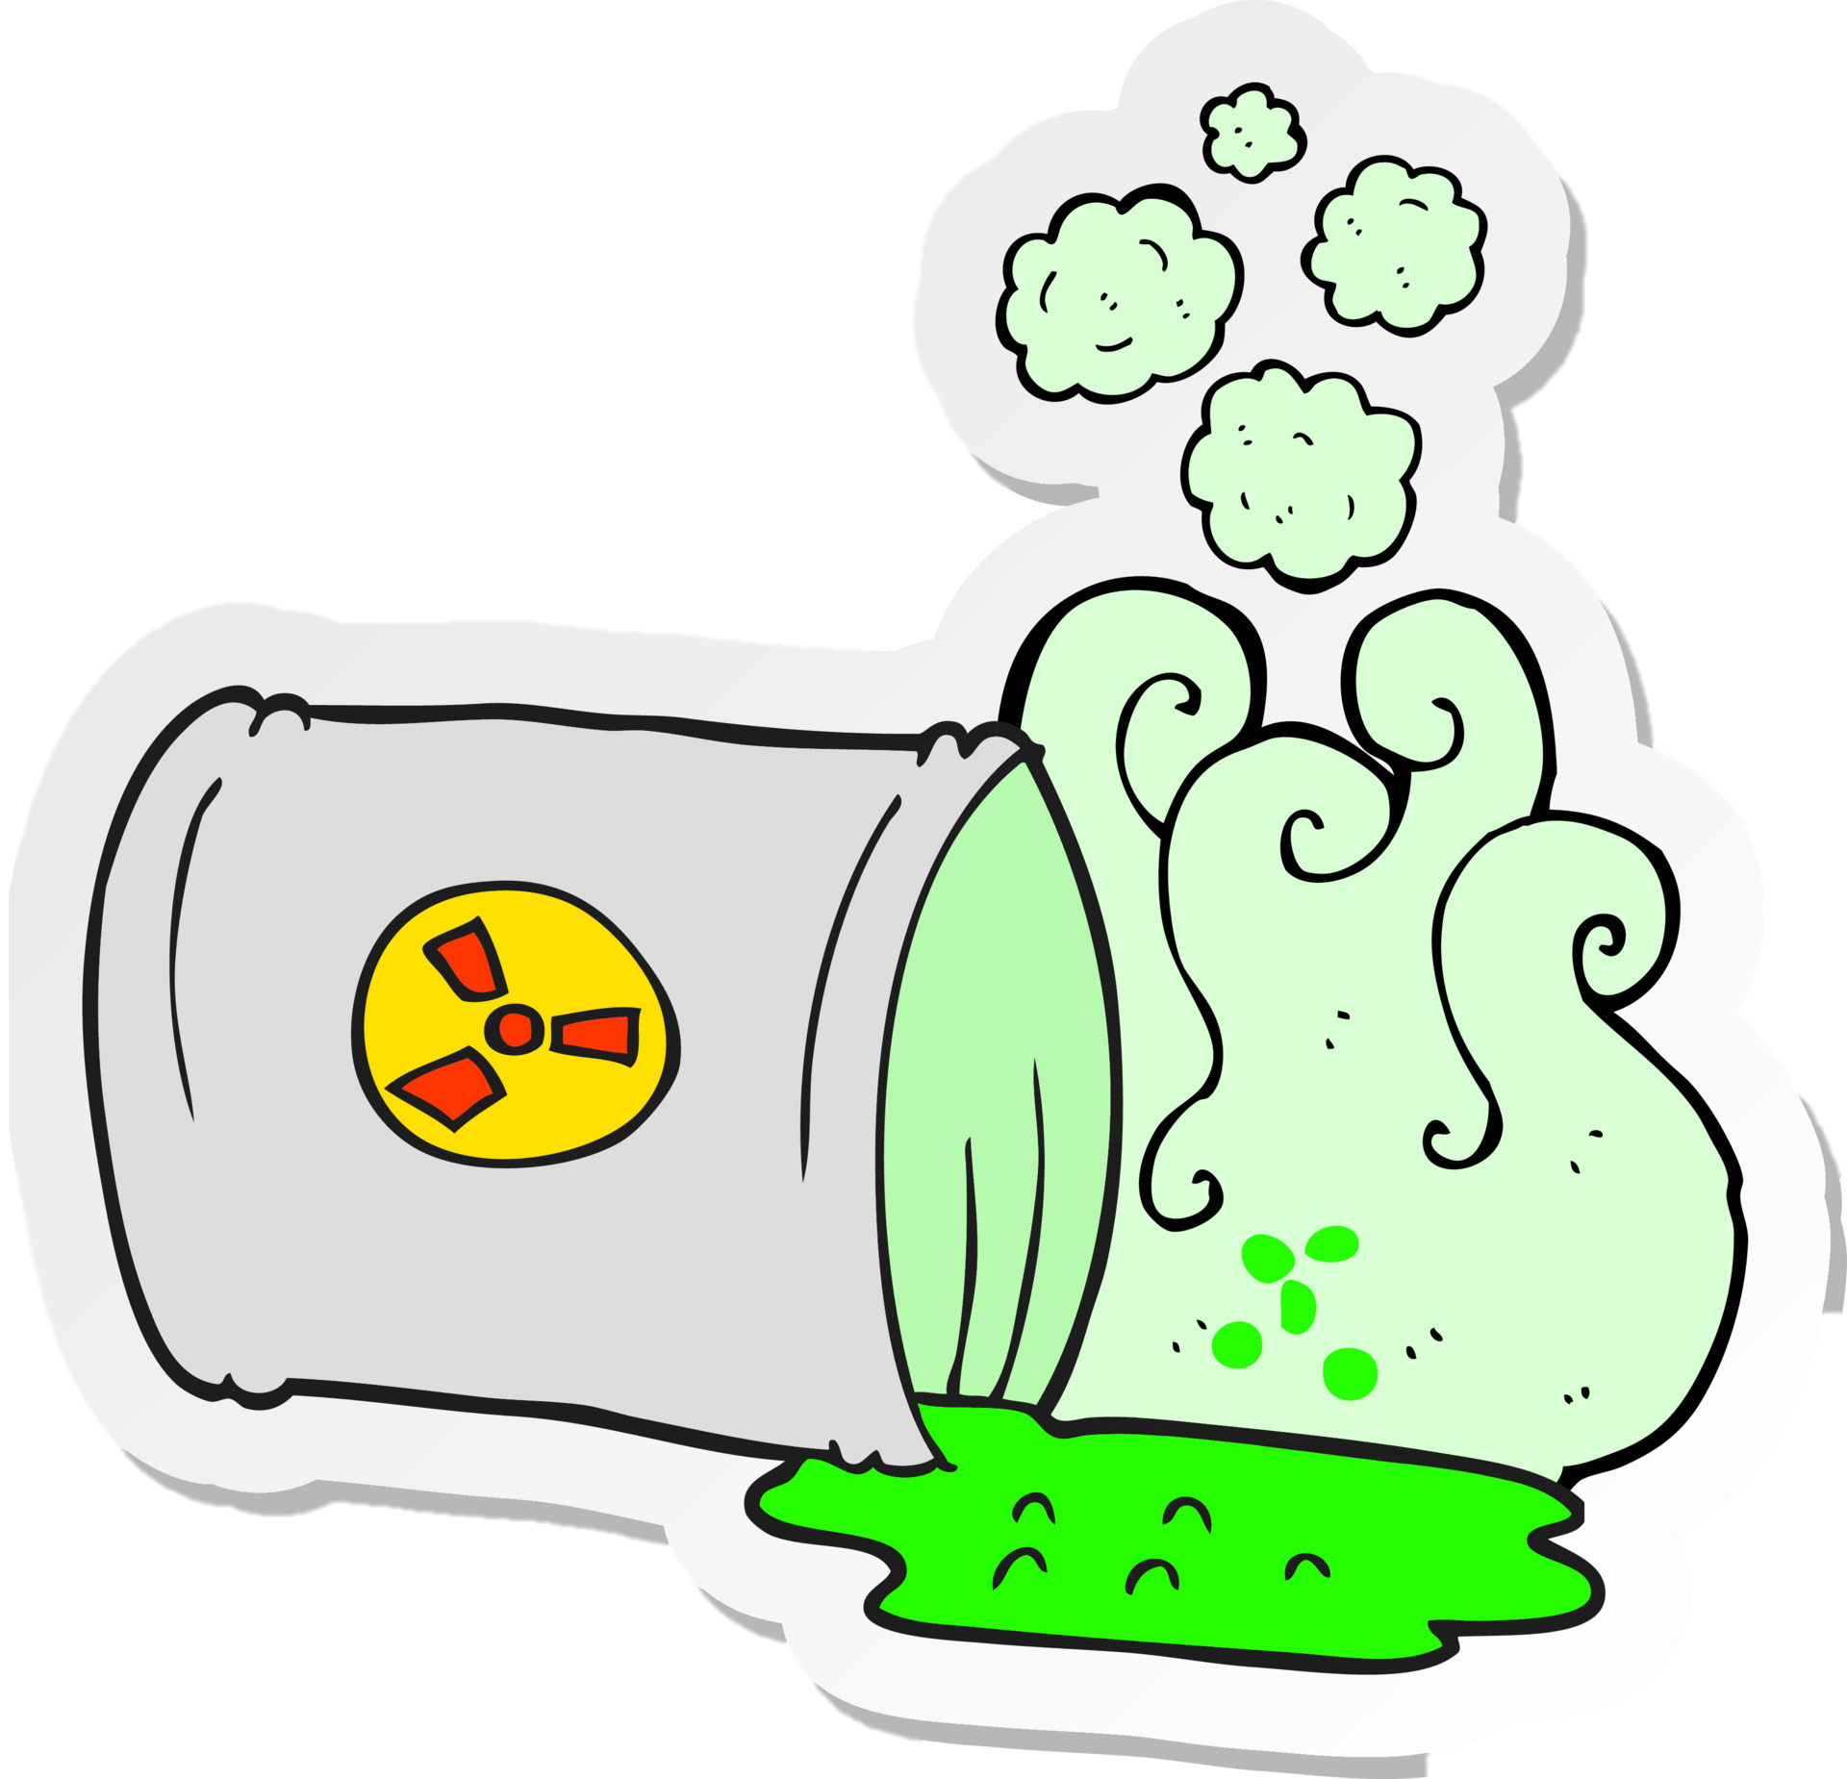
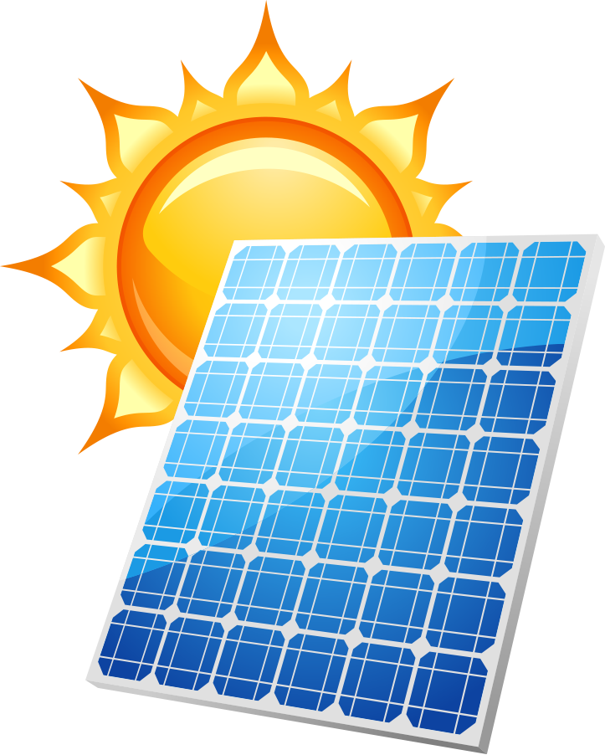
BRAINSTORMING
WIND
WATER
SUN
NUCLEAR
SOLAR PANNEL

Slide 3
OBJECTIVES
By the end of the lesson, students will be able to:
VOCABULARY | Name of energy sources Adjectives to describe about energy sources
PRONUNCIATION | Stress in three-syllable words

Slide 4
VOCABULARY

Slide 5
Ex 1. (p 106) Match the types of energy in A with the energy sources in B.
A B
1. Solar energy
solar energy – the sun
a. water
2. Wind energy
wind energy – wind
b. nuclear
3. Hydro energy
hydro energy – water
c. wind
4. Nuclear energy
nuclear energy – nuclear
d. the sun

Slide 6
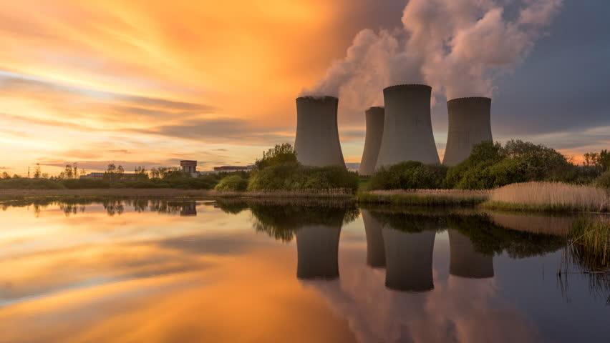
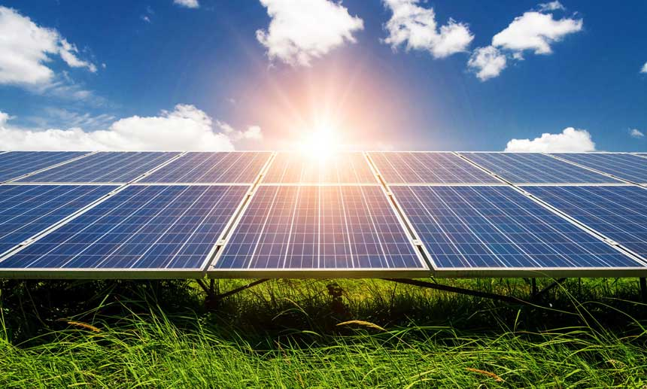
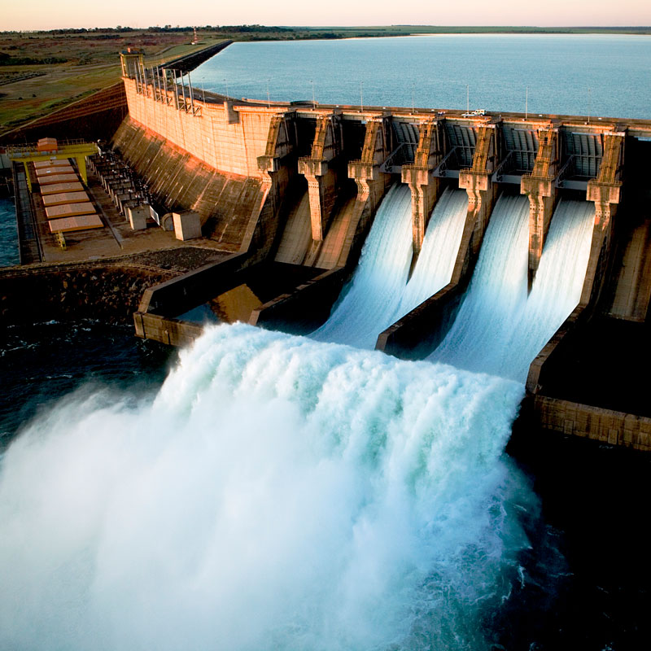
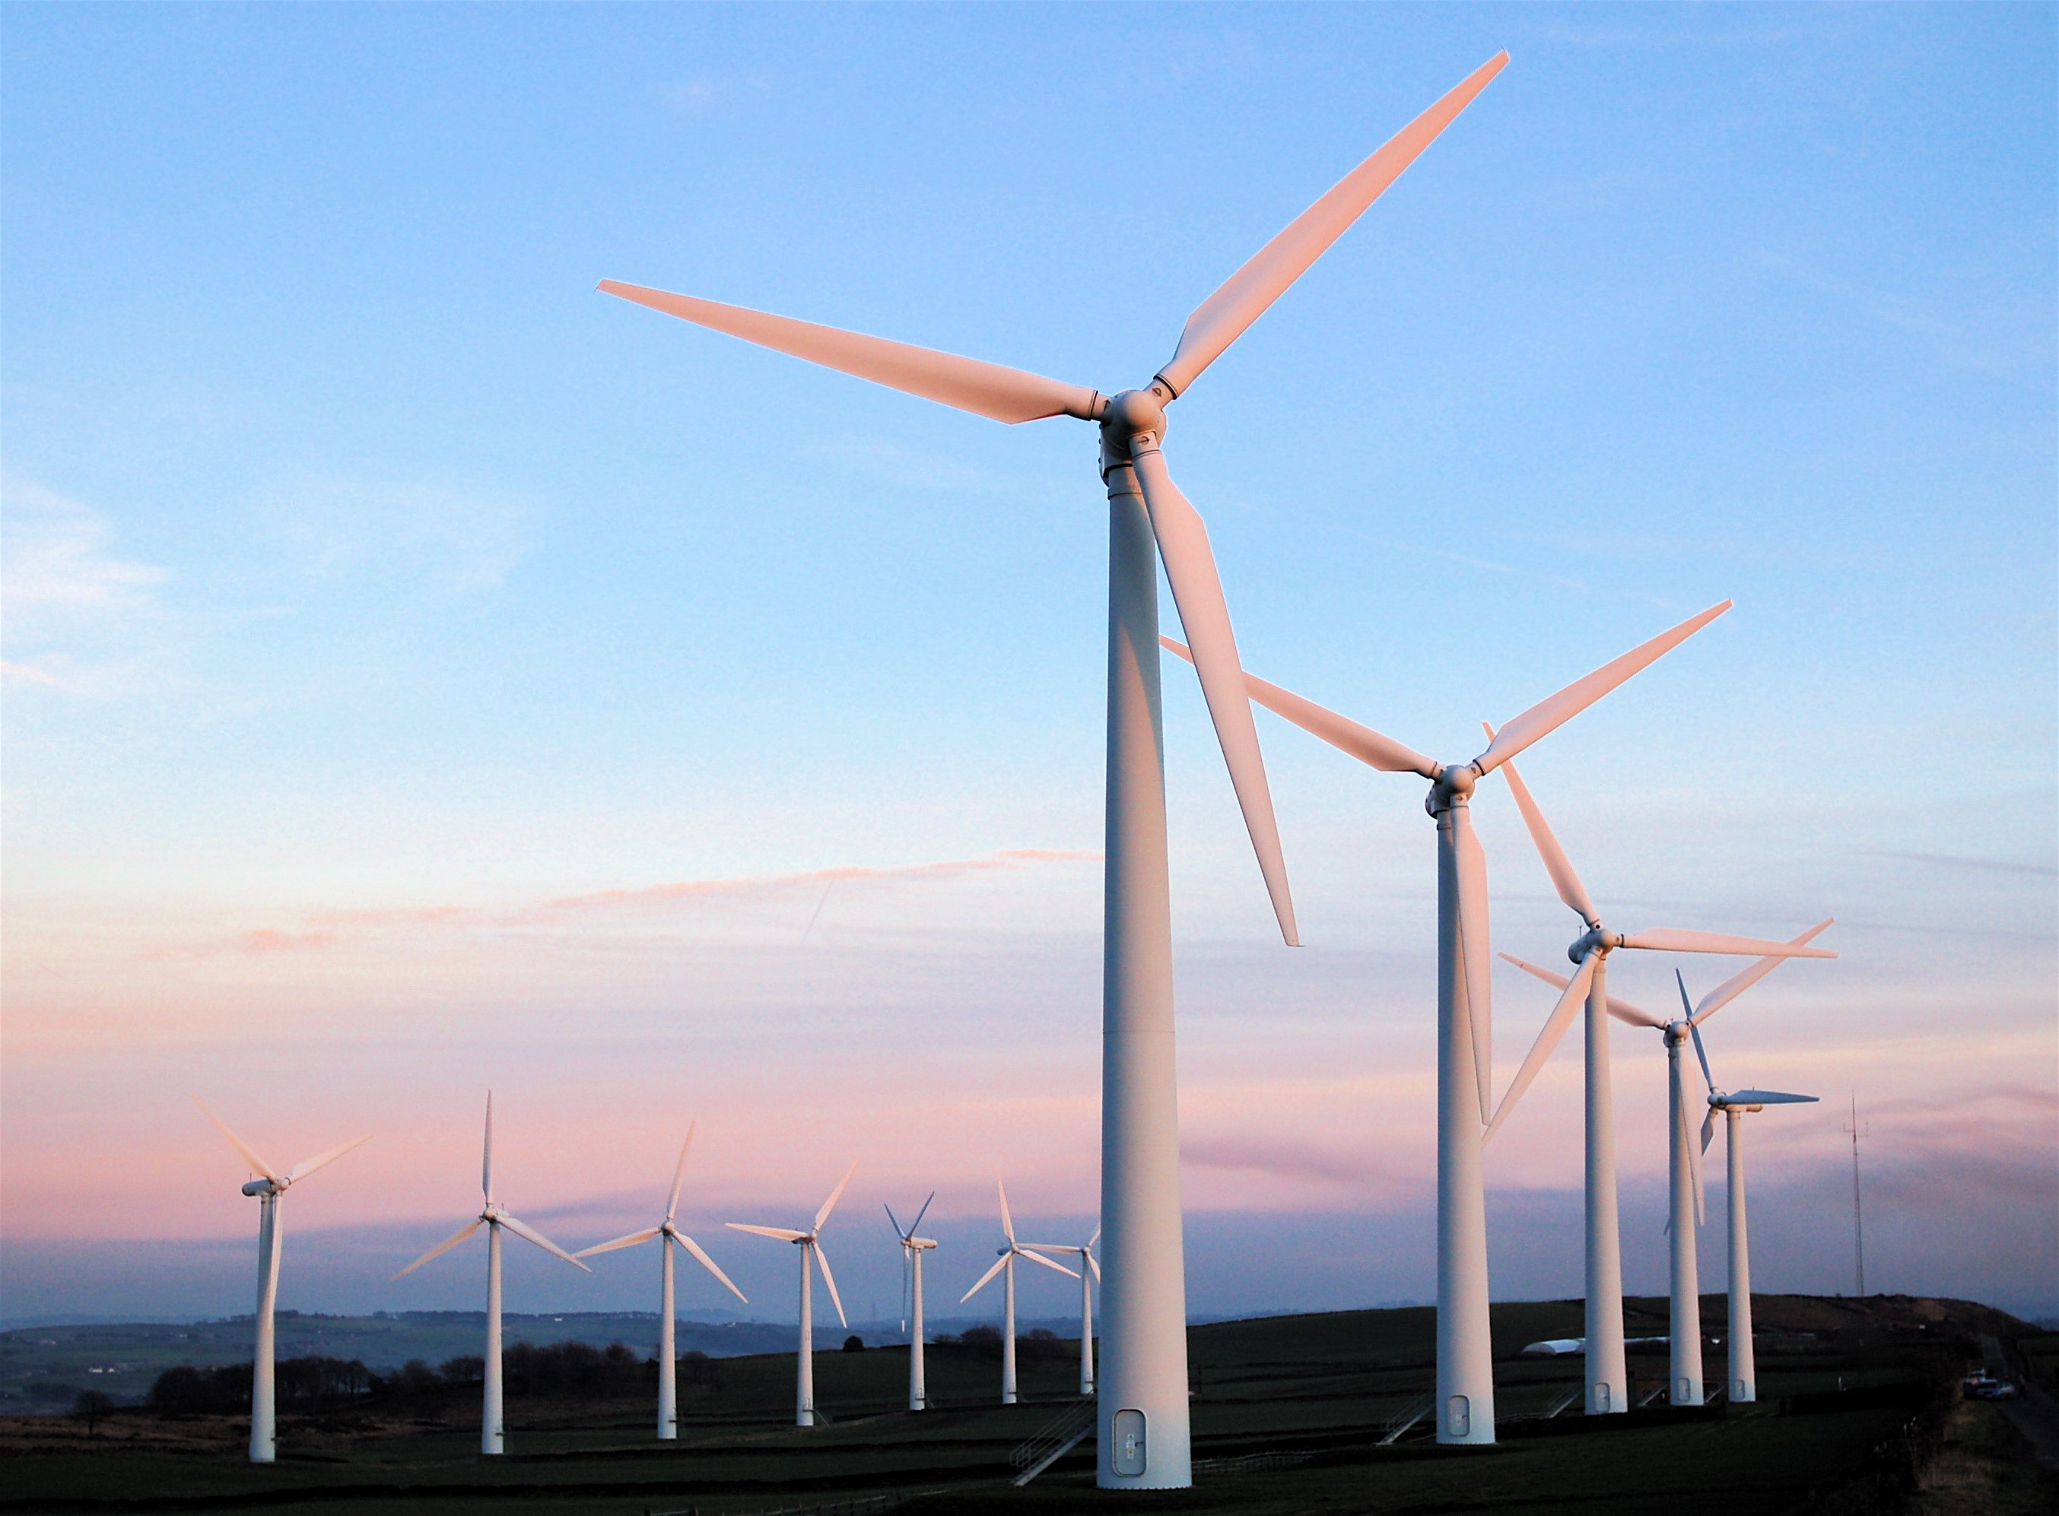
Ex 2. (106) Write the phrases to label the pictures.
Solar energy
Wind energy
Hydro energy
Nuclear energy
1
3
2
4

Slide 7
Ex 3. (p 106) Complete the sentences with the words and phrases from 1 or 2.
01
02
03
04
A good place to change ________ to energy is near the sea because of the sea breezes.
wind
They are putting solar panels on the roof of our building to produce ______________.
solar energy
When energy comes from __________, we call it hydro energy.
water
They are reducing the use of_______________ because it is not safe to produce.
nuclear energy

Slide 8
PRONUNCIATION
Stress in three-syllable words

Slide 9
Ex 4. (p 106) Listen and repeat. Pay attention to the stressed syllables in the words.
'energy
'dangerous
'easily
'government
re'cycle
ex'pensive
po'lluting
re'sources

Slide 10
Ex 5. (p 106) Listen and repeat, paying attention to the stressed syllables in the underlined words.
1 | Nuclear 'energy is 'dangerous and ex'pensive.
2 | We should ride a bike when 'travelling short 'distances.
3 | The word "re'cycle" has three 'syllables.
4 | Burning coal is po'lluting our environment.
5 | Our 'government is looking for new sources of 'energy to replace gas.

Slide 11
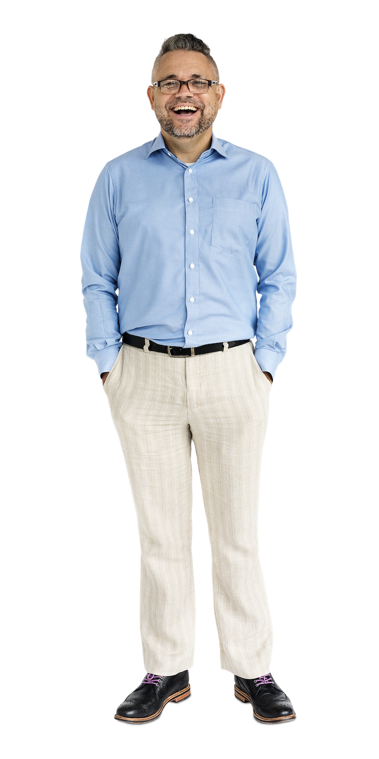
PRONUNCIATION GAME
Listen to the word and decide the stress of it.
1st
2nd
3rd
Cross arm
Sit down
Stand up

Slide 12
PRONUNCIATION GAME
 | WORD | PRONUNCIATION
WORD 1 | electric | /ɪˈlektrɪk/
WORD 2 | different | /ˈdɪfrənt/
WORD 3 | renewable | /rɪˈnjuːəbl/
WORD 4 | replace | /rɪˈpleɪs/
WORD 5 | expensive | /ɪkˈspensɪv/

Slide 13
Thank you!

