Slide 1
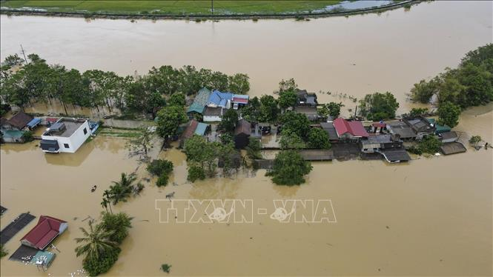
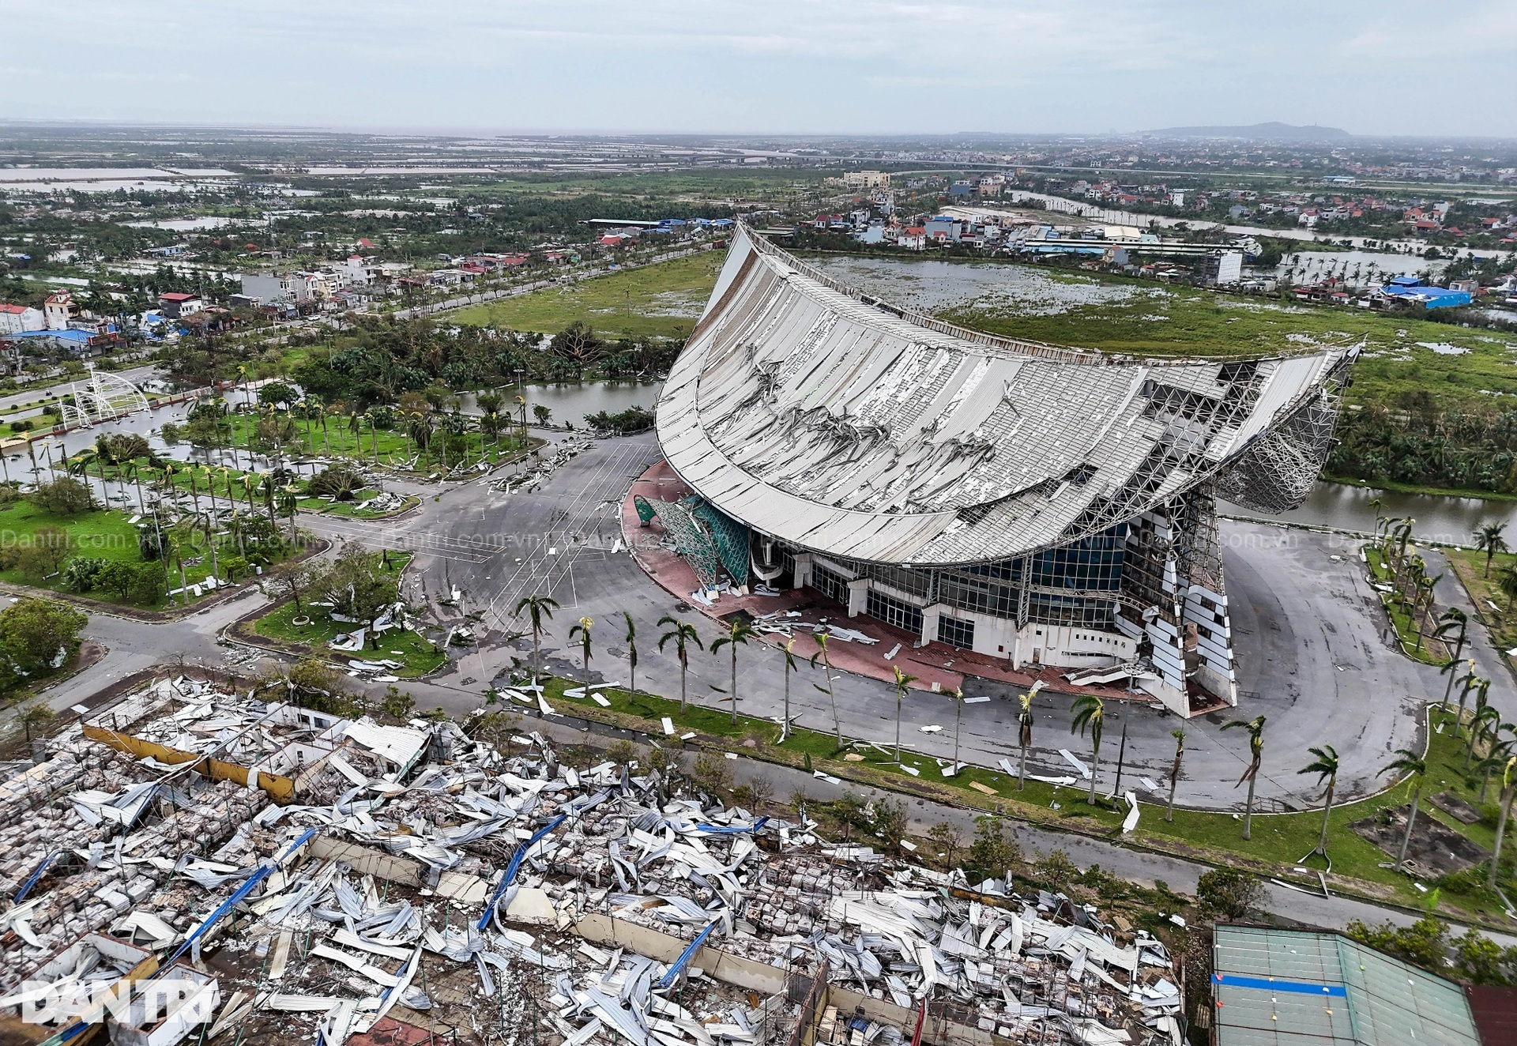
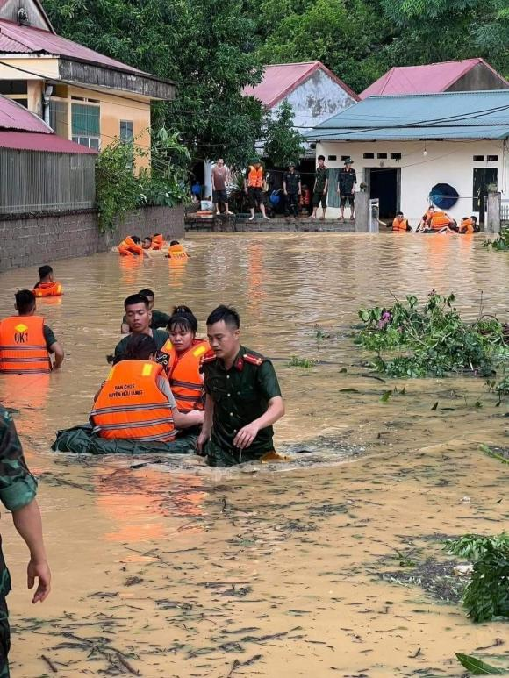
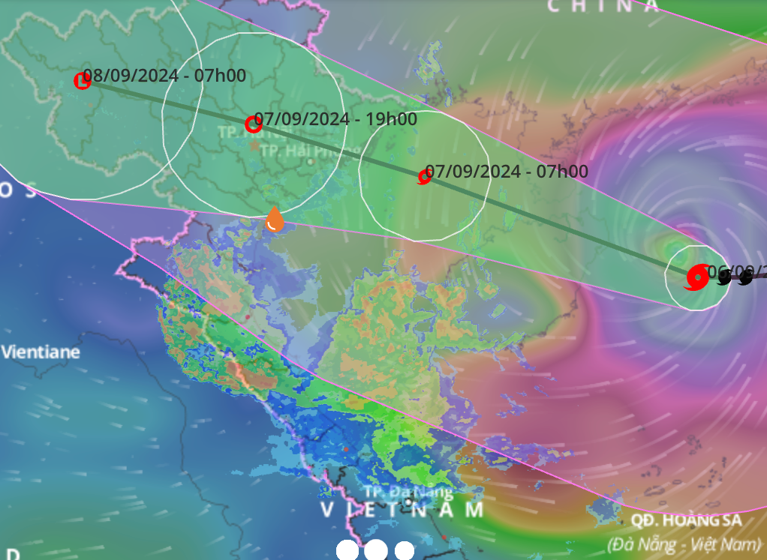
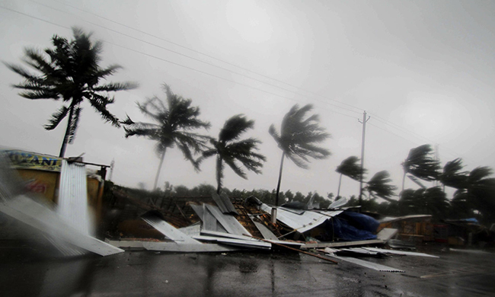
Look at pictures and answer question “what natural disasters are they ?”

Slide 2
“what natural disasters are they ?”

Slide 3
storm
flood

Slide 4
Unit 9. Natural Disasters
Lesson 6. Skills 2

Slide 5
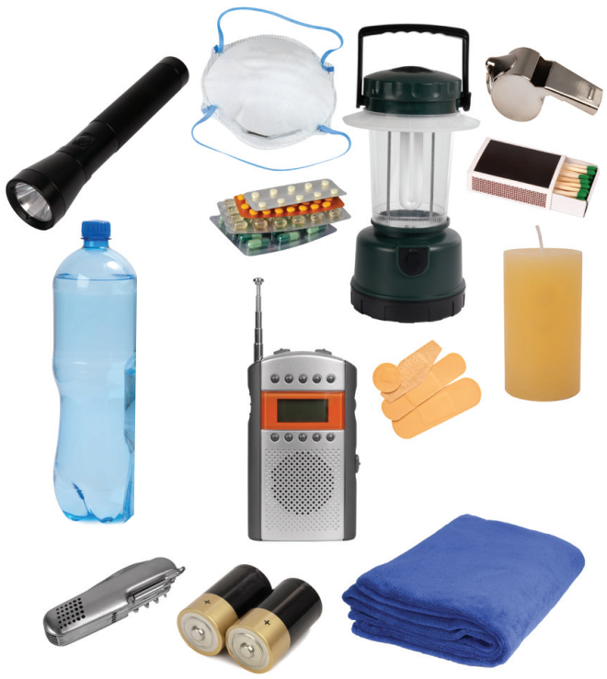
1. What can you see in the picture ?
“This is a quote, words full of wisdom that someone important said and can make the reader get inspired.”
I. LISTENING
A torch, a mask, a lamp, a whistle, a bottle of water, some medicine, matches, a radio, some plasters, a candle, a multi-purpose knife, some batteries, a blanket
2. When do we need these things ?
We need these things when it has a natural disaster.
Notes:
Divide the class into 2 teams and write the names of the objects in the picture within 3 minutes
Torch
Mask
Bottle water
Medicine
Matches
Whistle
walkie talkie
Candle
Knife
Towel
Battery
electric lamp

Slide 6
Example: there will be a storm next week.
Do you prepare an emergency kit before the storm ?
Emergency kit

Slide 7
Task 2. Listen to a broadcast. Put the activities (1 – 6) in the correct column.
During a storm
After a storm
Before a storm
3
5
1
4
2
6
1. Listen to instructions from local authorities
4. Keep away from dangerous areas
2. Prepare an emergency kit
5. Avoid windows and glass doors
3. Stay inside the house
6. Strengthen houses

Slide 8
Task 3. Listen again and tick T (True) or F (False) for each sentence.
 | True | False
1. The broadcast is on TV.
2. You should bring flowerpots and rubbish bins into the house.
3. Right after the storm, you can leave your home.
4. The local authority may warn you about dangerous places.
Proof
This is An Binh Commune Radio Station.
Bring in outdoor things like flowerpots or rubbish bin because they can get blown away by strong winds.
After the storm, don't leave your house right away.
Listen to important instructions from local authorities. They may warn you about which parts of your area are dangerous and should be avoided.

Slide 9
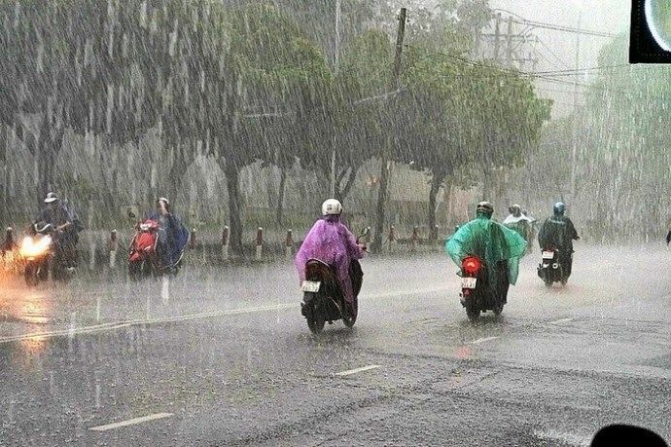
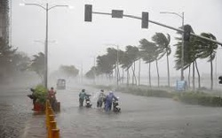

Slide 10
II. WRITING
To reduce flood’s damage, What should we do before, during and after a flood?

Slide 11
II. WRITING TASK 4: Work in pairs. Discuss what you should do before, during, and after a flood. Write your ideas in the columns.
Before a flood
During a flood
After a flood
Prepare an emergency kit.
……………
Stay inside a safe and high place.
…………..
Avoid moving water.
……………..

Slide 12
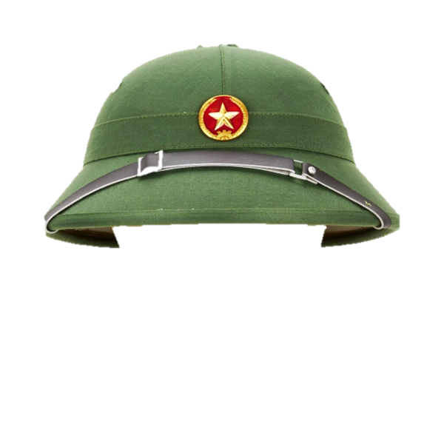
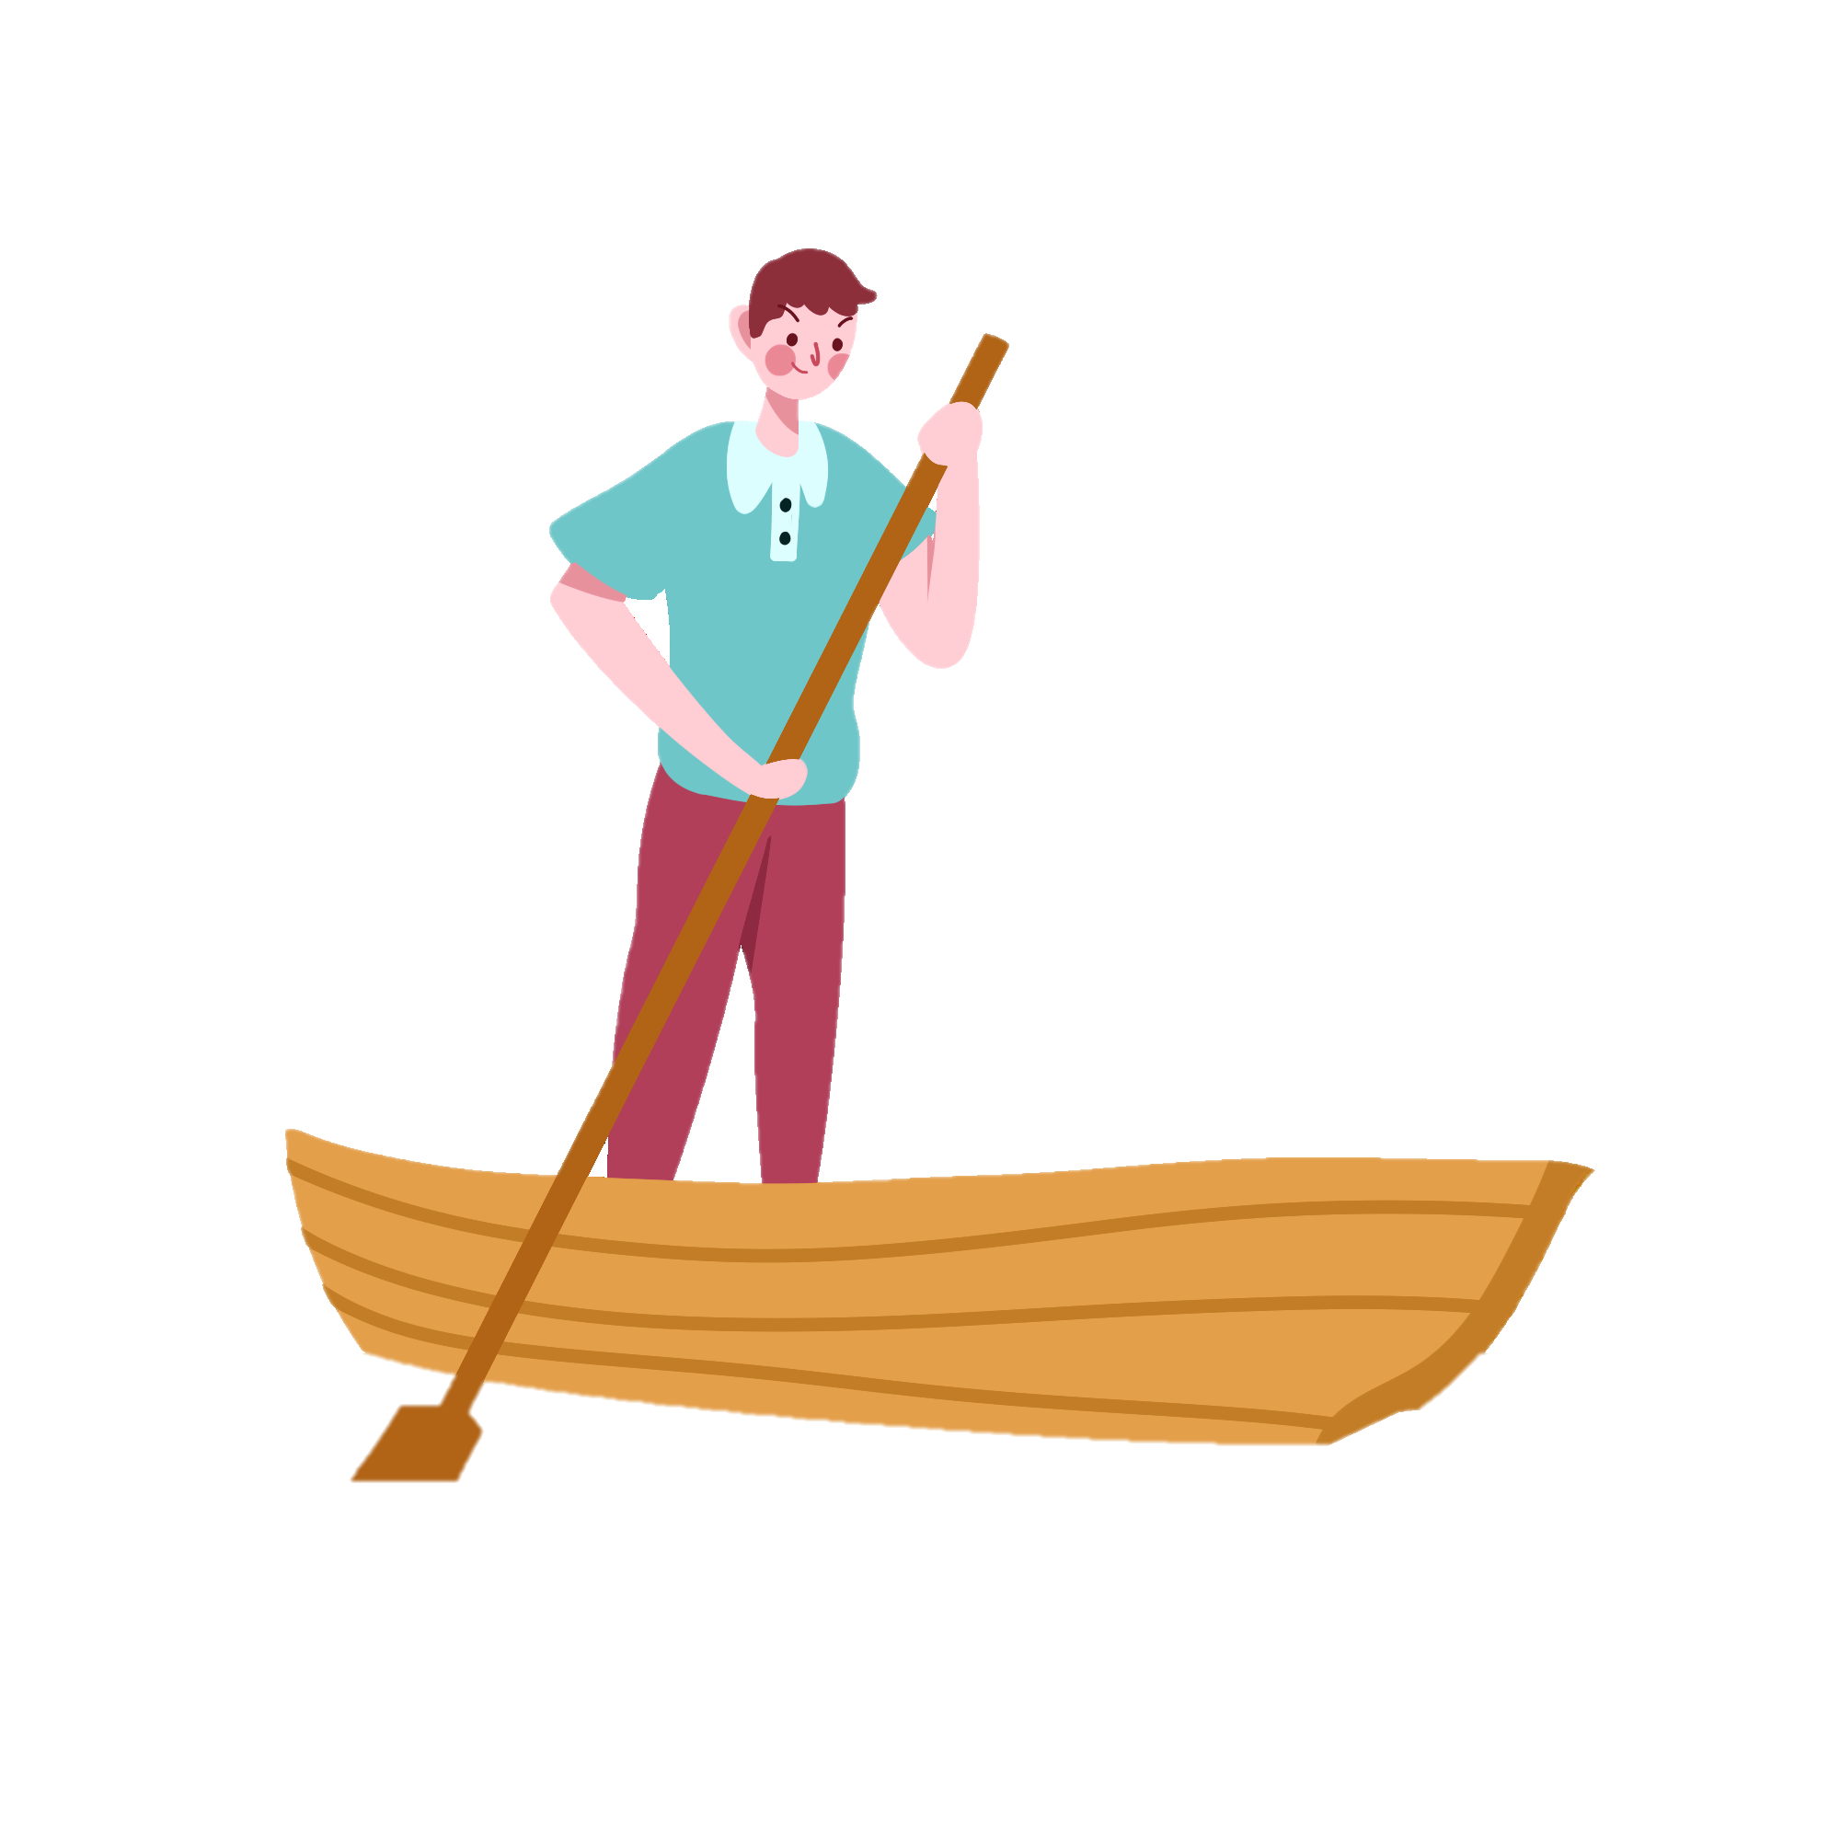
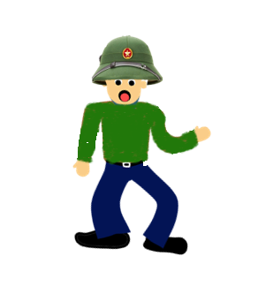
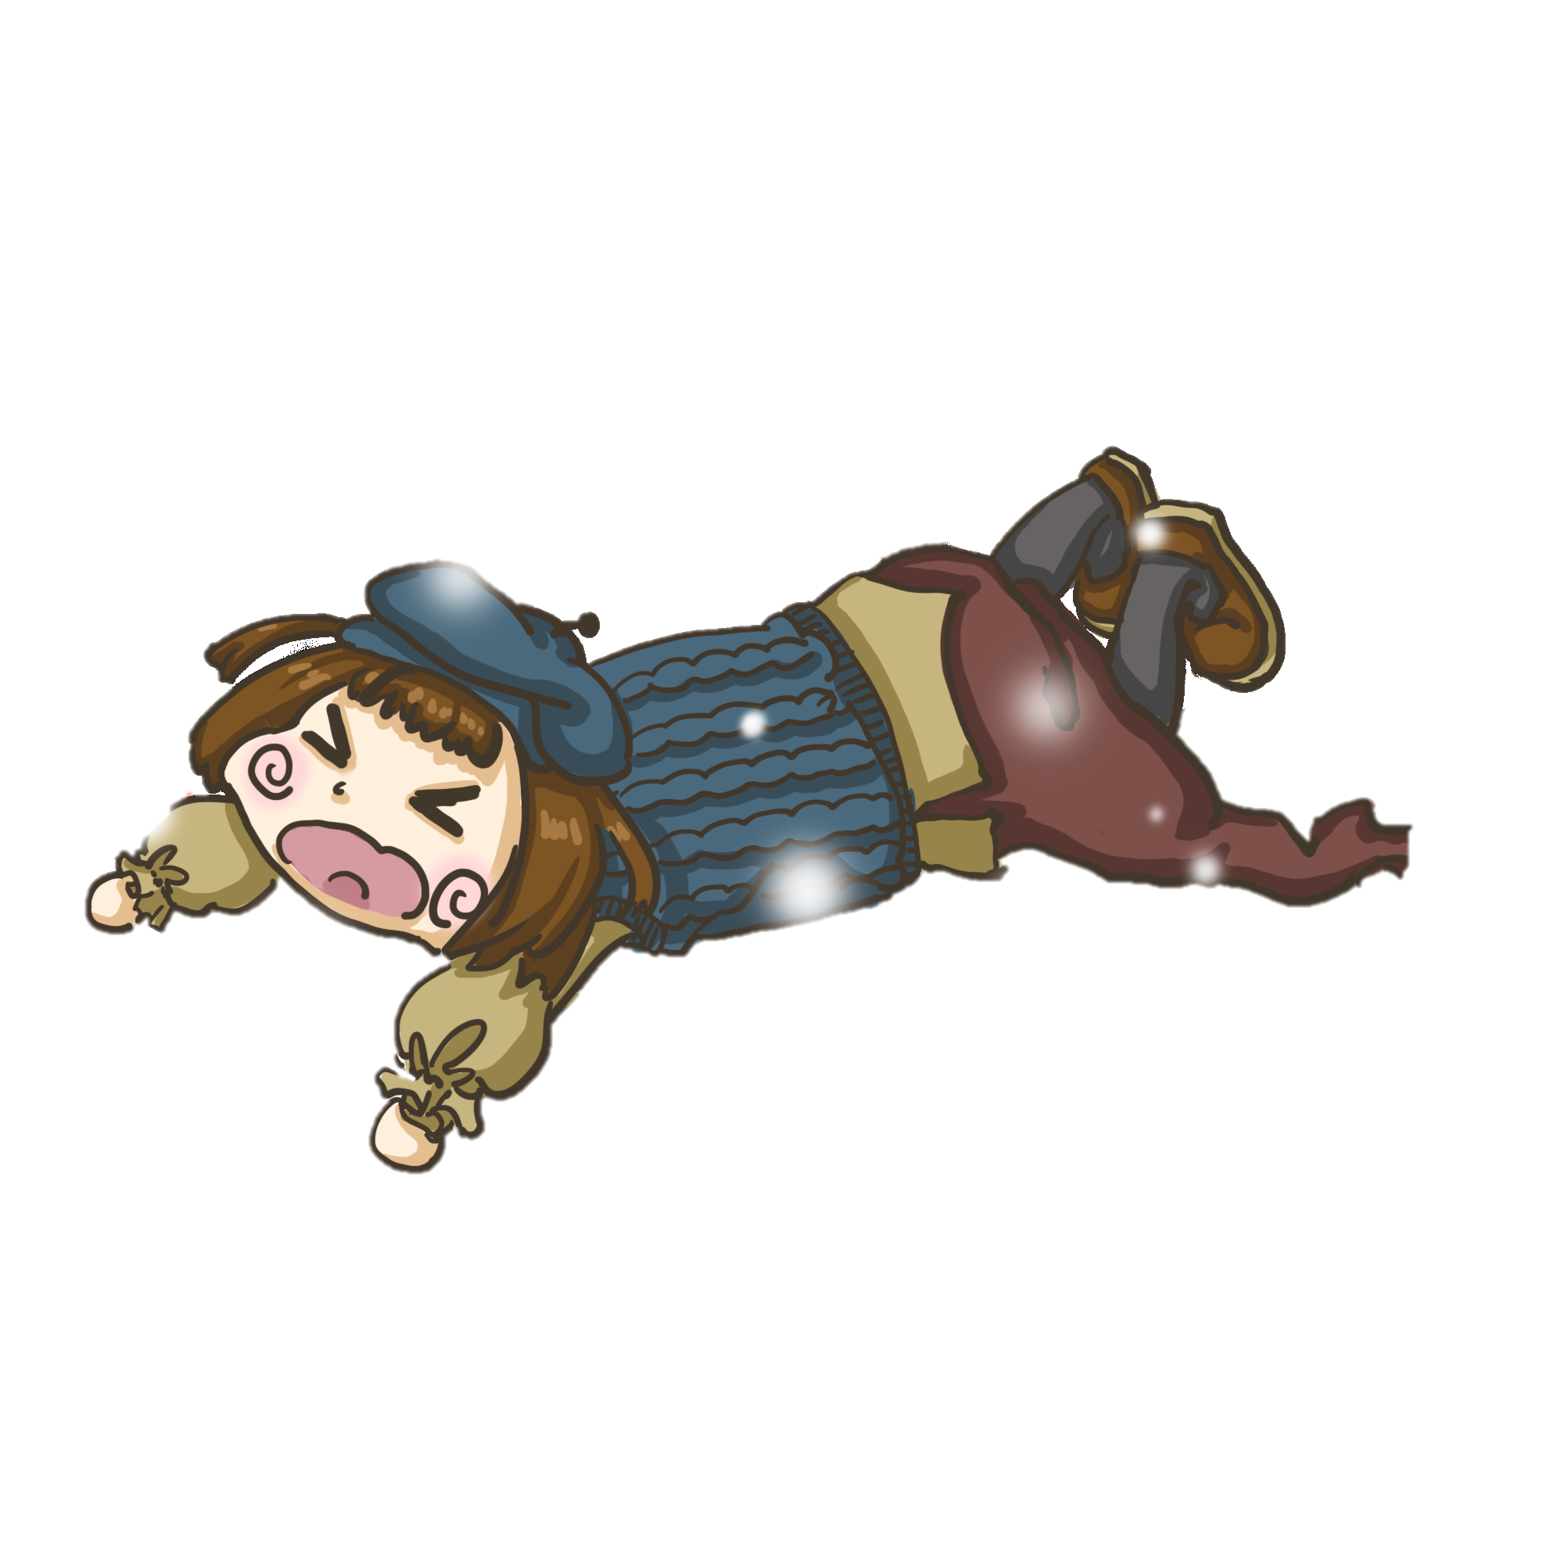
Emergency Rescue

Slide 13
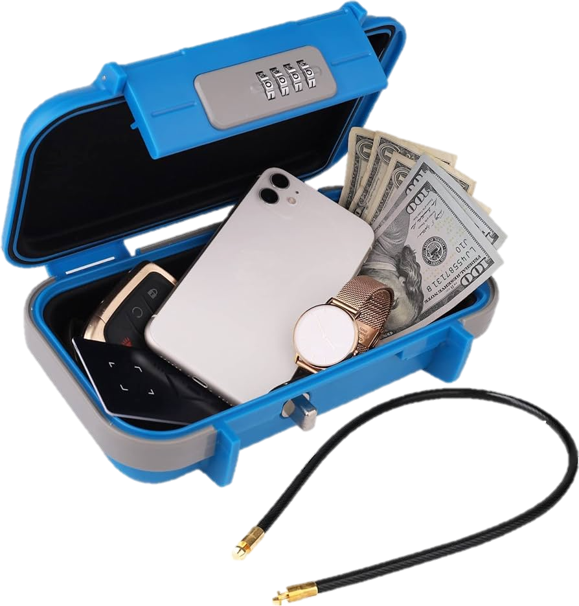
START
Time’s up
A. Protect your valuables in a plastic box
B. Protect your valuables in a safety deposit box
C. Throw away all your valuables to save yourself
D. Protect your valuables in waterproof containers

Slide 14
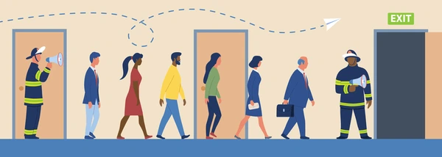
A. Return home and prevent home damage
B. Follow your own opinion
C. Follow the routes specified by officials
D. Stay to protect the workplace and company assets
START
Time’s up

Slide 15
A. Listen to the television for relaxation
B. Watch horror movies together
C. Stay home and watch cartoons
D. Watch TV for information
START
Time’s up

Slide 16
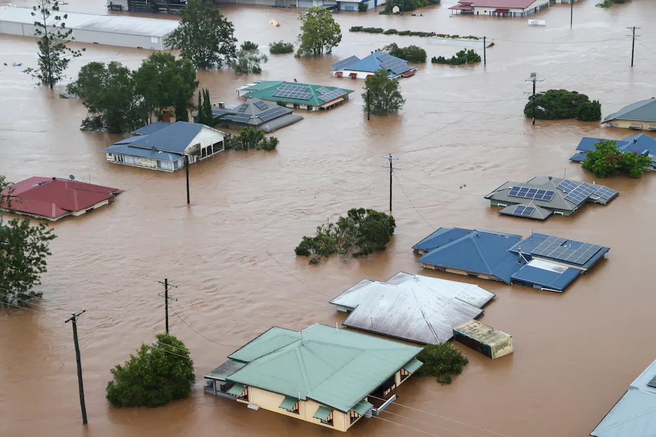
A. Live in flood zones and avoid bare land
B. Clean your house regularly to keep it looking like new
C. Return home only when authorities indicate it is safe.
D. Build a house on low land
START
Time’s up

Slide 17
II. WRITING TASK 4: Work in pairs. Discuss what you should do before, during, and after a flood. Write your ideas in the columns.
Before a flood
During a flood
After a flood
- Prepare an emergency kit.
- Protect your valuables in waterproof containers.
- Watch TV for information or listen to local radio.
- Stay inside a safe and high place.
- Follow the routes specified by officials.
- Avoid moving water.
- Return home only when authorities indicate it is safe.

Slide 18
Task 5. Write instructions (80 - 100 words) about things to do before, during, and after a flood.

Slide 19
Task 5. Write instructions (80 - 100 words) about things to do before, during, and after a flood.
Here a things you should do before, during and after a flood.
Before:
- Prepare an emergency kit and make a family communications plan.
- Protect your valuables in waterproof containers.
- Listen to the television for information.
During:
- Stay inside a safe and high place.
- Follow the routes specified by officials.
- Time permitting, leave a note informing others when you left and where you went.
After:
- Avoid moving water.
- Emergency workers will be assisting people in flooded areas. You can help them by staying off the roads and out of the way.
- Return home only when authorities indicate it is safe.

Slide 20
H0MEWORK
Do exercises in the workbook.
Prepare for Lesson 7 – Looking back + project.

Slide 21
Thank you!

