Slide 1
CLASS 8A2

Slide 2
SET 1
UNIT 7: ENVIRONMENTAL PROTECTION

Slide 3
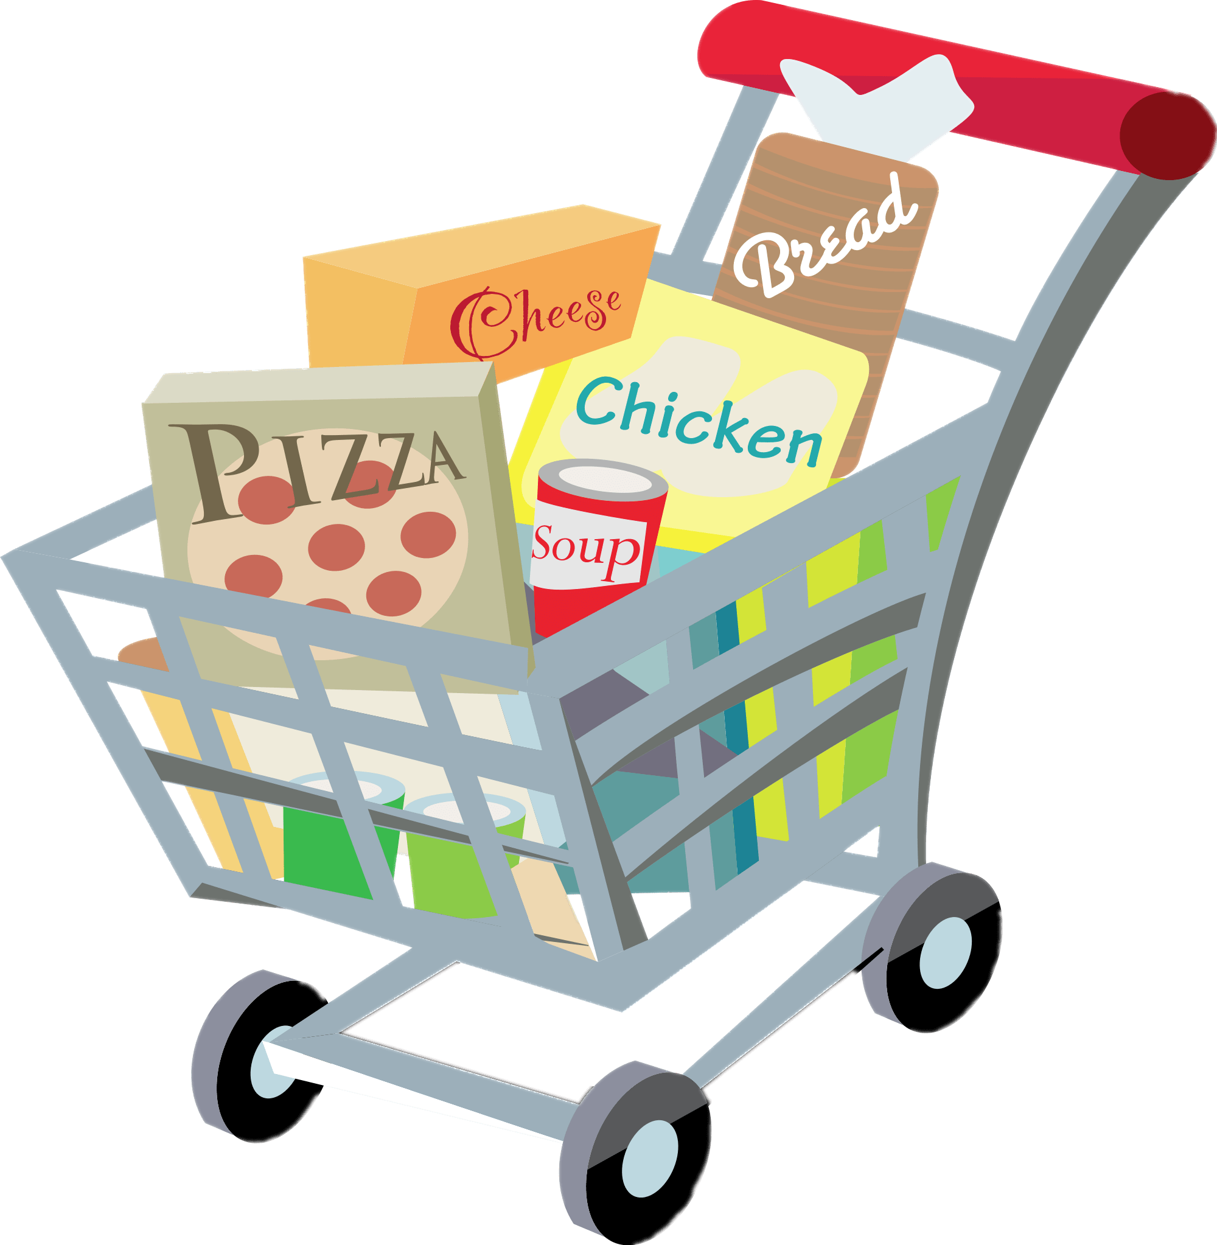
SET 2
UNIT 8: SHOPPING

Slide 4
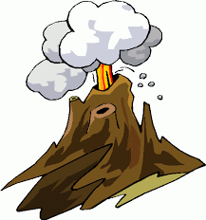
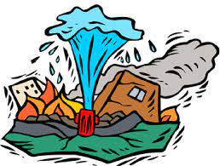
SET 3
UNIT 9: NATURAL DISASTERS

Slide 5
REVIEW 3
Lesson 1: Language Focus

Slide 6
1. Pronuciation
I. Revise the knowledge learnt in units 7,8,9
 Pronounce the sounds /bl/ and /kl/; /sp/ and /st/
1. a. Listen and repeat, paying attention to the underlined words.
1. The sky today is clear and blue.
clear /klɪə(r)/, blue /bluː/
2. The speaker talked a lot about honesty.
speaker /ˈspiːkər/, honesty /ˈɒnəsti/
3. The store on that corner sells local specialities.
store /stɔːr/, speciality /ˌspeʃiˈæləti/

Slide 7
1. Pronuciation
I. Revise the knowledge learnt unit 7,8,9
 Stress in words ending in -al and -ous
1. b. Choose A, B, C, or D to show the word in each group
with a different stress pattern.
1. A. humorous B. tremendous C. numerous D. generous
2. A. national B. animal C. arrival D. typical
3. A. festival B. cultural C. poisonous D. ambitious

Slide 8
1. Pronuciation
2. Vocabuary :
3. Grammar :
I. Revise knowledge learnt unit 7,8,9
 Pronounce the sounds /bl/ and /kl/; /sp/ and /st/
 Stress in words ending in -al and -ous
Unit 7,8,9
 Complex sentences with adverb clauses of time
 adverbs of frequency
 Present simple for future events
 Past continuous

Slide 9
1. Pronuciation
2. Vocabuary :
3. Grammar :
I. Revise knowledge learnt unit 7,8,9
 Pronounce the sounds /bl/ and /kl/; /sp/ and /st/
 Stress in words ending in -al and -ous
Unit 7,8,9
 Complex sentences with adverb clauses of time
 adverbs of frequency
 Present simple for future events
 Past continuous

Slide 10
1. Pronuciation
2. Vocabuary :
3. Grammar :
I. Revise knowledge learnt unit 7,8,9
 Pronounce the sounds /bl/ and /kl/; /sp/ and /st/
 Stress in words ending in -al and -ous
Unit 7,8,9
 Complex sentences with adverb clauses of time
 adverbs of frequency
 Present simple for future events
 Past continuous

Slide 11
1. Pronuciation
2. Vocabuary :
3. Grammar :
I. Revise knowledge learnt unit 7,8,9
 Pronounce the sounds /bl/ and /kl/; /sp/ and /st/
 Stress in words ending in -al and -ous
Unit 7,8,9
 Complex sentences with adverb clauses of time
 adverbs of frequency
 Present simple for future events
 Past continuous

Slide 12
 Complex sentences with adverb clauses of time
– A complex sentence contains one independent clause and at least one dependent clause.
Example:
The roads were slippery when it rained.
(independent clause) (dependent clause)
– An adverb clause is a dependent clause.
– An adverb clause of time shows when something happens. It is usually introduced by time connectors: before, after, when, while, till / until, as soon as, …

Slide 13
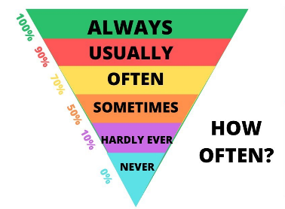
 adverbs of frequency
 Present simple for future events
We use the present simple with a future meaning to talk about timetables or schedules

Slide 14
 Past continuous
- Form of the past continuous:
(+): S + was/ were + V-ing.
(-): S + was/ were not + V-ing.
(?): Was/ were + S + V-ing?
- The use of the past continuous:
We use the past continuous to describe:
+ an action that was happening at a particular time in the past.
Ex: I was having dinner at 6 p.m yesterday.
+ a past action that was happening when another action interrupted it. We use the past simple for the action that interrupted it.

Slide 15
II. Practice:
Task 2. Complete each of the sentences with a word or phrase from the box.
customers bargain single-use habitats natural disasters
single-use
1. We should recycle various __________ products instead of throwing them away.
2. Shopping centres attract a lot of __________ during the sales season.
3. Population growth is causing destruction of wildlife ________ throughout the world.
4. Luckily, my home town rarely suffers from _______________, such as floods or storms.
5. Generally you can’t _______ over prices of goods in supermarkets.
customers
habitats
natural disasters
bargain

Slide 16
Task 3. Use the correct forms of the words in brackets to complete the sentences.
destructive
1. The tsunami in Tonga was very (destroy) __________; hundreds of houses were swept away.
2. One (advantage) ____________ of shopping online is that you do not know exactly what you will get.
3. Endangered species are animals in the wild that face a high risk of (extinct) _________.
4. (Addict) _________ shopping is a form of behaviour that makes shoppers buy many items they don’t need.
5. When a natural disaster happens, we must listen to (instruct) ___________ from local authorities.
disadvantage
extinction
addictive
instructions

Slide 17
Lucky circle
30
20
40
10
1
2
3
4
50
80
5
60
70
Turn

Slide 18
2. One ____________ of shopping online is that you do not know exactly what you will get.
A. Disadvantage B. advantage C. advantages
A
Return

Slide 19
3. Endangered species are animals in the wild that face a high risk of__________.
A. extinct B. extinction C. extincts
B
Return

Slide 20
5. When a natural disaster happens, we must listen to (instruct) ___________ from local authorities.
A. Instruct B. instructions C. instruction
B
Return

Slide 21
The tsunami in Tonga was very __________; hundreds of houses were swept away.
A. Destroy B. destructive C. destruction
B
Return

Slide 22
4. _________ shopping is a form of behaviour that makes shoppers buy many items they don’t need.
A. Addictive B. Addict C. Addicts
A
Return

Slide 23
Task 3. Use the correct forms of the words in brackets to complete the sentences.
1. The tsunami in Tonga was very (destroy) destructive ; hundreds of houses were swept away.
2. One (advantage) disadvantage of shopping online is that you do not know exactly what you will get.
3. Endangered species are animals in the wild that face a high risk of (extinct) extinction.
4. (Addict) addictive shopping is a form of behaviour that makes shoppers buy many items they don’t need.
5. When a natural disaster happens, we must listen to (instruct) instructions from local authorities.

Slide 24
Task 4. Use the correct forms of the words in brackets to complete the sentences.
1. While I (clean) ____________ out my cupboards, I found these photos.
2. Sam is studying hard. He (have) _________ his exam this Friday.
3. This brochure says that the big sale (start) ________ next Friday.
4. ______ the flood victims still (wait) _______ when the rescuers came?
5. I (fall) ______________ asleep last night when I (hear) ______ a knock at the door.
has
starts
Were
waiting
was cleaning
was just falling
heard

Slide 25
H0MEWORK
Do exercises in the workbook.
Prepare for next lesson

Slide 26
Website: hoclieu.vn
Fanpage: facebook.com/www.tienganhglobalsuccess.vn/

