Slide 2
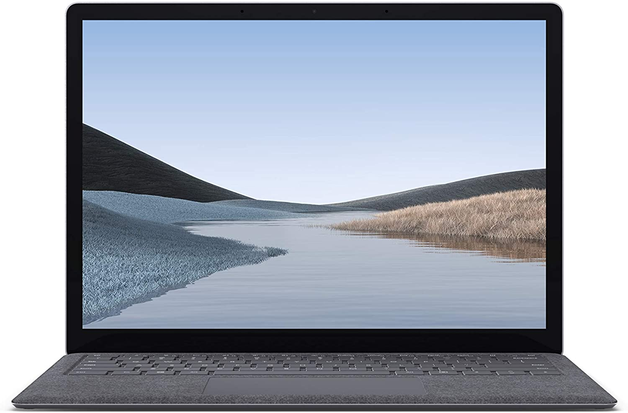
Can you guess what it is?
It’s a laptop!
Photo courtesy of Lisa L Wiedmeier (@flickr.com) - granted under creative commons licence - attribution

Slide 3
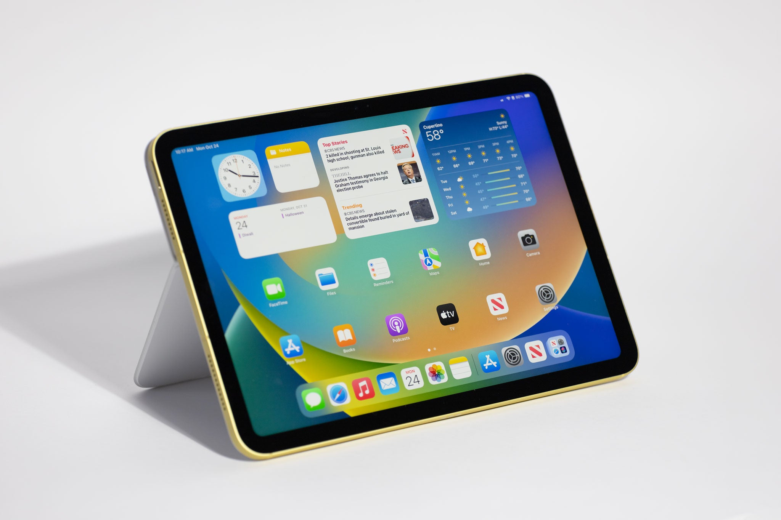
Can you guess what it is?
It’s a tablet!
Photo courtesy of Jon Mountjoy (@flickr.com) - granted under creative commons licence - attribution

Slide 4
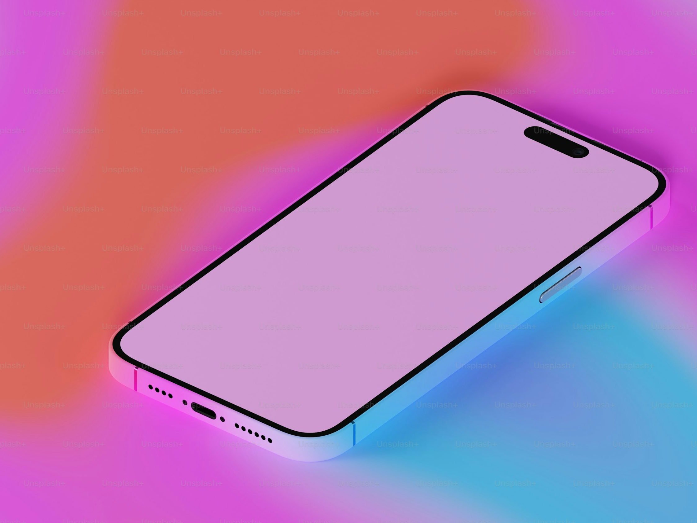
Can you guess what it is?
Can you guess what it is?
It’s a mobile phone!
Photo courtesy of Robbie Sproule (@flickr.com) - granted under creative commons licence - attribution

Slide 5
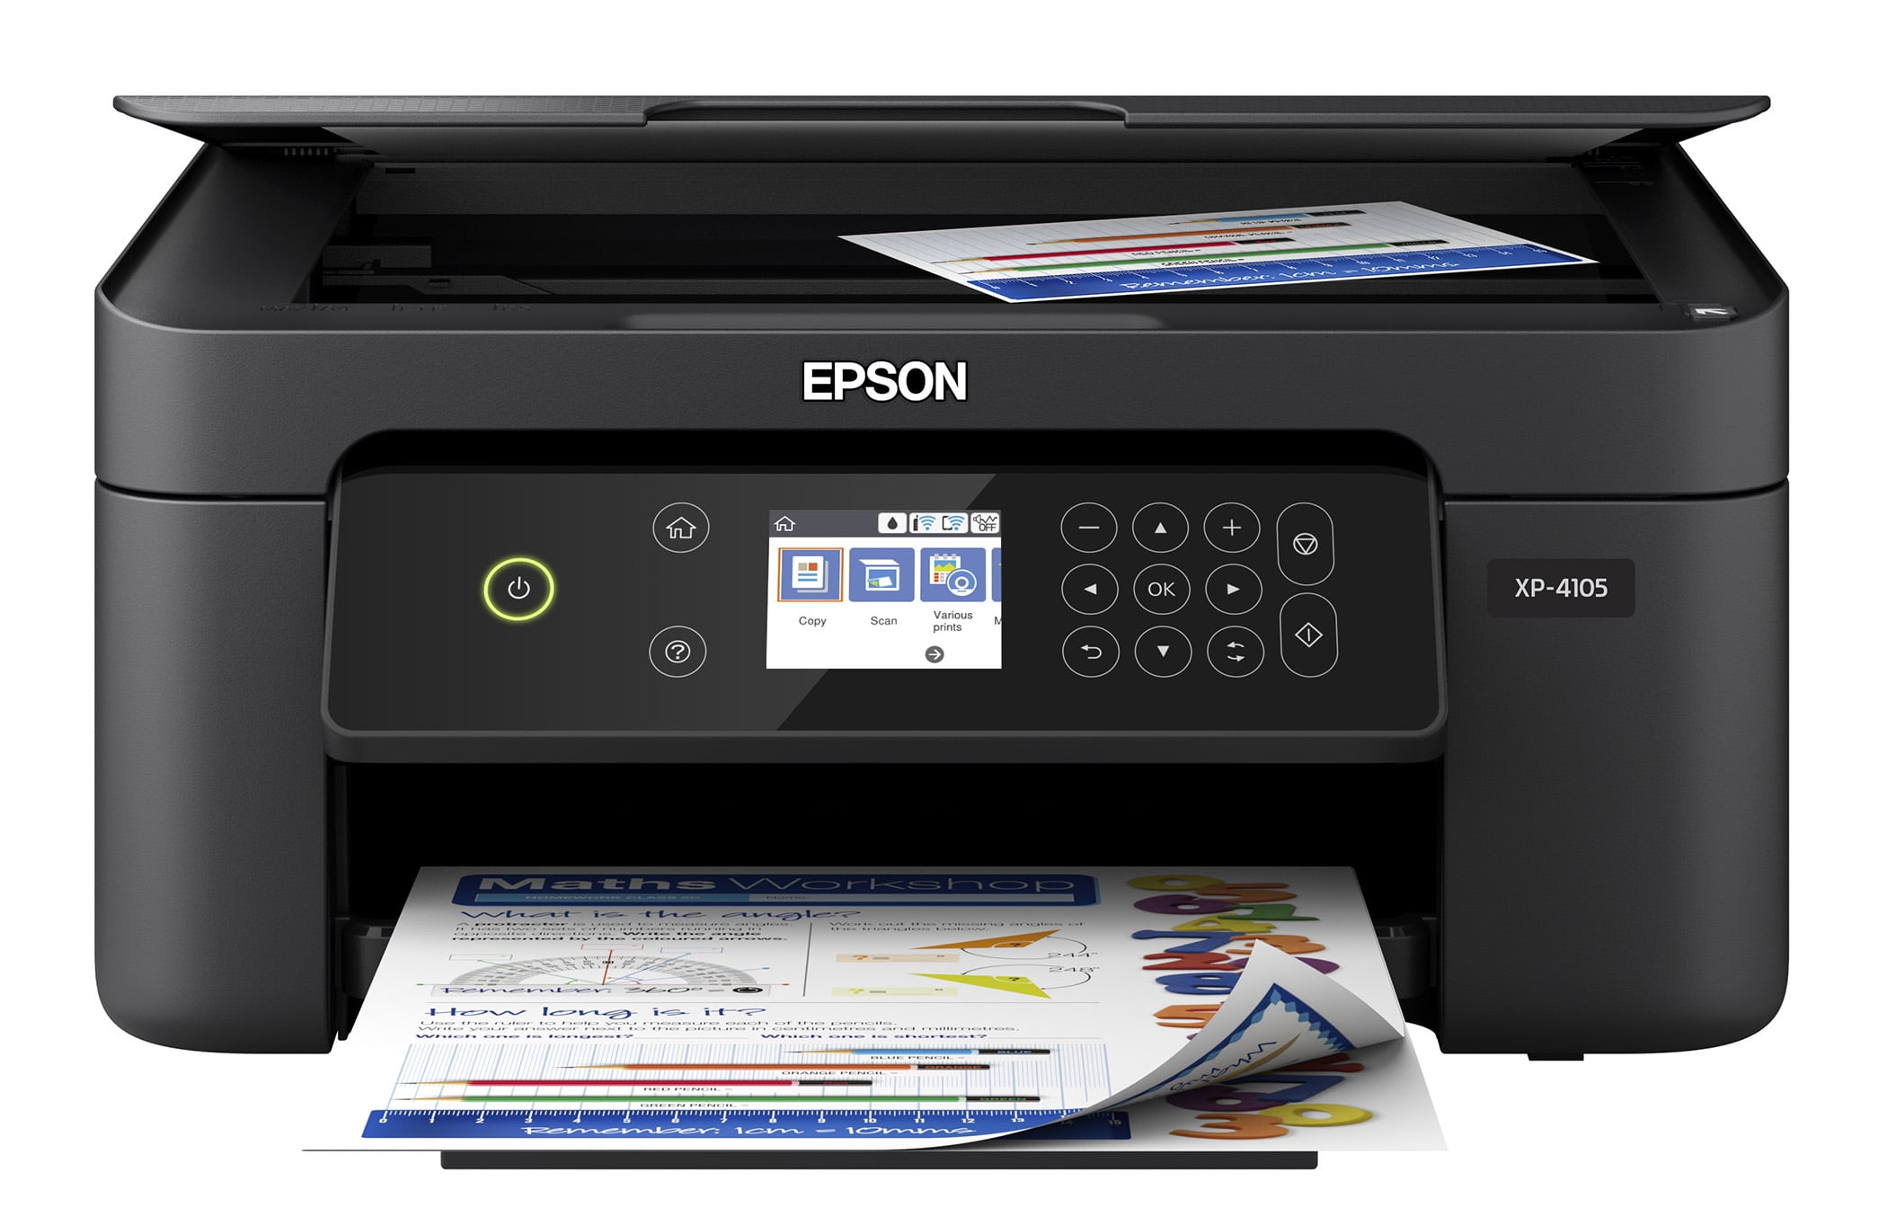
Can you guess what it is?
Can you guess what it is?
It’s a printer!
Photo courtesy of Robbie Sproule (@flickr.com) - granted under creative commons licence - attribution

Slide 6
Can you guess what it is?
It’s a headphone!
Photo courtesy of Robbie Sproule (@flickr.com) - granted under creative commons licence - attribution

Slide 7
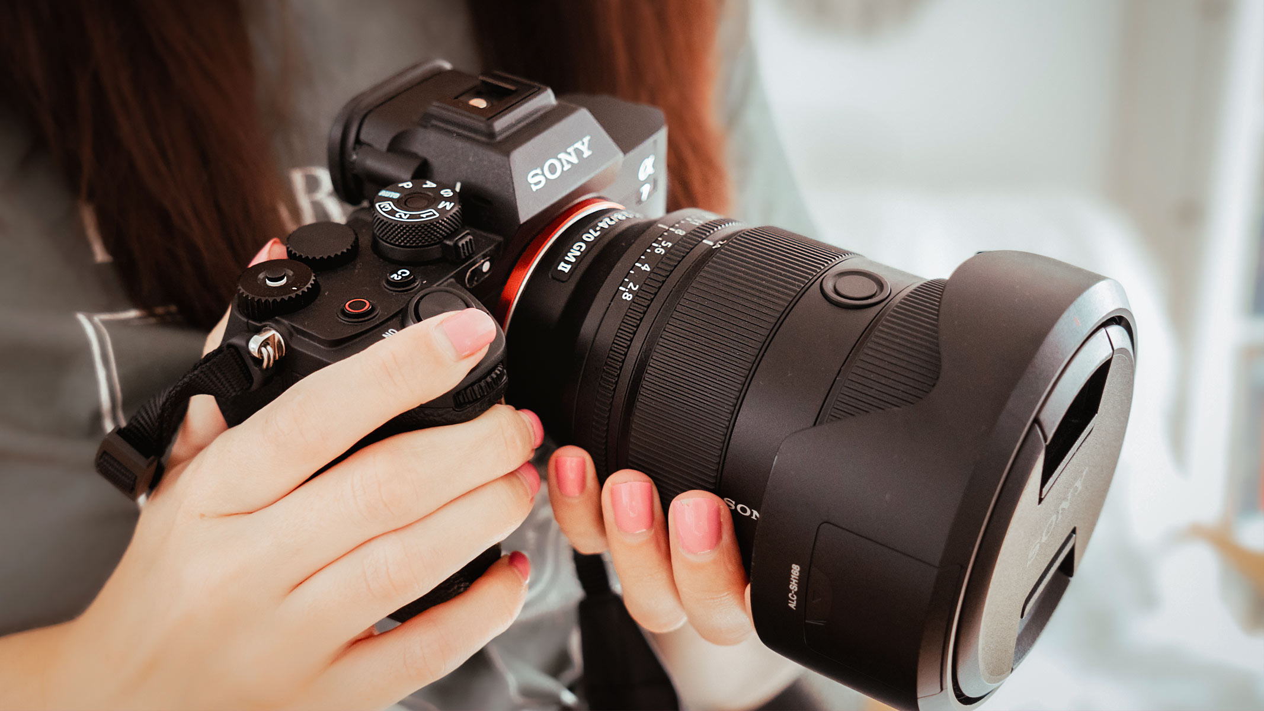
Can you guess what it is?
Can you guess what it is?
It’s a camera!
Photo courtesy of Geoff Livingston (@flickr.com) - granted under creative commons licence - attribution

Slide 8
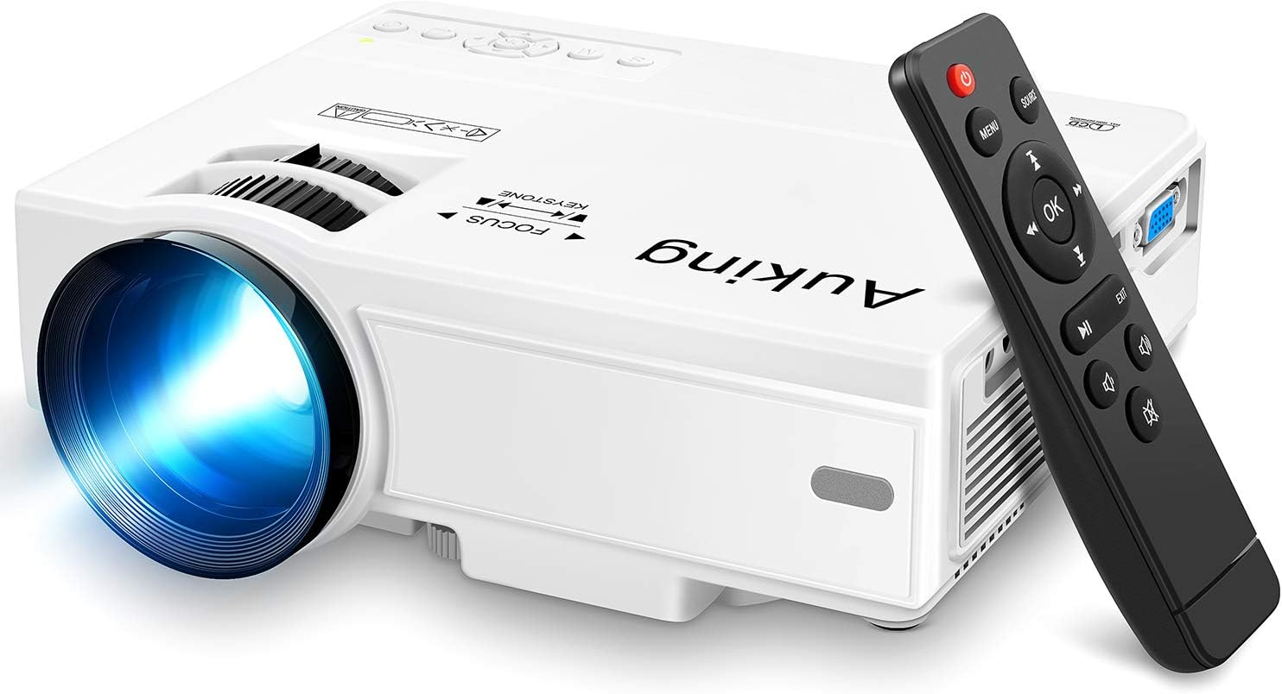
Can you guess what it is?
Can you guess what it is?
It’s a project!
Photo courtesy of Derek Keats (@flickr.com) - granted under creative commons licence - attribution

Slide 9
What is the topic you are going to learn today?

Slide 10
UNIT 11 ELECTRONIC DEVICES
Lesson 1: Getting started

Slide 11
OBJECTIVES
01
02
After this lesson, students will be able to
Have an overview about the topic ELECTRONIC DEVICES
use lexical items related to ELECTRONIC DEVICES

Slide 12
01
Vocabulary

Slide 13
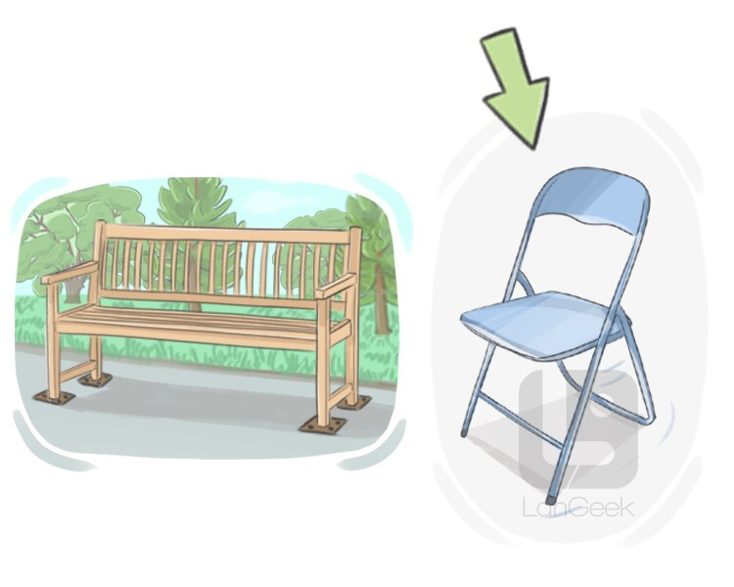
Vocabulary
portable (adj)
/ˈpɔːtəbl/
có thể mang theo, xách tay

Slide 14
Vocabulary
aluminium (n)
/ˌæljəˈmɪniəm/
nhôm

Slide 15
Vocabulary
virtual (adj)
/ˈvɜːtʃuəl/
ảo

Slide 16
Vocabulary
New words | Pronunciation | Meaning
1. portable (adj) | /ˈpɔːtəbl/ | có thể bỏ mang theo, xách tay
2. aluminium (n) | /ˌæljəˈmɪniəm/ | nhôm
3. virtual (adj) | /ˈvɜːtʃuəl/ | ảo

Slide 17
3. Match each word or phrase with its definition.
1. aluminium |  | a. a screen of a laptop or a tablet that enables the user to interact directly with what is displayed
2. portable |  | b. made to appear to exist by the use of computer software, rather than in the real world
3. touchscreen |  | c. not needing wires to make a connection or to communicate
4. wireless |  | d. a light, silver-grey metal
5. virtual |  | e. easy to carry or to move

Slide 18
Ex 4. Complete the sentences with the words from 3.
aluminium portable touchscreen
wireless virtual
virtual
1. The website allows you to take a ______ tour of the art gallery.
2. You can carry your __________ laptop with you from class to class
because it’s small and light.
3. Nowadays we often use __________ keyboards because they are portable.
4. We often use _____________ to make vehicles like aircraft or cars
because of its strength and lightweight.
5. Most smartphones today have a ____________ which allows us to
navigate, type, and interact with apps and games easily.
portable
wireless
aluminium
touchscreen

Slide 19
02
Listen and read
12:00

Slide 20
Look and answer
Who are they?
A shop assistant and a customer
Where are they now?
In an electronic shop
What are they talking about?
A. Selling a computer
B. Repairing a laptop
C. Buying a tablet
Listen and check

Slide 21
Shop assistant: Good morning! What can I do for you?
Customer: Good morning! I’d like to buy a computer for my son.
Shop assistant: We have desktops, laptops, and tablets. Which one are you interested in?
Customer: I want to buy one for my son that is portable and can be used for studying and entertainment.
Shop assistant: Ah, in this case I suggest you should buy a tablet. Look at this grey tablet. It can work as effectively as a laptop. But it’s the size of a book. And it’s much lighter than a laptop because it’s smaller. It also has a lightweight aluminium case.
Customer: Sounds good.
Shop assistant: It also has two cameras to take photos, shoot videos, and scan documents. It has a touchscreen, so you can do everything with your fingers.
Customer: Is it easy to type on?
Shop assistant: Yes, it is. There is a virtual keyboard. If you don’t want to use it, you can use the wireless hardware keyboard.
Customer: Can I write and draw on it?
Shop assistant: You can use its pencil to take notes, draw pictures or diagrams, and make 3D designs.

Slide 22
Ex 2. Read the conversation again and answer the following questions.
1. What does the customer want to buy?
2. What kind of electronic device does the shop assistant suggest the customer should buy?
3. What is the tablet’s case made of?
4. What is the tablet’s pencil used for?

Slide 23
Ex 2. Read the conversation again and answer the following questions.
1. What does the customer want to buy?
2. What kind of electronic device does the shop assistant suggest the customer should buy?
Customer: Good morning! I’d like to buy a computer for my son.
The customer wants to buy an electronic device for her / his son.
Shop assistant: Ah, in this case I suggest you should buy a tablet. Look at this grey tablet. It can work as effectively as a laptop.
The shop assistant suggests the customer (should) buy a tablet.

Slide 24
Ex 2. Read the conversation again and answer the following questions.
3. What is the tablet’s case made of?
4. What is the tablet’s pencil used for?
… It also has a lightweight aluminium case.
It is made of aluminum.
Shop assistant: You can use its pencil to take notes, draw pictures or diagrams, and make 3D designs.
It is used for taking notes, drawing pictures or diagrams, and making 3D designs.

Slide 25
Notes:
This template is for educational, non-commercial purposes only. For more free game templates like this one, visit https://www.taysteachingtoolkit.com
---------------------------------------
Background image by freepik on Freepik.com

Slide 26
1
2
3
One student from each team comes to the front of the class and faces away from the screen.
Notes:
TEACHER’S NOTES:
Split your class into teams. How many teams you have as well as the size of your teams is up to you.
Make sure the students from each team who come to the front of the class can’t see the TV/computer screen.
---------------------------------------
Background image by freepik on Freepik.com

Slide 27
It’s a small, flat computer. We can control it by touching its screen or
by using a special pen.
Is that a portable music player?
1
1
1
1
2
3
No. Try again
Other students in that team describe electronic devices for their friend to guess.
Notes:
TEACHER’S NOTES:
You decide if the clues they give are single word clues or sentence clues. I like to play this game like the gameshow “Password,” so I use single word clues.
The clues will be given to the students at the front one at a time. After a clue is given, a timer will start for 20 seconds allowing the students to guess.
---------------------------------------
Background image by freepik on Freepik.com

Slide 28
+2pts
…
1
2
3
The first student to say the correct answer gets points for their team!
Notes:
TEACHER’S NOTES:
How many points a team gets depends on how many clues were given before a correct answer was stated (see next slide).
---------------------------------------
Background image by freepik on Freepik.com

Slide 29
Notes:
---------------------------------------
Background image by freepik on Freepik.com

Slide 30
In this lesson, students have been able to
RECAP
Have an overview about the topic ELECTRONIC DEVICES
use lexical items related to ELECTRONIC DEVICES

Slide 31
Thanks for your attention!
12:00
Please keep this slide for attribution

