Slide 1
Good afternoon class !!!

Slide 2
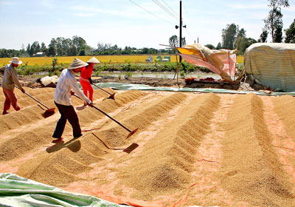
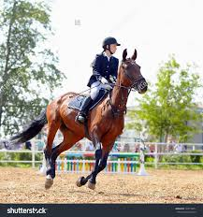
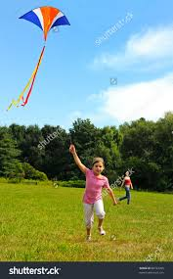
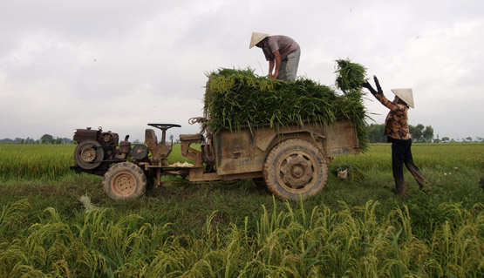
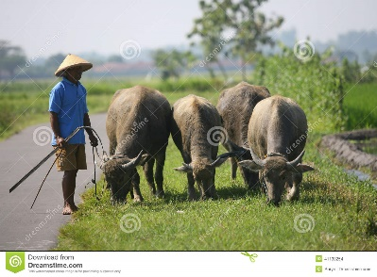
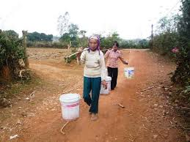
WARM UP
Match the activities with the pictures.
a
d
5. drying the rice
1. flying a kite
3. riding a horse
2. herding buffaloes
b
3. riding a horse
e
4. collecting water
1. flying a kite
5. drying the rice
6. loading the rice
c
6. loading the rice
f
2. herding buffaloes
4. collecting water

Slide 3
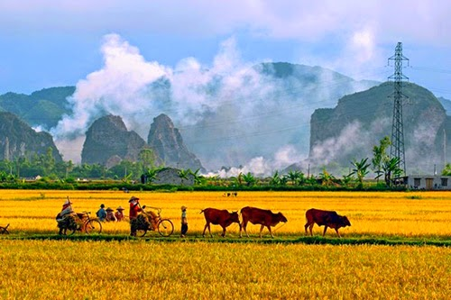
- Unit 2 - Life in the countryside

Slide 4
Unit
2
LIFE IN THE COUNTRYSIDE
LESSON 1: GETTING STARTED
Last summer holiday

Slide 5
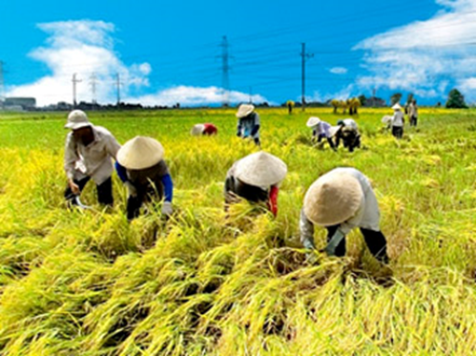
* Vocabulary
harvest (v)
/ˈhɑːvɪst/
thu hoạch

Slide 6
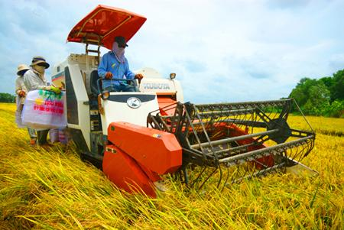
* Vocabulary
combine harvester (n)
/kəmˈbaɪn ˈhɑːvɪstər /
máy gặt đập liên hợp

Slide 7
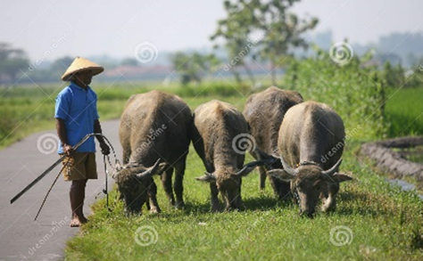
* Vocabulary
herd (v)
/hɜːd/
chăn (gia súc)

Slide 8
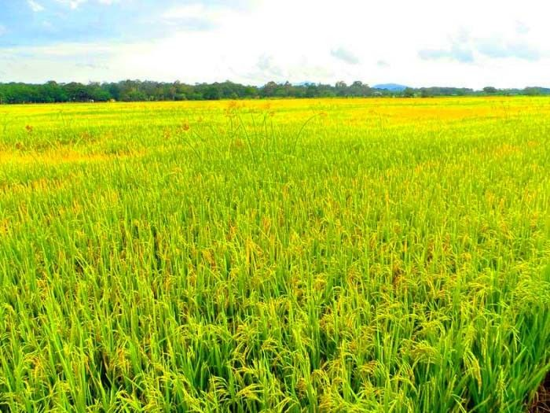
* Vocabulary
paddy field (n)
/ˈpædi ˌfiːld/
cánh đồng lúa

Slide 9
* Vocabulary
load (v) :
# unload
chất hàng lên, chở

Slide 10
* Vocabulary
New words | Pronunciation | Meaning
1. harvest (v) | /ˈhɑːvɪst/ | thu hoạch
2. combine harvester (n) | /kəmˈbaɪn ˈhɑːvɪstər/ | máy gặt đập liên hợp
3. herd (v) | /hɜːd/ | chăn
4. paddy field (n) | /ˈpædi ˌfiːld/ | đồng lúa
5. Load (v) | /loʊd/ | chất hàng lên, chở

Slide 11
* PRACTICE
1
Listen and read.
Nick: You look great with a tan, Mai!
Mai: Thank you. I’ve just come back from a very enjoyable summer holiday.
Nick: Really? Where did you stay?
Mai: I stayed at my uncle’s house in a small village in Bac Giang Province.
Nick: What did you do there?
Mai: A lot of things. It was harvest time. The villagers were harvesting rice with a combine harvester. I helped them load the rice onto a truck. Then we unloaded the rice and dried it.
Nick: Sounds great!
Mai: And sometimes I went with the village children to herd the buffaloes and cows. I made friends with them on my first day.
Nick: Were they friendly?
Mai: Yes, they were. They took me to the paddy fields to fly kites. And in the evening, we played traditional games like bamboo dancing and dragon-snake.
Nick: Oh, I envy you!
Mai: Things move more slowly there than in our city, but people seem to have a healthier life.

Slide 12
* PRACTICE
1
Listen and read.
Nick: You look great with a tan, Mai!
Mai: Thank you. I’ve just come back from a very enjoyable summer holiday.
Nick: Really? Where did you stay?
Mai: I stayed at my uncle’s house in a small village in Bac Giang Province.
Nick: What did you do there?
Mai: A lot of things. It was harvest time. The villagers were harvesting rice with a combine harvester. I helped them load the rice onto a truck. Then we unloaded the rice and dried it.
Nick: Sounds great!
Mai: And sometimes I went with the village children to herd the buffaloes and cows. I made friends with them on my first day.
Nick: Were they friendly?
Mai: Yes, they were. They took me to the paddy fields to fly kites. And in the evening, we played traditional games like bamboo dancing and dragon-snake.
Nick: Oh, I envy you!
Mai: Things move more slowly there than in our city, but people seem to have a healthier life.

Slide 13
2
Read the conversation again and choose the correct answer to each question.
1. How does Mai feel about her summer holiday?
A. She likes it.
B. She doesn’t like it.
C. She thought it was fine.
2. Where did she stay during her summer holiday?
A. At her friend’s house.
B. At her uncle’s house.
C. At her grandparents’ house.

Slide 14
2
Read the conversation again and choose the correct answer to each question.
3. During harvest time, people harvest rice by ______.
A. themselves
B. using a truck
C. using a combine harvester
4. Mai thinks people in the countryside lead ______.
A. a healthy life
B. an exciting life
C. an interesting life

Slide 15
3
Complete the sentences with the words and phrases from the box.
paddy field
herd
harvest time
load
combine harvester
1. It took them an hour to ___________ all the goods onto the truck.
2. Nowadays, people in my village use a _______________ to harvest their rice and separate the grains from the rest of the plant.
3. Today it is my turn to __________ the cows.
4. A place in which people grow rice is called a _______________.
5. A busy time when people cut and gather their crops is called _____________.
Game

Slide 16
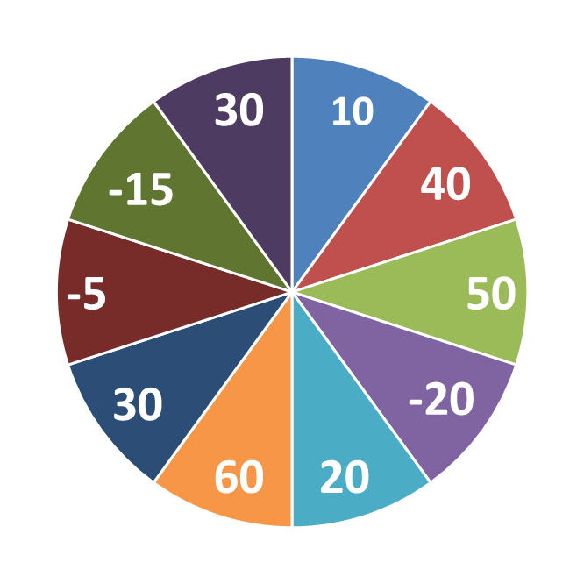
THE BIG WHEEL GAME
QUESTIONS
1
2
3
4
5
6
keys

Slide 17
3
Complete the sentences with the words and phrases from the box.
paddy field
herd
harvest time
load
combine harvester
It took them an hour to __________ all the goods
onto the truck.

Slide 18
3
Complete the sentences with the words and phrases from the box.
paddy field
herd
harvest time
load
combine harvester
2. Nowadays, people in my village use a ________________ to harvest their rice and separate the grains from the rest of the plant.

Slide 19
3
Complete the sentences with the words and phrases from the box.
paddy field
herd
harvest time
load
combine harvester
3. Today it is my turn to __________ the cows.

Slide 20
3
Complete the sentences with the words and phrases from the box.
paddy field
herd
harvest time
load
combine harvester
4. A place in which people grow rice is called a ____________.

Slide 21
3
Complete the sentences with the words and phrases from the box.
paddy field
herd
harvest time
load
combine harvester
5. A busy time when people cut and gather their crops is called _____________.
.

Slide 22
3
Complete the sentences with the words and phrases from the box.
paddy field
herd
harvest time
load
fresh
6. In the countryside , the air is very ___________.

Slide 23
3
Complete the sentences with the words and phrases from the box.
1. It took them an hour to ___________ all the goods onto the truck.
2. Nowadays, people in my village use a __________________ to harvest their rice and separate the grains from the rest of the plant.
3. Today it is my turn to __________ the cows.
4. A place in which people grow rice is called a _______________.
5. A busy time when people cut and gather their crops is called _____________.
load
combine harvester
herd
paddy field
harvest time

Slide 24
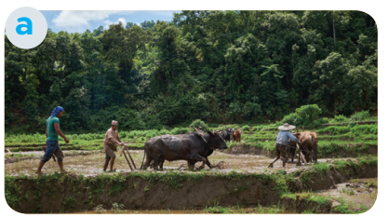
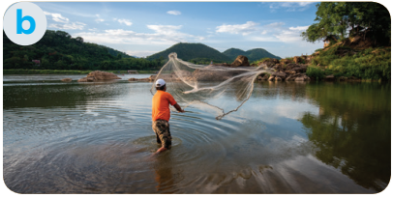
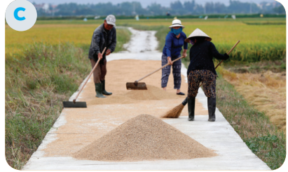
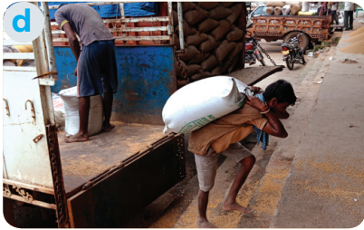
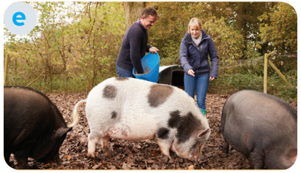
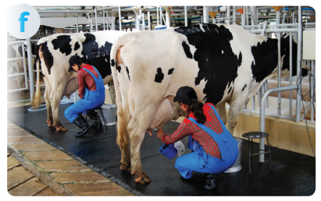
4
Match the activities that people living in the countryside often do with the pictures.
1. unloading rice
2. ploughing fields
3. milking cows
4. feeding pigs
5. catching fish
6. drying rice

Slide 25
* PRODUCTION
5
Work in pairs. ask and answer about the pictures in 4
Example:
A: What are they doing in picture a? B: They’re ploughing fields

Slide 26
* PRODUCTION
5
Work in pairs. ask and answer about the pictures in 4
A: What are they doing in picture b?
B : They're catching fish.

Slide 27
* PRODUCTION
5
Work in pairs. ask and answer about the pictures in 4
A: What are they doing in picture c?
B : They're drying rice.

Slide 28
* PRODUCTION
5
Work in pairs. ask and answer about the pictures in 4
A: What are they doing in picture d?
B : They're unloading rice.

Slide 29
* PRODUCTION
5
Work in pairs. ask and answer about the pictures in 4
A: What are they doing in picture b?
B : They're feeding pigs.

Slide 30
* PRODUCTION
5
Work in pairs. ask and answer about the pictures in 4
A: What are they doing in picture b?
B : They're milking cows.

Slide 31
* CONSOLIDATION
1
Wrap-up
What have we learnt in this lesson?
identify the topic of the unit
use lexical items related to life in the countryside
identify the language features that are covered in the unit

Slide 32
2
Homework
Do exercises in the workbook.
Start preparing for the Project of the unit.

Slide 33
Goodbye.
See you again

