Slide 1



WELCOME TO OUR CLASS

Slide 2
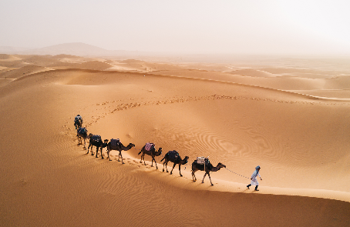

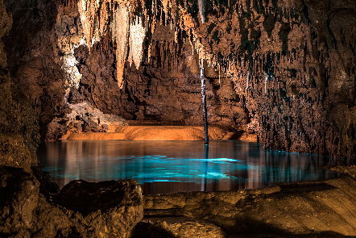
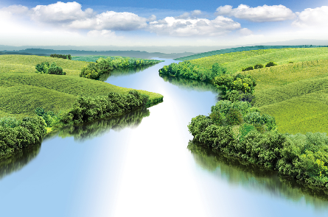
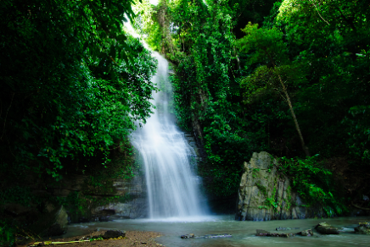
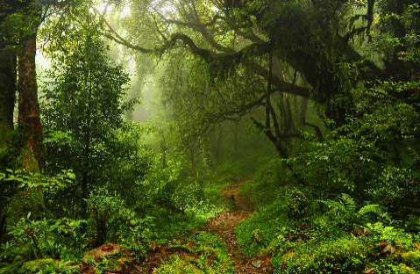
Warm up:
Game: Pelmanism
1
2
3
4
5
6
7
8
RIVER
DESERT
9
10
11
12
CAVE
FOREST
WATERFALL
ISLAND

Slide 3



Unit 5: Natural wonders of Viet Nam
LESSON 1

Slide 4
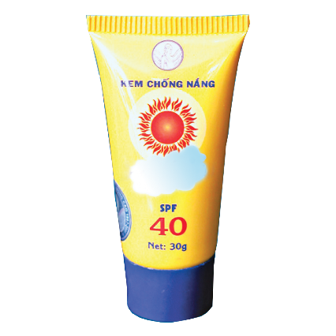

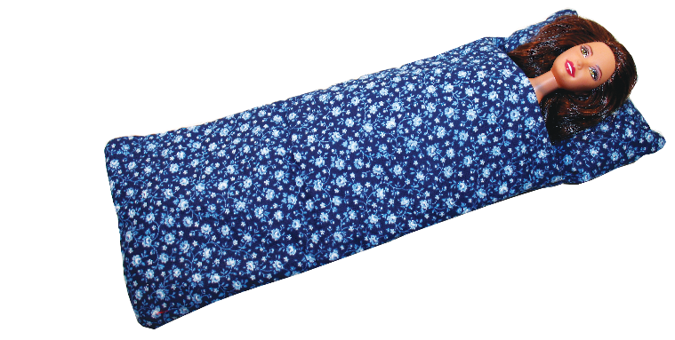
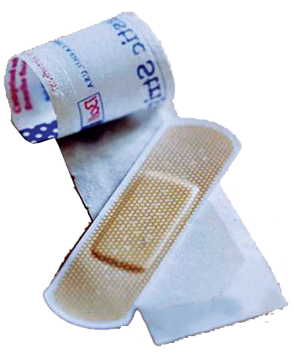

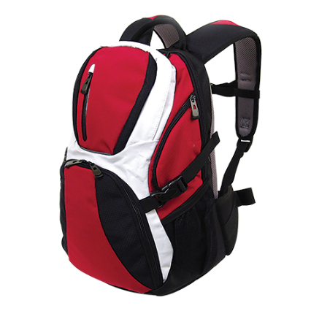
Unit 5: Natural wonders of the world
A closer look 1
I. Vocabulary
- plaster: (n)
băng, gạc y tế
- sleeping bag: (n):
túi ngủ
- backpack: (n):
ba lô
- Compass: (n)
la bàn
- sun cream: (n)
kem chống nắng
- scissors: (n)
cái kéo
If we go camping in the forest, What should we bring?

Slide 5
* Checking words.
RUB OUT AND REMEMBER
- plaster (n):
băng, gạc y tế
- sleeping bag (n):
túi ngủ
- backpack (n):
ba lô
- compass (n):
la bàn
- sun cream (n):
kem chống nắng
- scissors (n:
cái kéo

Slide 6

Write a word under each picture.
Practise saying the words.
plaster
sleeping bag
backpack
compass
suncream
scissors
1.
plaster
2.
suncream
3.
sleeping bag
4.
scissors
5.
backpack
6.
compass

Slide 7
Write a word under each picture.
Practise saying the words.
plaster
sleeping bag
backpack
compass
suncream
scissors
1.
plaster
2.
suncream
3.
sleeping bag
4.
scissors
5.
backpack
6.
compass

Slide 8
Write a word under each picture.
Practise saying the words.
plaster
sleeping bag
backpack
compass
suncream
scissors
1.
plaster
2.
suncream
3.
sleeping bag
4.
scissors
5.
backpack
6.
compass

Slide 9

Complete the following sentences. Use the words in 1.
We’re lost. Please give me the .
1.
compass
suncream
2.
It’s so sunny today. I need to put on some .
3.
A
sleeping bag
is very useful when you go camping overnight.
4.
I’ve finished packing. All my things are in my .
backpack
5.
plaster
My foot hurts. I need to put a on my foot.

Slide 10

Now put the items in order of usefulness. Number 1 is the most useful, number 6 is the least useful on holiday.
plaster
scissors
backpack
compass
suncream
Sleeping bag
1.
2.
3.
4.
5.
6.

Slide 11


* Pronunciation:
/t/ and /d/
Listen and repeat the words.
/t/ | /d/
mountain waterfall desert plaster | wonder island guide holiday

Slide 12

Listen and repeat. Pay attention to the bold-typed parts of the words.
1.
Where’s my hat?
Oh, it’s on your head.
2.
Where do they stay on their holiday?
3.
I need some meat for my cat.
4.
The Sahara is a very hot desert.
5.
I want to explore the island by boat.

Slide 13
* Production:
* Game: Whispering
Students stand in four lines. The member in the last place will make a sentence containing at least a word and a sound they have learnt; then, whisper the sentence to the next member of the group. They will continue until the member in the first place and this member will say the sentence aloud. The fastest group will win the game. Suggested sentences: I must bring a plaster when going camping. I want to visit a famous desert in the world. He lives in a quiet island.

Slide 14


Homework:
- Do the exercises again.
- Be ready for A closer Look 2

Slide 15

Thank you very much.

Slide 16

* Checking words.

