Slide 1
Unit 7
Natural wonders
of the world
Lesson 2 | A closer look 1

Slide 2
GUESS THE NATURAL WONDERS

Slide 3
OBJECTIVES
After learning this lesson, students will be able to:
Vocabulary
Use the lexical items related to the topic Natural wonders of the world.
Pronunciation
Pronounce the sounds /sl/ and /sn/ in words and sentences correctly.

Slide 4
NEW WORDS
permit (v)
to allow something
/pəˈmɪt/
cho phép/ đồng ý

Slide 5
NEW WORDS
paradise (n)
an amazing place that seems perfect
/ˈpærədaɪs/
thiên đường

Slide 6
NEW WORDS
Example:
Tết Nguyên Đán is an annual celebration that marks the beginning of the Lunar New Year in Vietnam
annual (adj)
happening once every year
/ˈænjuəl/
hằng năm

Slide 7
NEW WORDS
Example:
He has access to a good education.
access (n,v)
the method or possibility of getting near to a place or person
/ˈækses/
truy cập

Slide 8
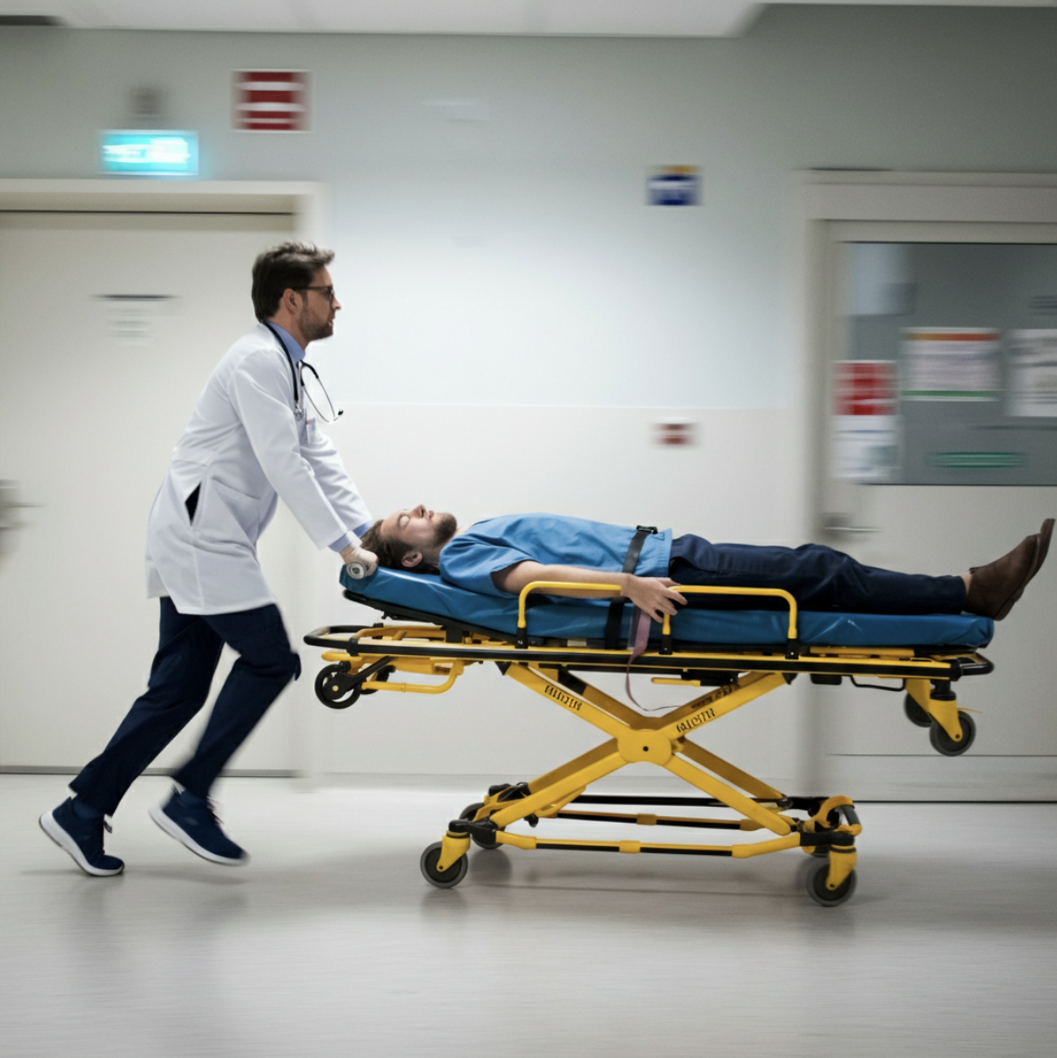
NEW WORDS
urgent (adj)
very important and needing attention immediately
/ˈɜːdʒənt/
khẩn cấp, cấp bách

Slide 9
NEW WORDS
hesitate (v)
to pause before you do or say something, often because you are uncertain or nervous about it
/ˈhezɪteɪt/
lưỡng lự

Slide 10
New words | Pronunciation | Meaning
1. permit (v) |  | cho phép/ đồng ý
2. paradise (n) |  | thiên đường
3. annual (adj) |  | hằng năm
4. access (n,v) |  | truy cập
5. urgent (adj) |  | khẩn cấp
6. hesitate (v) |  | lưỡng lự
/pəˈmɪt/
/ˈpærədaɪs/
/ˈænjuəl/
/ˈækses/
/ˈɜːdʒənt/
/ˈhezɪteɪt/

Slide 11
THE MEMORY
GAME
START!

Slide 12
HOW TO PLAY
-
Each player takes turns clicking on two cards to reveal their images.
-
If the two cards match, they stay face up. If not, they flip back over.
-
Matching cards earn you a point. Non-matching cards are turned back over for the next player.
-
The game ends when all pairs are matched. The player with the most points wins!

Slide 13
LETS GO!

Slide 14
1
A
permit
to allow or make something possible
2
B
paradise
a way of entering or reaching a place
C
3
a place that is extremely beautiful and that seems perfect
annual
D
diversity
happening once every year
4
E
5
a range of many things that are
very different from each other
access
F
urgent
that needs to be done or happen immediately
6
Notes:
The teacher reveals what's hidden behind a number and a letter by clicking on each. If the word and definition don't match, the teacher hides them again by clicking on them once more.

Slide 15
Checking answers
A | B
1. permit | a. happening once every year
2. paradise | b. a way of entering or reaching a place
3. annual | c. a range of many things that are very different from each other
4. diversity | d. that needs to be done or happen immediately
5. access | e. to allow or make something possible
6. urgent | f. a place that is extremely beautiful and that seems perfect
e
f
a
c
b
d

Slide 16
What part of speech is “permit”?
verb
What is noun form of “permit”
https://www.ldoceonline.com/dictionary
permission

Slide 17
Ex 2 (pg 74). Complete the following table. There is one example.
VERB
NOUN
discover
discovery
1. locate
location
location
2. hesitate
hesitation
hesitation
3. explore
exploration
exploration
4. possess
possession
possession
5. admire
admiration
admiration

Slide 18
Ex 3 (pg 74). Complete the following sentences with the words from the box.
located
hesitate
permit
urgent
diversity
1. The government encourages people to protect the _________ of their communities.
2. There is a(n) _________ need to preserve biological diversity of our national parks.
3. _________ between Israel and Jordan, the Dead Sea is the lowest place on Earth.
4. When I asked her to go to Lan Ha Bay with me, she agreed without _________.
5. They do not _________ visitors to take photographs of the palace.

Slide 19
Ex 3 (pg 74). Complete the following sentences with the words from the box.
located
hesitation
permit
urgent
diversity
1. The government encourages people to protect the _________ of their communities.
2. There is a(n) _________ need to preserve biological diversity of our national parks.
3. _________ between Israel and Jordan, the Dead Sea is the lowest place on Earth.
4. When I asked her to go to Lan Ha Bay with me, she agreed without _________.
5. They do not _________ visitors to take photographs of the palace.
.diversity (n): sự đa dạng
diversity
urgent
.urgent (n): sự khẩn cấp
Located
.Located (v): đặt ở đâu đó
.hesitation (n): sự chần chừ/ lưỡng lự
hesitation
permit
.permit (v): cho phép

Slide 20
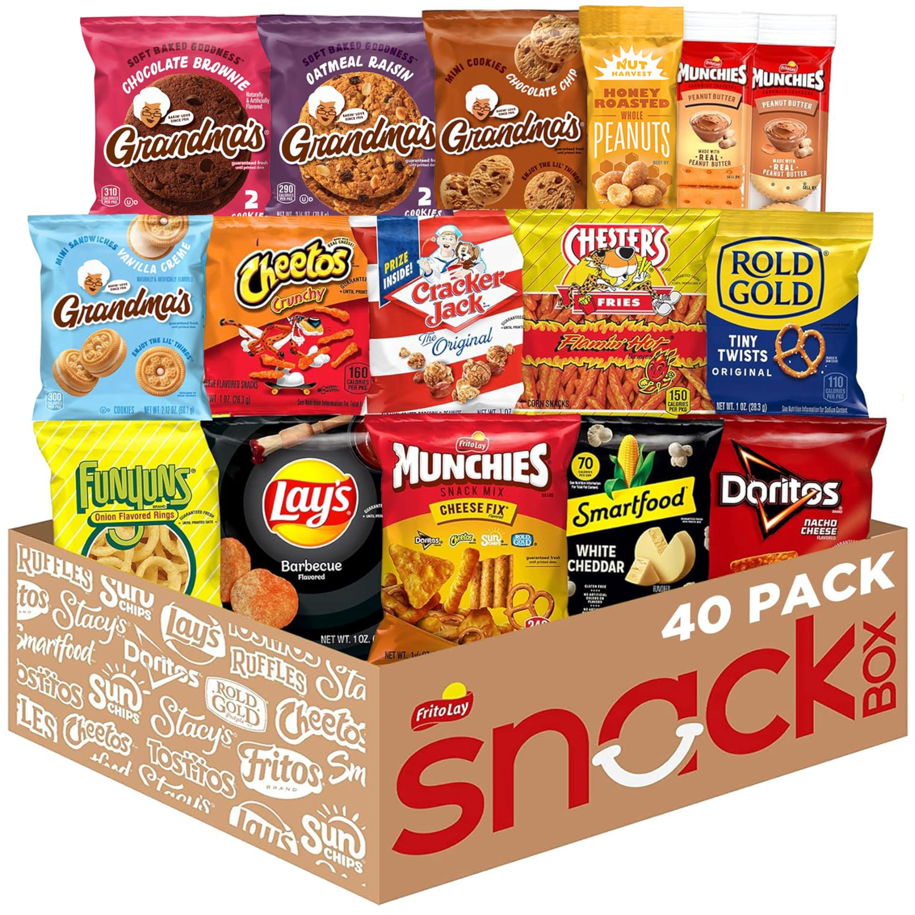
PRONUNCIATION
What is this called?
slippery
snack
slippery
snack
/sl/
/sn/

Slide 21
PRONUNCIATION

Slide 22
Ex 4 (pg 74). Listen and repeat the words.
Pay attention to the sounds /sl/ and /sn/.
/sl/ | /sn/
sleepy slice slippery slogan slope | snack snowy sneeze sneaker snake

Slide 23
Ex 5 (pg 74). Listen and repeat the sentences. Pay attention
the underlined words.
1. There are many snowstorms on Mount Everest.
2. He went down the slope, wearing a pair of sneakers.
3. She sneezed when I gave her a slice of pizza.
4. The way down the hill was slippery as it was covered in snow.
5. After eating a snack, she felt very sleepy.

Slide 24
SHODWE
HOME
ABOUT US
SERVICE
CONTACT
Thank You
for Attention
EMAIL
PHONE
6ps.teachingmaterials@gmail.com
039.702.7536
ZALO
Ms. Hanh
039. 702.7436

