Slide 1
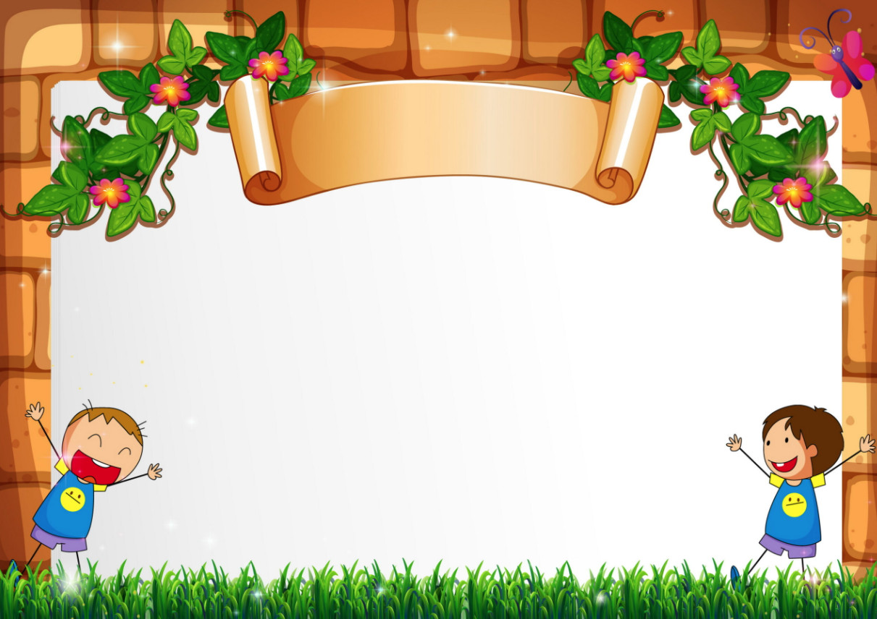
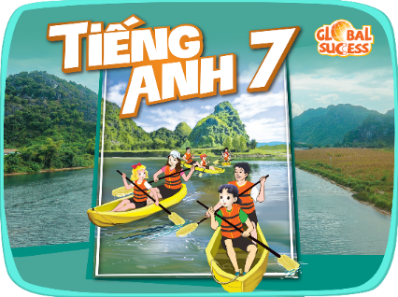
Unit
4
MUSIC AND ARTS
CAT HUNG SECONDARY SCHOOL
LESSON : SKILLS 1
READING
SPEAKING
WELCOME TO OUR CLASS !
Cat Hung Secondary School
Teacher : Thuy Tran
Unit
Teacher :Tran Thi Thu Thuy

Slide 2
WARM-UP
1. What’s the video about ?
=>Water puppetry/ Water sports/ Water dance
2. Where in Viet Nam did water puppetry originate?
=>In the North. / In the Central region./ In the South

Slide 3
Unit
4
MUSIC AND ARTS
LESSON 5 : SKILLS 1
READING
SPEAKING

Slide 4
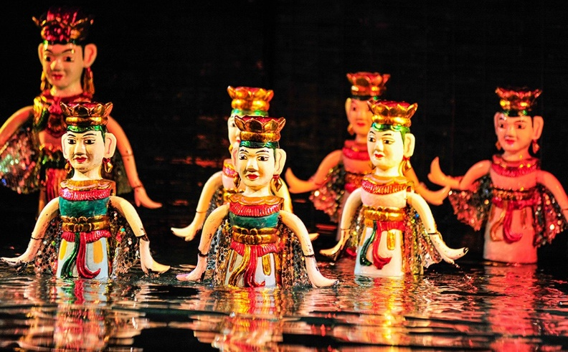
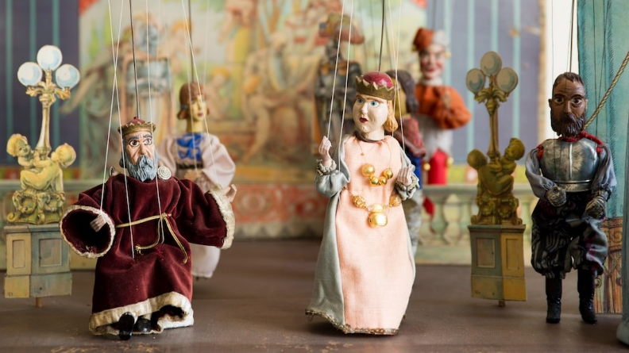
I. VOCABULARY
Water puppetry (n)
/'wɔ:tə[r] ˈpʌpɪtri/
múa rối nước

Slide 5
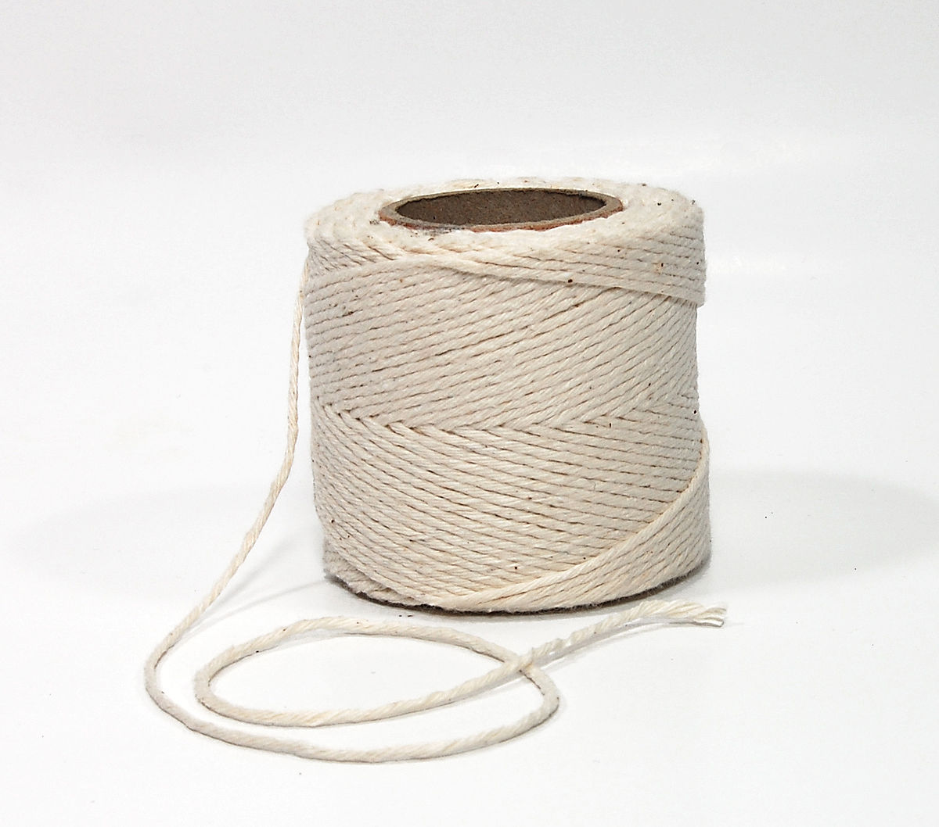
I. VOCABULARY
string (n)
/strɪŋ/
sợi dây

Slide 6
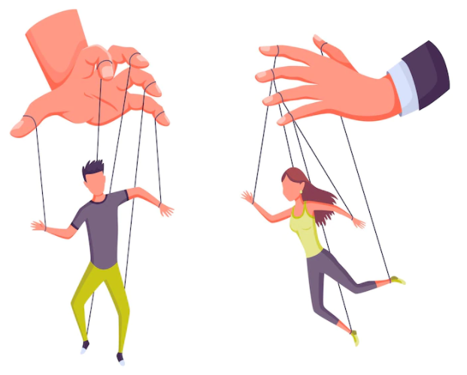
I. VOCABULARY
control (v)
/kənˈtrəʊl/
kiểm soát, điều khiển

Slide 7
I. VOCABULARY
New words | Pronunciation | Meaning
water puppetry (n) | / ˈwoːtəˈpʌpɪtri/ | múa rối nước
string (n) | /strɪŋ/ | sợi dây
control (v) | /kənˈtrəʊl/ | kiểm soát, điều khiển

Slide 8
DISCUSSION
The show was …………….(boring/ fantastic)
The artists stood ………………a screen. (behind/ in front of).
They used …………………….to control the puppets. (a remote control/ strings).
Water puppetry is a…………….art form. (modern/ traditional)

Slide 9
DISCUSSION
The show was …………….(boring/ fantastic)
The artists stood ………………a screen. (behind/ in front of).
They used …………………….to control the puppets. (a remote control/ strings).
Water puppetry is a…………….art form. (modern/ traditional)

Slide 10
READING
1
Read the email and match the highlighted words with their meanings.
To: sue@fastmail.com
Subject: A water puppet show
Dear Sue,
How are things with you? I arrived in Viet Nam three days ago, and everything is perfect.
Yesterday I went to see a puppet show at a theatre in the center of Ha Noi. The show was fantastic! The artists performed the show in a pool. They stood behind a screen. They used strings under the water to control the puppets and make them move on the water! The show was about rice farming and a festival in a village. People say that these shows are normally about everyday life in the countryside of Viet Nam. Water puppetry is a special traditional art form. People love it, and most tourists coming to Viet Nam love to see it. I wish you were here with me. See you next week.
Love,
Mary
What does ‘fantastic’ mean?

Slide 11
READING
1
Read the email and match the highlighted words with their meanings.
To: sue@fastmail.com
Subject: A water puppet show
Dear Sue,
How are things with you? I arrived in Viet Nam three days ago, and everything is perfect.
Yesterday I went to see a puppet show at a theatre in the center of Ha Noi. The show was fantastic! The artists performed the show in a pool. They stood behind a screen. They used strings under the water to control the puppets and make them move on the water! The show was about rice farming and a festival in a village. People say that these shows are normally about everyday life in the countryside of Viet Nam. Water puppetry is a special traditional art form. People love it, and most tourists coming to Viet Nam love to see it. I wish you were here with me. See you next week.
Love,
Mary
showed or presented
2. following tradition
3. nice, interesting
4. event or celebration
→ performed
→ traditional
→ fantastic
→ festival

Slide 12
READING
1
1
Read the email and match the highlighted words with their meanings.
To: sue@fastmail.com
Subject: A water puppet show
Dear Sue,
How are things with you? I arrived in Viet Nam three days ago, and everything is perfect.
Yesterday I went to see a puppet show at a theatre in the center of Ha Noi. The show was fantastic!
The artists performed the show in a pool. They stood behind a screen. They used strings under the water to control the puppets and make them move on the water! The show was about rice farming and a festival in a village. People say that these shows are normally about everyday life in the countryside of Viet Nam. Water puppetry is a special traditional art form. People love it, and most tourists coming to Viet Nam love to see it. I wish you were here with me. See you next week.
Love,
Mary
Who went to see a water puppet show yesterday?
=> Mary
2. Where did the artists perform the show?
=> In a pool.
3. Who controlled the puppets?
=> The artists
4. What are water puppet shows normally about?
=> About everyday life in the countryside of Viet Nam.
5. Is water puppetry a traditional Vietnamese art form?
=> Yes, it is

Slide 13
When was the puppet show?
2. Where was the show?

Slide 14
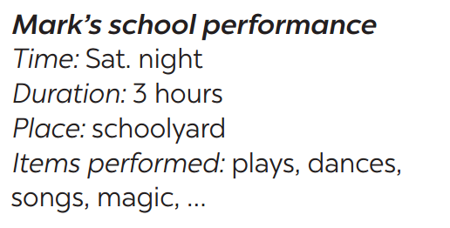
SPEAKING
4
Ask and answer about Mark’s school musical performance last year.
A: When was the performance?
B: On Saturday night.
A: How long did it last?
B: It lasted three hours.

Slide 15
When is Teacher’s Day?

Slide 16
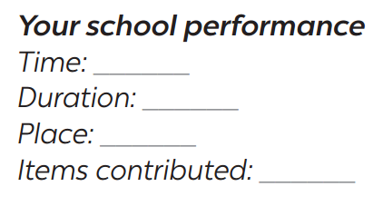
SPEAKING
5
Make a plan for the performance and talk about the items you will contribute.
Your school is going to have a musical performance to celebrate Teachers’ Day.

Slide 17
SPEAKING
5
Make a plan for the performance and talk about the items you will contribute.
Your school is going to have a musical performance to celebrate Teachers’ Day.

Slide 18
Unit
4
MUSIC AND ARTS
LESSON : SKILLS 1
CAT HUNG SECONDARY SCHOOL
READING
SPEAKING
THANKS FOR YOUR ATTENDENCE
Cat Hung Secondary School
Teacher : Thuy Tran
Unit

