Slide 1



Slide 2

What are possessive cases in the video?
The boy’s book
The girl’s dog
singular noun’s
Ben’s friend
proper name’s

Slide 3

UNIT 2
MY HOUSE
Lesson 3: A closer look 2

Slide 4

1. We use ’s after a proper name. (tên riêng)
Example: This is Elena’s room.
2. We use ’s after a singular noun. (danh từ đếm được số ít)
Example: This is my mum’s book.

Slide 5

Choose the correct answer
1
1. My (grandmothers / grandmother's) house is in Hanoi.
2. This is my (sister's / sister') desk.
3. My (cousin's / cousin) dad is my uncle.
4. (Nam's / Nam') house is small.
5. There are two bedrooms in (Ans / An's) flat.
singular noun
singular noun
singular noun
proper name
proper name

Slide 6
Complete the sentences with the correct possessive forms.
2
1. Thuc Anh is _________ cousin. (Mi)
2. This is their _________ chair. (teacher)
3. Where is _________ computer? (Nick)
4. My _________ motorbike is in the garden. (father)
5. My _________ bedroom is next to the living room. (brother)
Mi’s
teacher’s
Nick’s
father’s
brother’s

Slide 7


Where is the boy’s book?
The boy’s book is ON the desk.
Where is the boy’s book?
The boy’s book is ON the desk.
g
prepositions of place
A
B
C
To describe where people or things are, we use prepositions of place.
Notes:
Where is the book? A, B or C
Why? Con nhìn vào đâu để biết đc? ON => A
ON trả lời cho câu hỏi gì? WHERE? Ở đâu? Nên nó đc gọi là Preposition of place (giới từ chỉ vị trí)

Slide 8
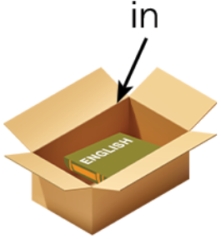

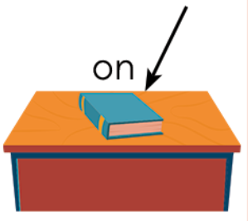
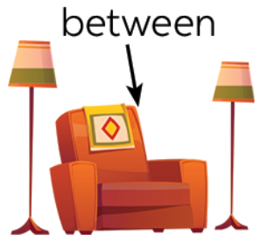
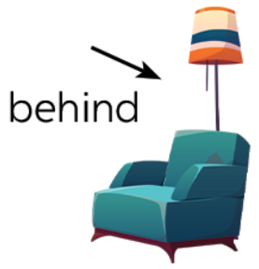
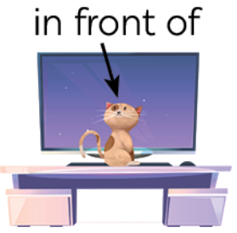

How many ‘prepositions of place’ do you know?
Prepositions of place

Slide 9

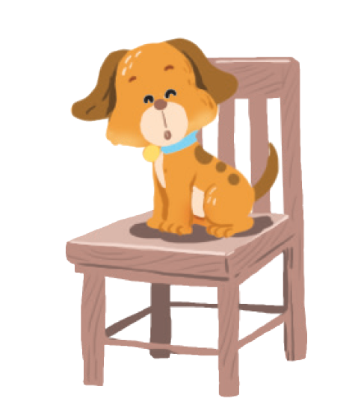
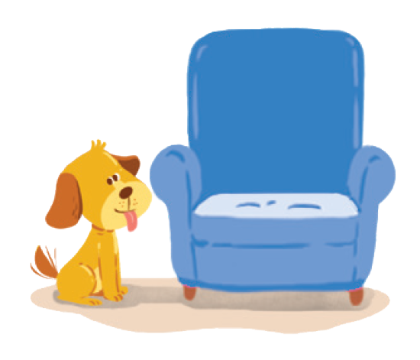



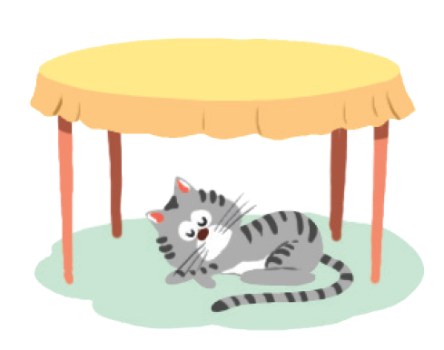
Write the correct preposition under the picture
3
  on
  in
  on
next to
behind
in front of
under
between

Slide 10
CHECK YOUR ANSWERS
next to
behind
The dog is next to
the armchair.
The cat is behind
the TV.

Slide 11
CHECK YOUR ANSWERS
in
in front of
The cat is in
the wardrobe.
The dog is in front of the doghouse.

Slide 12
between
under
The cat is between
the armchair and the lamp.
The cat is under
the table.

Slide 13
MEMORY CHALLENGE:
1
Remember the picture
2
Check True/False for the sentences.

Slide 14
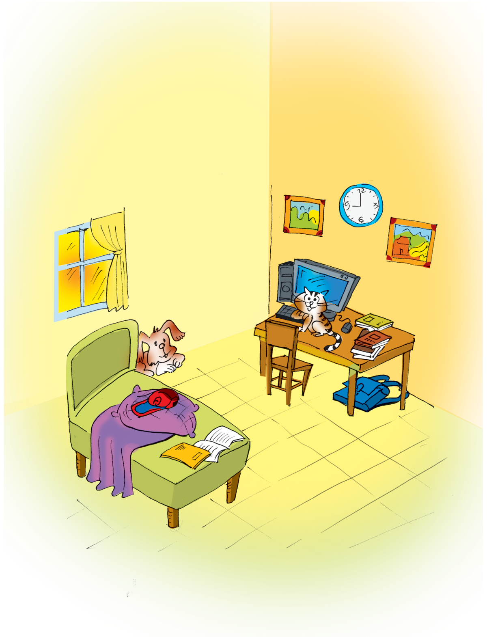

MEMORY CHALLENGE

Slide 15
Write T/F for each sentence. Correct the false sentences.
4
Example: The books are under the table. → The books are on the table. | F
1.The dog is behind the bed.
2.The school bag is on the table.
3.The picture is between the clocks.
4.The cat is in front of the computer.
5.The cap is under the pillow.

Slide 16
Open you book & check (page 20)
1.The dog is behind the bed.
2.The school bag is on the table.
3.The picture is between the clocks.
4.The cat is in front of the computer.
5.The cap is under the pillow.
T
F
under the table
clock
F
two pictures
T
on the pillow
F

Slide 17

During the time bomb, ask & answer.
1. Where is the cat?
2. Where is the dog?
3. Where are the pictures?
4. Where are the books?
5. Where is the school bag?
6. Where is the cap?
7. Where is the window?
8. Where is the table?

Slide 18








RECAP
Tick what you have learnt in the lesson today?
Possessive case
Prepositions of time
Prepositions of place

Slide 19

GREAT WORK! SEE YOU NEXT TIME

