Slide 1
Welcome all teachers attending to our class!

Slide 2
1
1
2
3
4
5
6
7
8
Team 1
1
Team 2
2
3
4
5
6
7
8
2
3
4
5
1
6
7
8
WIN
WIN

Slide 3
1. What is the name of the room where Nick is staying?
25
23
0
3
21
5
19
7
17
9
15
11
13
Answer

Slide 4
1. What is the name of the room where Nick is staying?
HOME
TIGER

Slide 5
2. How many rooms are there in the hotel?
25
23
0
3
21
5
19
7
ANSWER
17
9
15
11
13

Slide 6
2. How many rooms are there in the hotel?
HOME
TEN (10)

Slide 7
3. Is there a wardrobe in Nick’s room?
25
23
0
3
21
5
19
7
ANSWER
17
9
15
11
13

Slide 8
3. Is there a wardrobe in Nick’s room?
YES
HOME

Slide 9
4. Where is that Crazy House Hotel?
25
23
0
3
21
5
19
7
17
9
15
11
13
ANSWER

Slide 10
4. Where is that Crazy House Hotel?
IN DA LAT
HOME

Slide 11
5. Are the rooms named after different flowers?
25
23
0
3
21
5
19
7
17
9
15
11
13
ANSWER

Slide 12
5. Are the rooms named after different flowers?
NO
HOME

Slide 13
Lucky number

Slide 14
LUCKY NUMBER

Slide 15
7. Where is the bed in Nick’s room?
25
23
0
3
21
5
19
7
17
9
15
11
13
ANSWER

Slide 16
7. Where is the bed in Nick’s room?
Under the window
HOME

Slide 17
UNIT 2: MY HOUSE
LESSON 6: SKILLS 2

Slide 18
Listening
Lesson 6: Skills 2

Slide 19
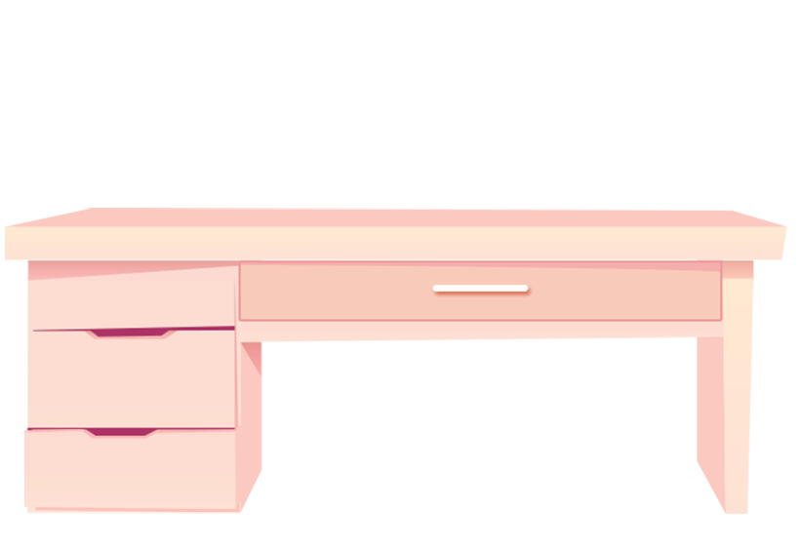
✓
2. SOFA
3. DESK
✓
1. BOOKSHELF
Guess what is mentioned in the listening text
Listen and tick (✓) things you hear
✓
✓
4. CLOCK
5. WINDOW

Slide 20
Ex 2: Listen and tick ( ) T (True) or F (False).
Correct the false ones.
✓
 | T | F
1. There are four people in Mai's family.
2. Mai's house has seven rooms.
3. The living room is next to the kitchen.
4. In her bedroom, there's a clock on the wall.
5. She often listens to music in her bedroom.
three
✓
six
✓
✓
✓
reads books
✓

Slide 21
Writing
Lesson 6: skills 2

Slide 22
Sample email
Group discussion
In groups of three, discuss:
How many parts are there in an email to your friend?
What are they?
What should you include when writing each part?
From: an@fastmail.com
To: sophia@quickmail.com
Subject: My house
Hi Sophia, Thanks for your email. Now I’ll tell you about my house.
I live with my parents in a flat. It’s big. There is a living room, a kitchen, two bedrooms and two bathrooms. I like my bedroom the best. What about you? Where do you live? Tell me in your next email.
See you soon! Nick

Slide 23
Sample email
address
From: an@fastmail.com
To: sophia@quickmail.com
Subject: My house
Hi Sophia, Thanks for your email. Now I’ll tell you about my house.
I live with my parents in a flat. It’s big. There is a living room, a kitchen, two bedrooms and two bathrooms. I like my bedroom the best. What about you? Where do you live? Tell me in your next email.
See you soon! Nick
subject
greeting
introduction
body
conclusion

Slide 24
Let’s brainstorm ideas for your email …
In your notebook, write full answers to the following question:
1. Where do you live?
2. How many rooms are there in your house? What are they?
3. Which room do you like the best in your house? Why?
Swap the answer with your partner

Slide 25
Ex.4: Write an e-mail to your pen friend.
Tell him/ her about your house. Use the answers in Ex.3
1. Where do you live?
2. How many rooms are there in your house? What are they?
3. Which room do you like the best in your house? Why?

Slide 26
SUGGESTION
To: mira@webmail.com
Subject: My house
Hi Mira,
Thanks for your email. Now I'll tell you about my house.
I live in a small townhouse in Ha Noi. There are five rooms: a living room, a kitchen, two bedrooms and a bathroom. My favourite room is my bedroom. It is very cozy. There is a big window, a small bed, a desk and a chair.
What about you? Where do you live?
Tell me in your next email.
All the best,

Slide 27
How to write an email?
In the subject line, write briefly what the email is about.
Begin the email with a greeting (Dear / Hi / Hello).
The introduction is the first paragraph. Ask about his / her health, thank him / her for the previous email or write the reasons for the email, etc.
In the body, write about the subject(s) of the email. Write each subject in a new paragraph.
The conclusion is the last paragraph. Say goodbye, ask your friend to write back, etc.

Slide 28
RECAP
Tick what you have learnt in the lesson today?
Listen about someone's house
Write a poster
Write an email

Slide 29
GREAT WORK! SEE YOU NEXT TIME

