Slide 1
WELCOME TO OUR CLASS

Slide 2
Unit 6: FOOD AND DRINKS
Review 1
Page 90

Slide 3
WARM-UP

Slide 5
It’s time to learn …

Slide 6
Listening

Slide 7
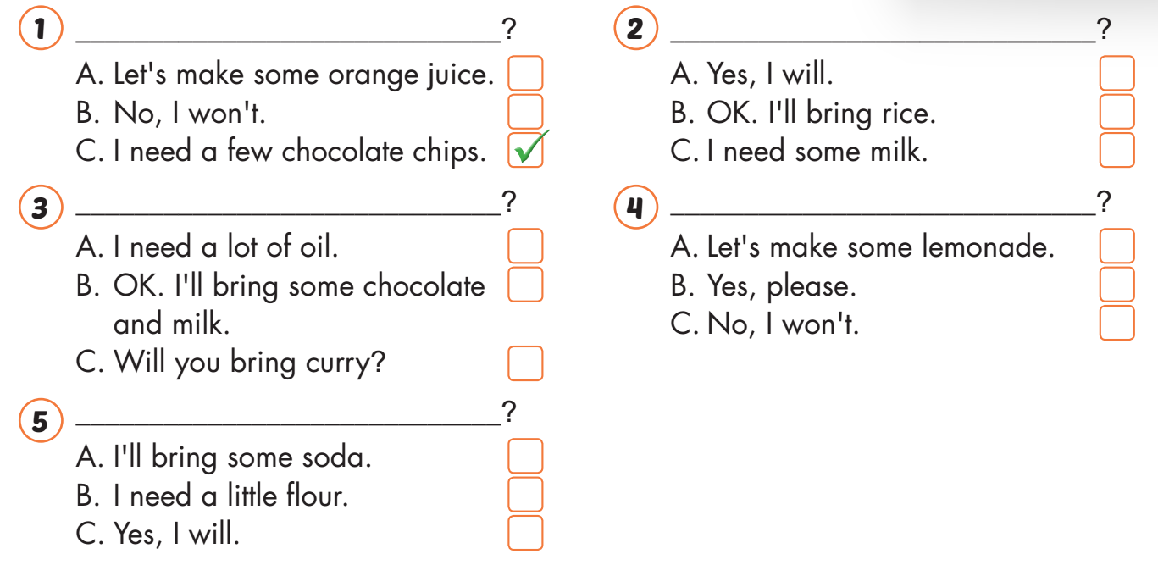
Listening

Slide 8
Listening

Slide 9
Listening

Slide 10
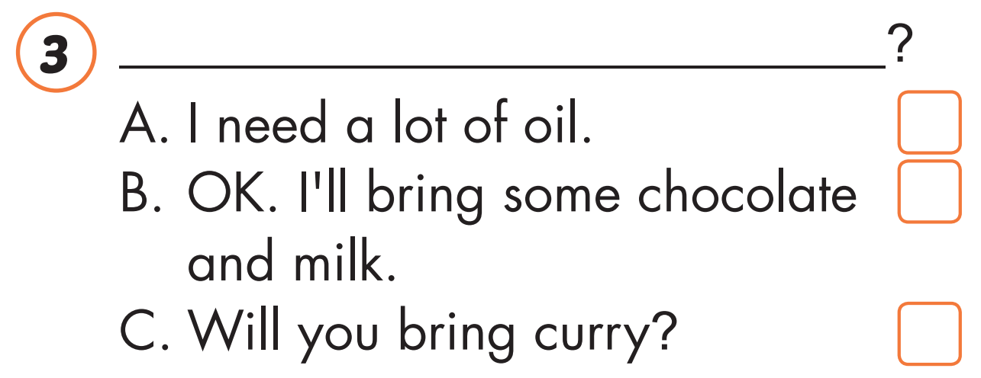

Slide 11
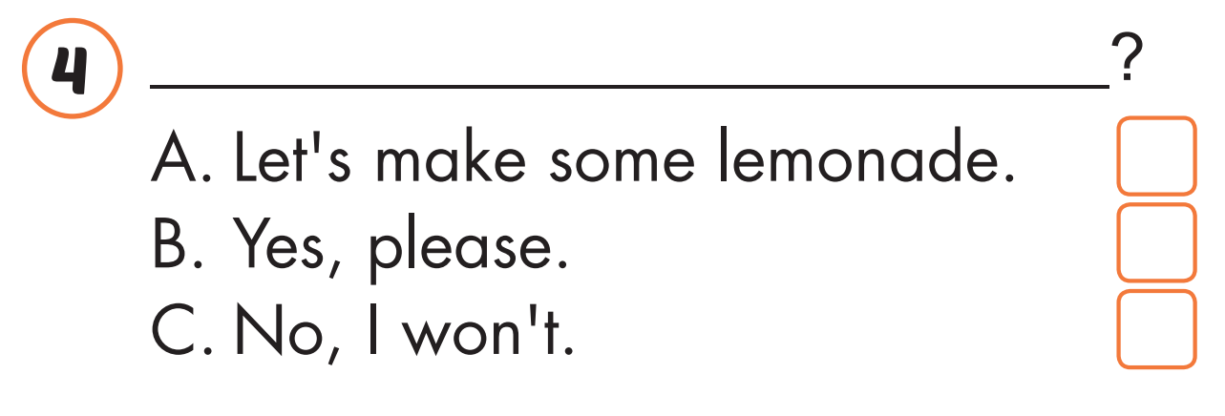
Listening

Slide 13
What do you need?
Listening

Slide 14
Will you bring pies, Sue
Listening

Slide 15
Let’s make some hot chocolate.

Slide 16
Will you bring hamburgers, Nick
Listening

Slide 17
Oh, you're making a cake.
What do you need

Slide 18
Reading

Slide 19
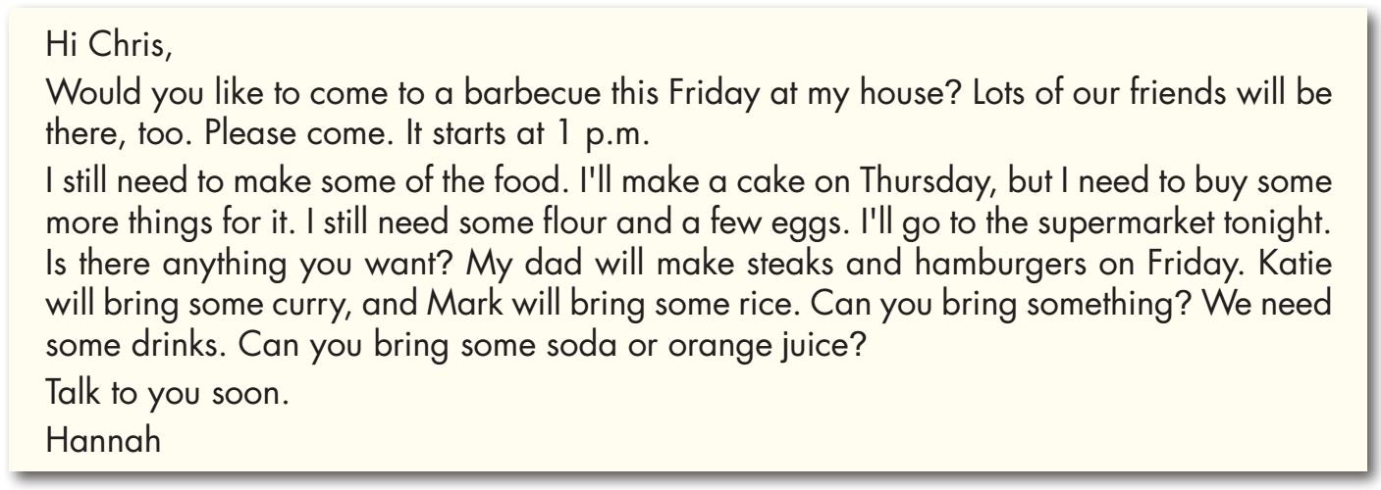

Slide 22
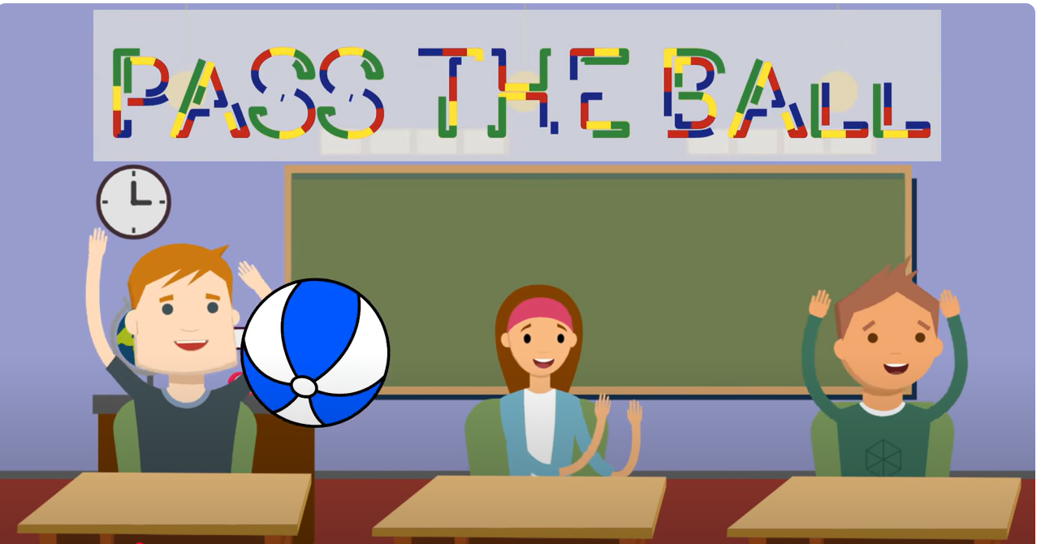

Slide 23
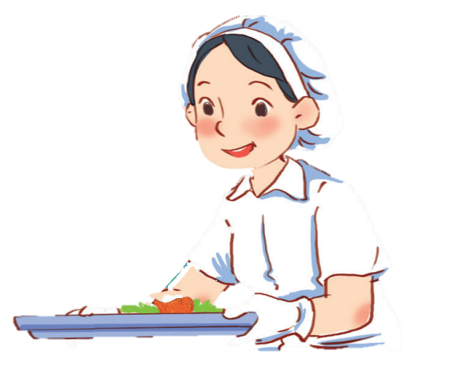
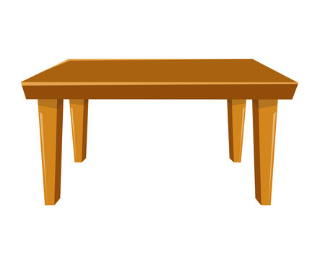
What do you need?
I need a lot of milk.
30

Slide 24
Let’s make smoothies?
Ok. I’ll bring milk.

Slide 25
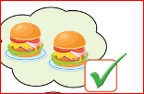
Will you bring hamburgers?
Yes, I will

Slide 26
Will you bring pie?
No, I won’t

Slide 27
What do people in the USA usually eat for breakfast?
They usually eat cereal with milk

Slide 28
CONSOLIDATION

Slide 29
Today’s lesson
Vocabularies
Review
Structures/ Sentence patterns
Review

Slide 30
Homework
Practice the vocabularies and structure, and make sentences using them.
Do the exercises in Tiếng Anh 5 i-Learn Smart Start WB (page 50).
Do the exercises in Tiếng Anh 5 i-Learn Smart Start Notebook.
Prepare the next lesson (page 77 SB).
Play the consolidation games in Tiếng Anh 5 i-Learn Smart Start DHA App on www.eduhome.com.vn

Slide 31
Enjoy your day!

