Slide 1
WELCOME TO OUR CLASS

Slide 2
Unit 7: JOBS
Lesson 1.1
Page 92

Slide 3
WARM-UP

Slide 4
Let’s play a game !

Slide 5
Play the game on DHA on Eduhome – Unit 6 – Review

Slide 6
It’s time to learn …

Slide 7
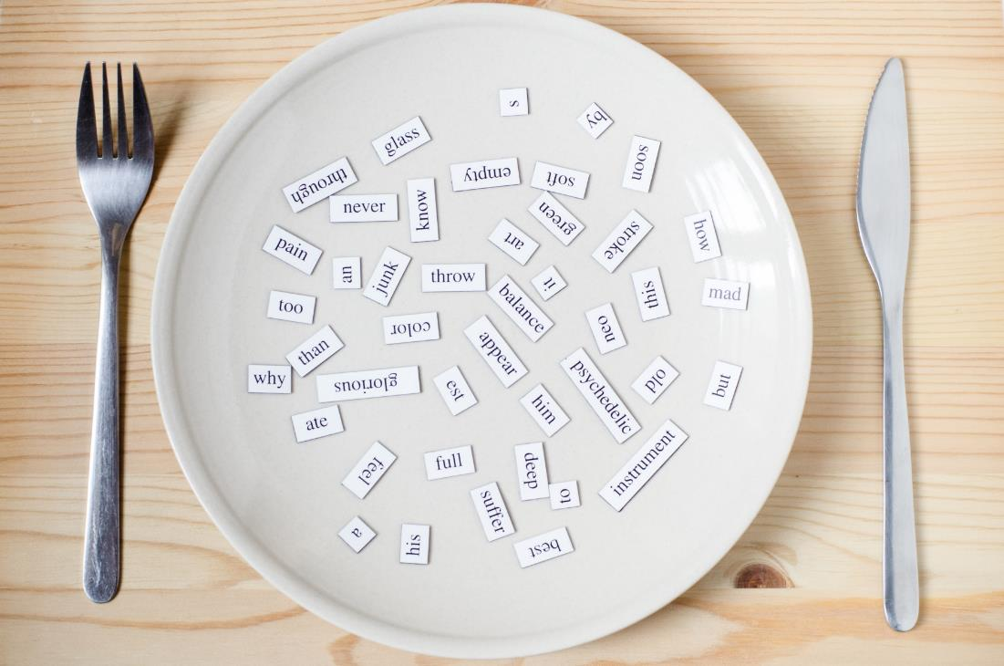
New words
scientist,
pilot,
tour guide,
business person,
hairdresser
designer

Slide 8
Presentation

Slide 9
Click on the picture to hear the sound.
scientist
/ˈsaɪəntɪst/
nhà khoa học

Slide 10
Click on the picture to hear the sound.
pilot
/ˈpaɪlət/
phi công

Slide 11
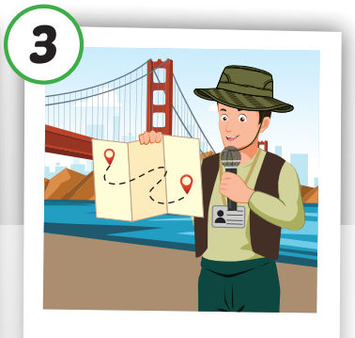
Click on the picture to hear the sound.
tour guide
/ˈtʊr ɡaɪd/
hướng dẫn viên du lich

Slide 12
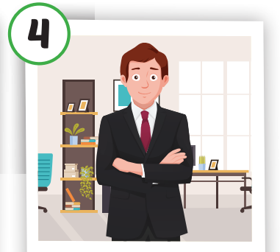
Click on the picture to hear the sound.
business person
/ ˈbɪznəs pɜːrsən/
doanh nhân

Slide 13
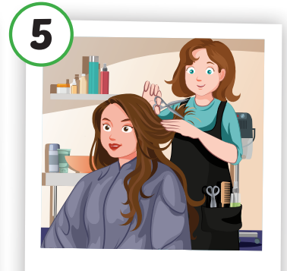
Click on the picture to hear the sound.
hairdresser
/ˈherˌdres.ɚ/
thợ cắt tóc

Slide 14
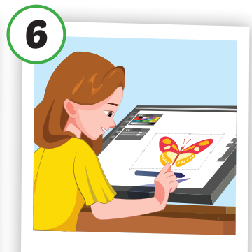
Click on the picture to hear the sound.
designer
/dɪˈzaɪ.nɚ/
nhà thiết kế

Slide 15
Click on the picture below to hear the sound.
Notes:
Click vào hình A. 1. Listen and point. Repeat để cho cả audio full chạy

Slide 16
Practice

Slide 17
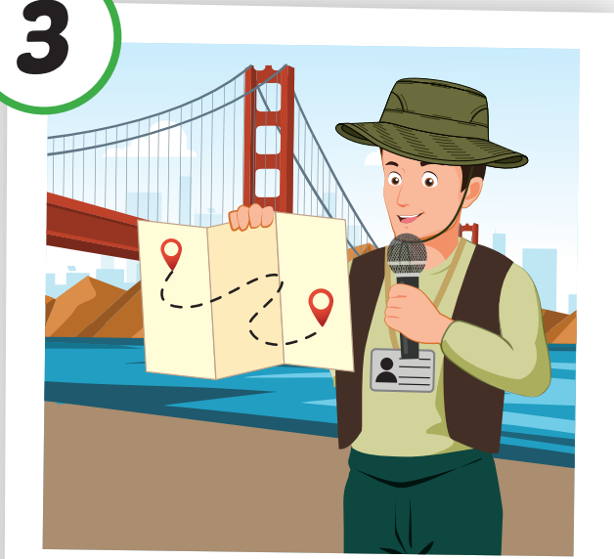
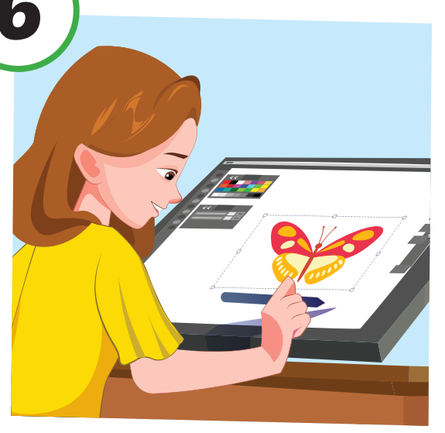
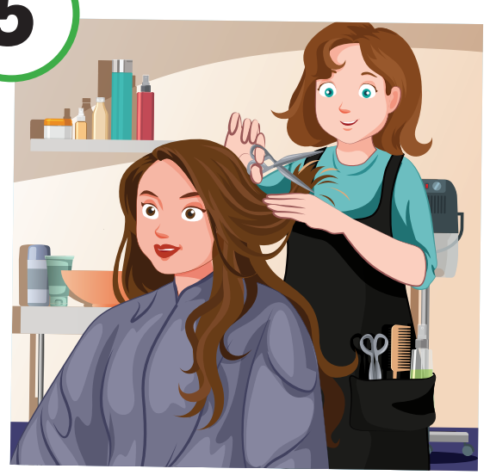
Let’s play – “Slow motion” game.

Slide 18
Structure
What would you like to be
when you grow up?
- I’d like to be a scientist.

Slide 19
Click on the picture to hear the sound.

Slide 20
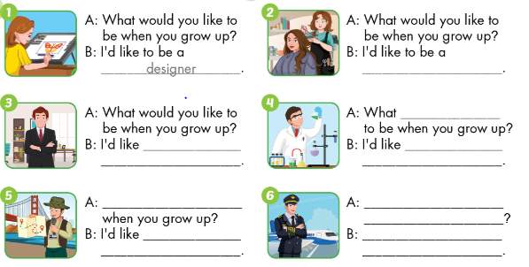

Slide 21
hairdresser

Slide 22
to be
a business person
would you like
to be
a scientist

Slide 23
What would you like to be
to be
a tour guide
What would you like to be
when you grow up
I’d like to be a pilot.

Slide 24
Production

Slide 25
Make a survey
Name | What would you like to be when you grow up?
1,
2,
3,

Slide 26
Pass the ball
What would you like to be when you grow up?
I’d like to be a ……………

Slide 27
Today’s lesson
Vocabularies
scientist, pilot,
tour guide, business person, hairdresser, designer.
Structures/ Sentence patterns
What would you like to do when you grow up?
- I’d like to be a scientist.

Slide 28
Homework
Practice the vocabulary and structure, and make sentences using them.
Do the exercises in Tiếng Anh 5 i-Learn Smart Start WB (page 62).
Do the exercises in Tiếng Anh 5 i-Learn Smart Start Notebook.
Prepare for the next lesson (page 93 SB).
Play the consolidation games in Tiếng Anh 5 i-Learn Smart Start DHA App on www.eduhome.com.vn

Slide 29
Enjoy your day!

Slide 30
Lesson 3
Stay positive and have a nice day!

