Slide 3
It’s time to learn …

Slide 4
Thursday, December 19th,2024
Unit 5 :FREE TIME ACTIVITIES
Lesson 1- Part A, B, C

Slide 5
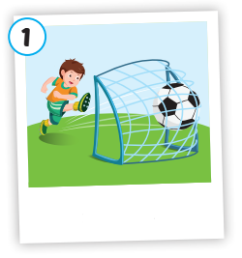
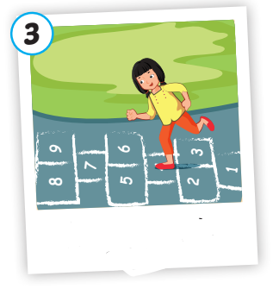
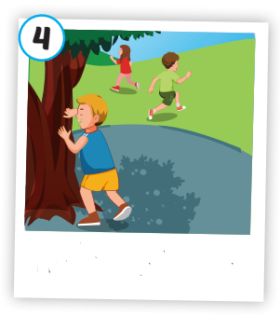
hopscotch
soccer
tag
hide and seek

Slide 6
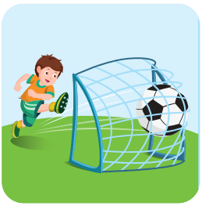
soccer
/ˈsɒkər/
môn bóng đá

Slide 7
tag
/tæɡ/
trò đuổi bắt

Slide 8
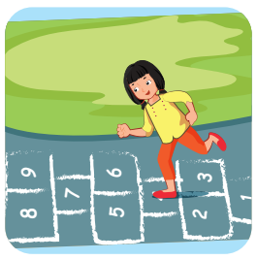
hopscotch
/ˈhɒpskɒtʃ/
trò chơi nhảy lò cò

Slide 9
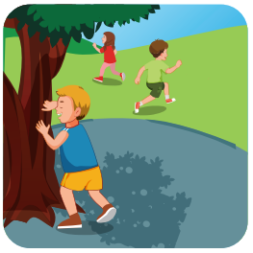
hide and seek
/ˌhaɪd ən ˈsiːk/
trò chơi trốn tìm

Slide 10
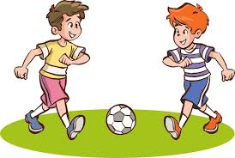
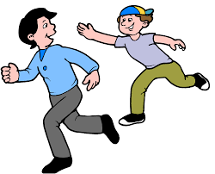
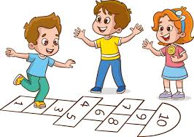
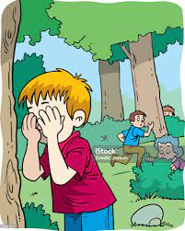
Vocabulary
soccer
:môn bóng đá
tag
: trò chơi đuổi bắt
hopscotch
: trò chơi nhảy lò cò
hide and seek
: trò chơi trốn tìm

Slide 11
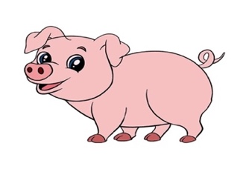
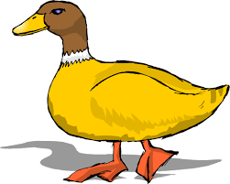
What’s the missing picture?

Slide 12
pig
What’s the missing picture?
Example:

Slide 13
What’s the missing picture?
Question 1:
hide and seek

Slide 14
What’s the missing picture?
Question 2:
soccer

Slide 15
What’s the missing picture?
Question 3:
hopscotch

Slide 16
What’s the missing picture?
Question 4:
tag

Slide 17
What’s the missing picture?
Question 5:
dog

Slide 18
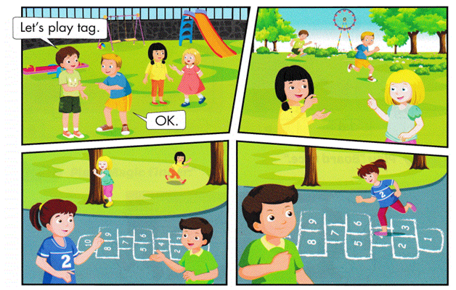

Slide 19
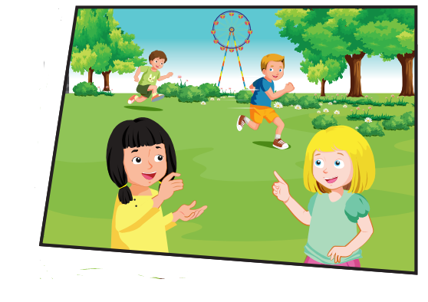
Let’s play tag.
OK.

Slide 20
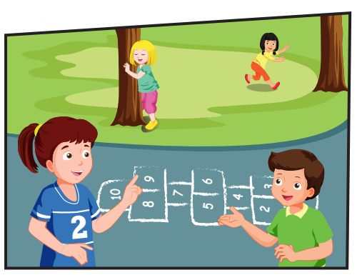
OK.
Let’s play
hide and seek.

Slide 21
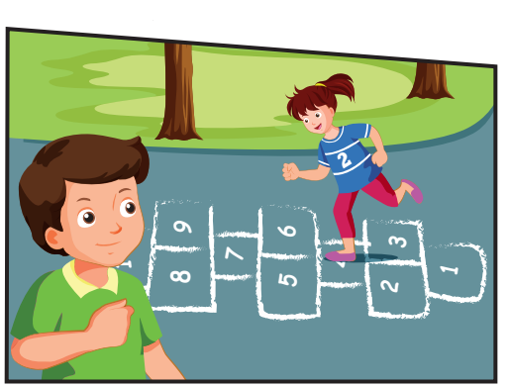
Yeah, OK.
Let’s play hopscotch, Lucy.

Slide 22
Sentence pattern
tag
soccer
hide and seek
hopscotch
Let’s play…. ……….
OK.

Slide 23
Look and say.

Slide 24
Let’s play tag.
Let’s play soccer.
Let’s play tag.
Let’s play soccer.
OK.
OK
.
OK.
OK.
Let’s play hopscotch.
Let’s play hide and seek.
Let’s play hopscotch.
Let’s play hide and seek.
OK.
OK.
OK.
OK.

Slide 26
Practice
OK.
Let’s play………..

Slide 27
CONSOLIDATION

Slide 28
Today’s lesson
Vocabulary
soccer
tag
hopscotch
hide and seek
Sentence patterns
Let’s play (soccer).
OK.

Slide 29
Homework
Practice vocabularies and structure.
Make sentences using them.
Practice the vocabulary and structure in Tiếng Anh 2 i-Learn Smart Start Student book (page 34).
Do the exercises in Tiếng Anh 2 i-Learn Smart Start Workbook (page 32).

Slide 30
Goodbye
See you again

