Slide 1
BONG SON 2 PRIMARY SCHOOL
WELCOME TO CLASS 4A2
Unit 8: MY FRIENDS AND I
Lesson 3 - Page 112
TEACHER: PHAM THI KIEU ANH

Slide 2
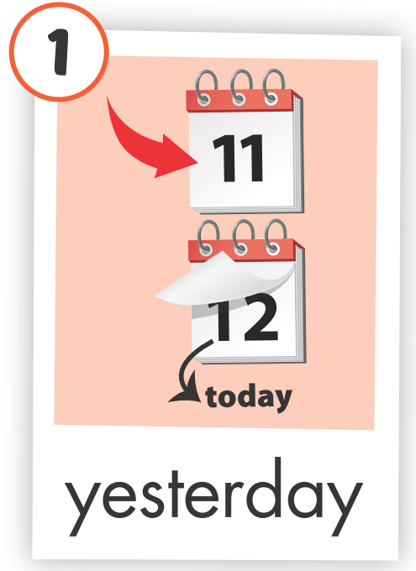
WHAT’S MISSING?

Slide 3
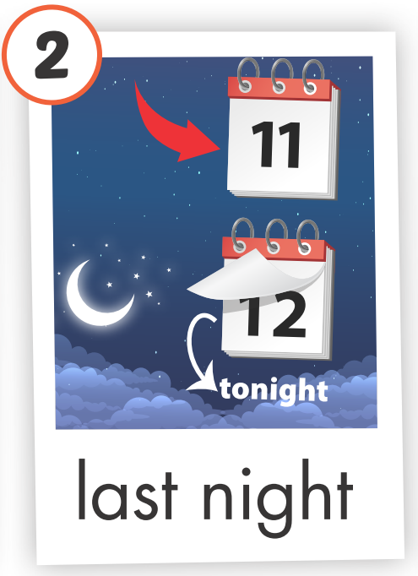
WHAT’S MISSING?

Slide 4
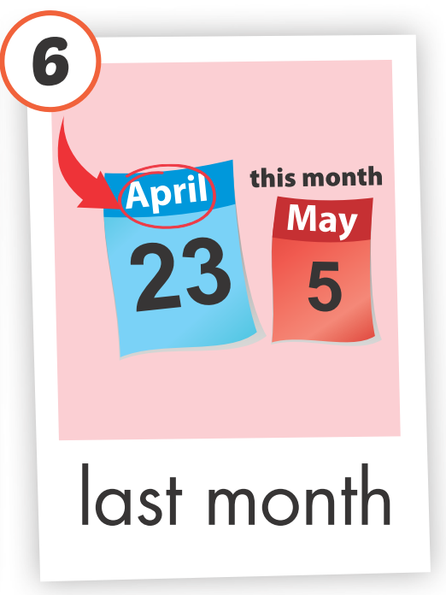
WHAT’S MISSING?

Slide 5
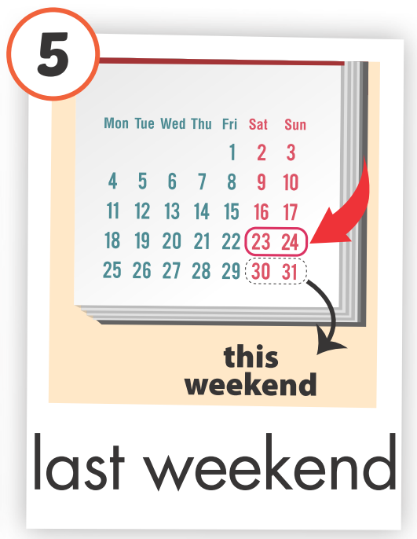
WHAT’S MISSING?

Slide 6
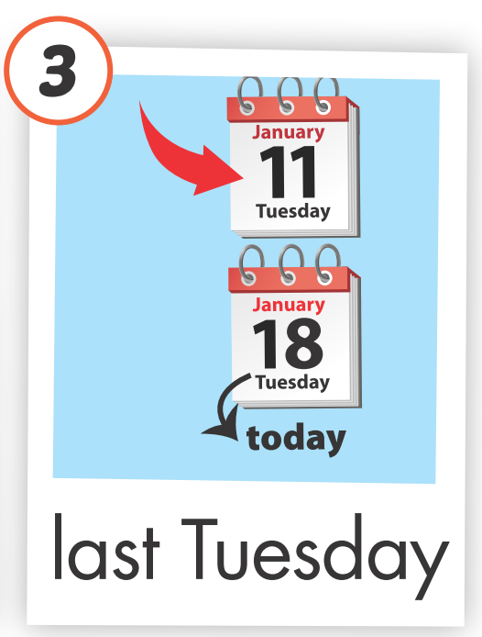
WHAT’S MISSING?

Slide 7
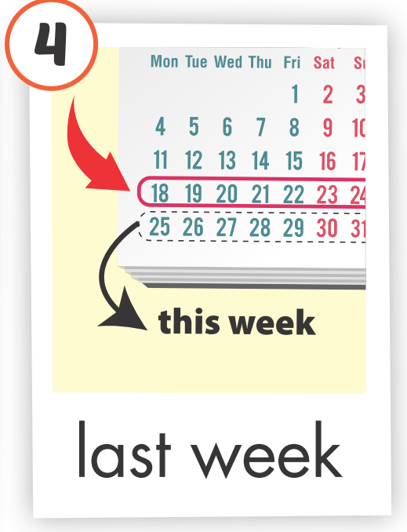
WHAT’S MISSING?

Slide 8
Click each picture to hear the sound

Slide 9
New words
movie theater
playground
museum
mall
Supermarket
amusement park

Slide 10
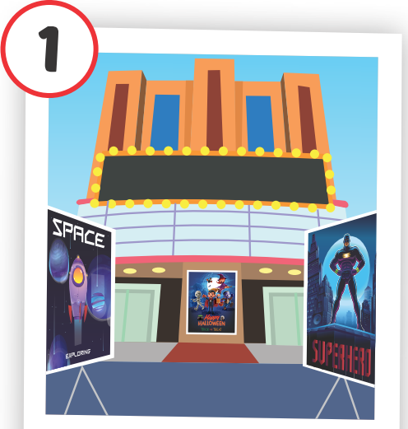
movie theater
Click on each English word to hear the sound.

Slide 11
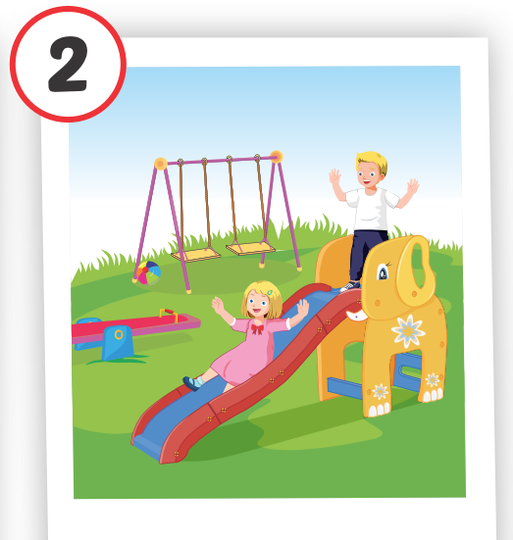
playground
Click on each English word to hear the sound.

Slide 12
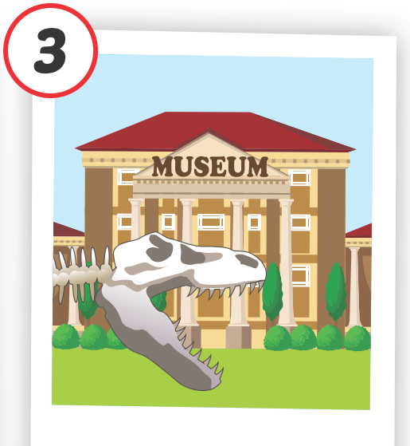
museum
Click on each English word to hear the sound.

Slide 13
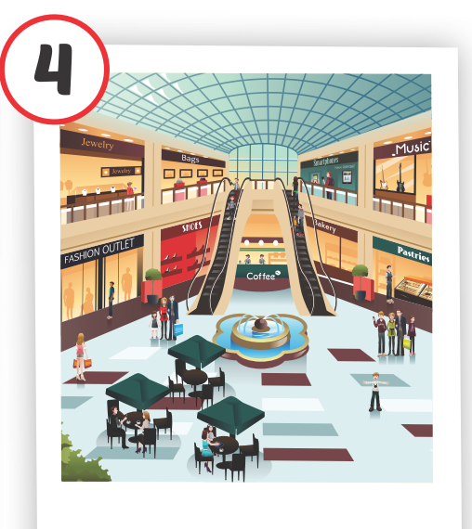
mall
Click on each English word to hear the sound.

Slide 14
supermarket
Click on each English word to hear the sound.

Slide 15
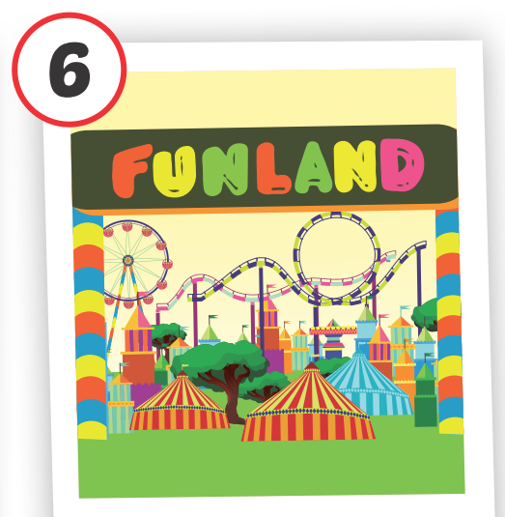
amusement park
Click on each English word to hear the sound.

Slide 16
PLAY
“WHAT AND WHERE?”

Slide 25
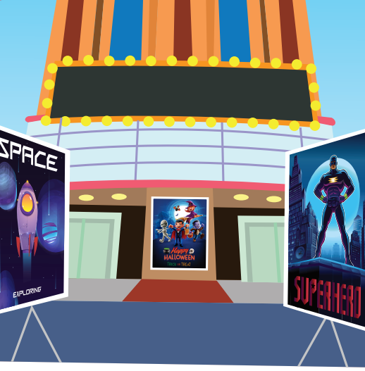
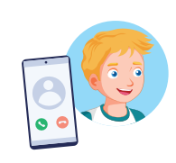
Where were you last night?
I was at the movie theater.

Slide 26
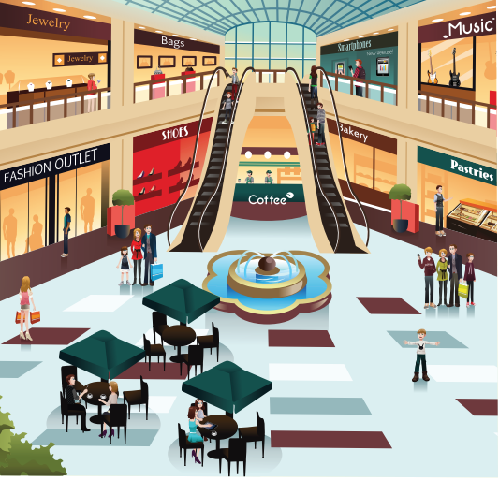
Where were you last weekend?
I was at the mall.

Slide 27
Where was your father yesterday?
He was at the supermarket.

Slide 28
Where were Ann and Lucy last Tuesday?
They were at the amusement park.

Slide 29
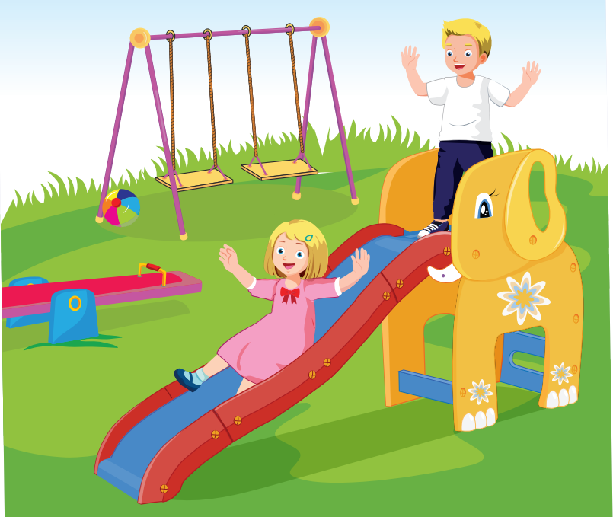
Where were you last week?
I was at the playground.

Slide 30
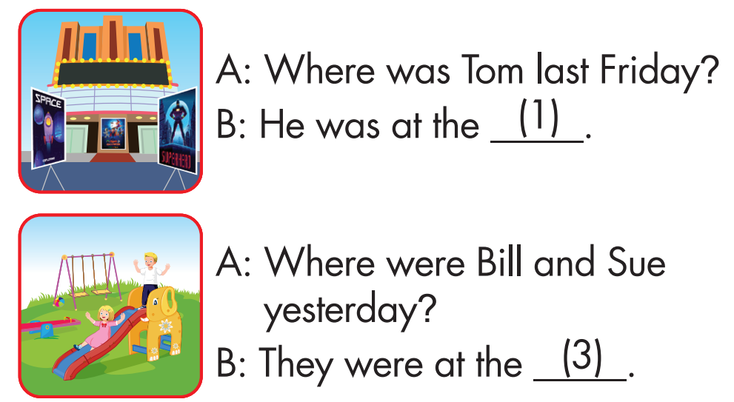
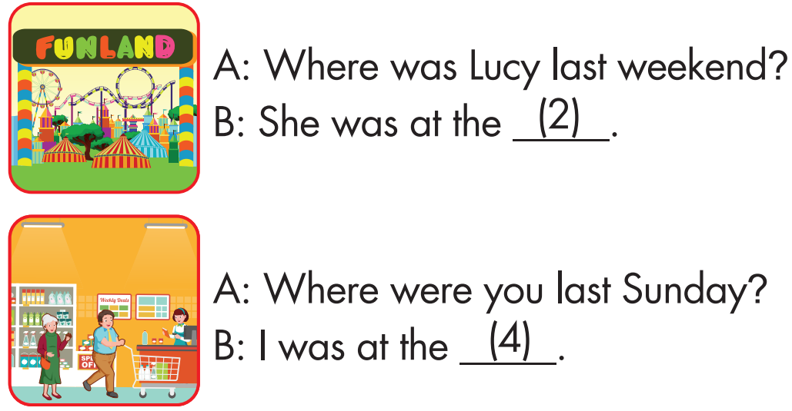
4
3
2

Slide 31
PLAY IN GROUPS
“THROW THE BALL”

Slide 32
THANK YOU
FOR WATCHING

