Slide 1
Bong Son 2 Primary School
Welcome to class 5A4

Slide 2
MIMING

Slide 3
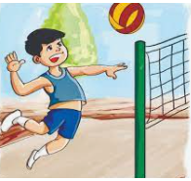

Slide 4
Unit 10
When will
Sports Day be?
Lesson 2- Part 4,5,6

Slide 6
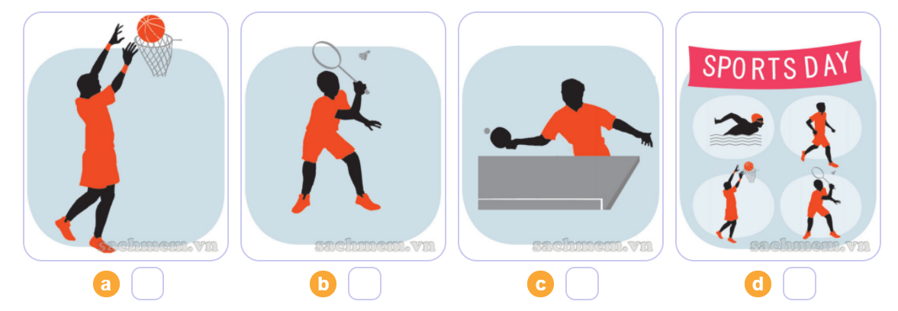
4. Listen and number
4
2
3
1
1
2
3
4

Slide 7
4. Listen and number
4
2
3
1

Slide 9
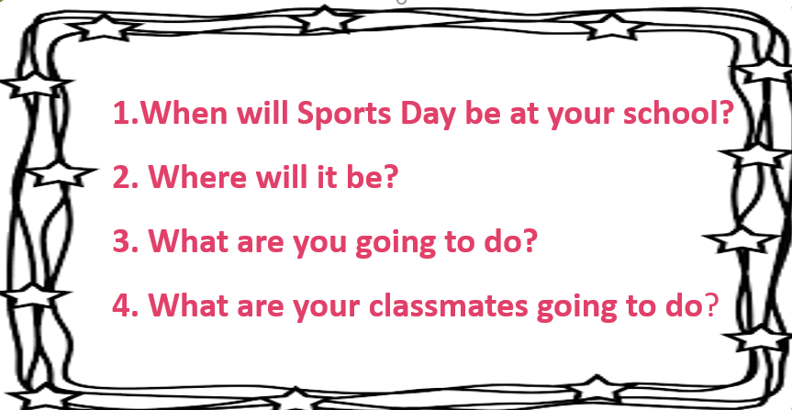
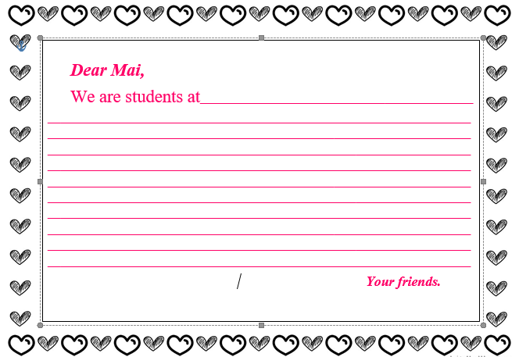
5. Write about you.

Slide 10
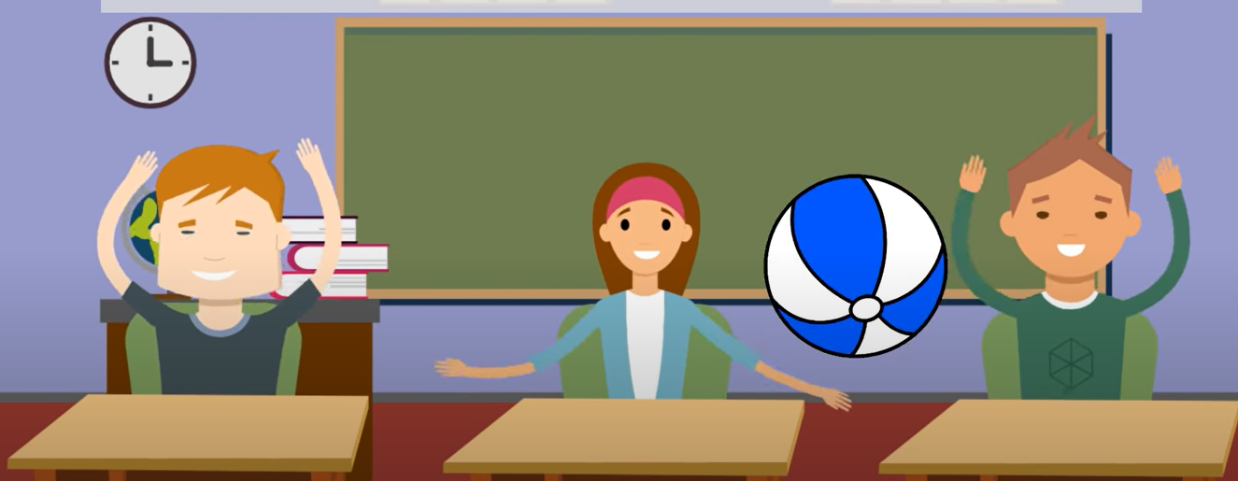
MUSICAL BALLS

Slide 11
HOMEWORK
- Learn vocabulary and structures
- Do exercise in workbook.

