Slide 1
WELCOME TO OUR CLASS 4A1

Slide 2
01 WARM UP

Slide 3
A. SING AND DANCE

Slide 5
B. DO A PUZZLE

Slide 6
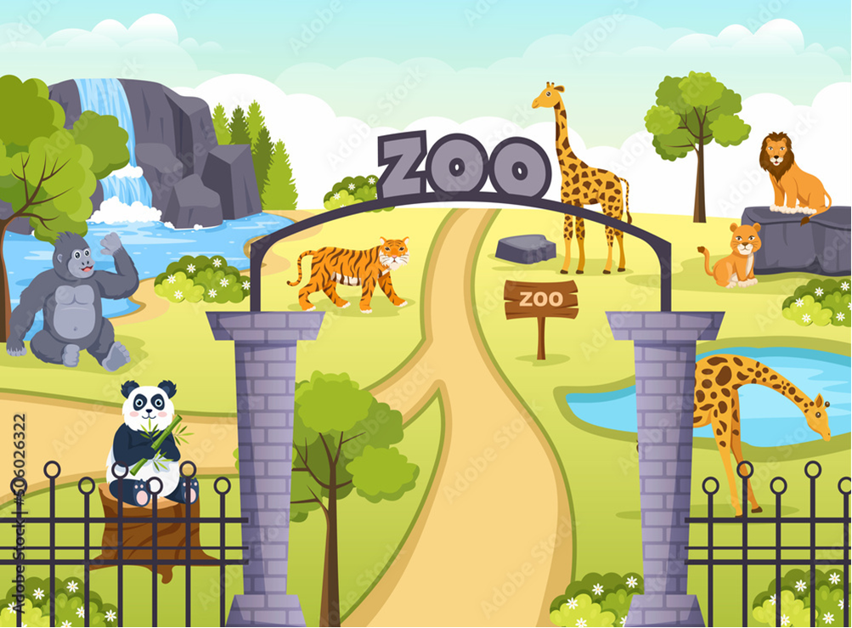
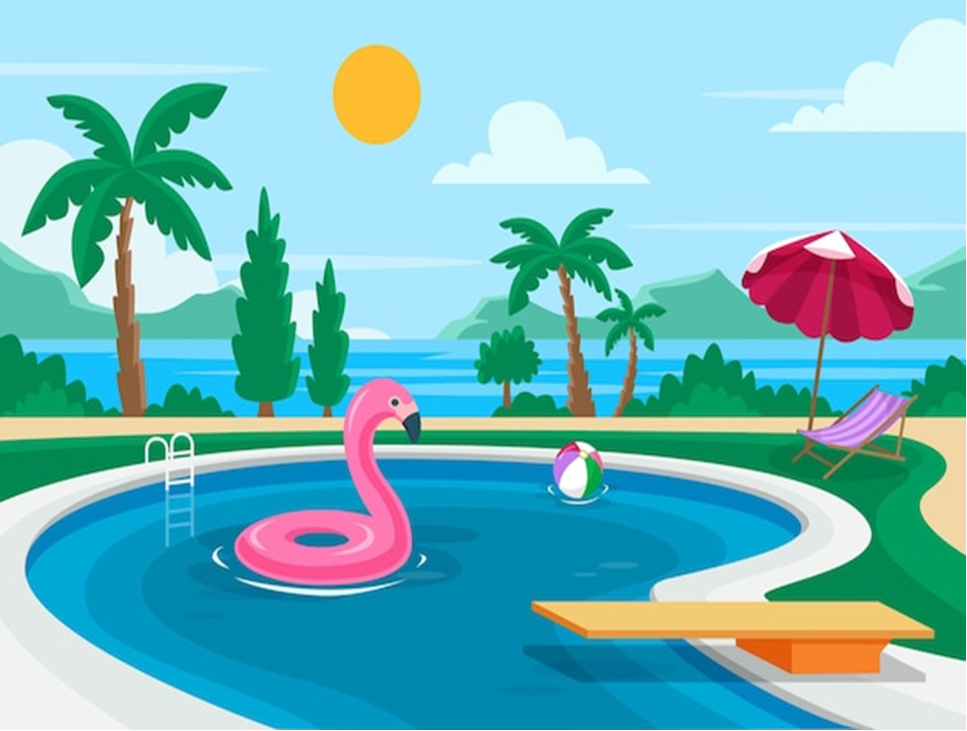
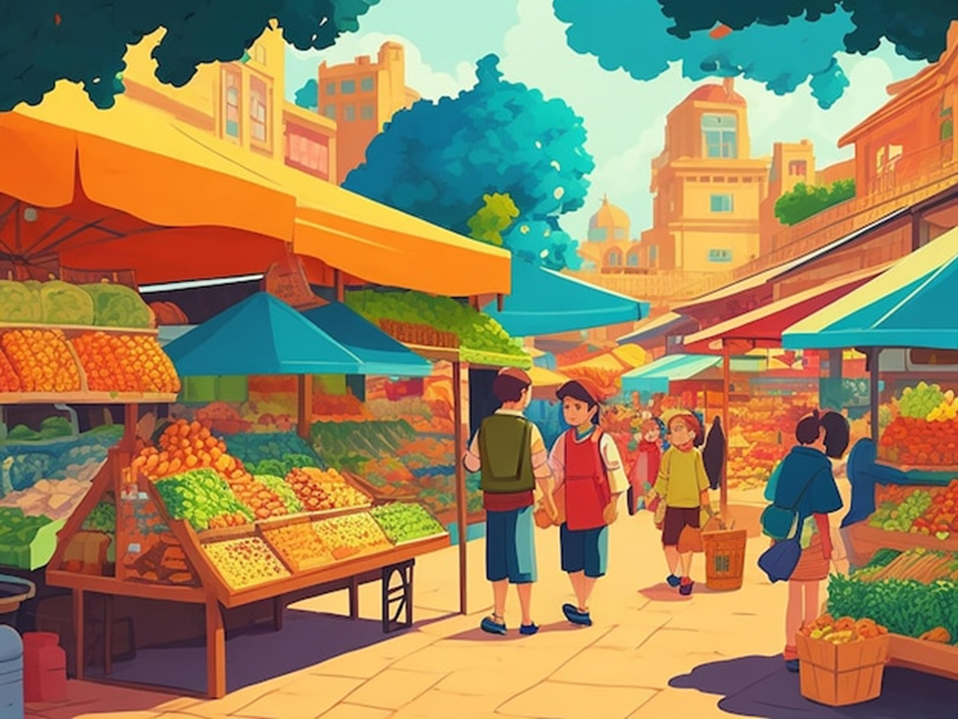
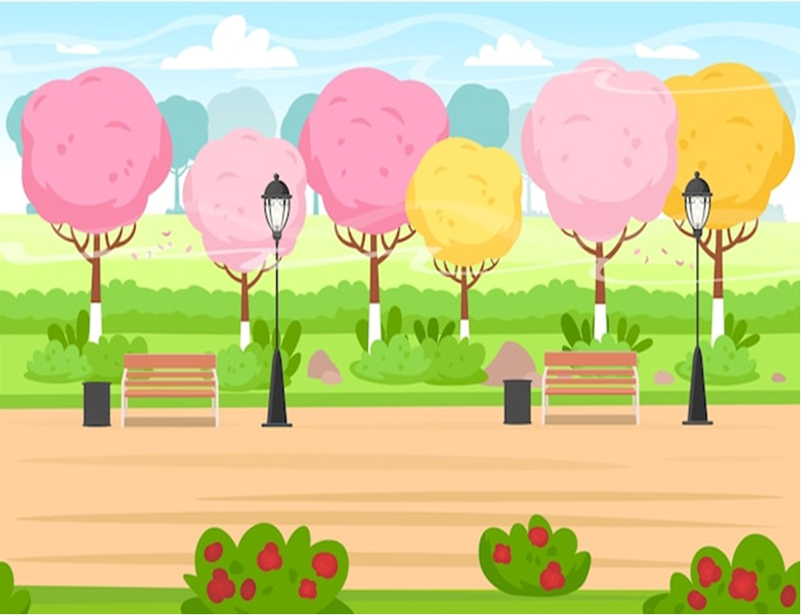
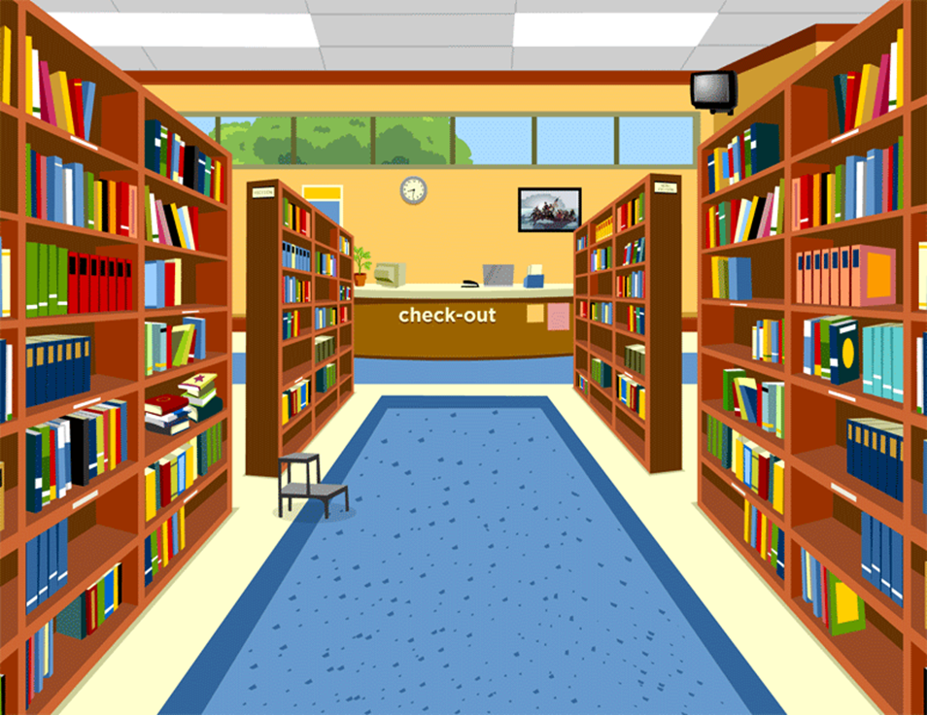
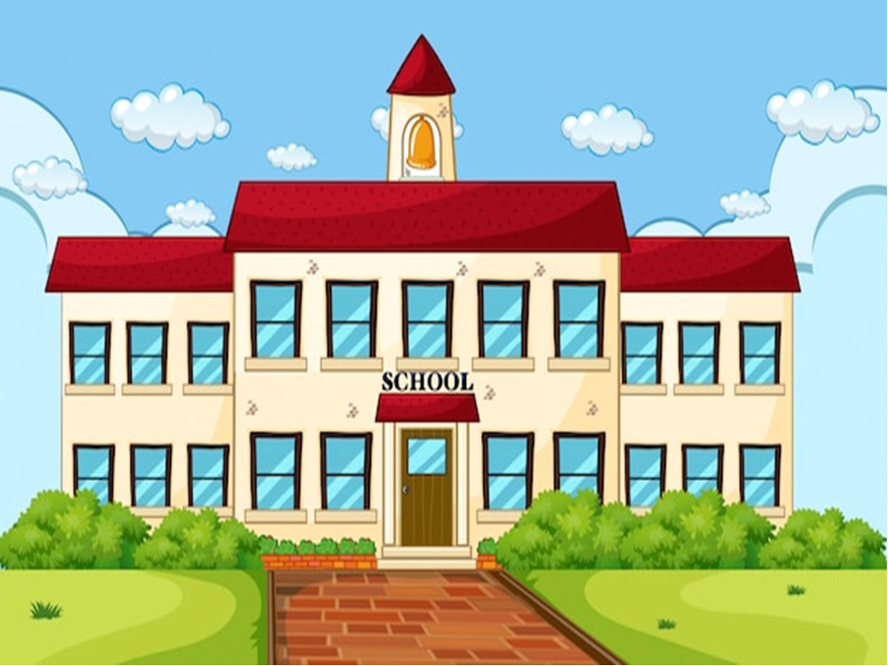

Slide 7
UNIT 5 GETTING AROUND
LESSON 2.1

Slide 8
02 VOCABULARY

Slide 9
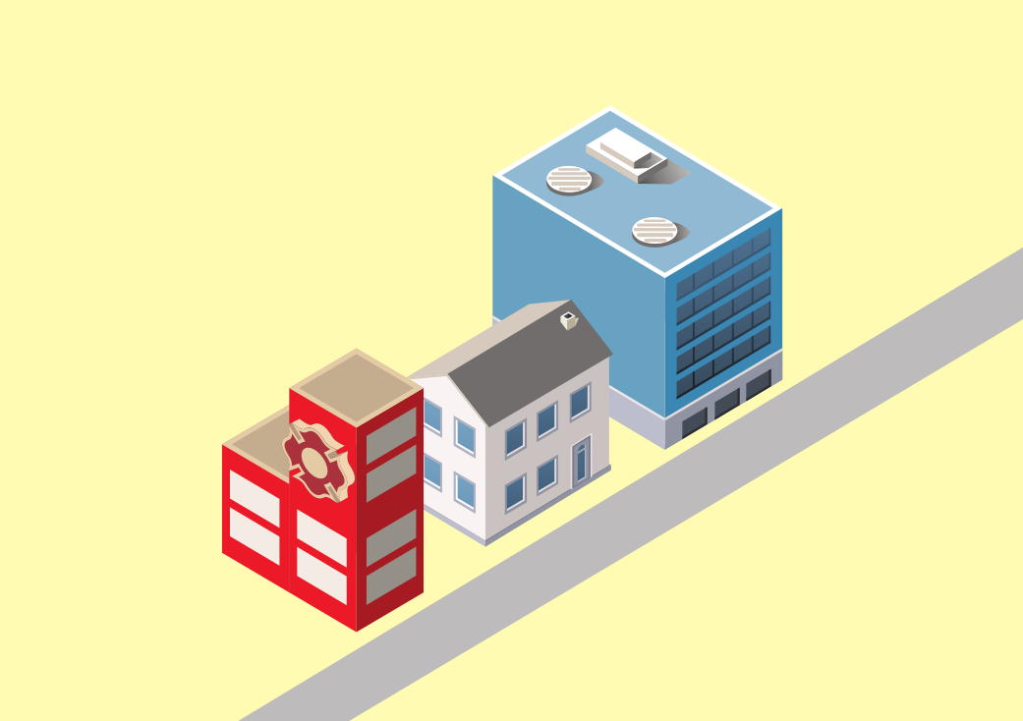
near

Slide 10
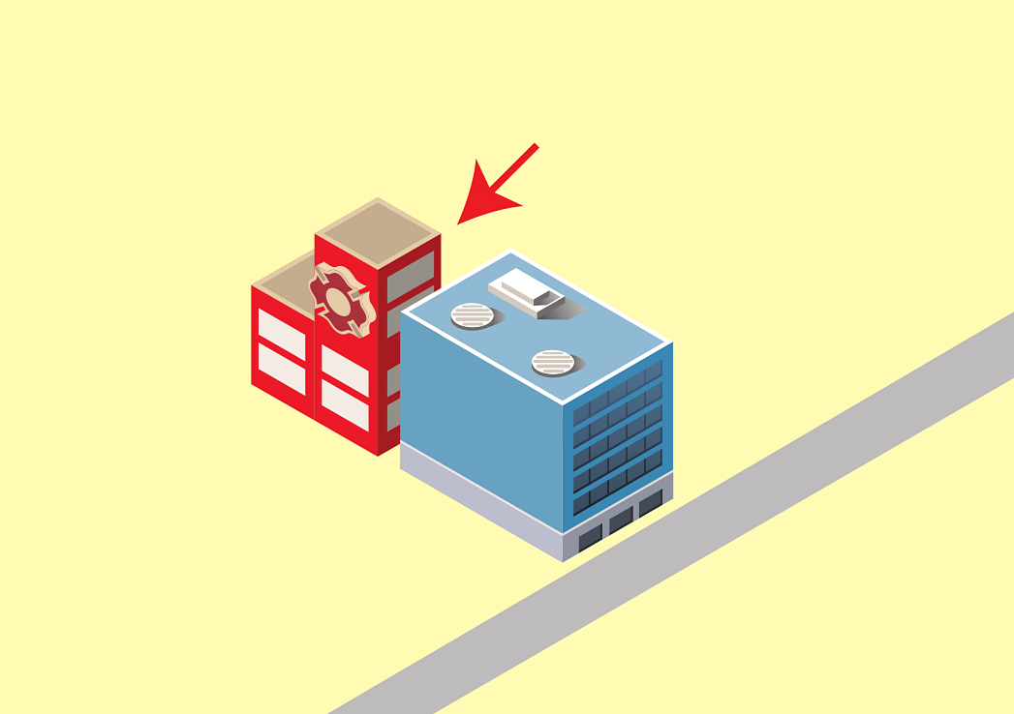
behind

Slide 11
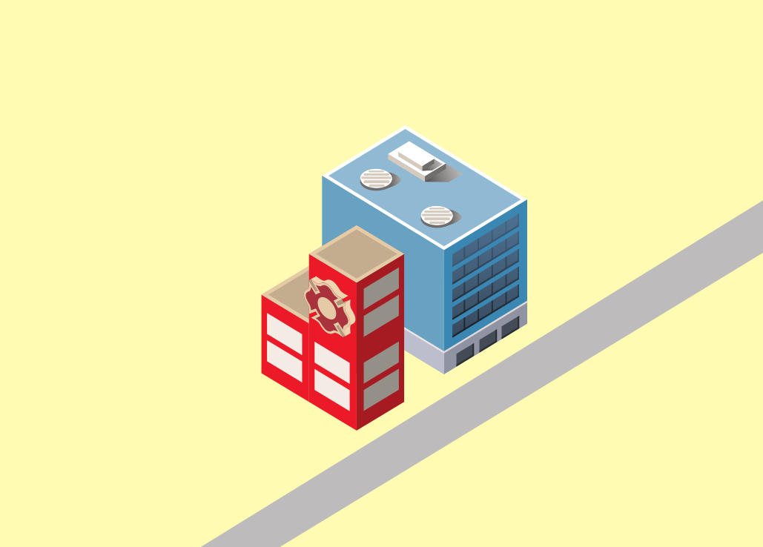
next to

Slide 12
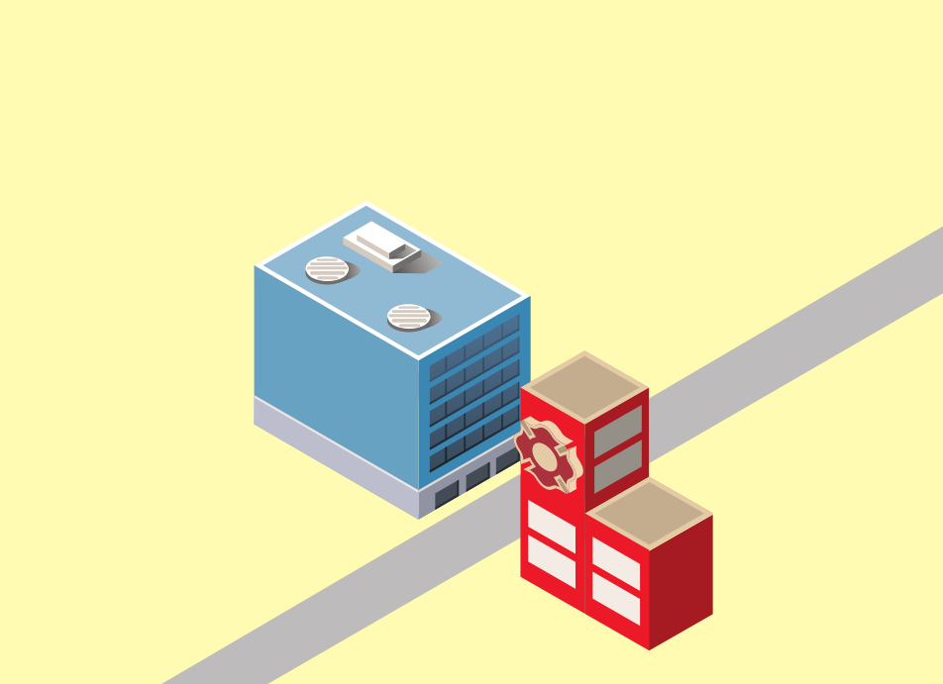
opposite

Slide 13
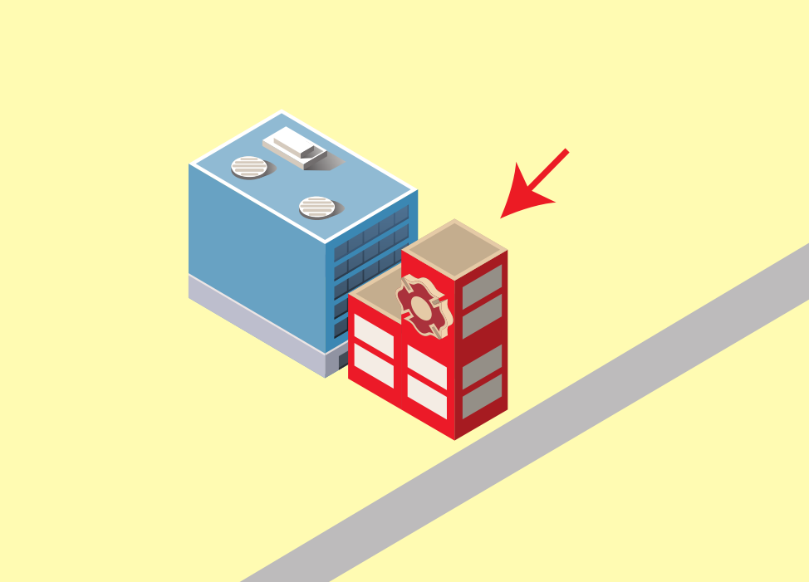
in front of

Slide 14
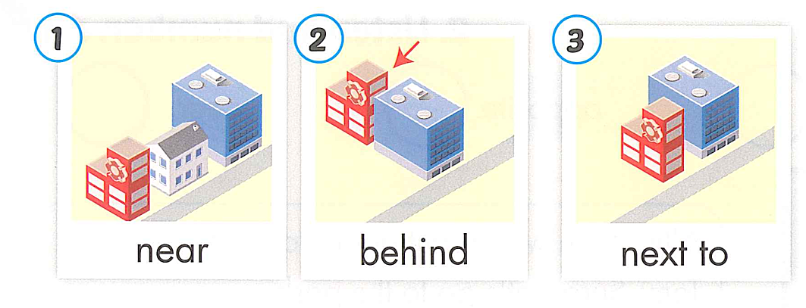
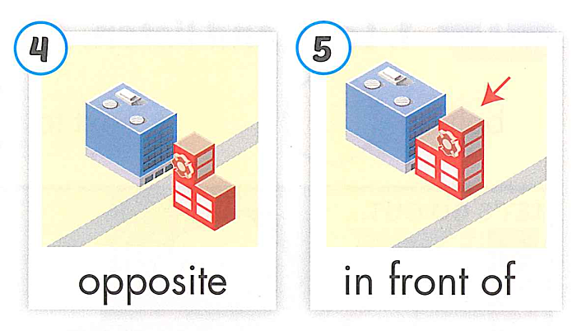

Slide 15
“Pick up the pictures”

Slide 16
03 STRUCTURE

Slide 19
04 PRACTICE

Slide 20
A. LISTEN AND PRACTICE
Where’s the park?
It’s next to the library.

Slide 21
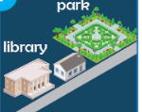
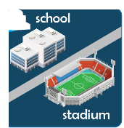
B. Circle the correct words. Practice
1. A: Where’s the library?
B: It’s near/ opposite the park.
2. A: Where’s the school?
B: It’s in front of / behind the market.
3. A: Where’s the zoo?
B: It’s next to/ near the market.
4. A: Where’s the stadium?
B: It’s in front of/ opposite the school.
5. A: Where’s the library?
B: It’s behind/ near the swimming pool.

Slide 22
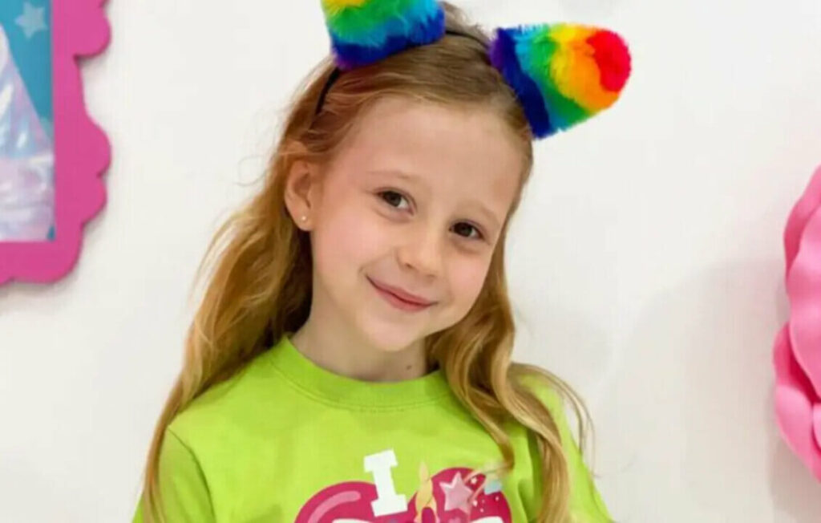

Slide 24
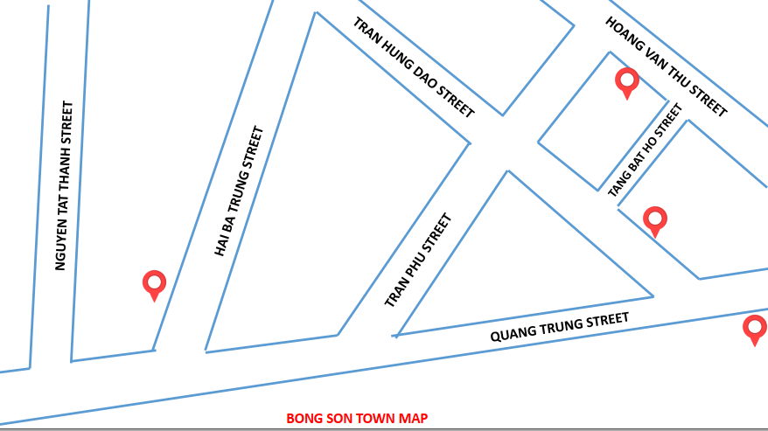
5. INTRODUCE SOME PLACES IN YOUR TOWN

Slide 25
GOOD BYE

